Slide 1
Planetary Equilibrium Temperature
α = albedo; S_{o} = <1367 W per square meter>

Slide 2
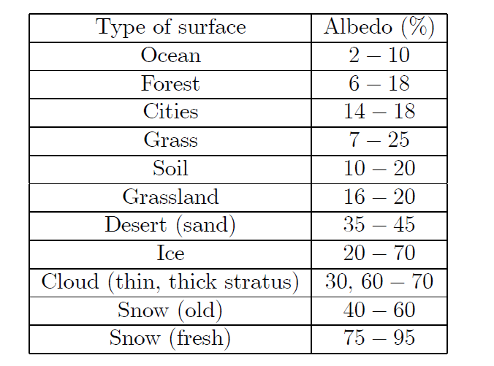
Planetary Albedo
Integrated various surface components
Measured Value is 0.30 from ERBE:
26% comes from clouds
4% comes from land surface
Recovery:
50% Clouds: 0.5*0.5 = 0.25
40% Oceans: 0.4*0.02 = 0.008
4% Snow: 0.04*0.5 = .02
6% land: 0.06*0.2 = 0.012

Slide 3
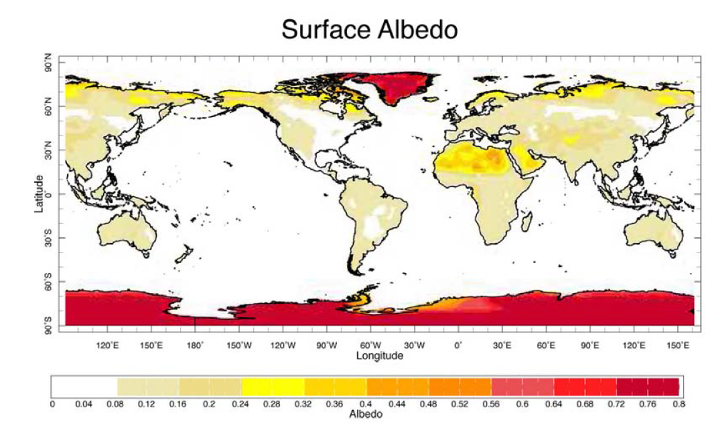

Slide 4
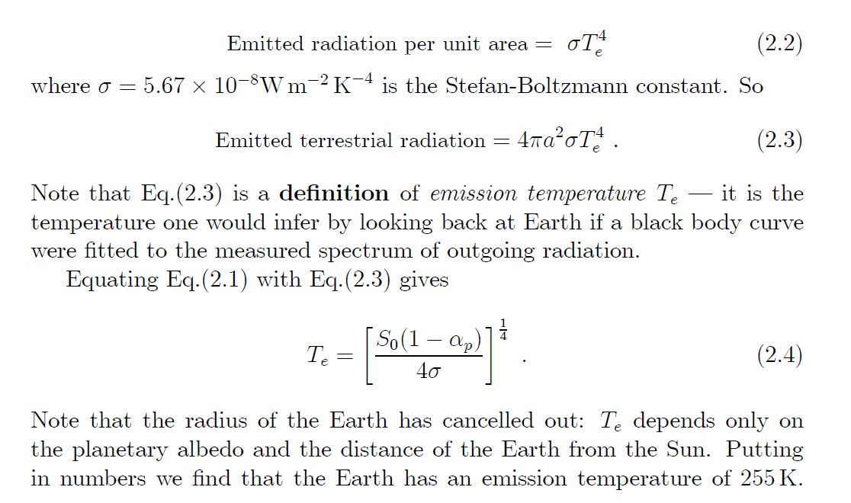
Treating Earth As Blackbody; T=255K has peak emission at 14 microns; $T_{e}$= emission temp.

Slide 5
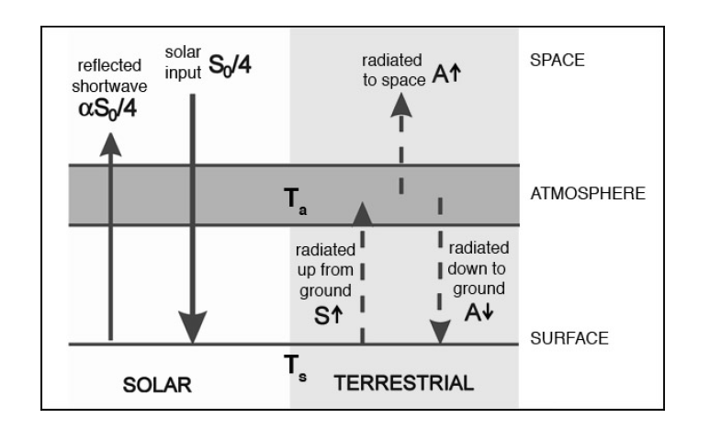
Earth is Rotating

Slide 6
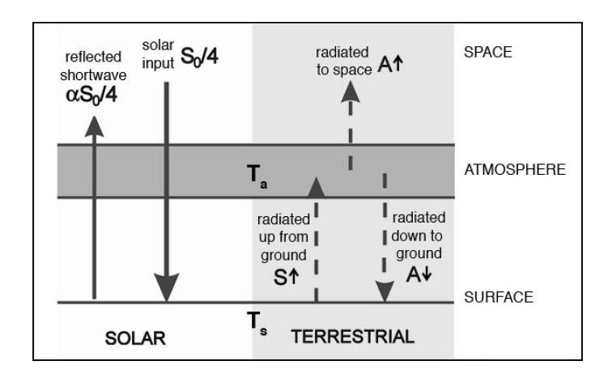
$T_{e}$=emission temp.
Received flux
In equilibrium the net flux at the ground must be zero.

Slide 7
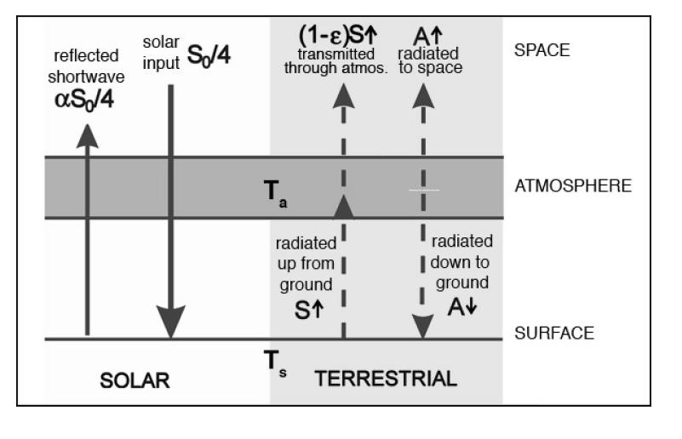
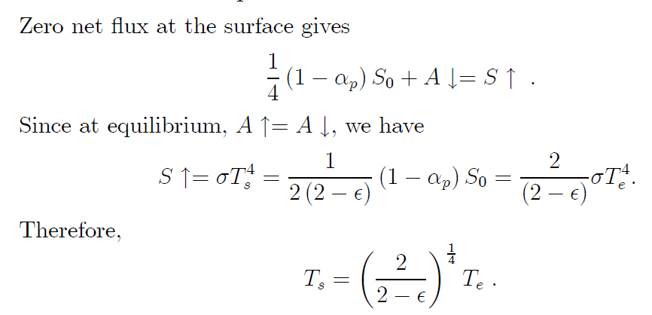
Add emissivity

Slide 8
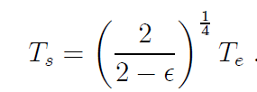
The measured value for $T_{s }$is 288K and we already know that $T_{e}$= 255K. Therefore we infer that ε = .78 for the emissivity of the atmosphere.
${1/2}^{1/4}$ = 0.841

Slide 9
Humans are Screwing with Emissivity Value for the Atmosphere

