Slide 1
Earth’s Radiation Balance

Slide 2
1997 Model
342 from sun (1370/4)
107/342 =.31
342-107 = 235
4. 235 -67 = 168
Finite temp of atm. → 324 back radiation
Surface=168+324 =492
24 thermal
78 latent heat
390 surface radiation
Out of the 492 only 235 can go back into space since that is what reaches the atmosphere
390 emitted by surface and 40 goes back directly through absorption free window
350 absorbed by atm. but 324 back radiation =26 net atm. absorption
Additional atm. Absorption =24+78 from ground +67 from incoming solar
26+24+78+67 = 195 emitted by atmosphere
195 + 40 clear channel = 235 and Earth is in Balance!

Slide 3
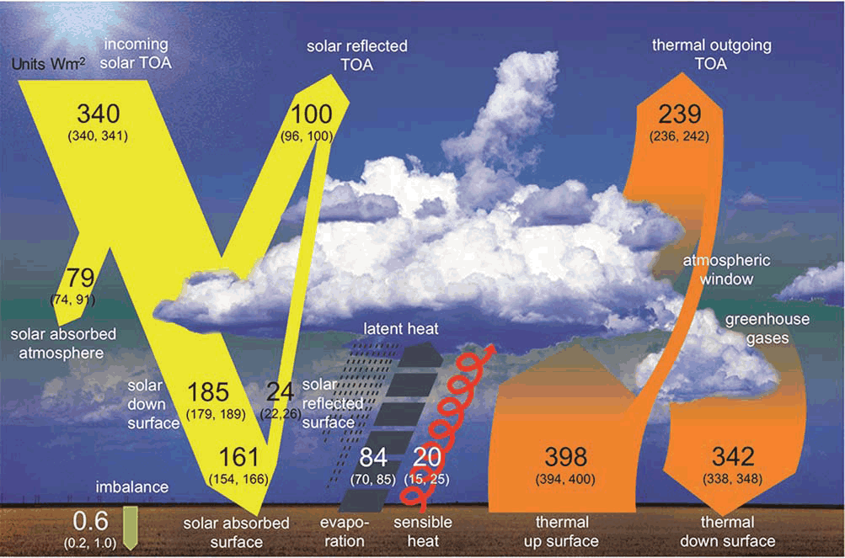
New 2013 Model
340 from sun
100/342 =.29 (.31)
340-100 = 240 (235)
4. 240 -79 = 161 (168)
Finite temp of atm. → 342 (324) back radiation
Surface=161+342-1 (soil) =502 (492)
20 (24)thermal
84 (78)latent heat
398 (350) radiation
Out of the 502 only 239 can go back into space since that is what reaches top of atm.
398 emitted by surface and 40 goes back directly through absorption free window
358 absorbed by atm. but 342 back radiation =16 net atm. absorption
Additional atm. Absorption =20+84 from ground +79 from incoming solar
16+20+84+79 = 199 emitted by atmosphere
199 + 40 clear channel = 239 and Earth is still in Balance!; 342>324 = global warming?

