Slide 1
Climate Sensitivity, Forcings, And Feedbacks

Slide 2
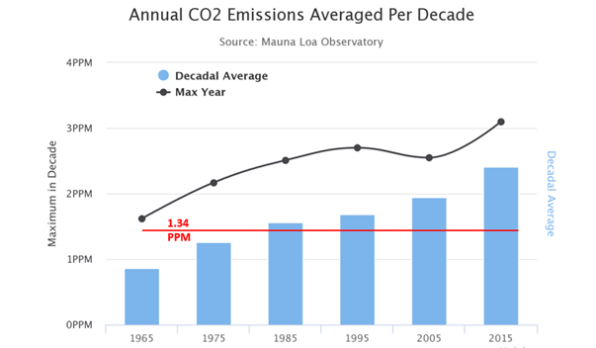
Accelerating Rates

Slide 3
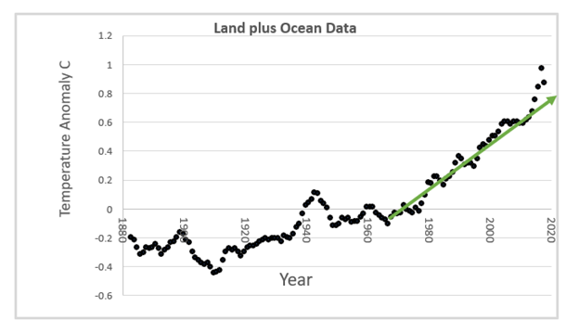
Feedbacks likely kicking in now

Slide 4
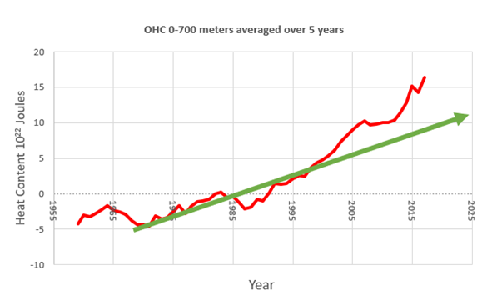
Ocean Heat Content (1997-2005 reference period)

Slide 5
The rise in OHC
This is the thermal inertia of the system --once an extra molecule of CO2 enters the atmosphere from the chimney of a coal plant or the exhaust pipe of a fossil fuel-driven car, it immediately starts to absorb solar radiation and therefore immediately starts to add tiny amounts of infrared radiation to the atmosphere – heat. But the atmosphere is very thin and it connects not only to the cosmos, but also to much cooler surfaces, like ice sheets and oceans – that have a much larger mass, and therefore absorb large quantities of that heat. Meanwhile the oceans also warms up, just like the atmosphere – but it takes a far longer time to reach equilibrium. And all that time (especially during La Niña-dominant phases, with a lot of deep-water upwelling) the oceans in turn buffer atmospheric warming – creating a substantial time lag between emissions and net atmospheric warming.
We may be now seeing the end of this LAG!
Estimates (Hansen etal 2005) is 0.6 degrees (now 0.9) remains if call CO2 were shutoff immediately. Warming in the Pipeline.

Slide 6
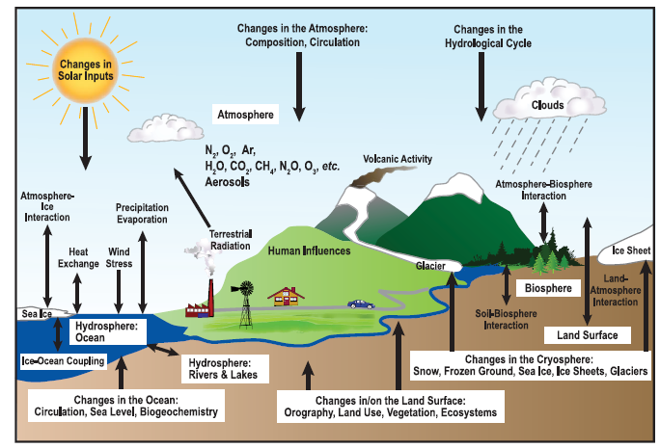
Forcings and Feedbacks in the Climate System
Schematic view of the components of the climate system, their processes and interactions.
Image credit: IPCC Assessment Report 4
Notes:
6

Slide 7
Forcings and Feedbacks –this is similar to what has already been introduced
Consider the total flux of radiation through the top of the atmosphere:
The net top-of-the-atmosphere flux may be regarded as a function of the surface temperature, T_{s}, and many other variables x_{i} :
By the chain rule,

Slide 8
Now let’s call the N^{th} process a “forcing”,
Then

Slide 9
Climate sensitivity without feedbacks
Climate sensitivity
Feedback factors; can be of either sign
Note that feedback factors do NOT add linearly in their collective effects on climate sensitivity

Slide 10
Examples of Forcing:
Changing solar constant
Orbital forcing
Changing concentrations of non-interactive greenhouse gases
Volcanic aerosols
Manmade aerosols
Land use changes

Slide 11
Earth Rotation and Orbital Variations

Slide 12
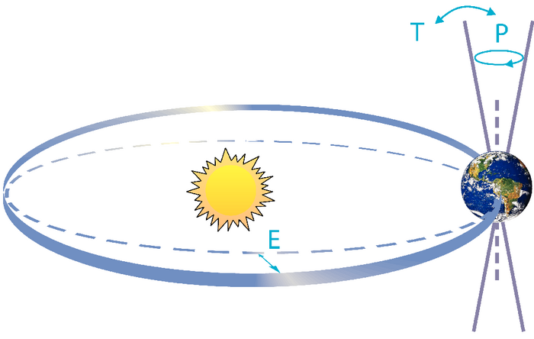
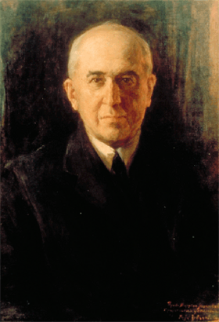
Climate Forcing by Orbital Variations
Schematic of the Earth’s orbital changes (Milankovitch cycles) that drive the ice age cycles. ‘T’ denotes changes in the tilt (or obliquity) of the Earth’s axis, ‘E’ denotes changes in the eccentricity of the orbit (due to variations in the minor axis of the ellipse), and ‘P’ denotes precession, that is, changes in the direction of the axis tilt at a given point of the orbit. Source: Rahmstorf and Schellnhuber (2006): Der Klimawandel – Diagnose, Prognose, Therapie, C. H. Beck, Munich
Milutin Milanković, 1879-1958
Portrait by Paja Jovanović (1859-1957)
Notes:
Right-side figure: S. Rahmstorf/H. J. Schellnhuber:
Der Klimawandel – Diagnose, Prognose, Therapie
2006. 144 S., 7,90 Euro
ISBN 3-406-50866-9
C.H. Beck, München
http://www.pik-potsdam.de/~stefan/klimawandel.html
Also printed in IPCC AR4

Slide 13
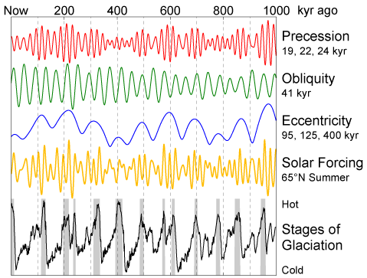
Climate Forcing and Response
Image credit: Robert A. Rohde, Wikipedia
Notes:
http://commons.wikimedia.org/wiki/File:Milankovitch_Variations.png

Slide 14
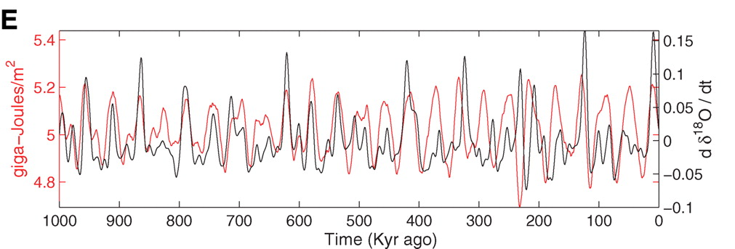
Strong Correlation between High Latitude Summer Insolation and Ice Volume
Black: Time rate of change of ice volume
Red: Summer high latitude sunlight
Huybers, P., Science 28 July 2006, Vol. 313 no. 5786 pp. 508-511, DOI: 10.1126/science.1125249

Slide 15
Solar Variability

Slide 16
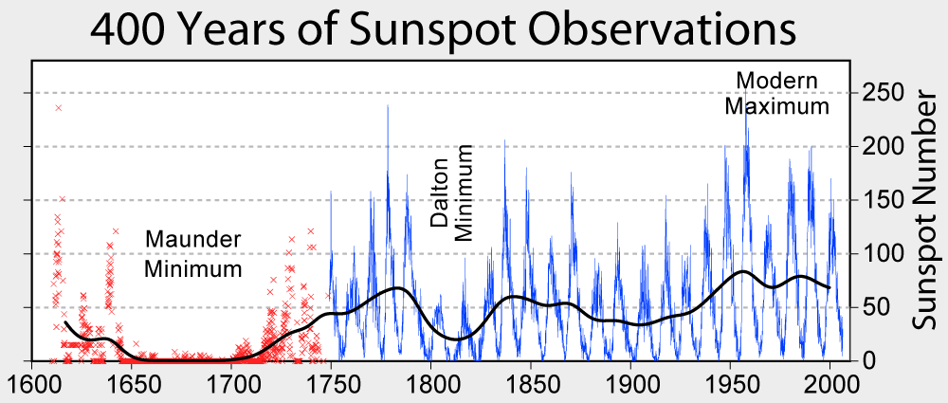
Observations of Sunspots
Image credit: Robert A. Rohde, Wikipedia
Notes:
http://commons.wikimedia.org/wiki/File:Sunspot_Numbers.png

Slide 17
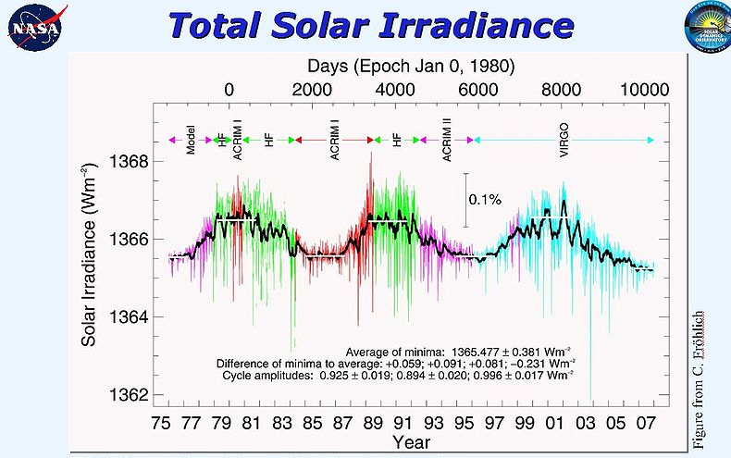
Satellite Observations of Solar Irradiance
Image credit: NASA

Slide 18
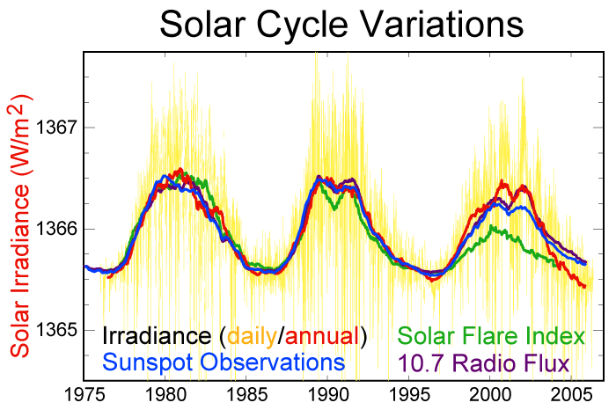
Solar Irradiance, Sunspots, and Solar Flares
Image credit: Robert A. Rohde, Wikipedia
Notes:
http://en.wikipedia.org/wiki/File:Solar-cycle-data.png

Slide 19
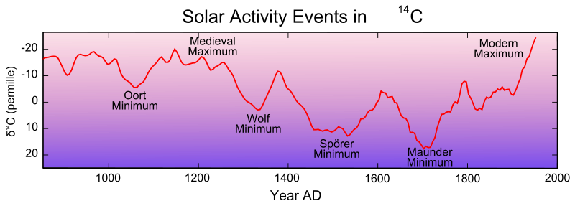
Proxies for Solar Activity
Changes in the ¹⁴C record, which are primarily (but not exclusively) caused by changes in solar activity. Note that "before present" is used in the context of radiocarbon dating, where the "present" has been fixed at 1950.
Image credit: Leland McInnes, Wikipedia
Notes:
http://en.wikipedia.org/wiki/File:Carbon14_with_activity_labels.svg . The production of carbon-14 (radiocarbon: ¹⁴C) also is related to solar activity. Carbon-14 is produced in the upper atmosphere when cosmic ray bombardment of atmospheric nitrogen (¹⁴N) induces the Nitrogen to undergo β+ decay, thus transforming into an unusual isotope of carbon with an atomic weight of 14 rather than the more common 12. Because cosmic rays are partially excluded from the Solar System by the outward sweep of magnetic fields in the solar wind, increased solar activity results in a reduction of cosmic rays reaching the Earth's atmosphere and thus reduces ¹⁴C production. Thus the cosmic ray intensity and carbon-14 production vary inversely to the general level of solar activity.^{[52]}
Therefore, the atmospheric ¹⁴C concentration is lower during sunspot maxima and higher during sunspot minima. By measuring the captured ¹⁴C in wood and counting tree rings, production of radiocarbon relative to recent wood can be measured and dated. A reconstruction of the past 10,000 years shows that the ¹⁴C production was much higher during the mid-Holocene 7,000 years ago and decreased until 1,000 years ago. In addition to variations in solar activity, the long term trends in carbon-14 production are influenced by changes in the Earth's geomagnetic field and by changes in carbon cycling within the biosphere (particularly those associated with changes in the extent of vegetation since the last ice age).^{[53]}

Slide 20
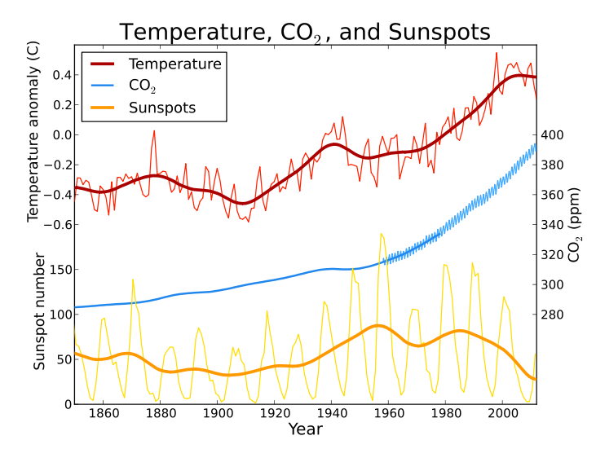
Global average temperature, atmospheric CO₂, and sunspot activity since 1850. Thick lines for temperature and sunspots represent a 25 year moving average smoothing of the raw data.
Image credit: Leland McInnes, Wikipedia
Notes:
http://commons.wikimedia.org/wiki/File:Temp-sunspot-co2.svg

Slide 21
Examples of Forcing Magnitudes:
A 1.6% change in the solar constant, equivalent to 4 Wm⁻², would produce about 1ºC change in surface temperature in the absence of feedbacks
Doubling CO₂, equivalent to 4 Wm⁻², would produce about 1ºC change in surface temperature in the absence of feedbacks

Slide 22
Image Credit: IPCC WGI Fifth Assessment Report

Slide 23
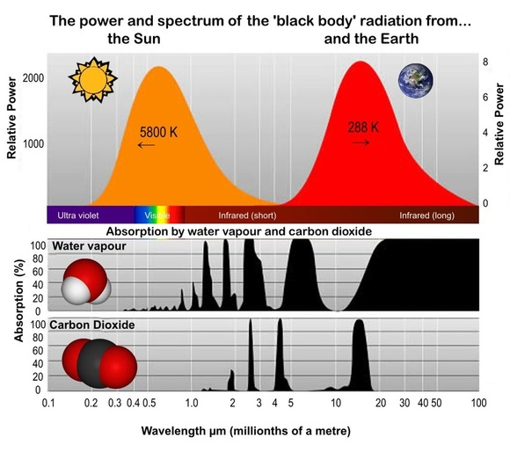

Slide 24
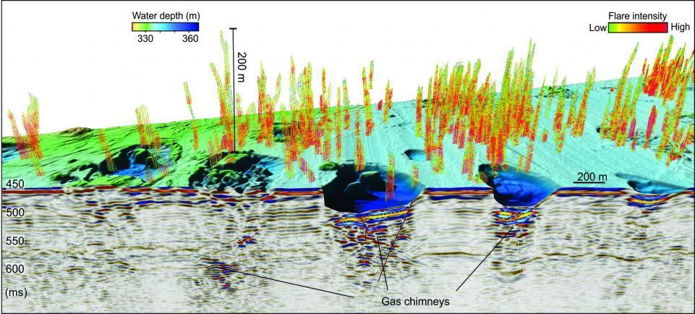
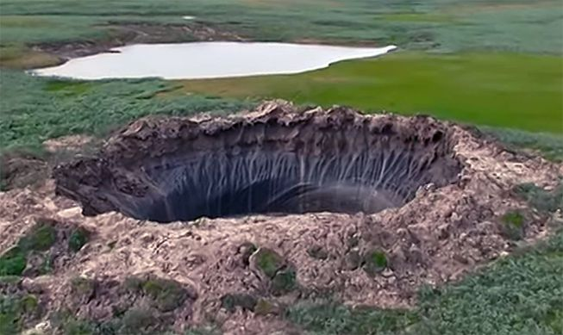
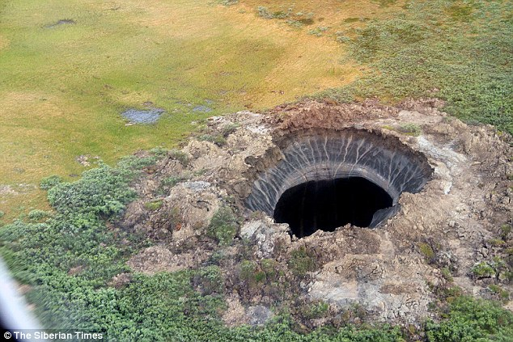

Slide 25
Aerosols

Slide 26
Global sulfur dioxide emissions by (a) source and (b) end-use sector. Emissions by source are the primary inventory result from this work.
Smith, S.J., and co-authors, 2011: Anthropogenic sulfur dioxide emissions: 1850–2005. Atmos. Chem. Phys., 11, 1101–1116

Slide 27
SOA=secondary organic aerosols
OC= Organic carbon
Time evolution of RF due to aerosol-radiation interaction and BC on snow and ice. Multi-model results for
1850, 1930, 1980, and 2000 from ACCMIP for aerosol-radiation interaction (Shindell et al., 2013c) and BC on snow and ice (Lee et al., 2013) are combined with higher temporal-resolution results from the GISS-E2 and Oslo-CTM2 models (aerosol-radiation interaction) and Oslo-CTM2 (BC on snow and ice). Uncertainty ranges (5–95%) for year 2010 are shown with vertical lines. Values next to the uncertainty lines are for cases where uncertainties go beyond the scale. The total includes the RF due to aerosol-radiation interaction for six aerosol components and RF due to BC on snow and ice.
Image Credit: IPCC WGI Fifth Assessment Report

Slide 28
Variation with Time of Climate Forcings:
Time evolution of forcing for anthropogenic and natural forcing mechanisms. Bars with the forcing and
uncertainty ranges (5–95% confidence range) at present are given in the right part of the figure. For aerosol the ERF due to aerosol-radiation interaction and total aerosol ERF are shown. The uncertainty ranges are for present (2011 versus 1750) and are given in Table 8.6. For aerosols, only the uncertainty in the total aerosol ERF is given. For several of the forcing agents the relative uncertainty may be larger for certain time periods compared to present.
Image Credit: IPCC WGI Fifth Assessment Report
Notes:
28

Slide 29
Contributions to net radiative forcing change, 1750-2011:
Image Credit: IPCC WGI Fifth Assessment Report
Notes:
29

Slide 30
Uncertainties in aerosol and greenhouse gas forcings
Image Credit: IPCC WGI Fifth Assessment Report

Slide 31
Examples of Feedbacks:
Water vapor
Ice-albedo
Clouds
Biogeochemical feedbacks

Slide 32
Estimates of Climate Sensitivity
Suppose that T_{s} = T_{e} + constant and that shortwave radiation is insensitive to T_{s}:

Slide 33
Examples of feedback magnitudes:
Experiments with one-dimensional radiative-convective models suggest that holding the relative humidity fixed,
Thus water vapor, by itself, doubles climate sensitivity; with other positive feedbacks, effect on sensitivity is even larger.

Slide 34
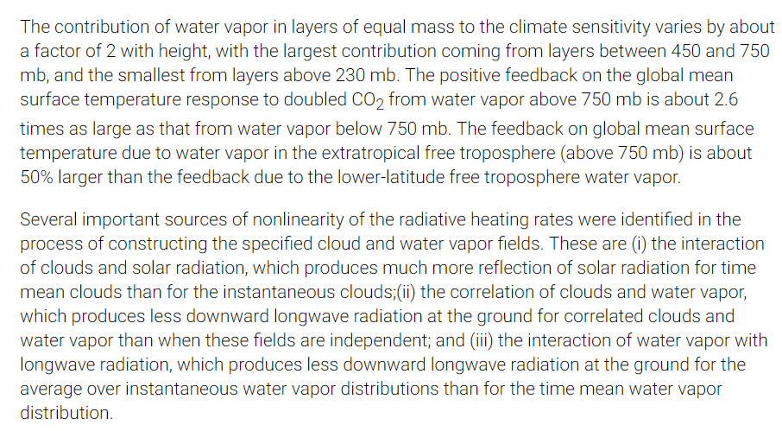
Note that Water Vapor Is Complicated

Slide 35
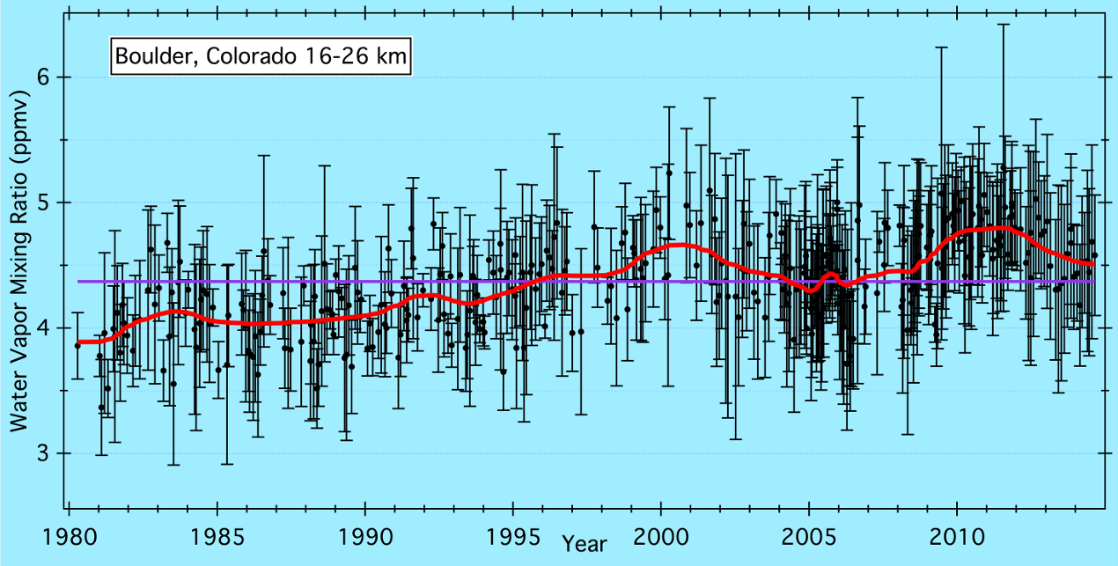
20% increase since 1980 but much qualitatively different behavior 2000 - current

Slide 36
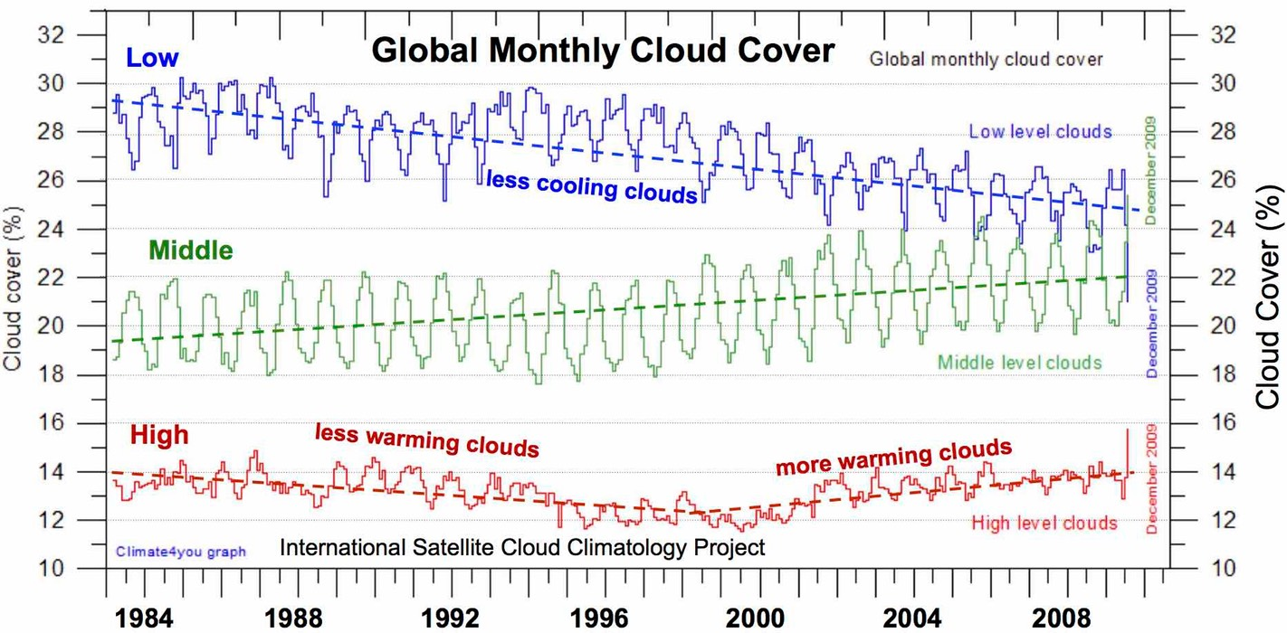
Cloud Cover Data – maybe low level clouds are decreasing

Slide 37
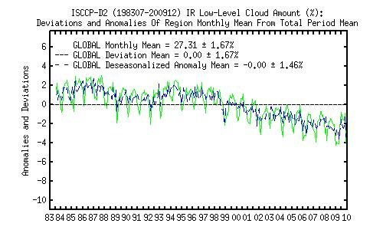
https://isccp.giss.nasa.gov/climanal7.html

Slide 38
Ice-Albedo Feedback
Image credit: Kukla, D., and G. Robinson, 1980: Annual cycle of surface albedo. Mon. Wea. Rev., 108, 56-68

Slide 39
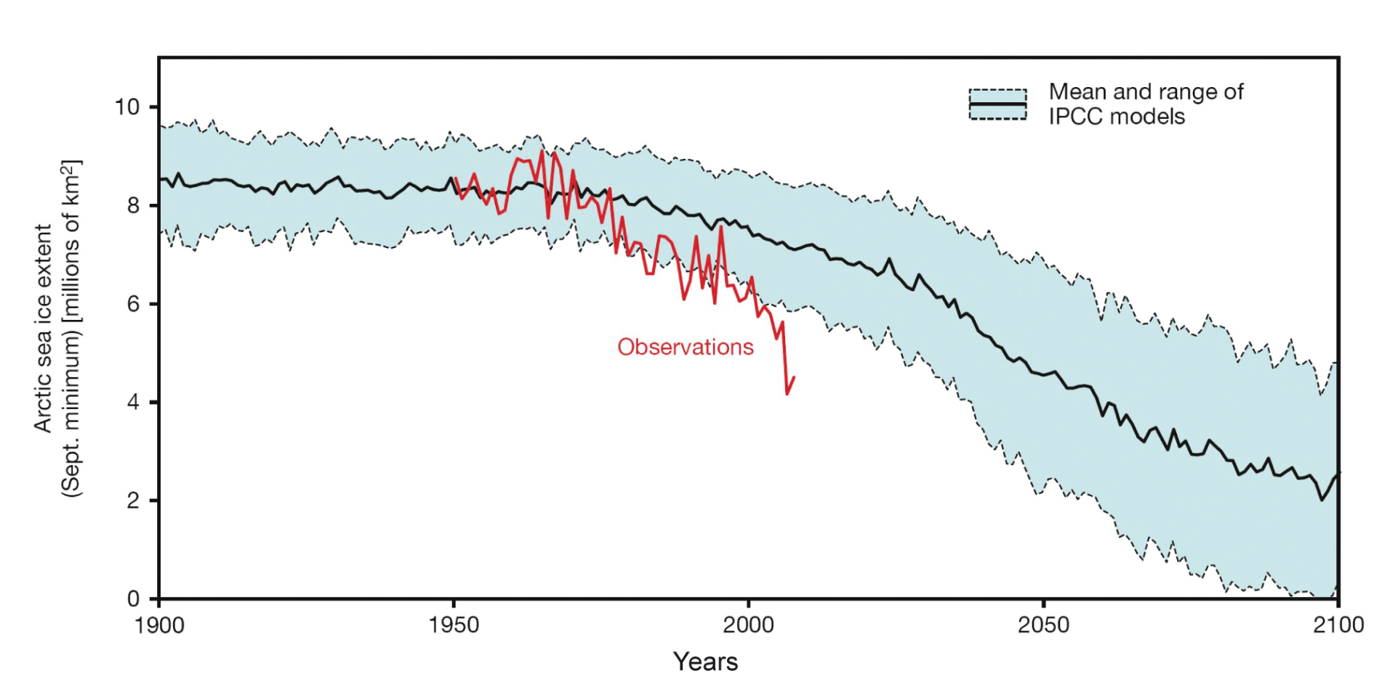
The Problem with Consensus

Slide 40
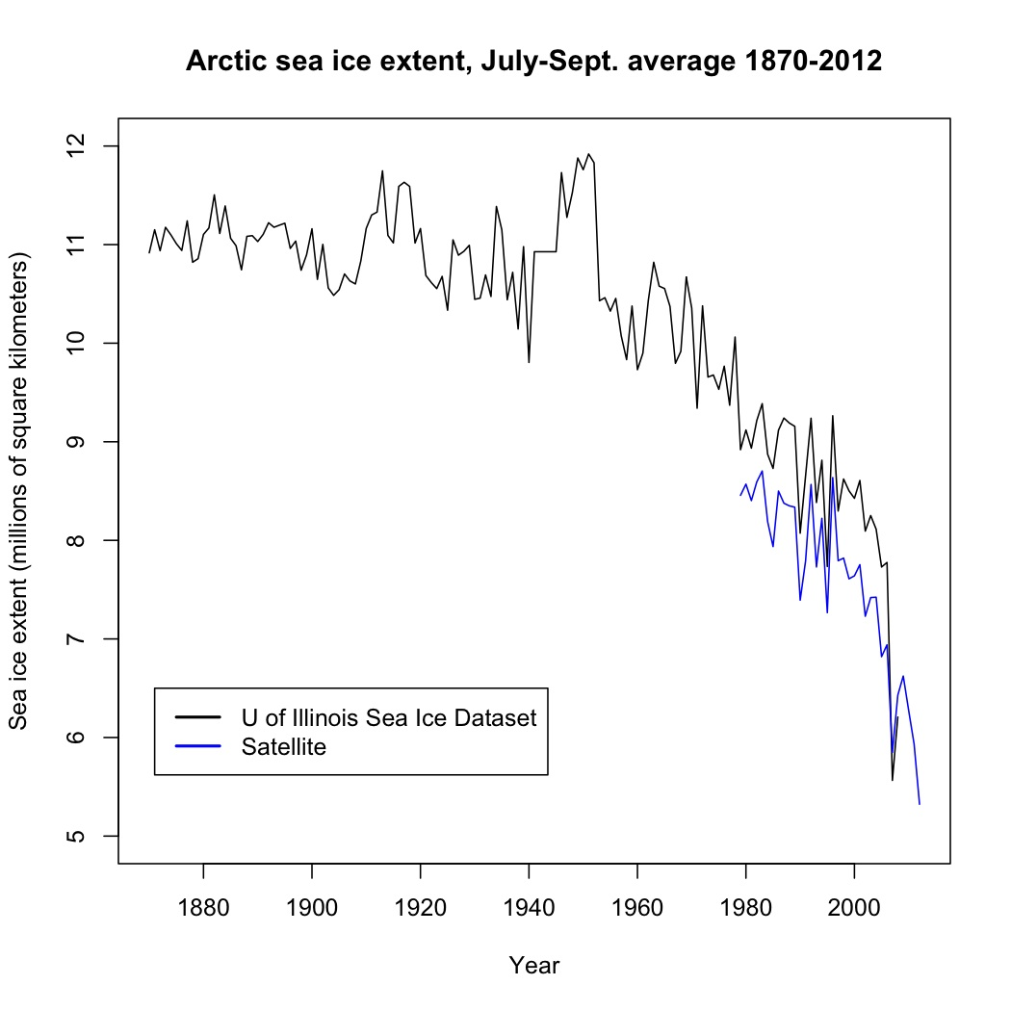

Slide 41
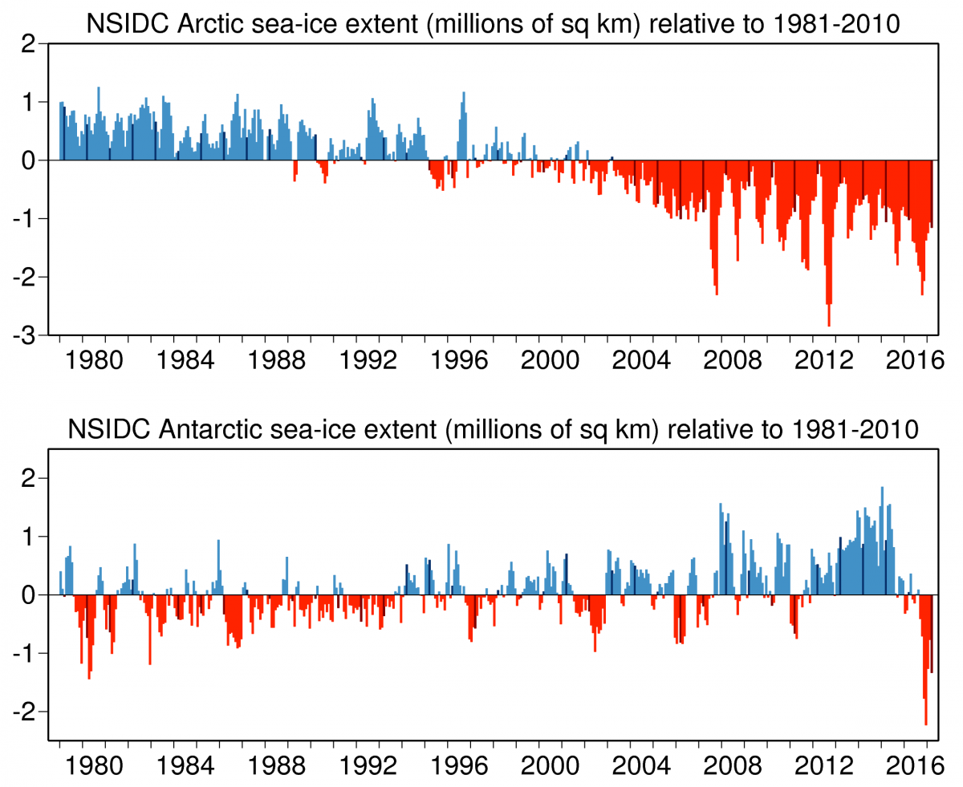

Slide 42
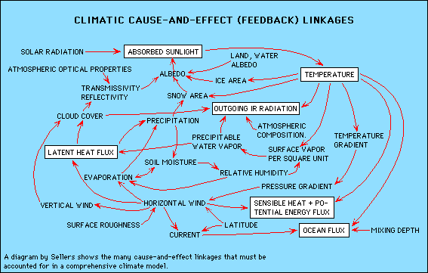
Full Feedbacks are Complicated

Slide 43
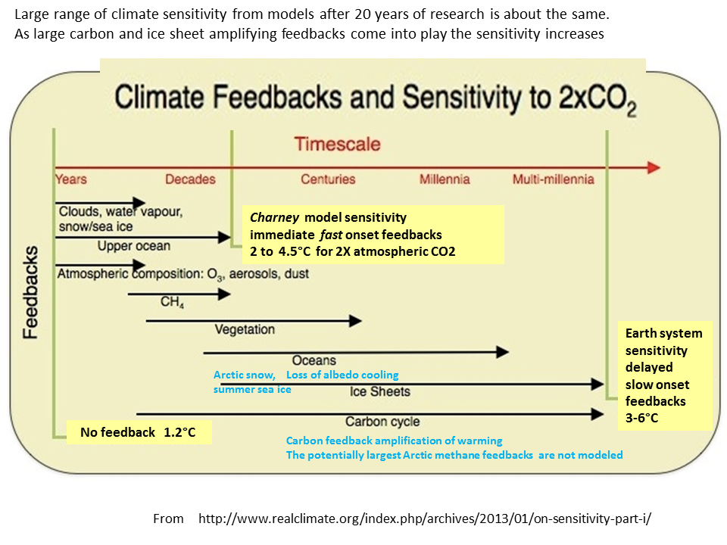

Slide 44
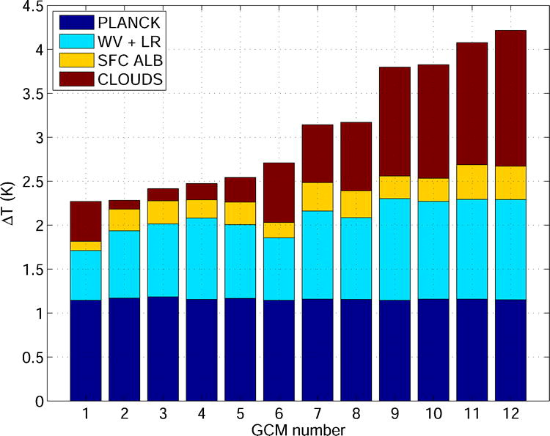
Equilibrium temperature change associated with the Planck response and the various feedbacks, computed for 12 CMIP3/AR4 AOGCMs for a 2 × CO₂ forcing of reference (3.71 W m⁻²). The GCMs are sorted according to ΔT^{e}_{s}.
Image credit: Dufresne, Jean-Louis, Sandrine Bony, 2008: An Assessment of the Primary Sources of Spread of Global Warming Estimates from Coupled Atmosphere–Ocean Models. J. Climate, 21, 5135–5144.

