Slide 1
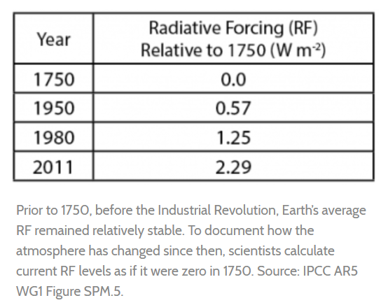

Slide 2
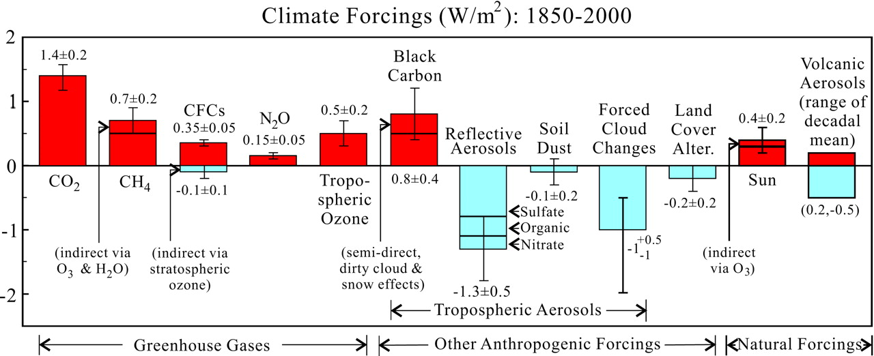
Estimated climate forcings; error bars are partly subjective 1σ uncertainties.
James E. Hansen, and Makiko Sato PNAS 2001;98:26:14778-14783
©2001 by National Academy of Sciences
Notes:
Estimated climate forcings; error bars are partly subjective 1σ uncertainties.

Slide 3
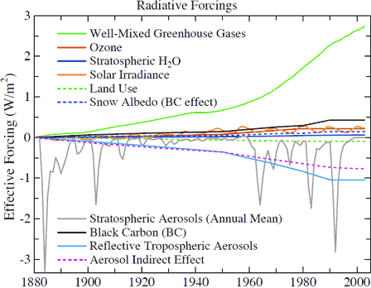

Slide 4
Direct Forcing from Volcanoes
Equatorial Volcanoes
1902 Pelee
1964 Mt. Agung
1982 El Chicon
1991 Pinatuabo

Slide 5
The solar constant does very a small amount and can vary on minutes time scale – The Earth only cares about an annual average

Slide 6
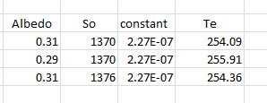
Assumptions:
1 extra W per square meter gives you 0.25K increase in surface temperature but this requires 6 extra watts per square meter from the sun given the albedo. So +/- 2 watts per sq. meter is negligible

Slide 7
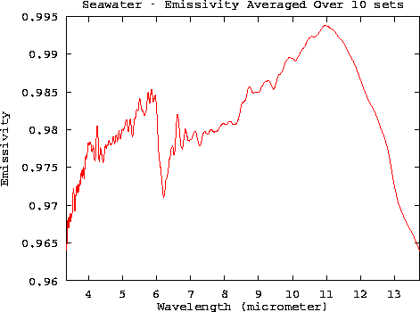
Extra Forcing
When water vapor is considered the constant is about double that of just BB radiation
This is because water vapor
has high emissivity in the IR

Slide 8
Ice Age Calibration

Slide 9
Doubling CO2 scenario
As of 2000 Combined positive (GHG) + negative (aerosols) seems to be about 2 Wm⁻²
Double CO2 = 5.35(ln2) = 3.7 Watts per square meter;
Flux on ground is about 160 watts per square meter so this is equivalent to increase in sun’s output by
3.7/160 = 2.3%; (1370 → 1400 for TSI) Increase S in below relation by 2.3% to get 1.5 C of
Temperature increase.
This is equivalent to 2/160 = 1.25% leading to 0.8 C increase in the year 2000
Data suggest bigger increase most likely due to water vapor feedback

Slide 10
The heat content of the land-atmosphere-ocean system is

Slide 11
Feedbacks
Water vapor changes
Clouds
Albedo changes
Lapse rate
Added GHGs
These all change OLR (outgoing long wavelength radiation)
At equilibrium

Slide 12
First term = changes in solar output
Second term = changes in lapse rate
Third term = water vapor
Fourth term = GHG
Fifth term = Clouds
Sixth Term = Albedo change
If each degree C of warming leads to a feedback factor f of additional warming this then leads to:
Constraints: 0<f<1 for the series to converge; f > 1 = runaway (Venus)

Slide 13
F _{H2O} is about 0.5 so doubling of C02 with H20 Feedback is now 1.5/.5 = 3 C
Suppose this results in more low clouds and lowers the albedo by 0.2 (positive feedback) then this results in
1.5/(1-.5-.2) = 5 C – shit!
Some feedback scenarios that include methane release can lead to +10 C by the year 2100

Slide 14
