Slide 1
Ice Ages

Slide 2
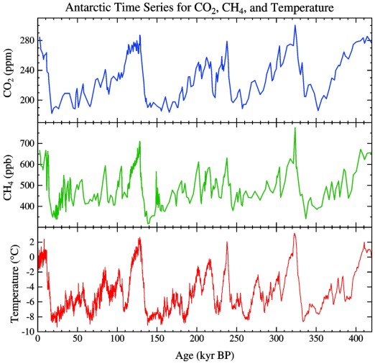

Slide 3
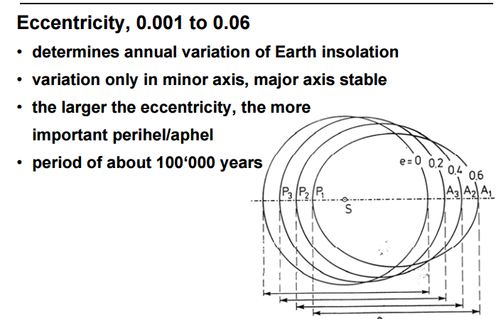

Slide 4
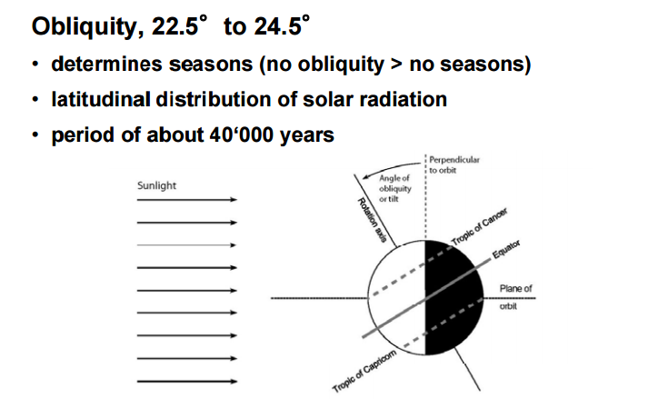

Slide 5
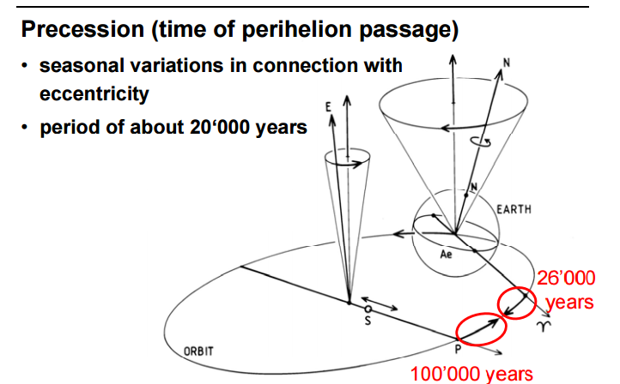

Slide 7
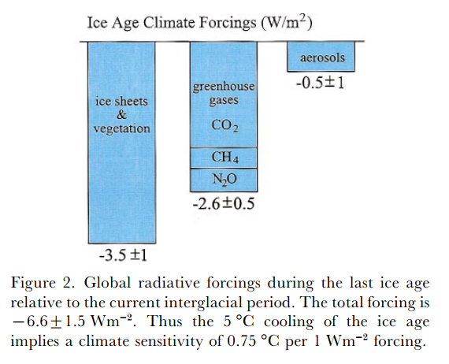
From the Last class, this implies a change of 05 6.6/160 = 4% change in the incoming solar constant – this is too small of variation for the amplitude of the orbital variations. Some thing else is happening ➔
Albedo increases due to more ice coverage to something like about 0.35 which is then equivalent to a 6% change (3 % change in mean geometric distance from the Sun)

Slide 8
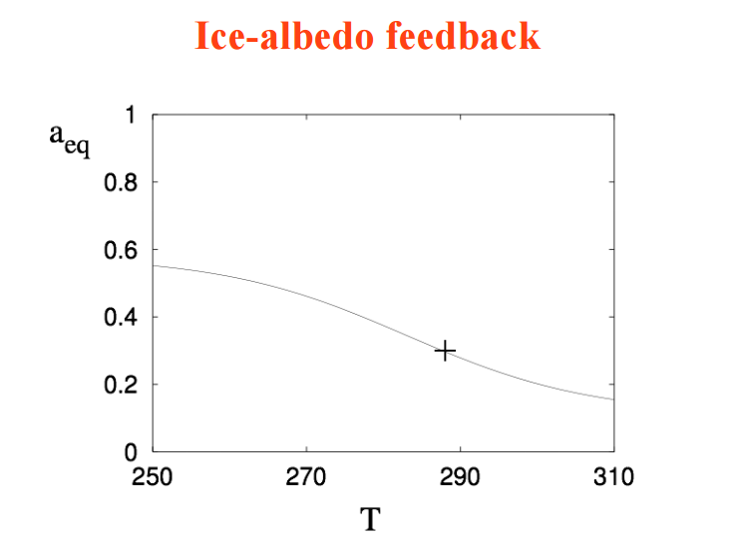

Slide 9
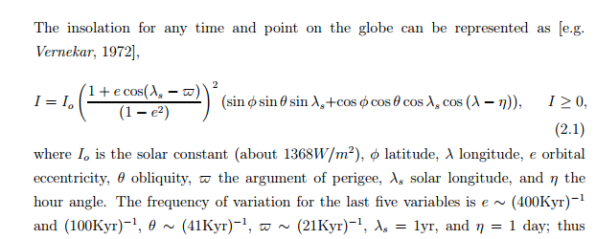

Slide 10
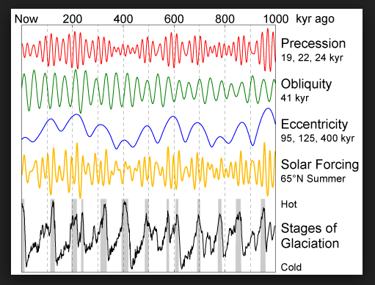

Slide 11
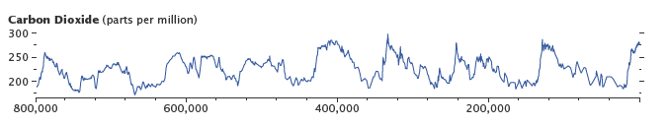
Qualitative Albedo Feedback loop:
Earth has more biomass on it and absorbs more CO2 so CO2 lowers pre ice age => this is negative radiative forcing by an amount of ~ 5.35 ln(180/280) = -2.3 watts per square meter
Planetary Albedo has decreased at max biomass (min ice extent) to something like 0.27 which increases solar radiation on the ground by 11% so the earth is net warmer during this period as the albedo change dominates the loss of CO2
Orbital forcing then provide the threshold to overcome the albedo change surface warming to lead to surface global cooling which rapidly depletes the biomass thus allowing the CO2 (as well as CH4) to rapidly build back into the atmosphere
This then enhances the “greenhouse effect” which rapidly causes glacial melt (thus releasing more H2O for the H2O feedback signal to come into play thus accelerating surface warming)
For the last ice age it seems the onset and advancement of glaciation occurred over about a 12,000 year period and the “meltwater phase” occurs over about a 2000 year period.

