Slide 1
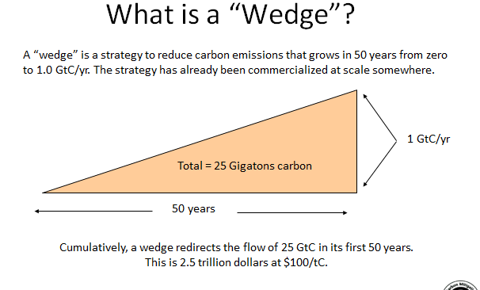
Princeton University CMI: The idea of Stabilization Wedges - 2004

Slide 2
Historical Emissions
Billions of Tons Carbon Emitted per Year
16
8
Historical
emissions
0
1950
2000
2050
2100
Notes:
2

Slide 3
The Stabilization Triangle
Billions of Tons Carbon Emitted per Year
16
Current path = “ramp”
Stabilization Triangle
Interim Goal
8
Historical
emissions
Flat path
1.6
0
1950
2000
2050
2100
Notes:
3

Slide 4
The Stabilization Triangle
Billions of Tons Carbon Emitted per Year
Easier CO₂ target
16
Current path = “ramp”
~850 ppm
Stabilization Triangle
Interim Goal
8
Historical
emissions
Flat path
Tougher CO₂ target
~500 ppm
1.6
0
1950
2000
2050
2100
Notes:
4

Slide 5
Stabilization Wedges
Billions of Tons Carbon Emitted per Year
16 GtC/y
16
Current path = “ramp”
Eight “wedges”
Goal: In 50 years, same
global emissions as today
8
Historical
emissions
Flat path
1.6
0
1950
2000
2050
2100
Notes:
5

Slide 6
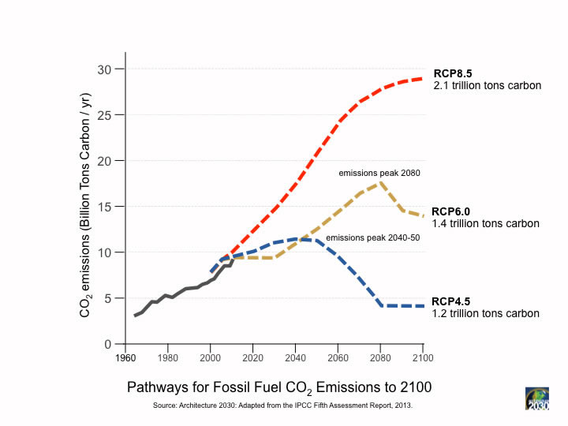

Slide 7
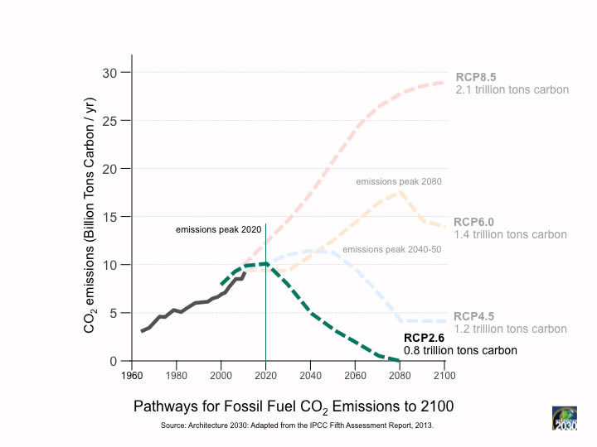

Slide 8
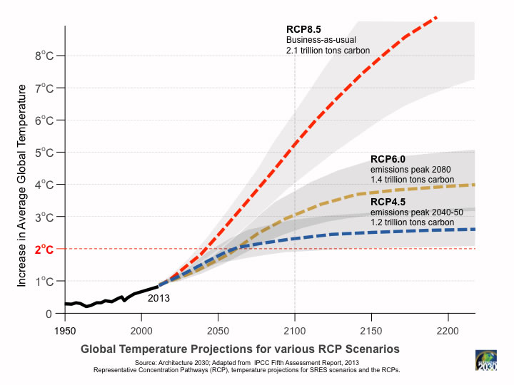

Slide 9
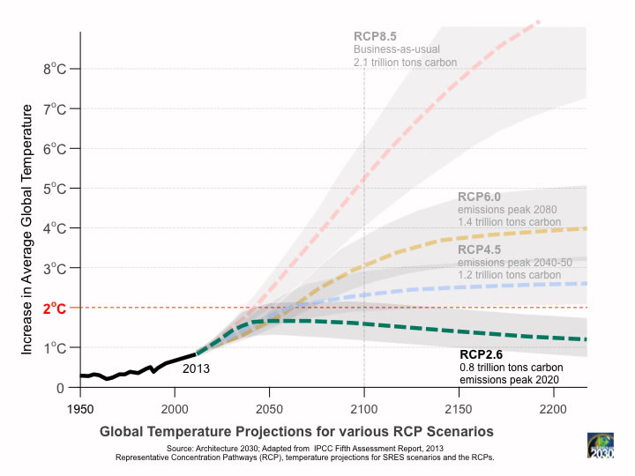

Slide 10
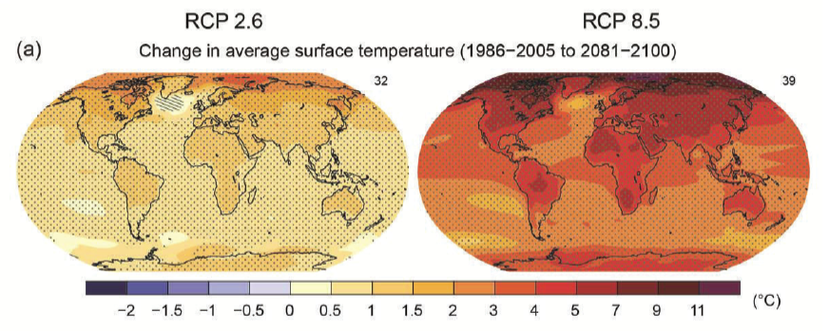

Slide 11
15 Wedge Strategies in 4 Categories
Energy Efficiency
& Conservation
Fossil Fuel-Based Strategies
Stabilization
Stabilization
Triangle
Triangle
Renewables & Biostorage
Nuclear Power
2010
2060

Slide 12
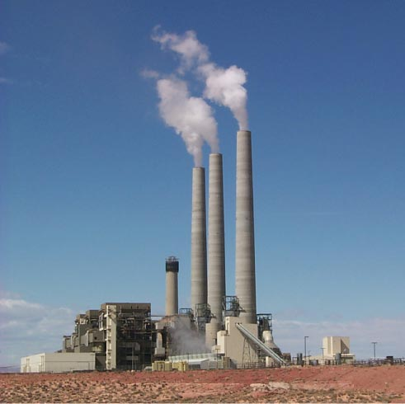
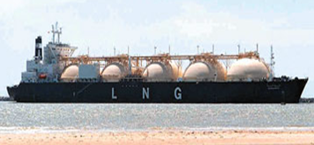
Fuel Switching
Substitute 1400 natural gas electric plants for an equal number of coal-fired facilities (no pipeline leakage)
Photo by J.C. Willett (U.S. Geological Survey).
A wedge requires an amount of natural gas equal to that used for all purposes today
E, H / $
50 LNG tanker discharges/day by 2054
Notes:
“E,H” = can be applied to electric or heating sectors, $=rough indication of cost (on a scale of $ to $$$)
Effort needed for 1 wedge:
Build 1400 GW of capacity powered by natural gas instead of coal (60% of current fossil fuel electric capacity)
Requires an amount of natural gas equal to that used for all purposes today
So a slice is 50 LNG tanker discharges/day by 2054 @200,000 m3/tanker, or
one new “Alaska” pipeline/year @ 4 Bscfd.
Detailed Description: NATURAL GAS TURBINES ARE BEING DEVELOPED TO PRODUCE ELECTRICITY IN A SIMPLE, LOW COST ENVIRONMENTALLY FRIENDLY WAY. DOE'S NATIONAL ENERGY TECHNOLOGY LABORATORY (NETL) INITIATED THE ADVANCED TURBINE SYSTEMS (ATS) PROGRAM AND HAS PARTNERED WITH INDUSTRY TO PRODUCE A NEW GENERATION OF HIGH EFFICIENCY GAS TURBINES FOR CENTRAL STATION ELECTRICITY PRODUCTION, USING CLEAN BURNING NATURAL GAS.
700 1-GW baseload coal plants (5400 TWh/y) emit 1 GtC/y.
Natural gas: 1 GtC/y = 190 Bscfd
Yr 2000 electricity:
Coal : 6000 TWh/y; Natural gas: 2700 TWh/y.

Slide 13
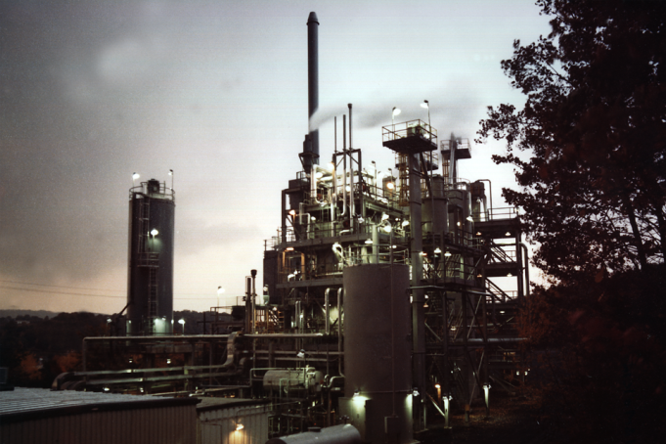
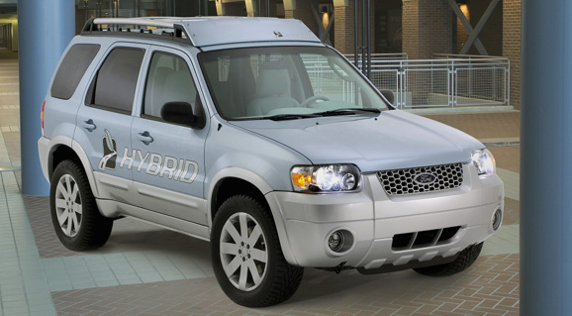
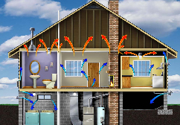
Efficiency
Produce today’s electric capacity with double today’s efficiency
Average coal plant efficiency is 32% today
Double the fuel efficiency of the world’s cars or halve miles traveled
There are about 600 million cars today, with 2 billion projected for 2055
E, T, H / $
Use best efficiency practices in all residential and commercial buildings
Sector s affected:
E = Electricity, T =Transport,
H = Heat
Cost based on scale of $ to $$$
Replacing all the world’s incandescent bulbs with CFL’s would provide 1/4 of one wedge
Photos courtesy of Ford Motor Co., DOE, EPA
Notes:
“E,T, H” = can be applied to electric, transport, or heating sectors, $=rough indication of cost (on a scale of $ to $$$)

Slide 14
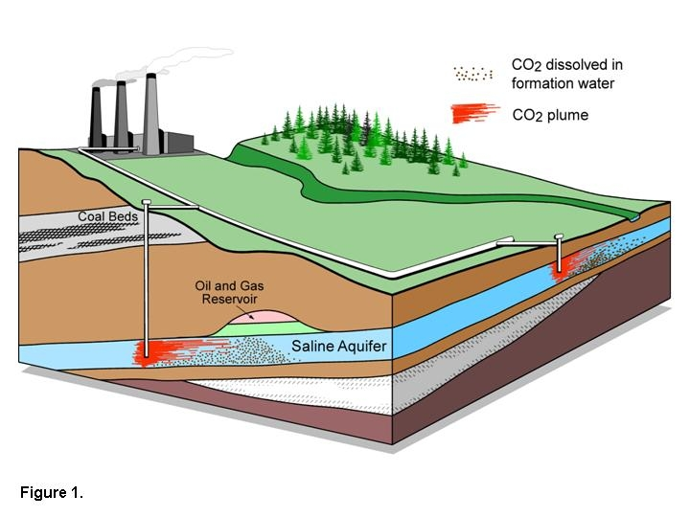
Carbon Capture & Storage
Implement CCS at
800 GW coal electric plants or
1600 GW natural gas electric plants or
180 coal synfuels plants or
10 times today’s capacity of hydrogen plants
Graphic courtesy of Alberta Geological Survey
There are currently three storage projects that each inject 1 million tons of CO₂ per year – by 2055 need 3500.
E, T, H / $$
Notes:
“E,T, H” = can be applied to electric, transport, or heating sectors, $=rough indication of cost (on a scale of $ to $$$)

Slide 15
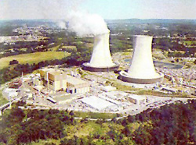
Nuclear Electricity
This is Never Gonna Happen
Triple the world’s nuclear electricity capacity by 2060
Graphic courtesy of NRC
The rate of installation required for a wedge from electricity is equal to the global rate of nuclear expansion from 1975-1990.
E/ $$
Notes:
“E” = can be applied to electric sector, $$=rough indication of cost (on a scale of $ to $$$)
Plutonium (Pu) production by 2054, if fuel cycles are unchanged: 4000 t Pu (and another 4000 t Pu if current capacity is continued).
Compare with ~ 1000 t Pu in all current spent fuel, ~ 100 t Pu in all U.S. weapons.
5 kg ~ Pu critical mass.

Slide 16
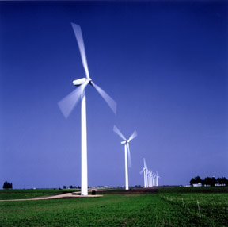
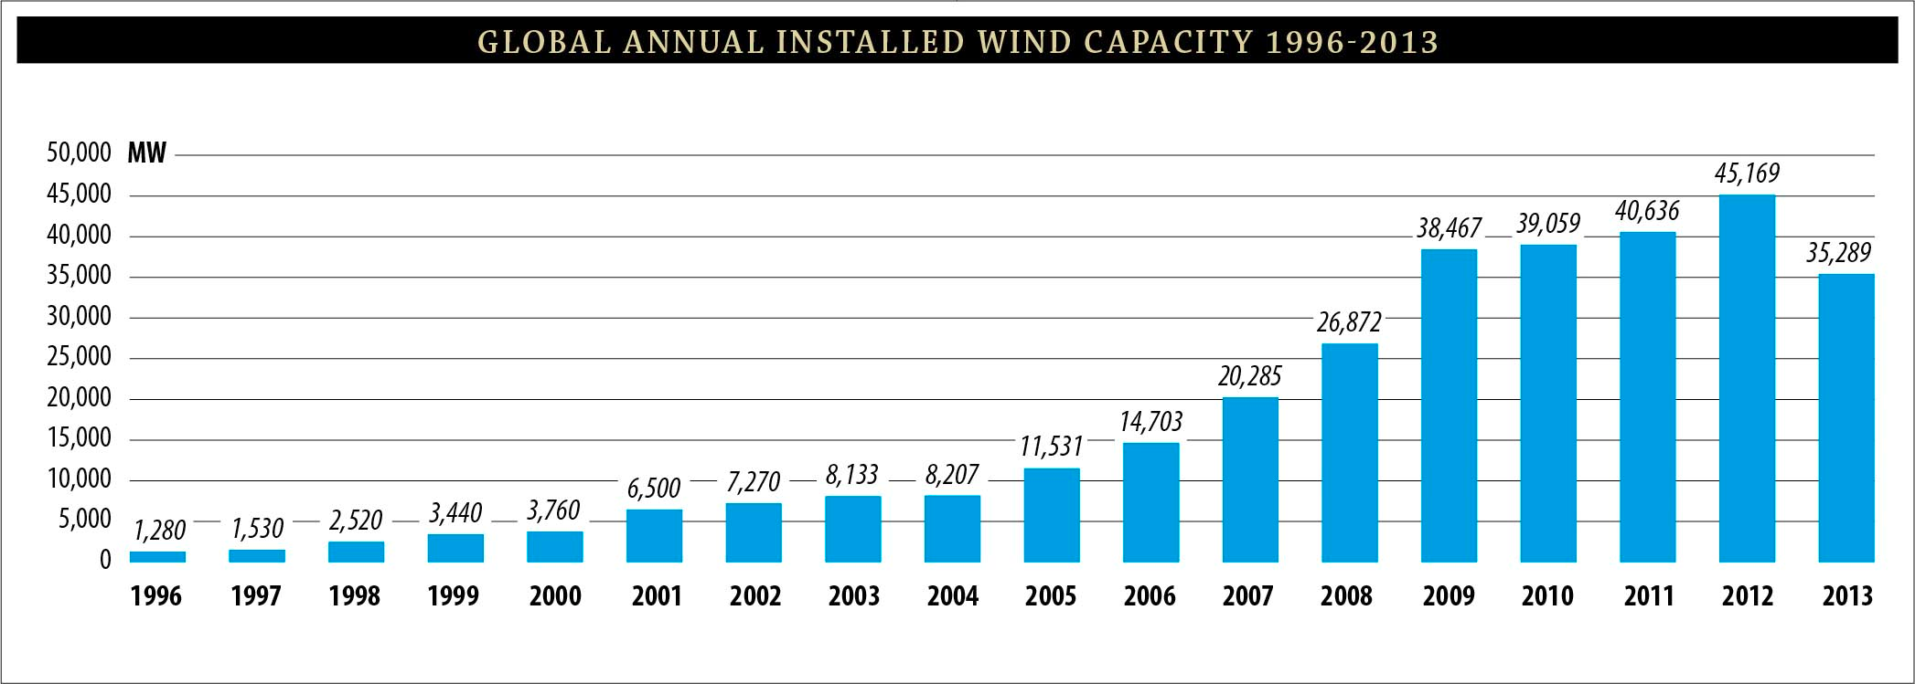
Wind Electricity
Install 1 million 2 MW windmills to replace coal-based electricity,
OR
Use 2 million windmills to produce hydrogen fuel
Global Economic Meltdown of 2009 produced serious loss of momentum
Photo courtesy of DOE
A wedge worth of wind electricity will require increasing current capacity by a factor of 10
E, T, H / $-$$
Notes:
“E,T, H” = can be applied to electric, transport, or heating sectors, $-$$=rough indication of cost (on a scale of $ to $$$)

Slide 17
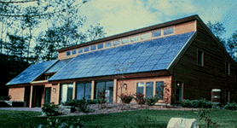
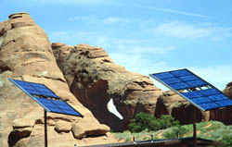
Solar Electricity
Install 20,000 square kilometers for dedicated use by 2060
A wedge of solar electricity would mean increasing current capacity 100 times in just the next 45-50 years! UNLIKELY
E / $$$
Photos courtesy of DOE Photovoltaics Program
Notes:
“E” = can be applied to electric sector, $$$=rough indication of cost (on a scale of $ to $$$)

Slide 18
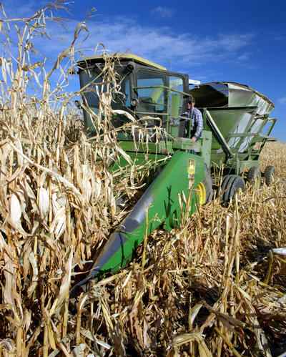
Biofuels
Scale up current global ethanol production by ~12 times
Photo courtesy of NREL
Using current practices, one wedge requires planting an area the size of India with biofuels crops
T, H / $$
Notes:
“T, H” = can be applied to transport or heating sectors, $$=rough indication of cost (on a scale of $ to $$$)

Slide 19
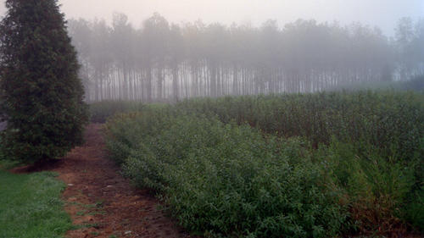
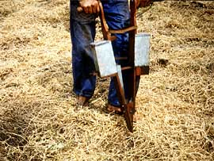
Natural Sinks
Eliminate tropical deforestation
OR
Plant new forests over an area the size of the continental U.S.
OR
Use conservation tillage on all cropland (1600 Mha)
Conservation tillage is currently practiced on less than 10% of global cropland
B / $
Photos courtesy of NREL, SUNY Stonybrook, United Nations FAO
Notes:
“B” = biostorage sector, $=rough indication of cost (on a scale of $ to $$$)

Slide 20
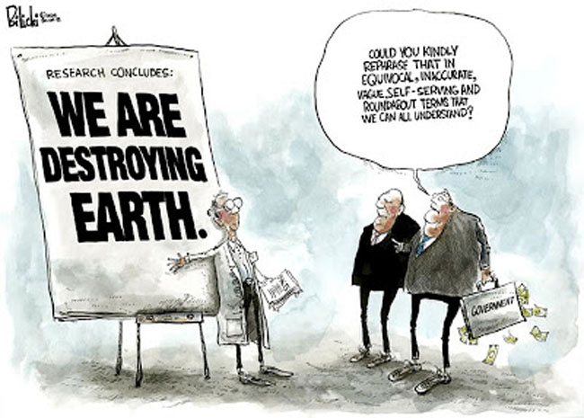
Take Home Messages
In order to avoid a doubling of atmospheric CO₂, we need to rapidly deploy low-carbon energy technologies and/or enhance natural sinks
We already have an adequate portfolio of technologies to make large cuts in emissions
No one technology can do the whole job – a variety of strategies will need to be used to stay on a path that avoids a CO₂ doubling
Every “wedge” has associated impacts and costs

