Slide 1
Quick Summary
National Climate Assessment Report of May 6, 2014

Slide 2
Changes in Heavy Precip

Slide 3
Average Land Temperature to date

Slide 4
Flood threats to date

Slide 5
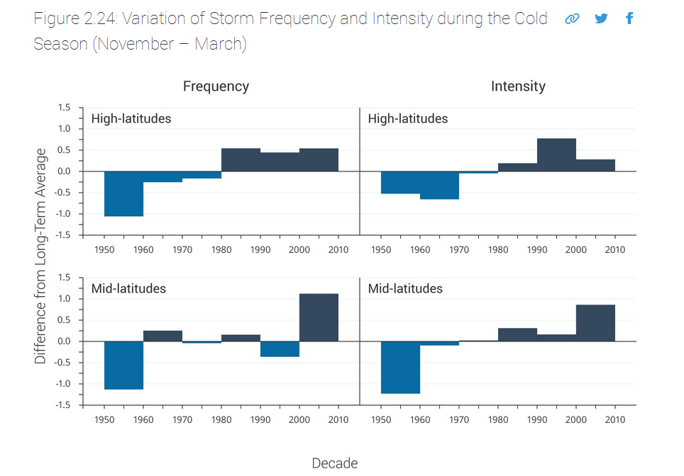

Slide 6
Wildfire Future Porjections

