Slide 1
Regional Climate Change Detection
What is a climate?
How does one define a climate in terms of measured variables?
After defining it, how does one measure actual change in a statically defensible manner.
Most of local climate change is simply assumed to be occurring because global change is occurring

Slide 2
Anecdotal Evidence Often Used
More frequent extreme-heat days
A longer growing season
An increase in heavy rainfall events
Earlier breakup of winter ice on lakes and rivers
Earlier spring snowmelt resulting in earlier high spring river flows
Less precipitation falling as snow and more as rain
Reduced snowpack and increased snow density

Slide 3
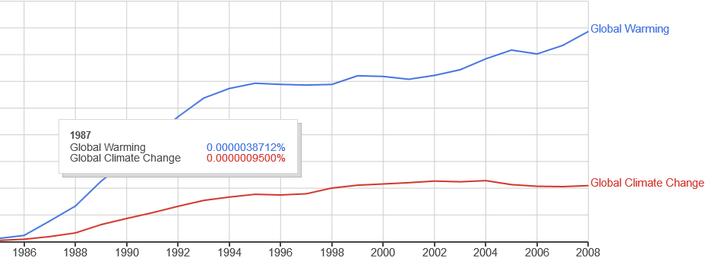
Terms Matter for EXPECTATIONS
From Google Ngram:
4 to 1 ratio in 2008

Slide 4
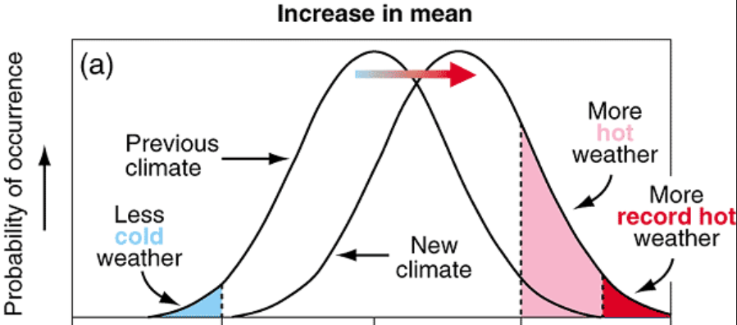
Possible Waveforms of Climate Change
Global Warming Expectation:
This observed data is strongly inconsistent with this expectation

Slide 5
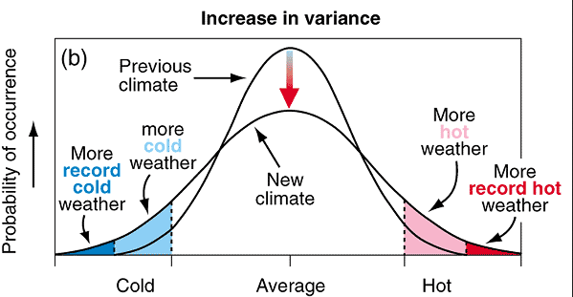
Possible Waveforms of Climate Change
Random volatility expectation
This observed data is weakly inconsistent with this expectation

Slide 6
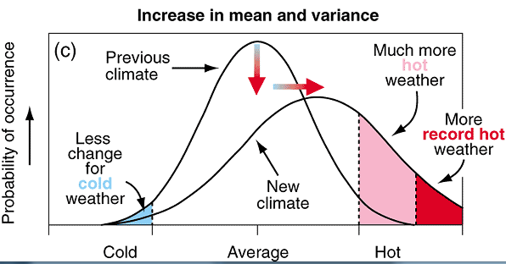
Possible Waveforms of Climate Change
Systematic + volatility increase
This data is more supportive of this case but observed record cold temperatures world wide suggest a bigger tail. In North America, the “much more hot weather” is well supported

Slide 7
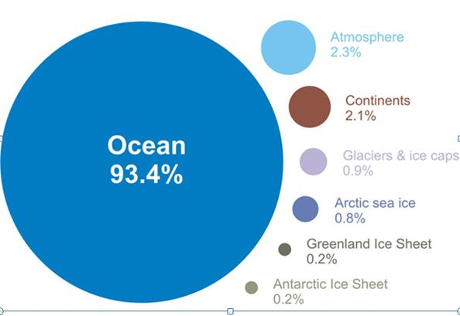
Climate Literacy Part I
How does “waste heat” get redistributed on the planet?

Slide 8
Ocean Atmosphere Coupled System
Greenland Melt
Major Unknown: Role of Deep Sea Transport – is the rate changing?

Slide 9
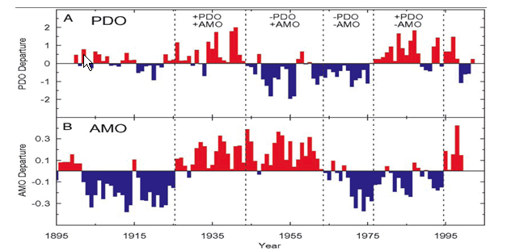
Basic Climate Literacy

Slide 10
4 Different Climates: ½ the time there is a large scale drought

Slide 11
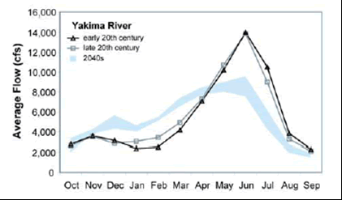
PNW hydrology changes
Less winter snow accumulation,
Higher winter streamflows,
Earlier spring snowmelt,
Earlier peak spring streamflow and lower summer streamflows in rivers that depend on snowmelt (most rivers in the Pacific Northwest)

Slide 13
Policy Debate
"Climate change, once considered an issue for a distant future, has moved firmly into the present," the National Climate Assessment says, adding that the evidence of man-made climate change "continues to strengthen" and that "impacts are increasing across the country.“
Today’s global warming doomsayers simply lack the scientific evidence to support their claims. A host of leaders in the scientific community have recognized that the argument for drastic anthropogenic global warming is no longer based on science, but is being driven by irrational fanaticism.”

