Slide 1
Elements of Climate Change Policy
What should it look like

Slide 2
What should it be based on?
Impacts?
Economics?
Fairness/differential vulnerability?
Carbon Consumption (tax)?
Global vs Local? (global = N*local)
Stabilization Goals?
Security Issues?
Adaptation vs Mitigation?
Public Health Issues?
Least Effective
Least Effective
Obviously it should be based on everything but what on this list do you think has priority?
Most effective

Slide 3
EU green taxes
Taxes on batteries in Belgium, Bulgaria, Denmark, Italy, Latvia, Lithuania and Sweden
Tax on plastic carrier bags in Denmark, Italy and Ireland
Tax on disposable beverage containers in Belgium, Denmark, Estonia, Finland, Latvia, Lithuania, Poland and Sweden
Taxes on tires in Bulgaria, Denmark, Finland, Latvia and Sweden
Taxes on disposable cameras in Belgium
Taxes on lubricant oil in Finland, Italy, Latvia, Norway, Slovenia, Spain and Sweden
Landfill tax in the UK

Slide 4
Projected impacts of climate change
Global temperature change (relative to pre-industrial)
0°C
1°C
2°C
3°C
4°C
5°C
Food
Falling crop yields in many areas, particularly developing regions
Possible rising yields in some high latitude regions
Falling yields in many developed regions
Water
Small mountain glaciers disappear – water supplies threatened in several areas
Significant decreases in water availability in many areas, including Mediterranean and Southern Africa
Sea level rise threatens major cities
Ecosystems
Extensive Damage to Coral Reefs
Rising number of species face extinction
Extreme Weather Events
Rising intensity of storms, forest fires, droughts, flooding and heat waves
Risk of Abrupt and Major Irreversible Changes
Increasing risk of dangerous feedbacks and abrupt, large-scale shifts in the climate system

Slide 5
August 2015 model: Possible Futures
RCP4.5
VS.
RCP8.5

Slide 6
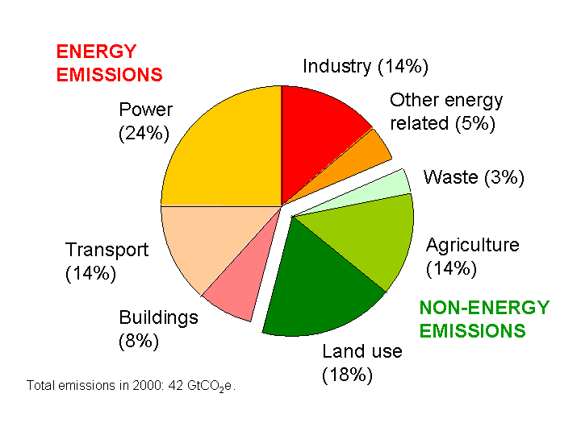
Sources of emissions (and tax assessment) – is this manageable?

Slide 8
From 2006 report – preponderance of evidence argument (e.g. a Law argument not a scientific one)

Slide 9
Local (Country) Energy Security Example: Strong motivation for policy

Slide 10
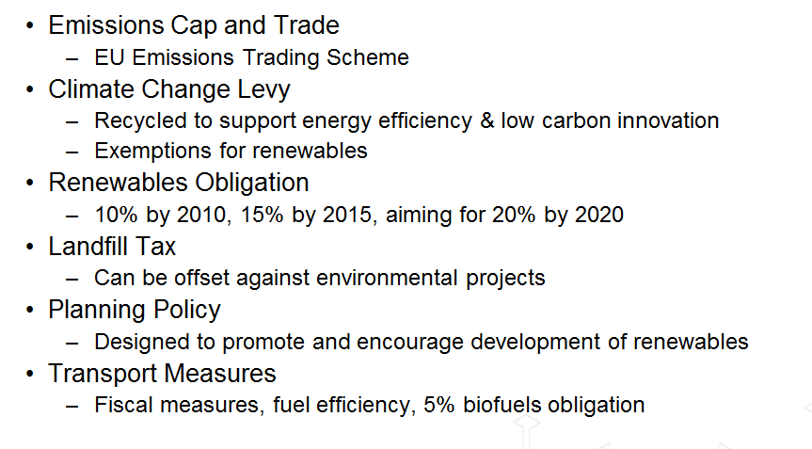
An Integrated (Portfolio) Approach

Slide 11
Example Costs of Inaction
This is what the insurance companies keep saying to deaf government ears

Slide 12
30 Nov 2015 Paris Conference
But its too late for this given ocean heating buffer → we will exceed +2 C
Previously, the Kyoto Protocol was a NONBINDING agreement to lower GHG emissions to 5% below 1990 levels between 2008 and 2012. This Was NOT Achieved

Slide 13
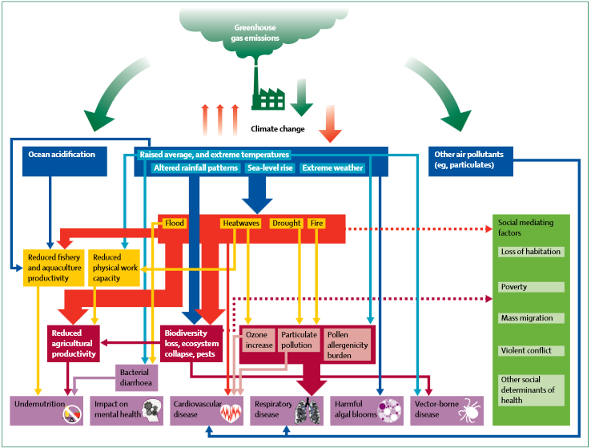
Climate change and public health impact

Slide 14
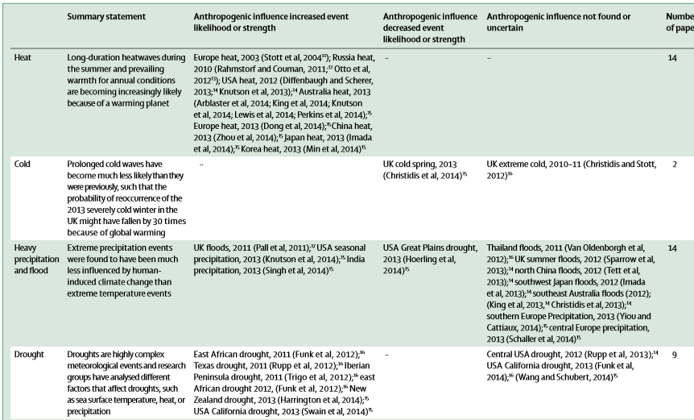
Evidence

Slide 15
The Chain of Effects

Slide 16
Reframing the Argument – 7 points starting with Science and Technology
In Science we need a new social contract between scientists and society; moving away from a hands off view of just giving the facts towards deeper engagement with communication and policy. Scientists need to be trained to become adept at this.
From Technology we need deep decarbonisation at scale - we need more and better tools to decarbonise energy, and as quickly as possible. Scale matters – supply chains matter to get to scale, investment is required.

Slide 17
Behavior, Economy
With Behavior we need to face up to 'stealth denial' - the fact that the majority of those who understand the problem intellectually don't live as though they do. This requires an actual commitment, something we no longer may be capable of?
Our Economy needs to invest in the future; which is mostly about sending money away from fossil fuels towards renewables, but may also be about rethinking economic growth models. This requires new and better economic models that properly account for “externalities”

Slide 18
Democracy, Law, Culture
Our Democracy needs to overcome the governance trap - people expect the government to act but government thinks people don't care about the issue enough so everything remains in policy paralysis
In Law we need a constraint on extraction at a global level i.e. a legal mechanism to keep fossil fuels in the ground based on a “greater good” set of conditions that requires a MORAL dimension.
Throughout our Culture: we need to break 'climate silence' and normalize discussions on the issue; moving away from whether it's happening to what we're doing about it.

Slide 19
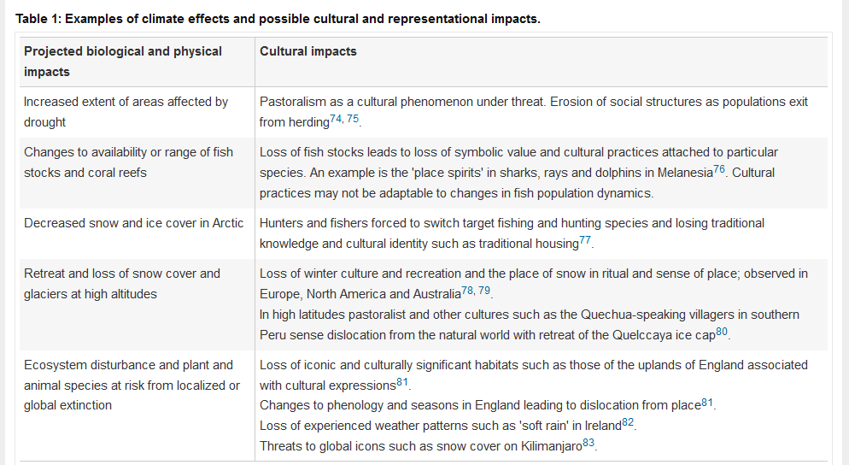
Cultural Dimensions

Slide 20
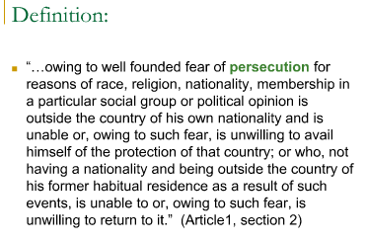
Climate Change Refugees
1951 Convention (adopted by the world now for criteria for refugee status)

Slide 23
Environmental Persecution = cumulative grounds?

Slide 24
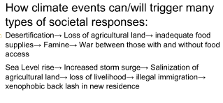
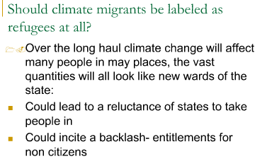
Are there really climate change refugees? –Yes and No

Slide 26
2015 Reality Check
Global Carbon Emissions rising, but may be flattening now – BUT NOT REDUCING

Slide 27
Business As Usual

Slide 28
One Scenario (oil is gone by 2040 anyway)

Slide 29
Daunting Task for New Energy Economy at Scale

Slide 30
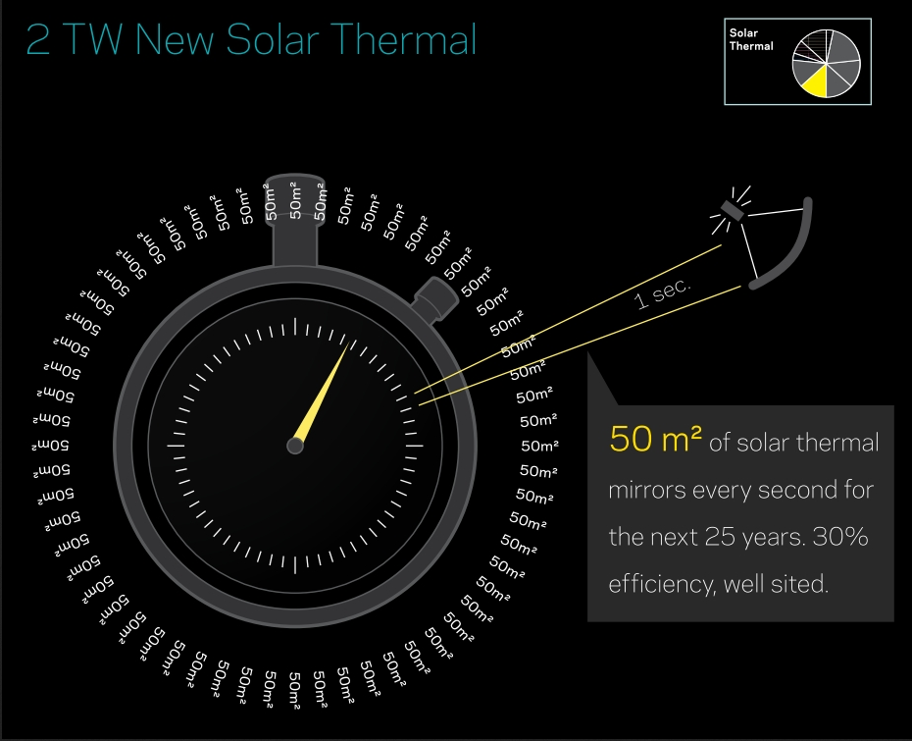
Daunting Task for New Energy Economy at Scale

Slide 31
Daunting Task for New Energy Economy at Scale

Slide 32
Daunting Task for New Energy Economy at Scale

Slide 33
Daunting Task for New Energy Economy at Scale

Slide 34
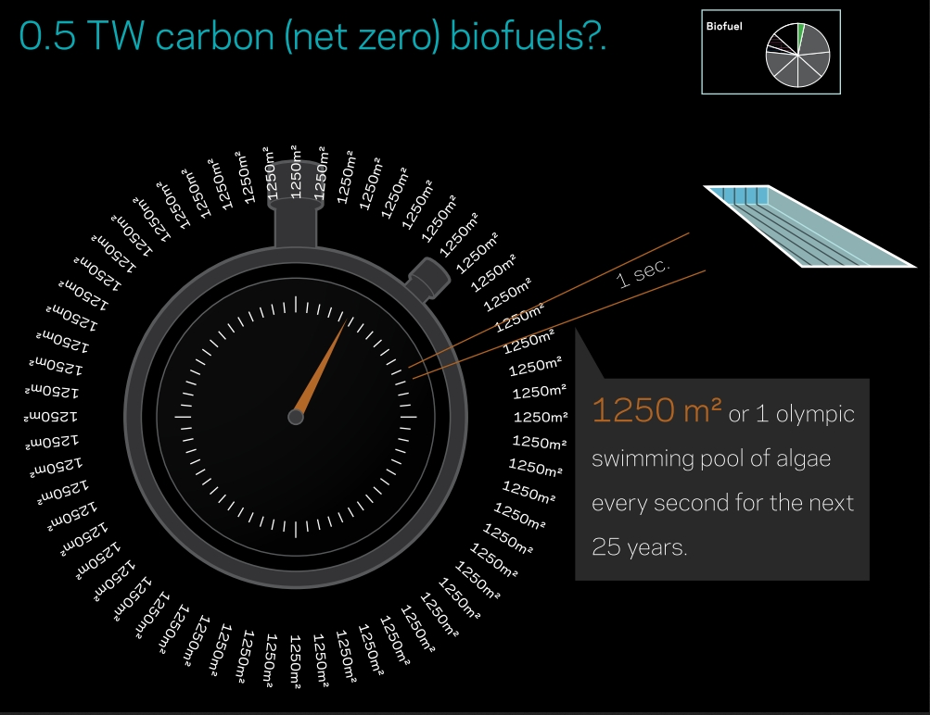
Daunting Task for New Energy Economy at Scale

Slide 35
Daunting Task for New Energy Economy at Scale
To quote one random BLOG:

Slide 36
Daunting Task for New Energy Economy at Scale

Slide 37
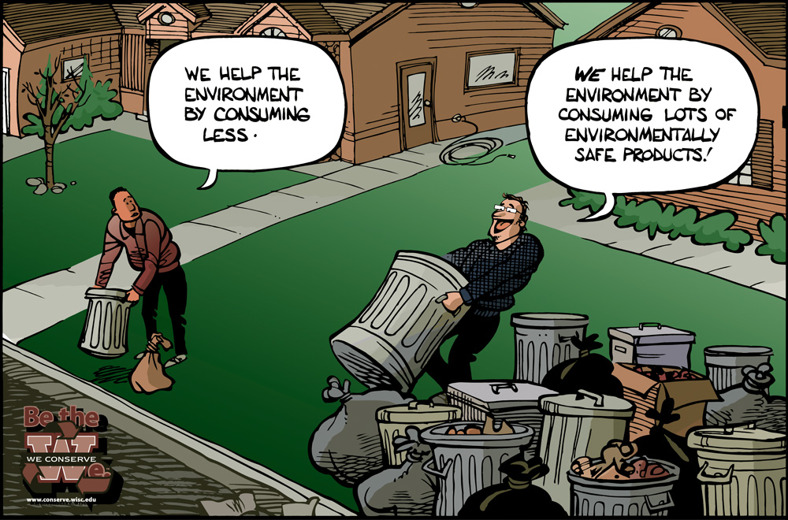
Daunting Task for New Energy Economy at Scale
It’s a lot
Green Spin Disease

Slide 38
Consumption Driven Increased Inequity or Something Else
Business as Usual
Is our GOD

Slide 39
One Earth Equal For All
The Moral Perspective of Planetary Management

