Slide 1
Food Security and Climate Change

Slide 3
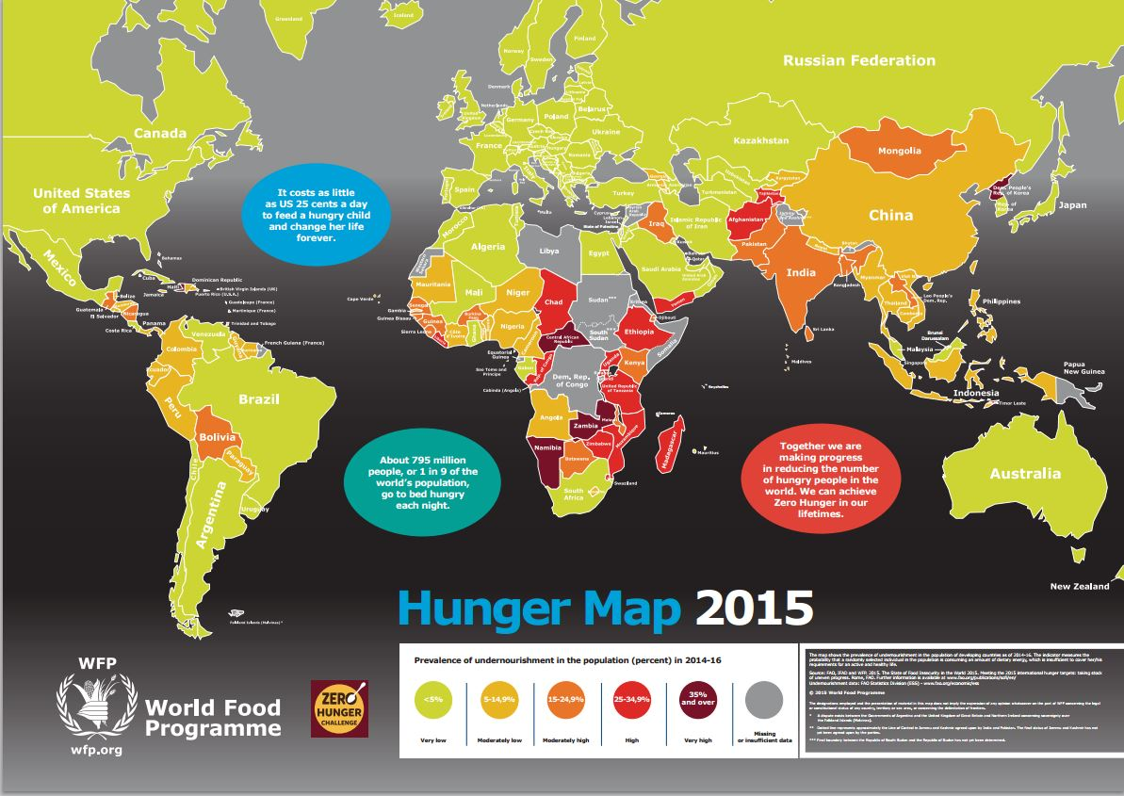

Slide 16
Food Security Challenges in Iraq
Food Supply and Global Food Price Increases
The high import dependency (62% of cereals and 48% of meat) means it is vulnerable to rising global food prices.
Despite the availability of land and water (Tigris and Euphrates), productivity of agribusiness is very low.
1.25 metric tons of wheat per hectare
Poor agricultural practices
The quality of research in Iraq is poor
Poor interface between the science and practice.

Slide 17
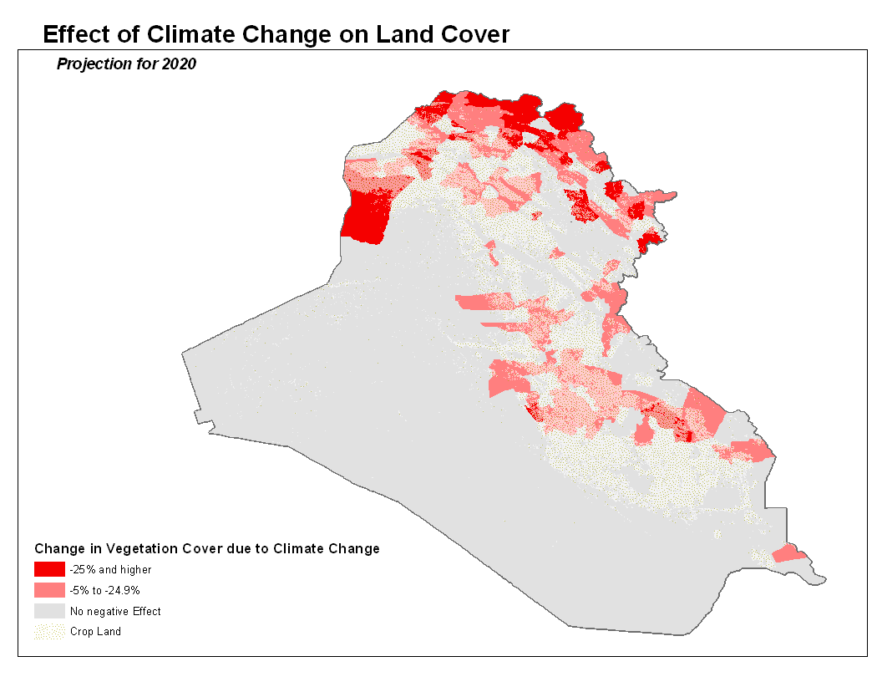
Iraq is significantly affected by climate change.
Suffered drought for 3 years in the past 5
Annual rate of loss of arable land is high – approx. 92% of land is at risk of desertification
Wheat yield is likely to fall by 12.5% by the year 2020 due to climate change
Map of Iraq showing the areas where vegetation cover would be most affected by climate change by the year 2020. Much of the affected area is traditional crop land.

Slide 18
Climate Change and Food Supply
Projected impact of climate change:
Pressure from both climate change and growing population could
Raise wheat import dependency from 64% (current) to as high as 76% (2020 projections)
Rural income from agricultural production will
Fall by 8% due to climate change alone in 2020 –
Leading to a decline in food intake by 3% and an
Estimated increase in the number of food deprived by another 150,000 in the rural areas.

