Slide 1
Radiation Balance and Feedbacks

Slide 3
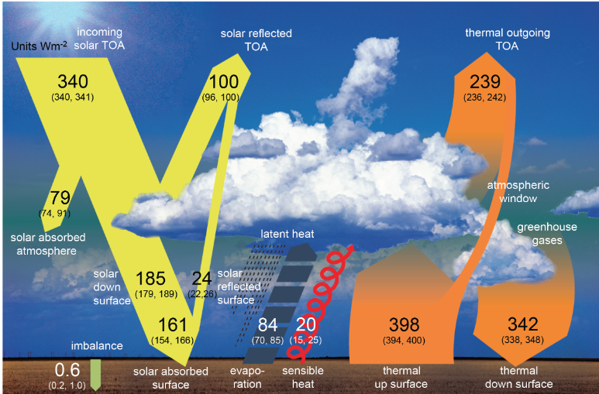

Slide 4
Differences New - Old
Absorbed by atmosphere 79/67 = 18% increase
Reflected by Surface 24/30 = 20% decrease
Total reflection = 107/100 = 7% decrease
“Back Radiation” = 342/324 = 5% increase go more “global warming”

Slide 5
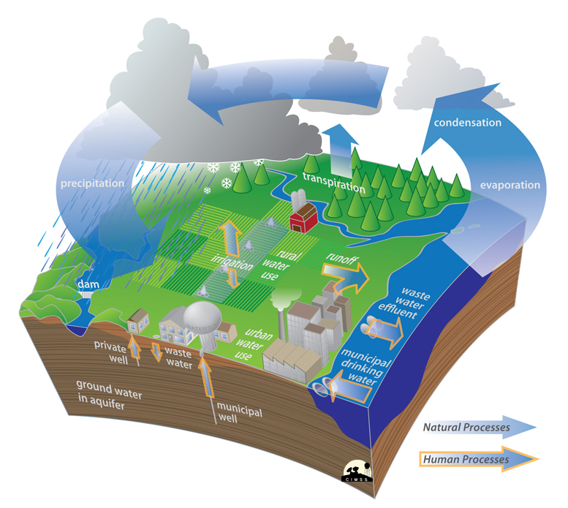
One way to think about Climate Change is an intensification of the water cycle
As the temperature of the atmosphere rises, more water is evaporated from ground storage (rivers, oceans, reservoirs, soil). Because the air is warmer, the relative humidity can be higher, and the atmosphere can 'hold' more water vapor. As a greenhouse gas, the higher concentration of water vapor is then able to absorb more thermal IR energy radiated from the Earth, thus further warming the atmosphere. The warmer atmosphere can then hold more water vapor and so on and so on. This is referred to as a 'positive feedback loop'.
In a warming climate, water vapor plays a major role in a positive feedback loop that amplifies global climate change. (H₂0 responds to changes in climate, but it doesn’t drive climate change)

Slide 6
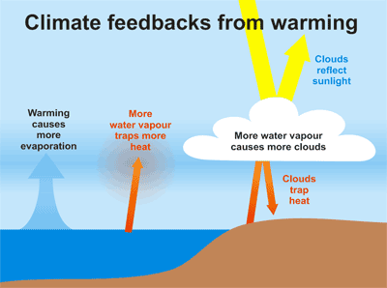

Slide 7
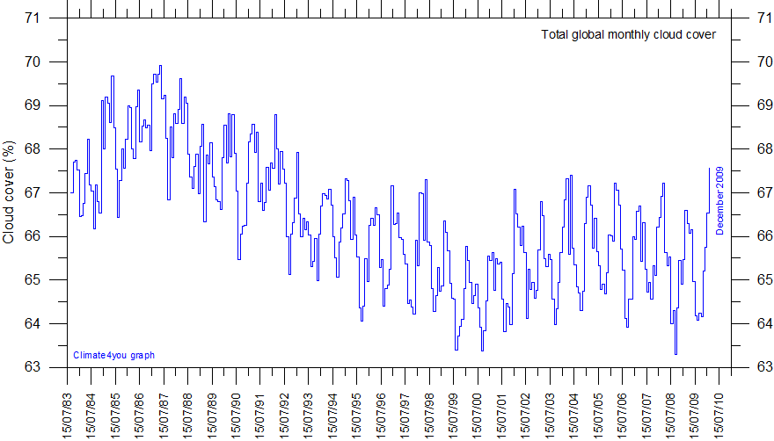
No Evidence of “recent” increasing cloud cover

Slide 8
Observed warming is consistent with observed changes:
There is a widespread retreat of nonpolar glaciers.
Arctic sea-ice has thinned by 40% in recent decades (summer & autumn)
And decreased in extent by 15% since the 1950s in spring and summer.
Northern Hemisphere snow cover has decreased by 10% since the 1960s.
The growing season has lengthened by about 1 to 4 days per decade during the last 40 years in the Northern Hemisphere, especially at higher latitudes.
The duration of ice cover on lakes decreased by about 2 weeks over
the 20th century in mid- and high latitudes of the Northern Hemisphere.
The global mean sea level has increased at an average annual rate of
1 to 2 mm during the 20th century.

Slide 9
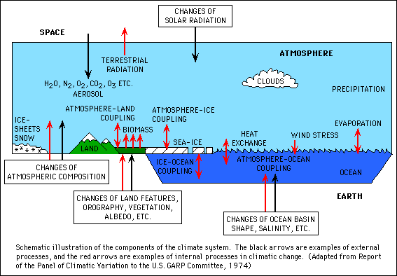
Closer Look at Climate System

Slide 10
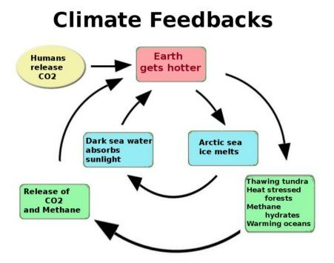

Slide 11
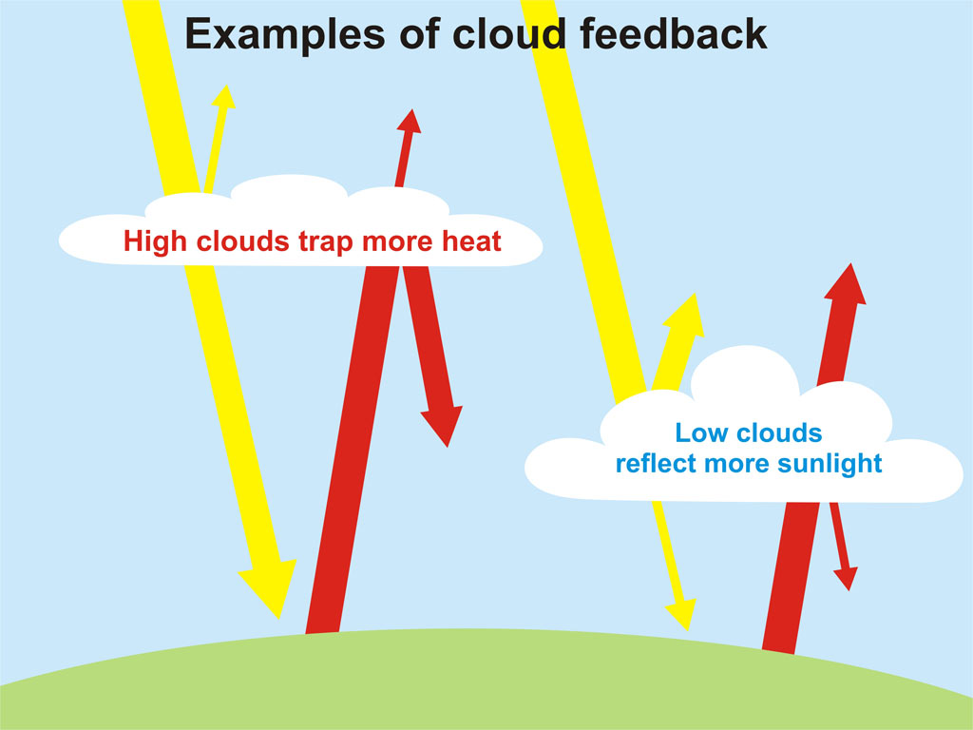

Slide 12
Climate Feedback Mechanisms

Slide 13
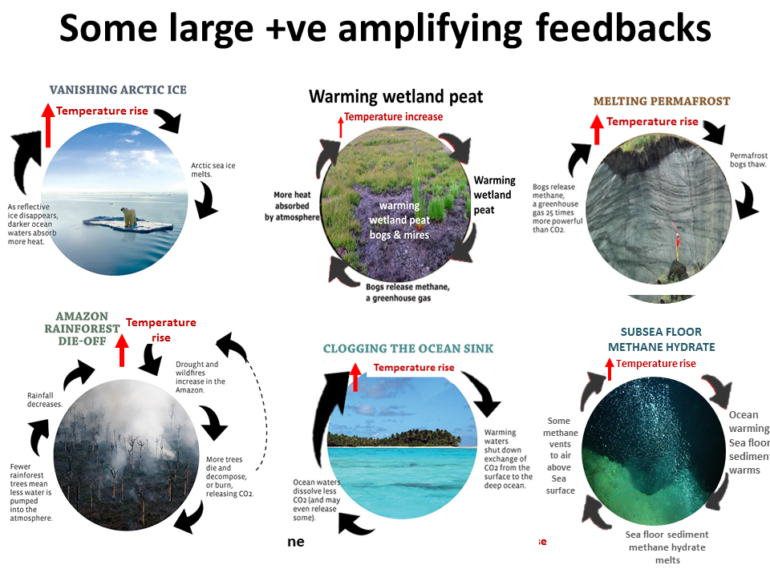

Slide 14
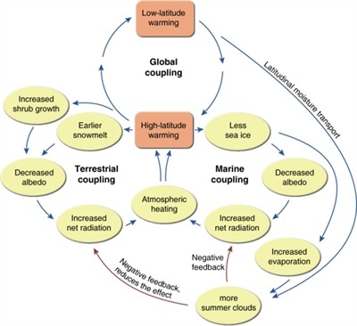

Slide 15
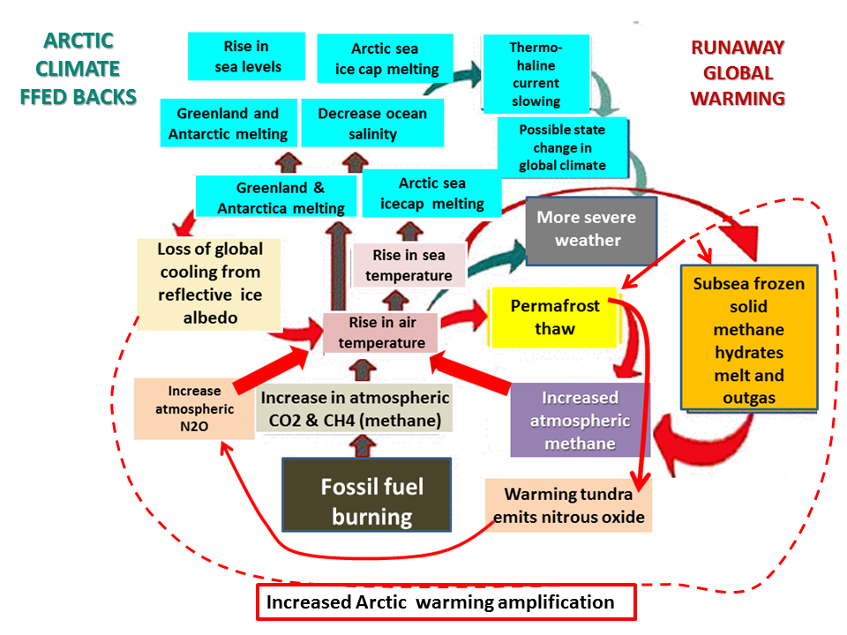

Slide 16
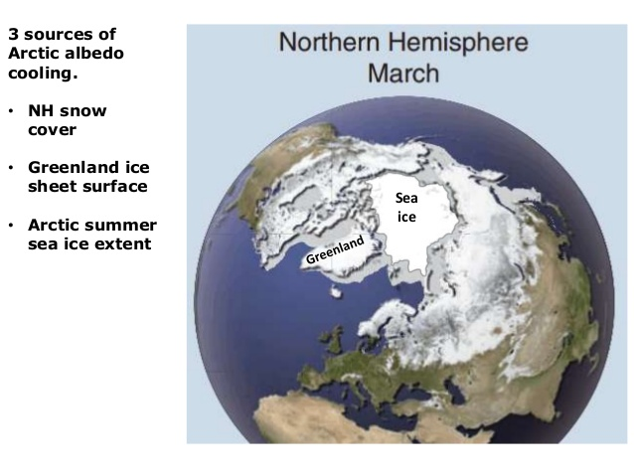

Slide 17
