Slide 1
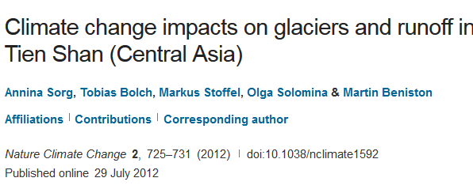
The Tibetan Plateau
Providing Fresh Water to 1/3 of Humanity

Slide 2
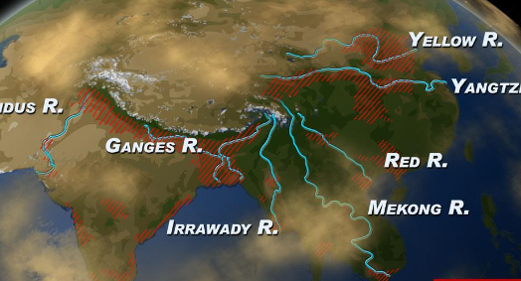

Slide 3
2013

Slide 5
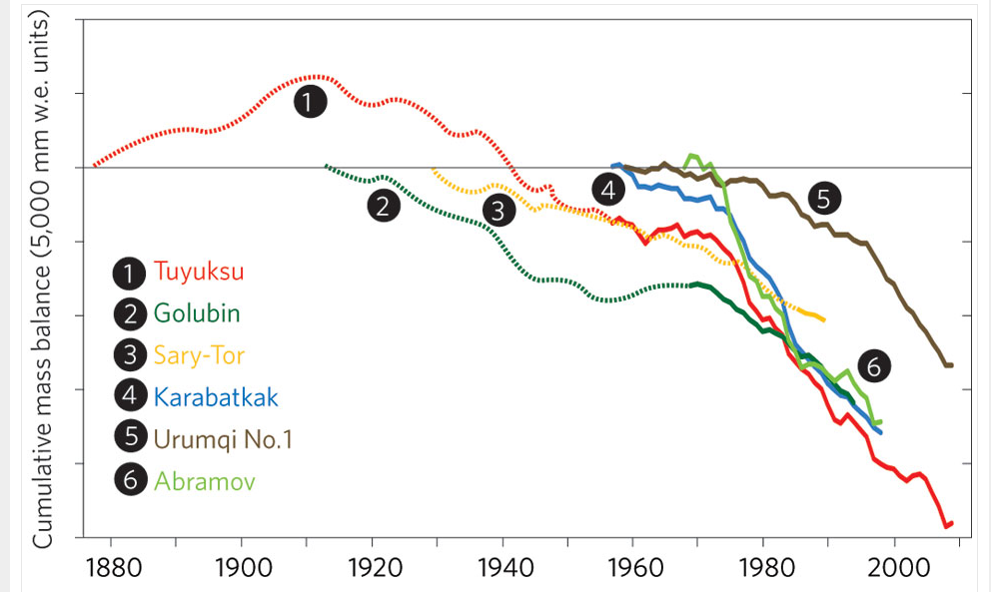
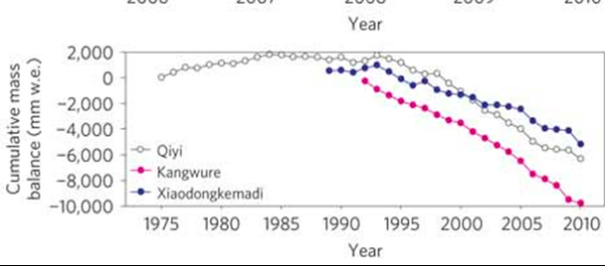
Rapid Glacial Melt ~7% per year

Slide 9
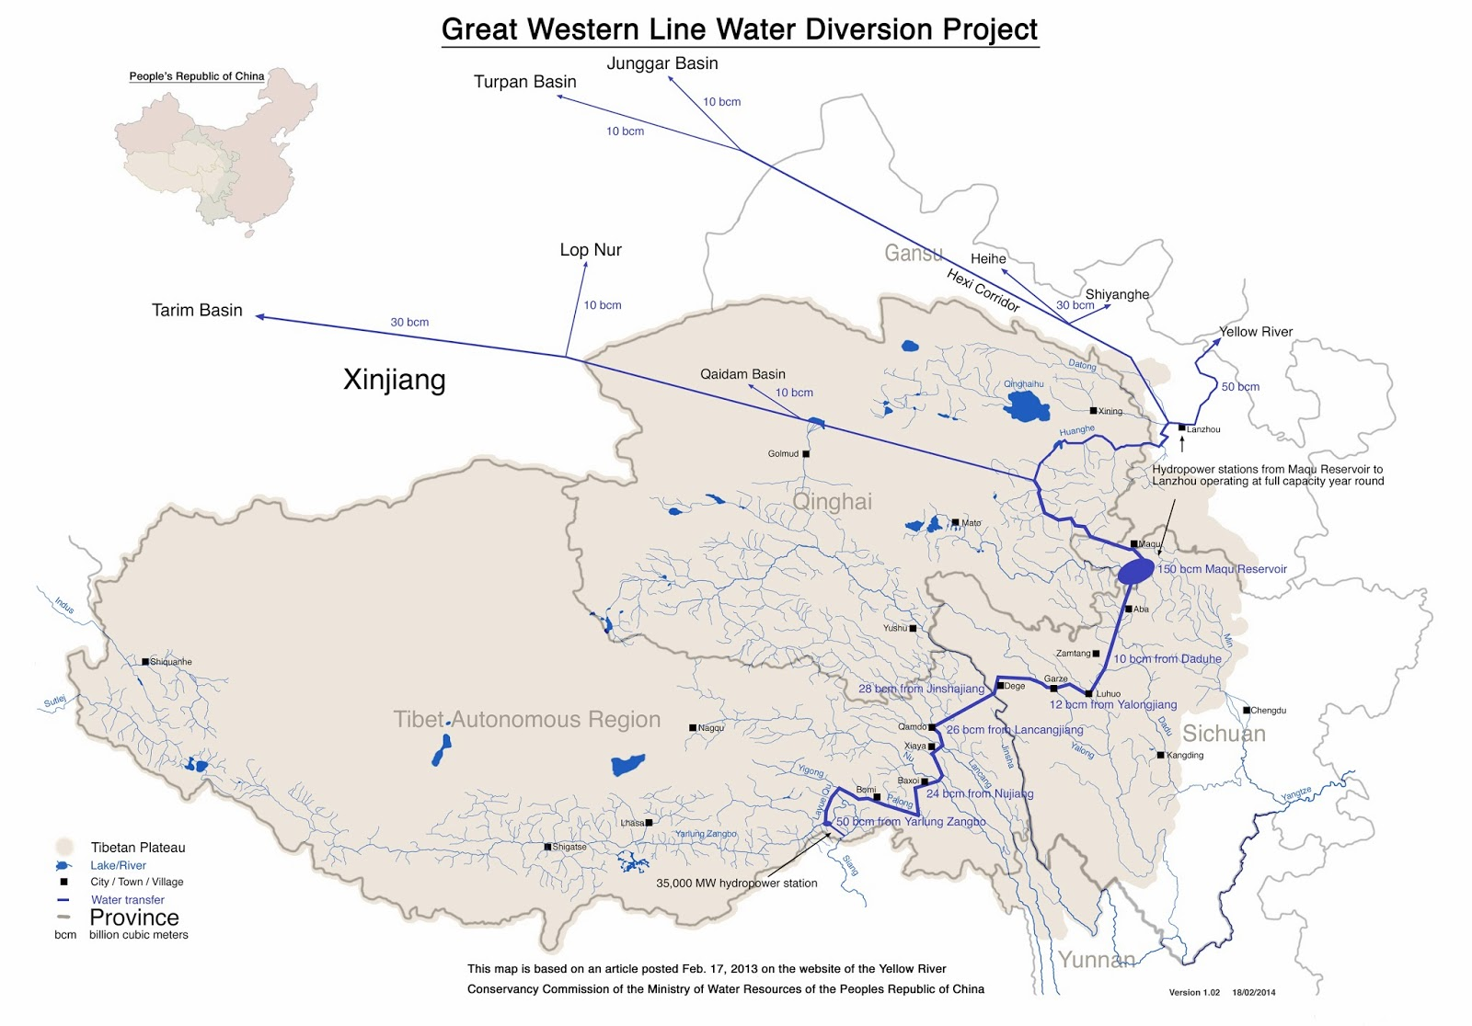
The Tibetan Water Diversion Project

