Slide 1
Water Security: threats to both biodiversity and humans

Slide 2
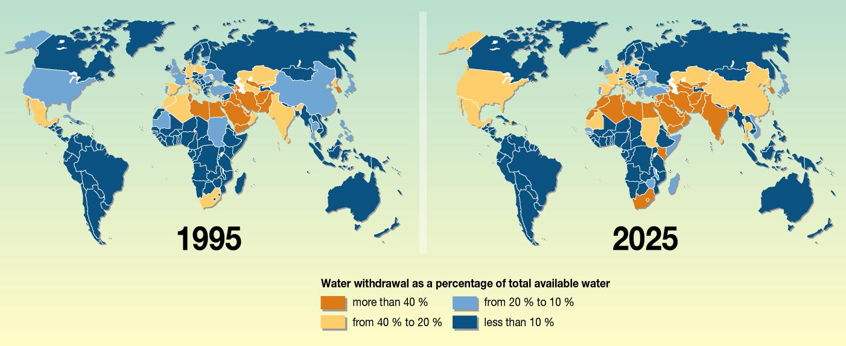

Slide 4
Livestock Density

Slide 5
Cropland

Slide 6
Urbanization (impervious surfaces)

Slide 7
Pesticide Loading

Slide 8
Sediment Loading

Slide 9
Consumptive Water Losses

Slide 10
Human Water Stress

Slide 11
Agricultural Water Stress

