Slide 1
The 10 Potentially Deadliest Volcanoes just waiting to Explode

Slide 2
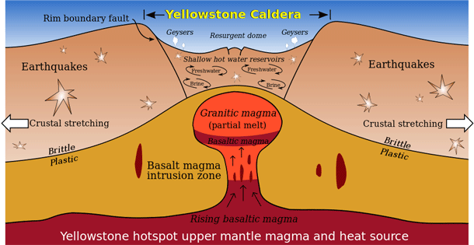
Last Erupted 600,000 years ago: If erupted today would kill about 90,000 immediately but trigger worldwide crop failure

Slide 3
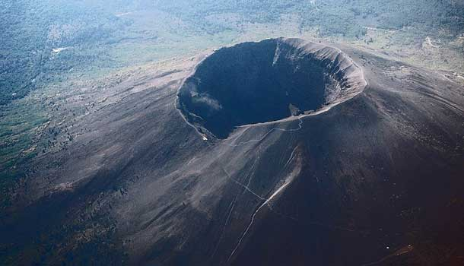
Vesuvius
Last significantEruption 1944 with a cycle of about 20 years for minor eruptions; 5 miles East of Naples – 3 million people in harms way

Slide 4
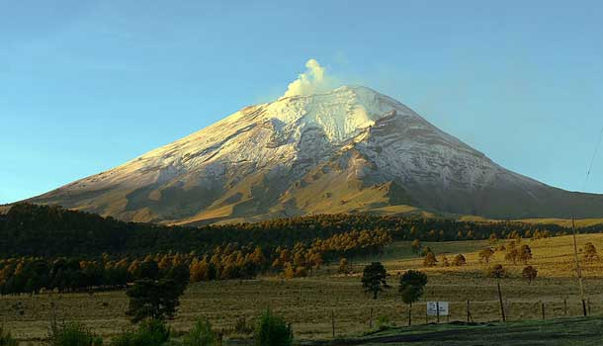
Popocatépetl, Mexico
Last erupted in 2000. Has erupted 20+ times since 1519. 9 million people live within the “blast” radius of major eruption.

Slide 5
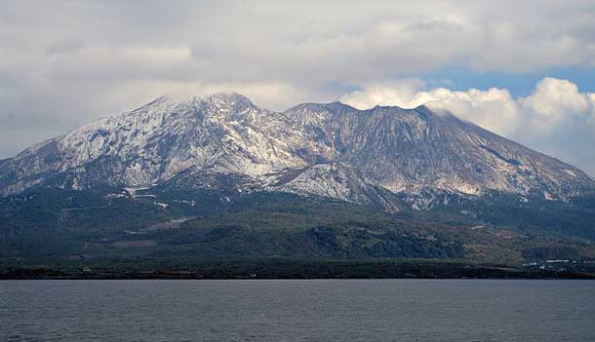
Sakurajima, Japan
Last eruption in 1914 but constant small ash eruptions every year. 700,000 people live nearby in Kagoshima

Slide 6
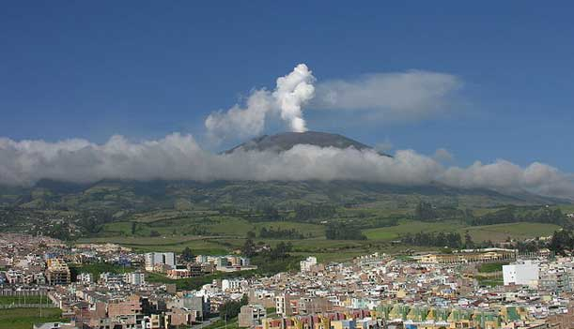
Galeras, Columbia
While it went dormant in 1978, it went active again in 1988 after just 10 years. When scientists held a Decade Volcano conference in 1993 to address the dangers of Galeras, an unexpected eruption occurred, killing 6 scientists and 3 tourists. Since 2000, it has erupted almost every year, spouting out ash and lava and causing tremors in the region. 450,000 people nearby

Slide 7
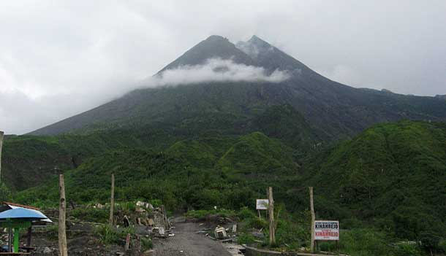
Mt. Merapi, Indonesia
One of the most active volcanoes in the world. Has erupted “regularly” since 1548. In 2010 fast moving lava flows killed 353 and displaced 320,000 local residents. Experts believe that its activity led to the demise of the Hindu Kingdom of Mataram

Slide 8
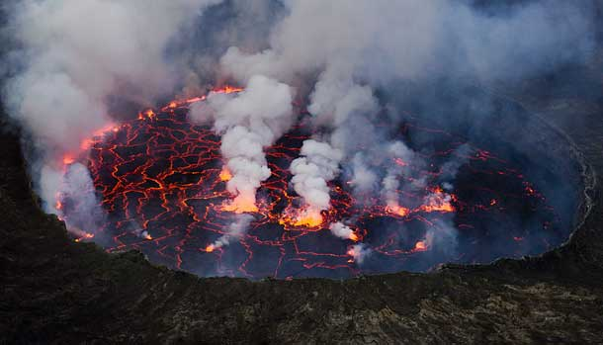
Mt. Nyiragongo, of Congo
In 2002, another major eruption at Mt. Nyiragongo caused a lava stream to flow through the provincial capital of Goma. Fortunately, the 400,000 residents had already been evacuated, but 147 people still died as a result of the eruption. 4,500 buildings were destroyed in Goma, leaving 120,000 people homeless. Ensuing tremors destroyed even more buildings.

Slide 9
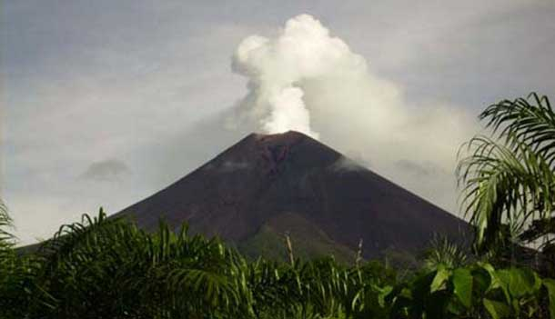
Ulawun, Papua New Guinea
There have been 22 eruptions recorded at Ulawun since the 1700s.
Due to its height, the biggest threat posed by Ulawun is a catastrophic structural collapse, which could generate an eruption that would cause devastation to 100s of square km of surrounding land.

Slide 10
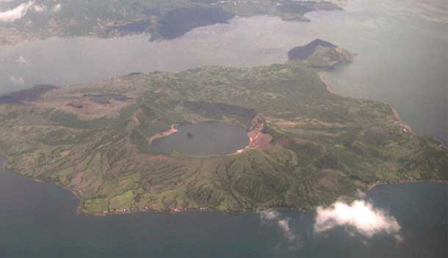
Taal Volcano, Philippines
Taal Volcano has had 33 recorded eruptions since 1572. While most of these eruptions are confined to the intracaldera area, some eruptions devastate the entire region with its fallout. Altogether, it’s estimated that 5,000-6,000 people have been killed by eruptions at Taal. Even today, the only safe way to view the active Taal Volcano is from a safe distance. Of course, that doesn’t stop adventurers from trekking on “Volcano Island”.

Slide 11
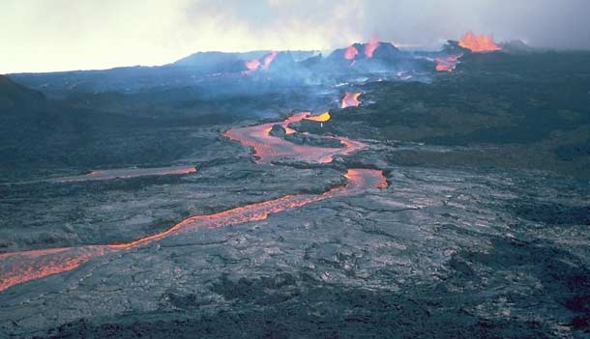
Mauna Loa, Hawaii
Mauna Loa has been erupting regularly for at least the past 700,000 years, with its most recent eruption occurring in 1984. The most significant hazard Mauna Loa poses to surrounding communities are its lava flows. Although most of the flows from Mauna Loa advance at a slow pace, posing little danger to human life, major eruptions can cause fast moving flows. In 1950 for example, the village of Ho’okena Mauka was destroyed by flowing lava. The intense 1984 eruption saw lava flows that moved towards the highly populated Hilo, but didn’t reach any buildings.

