Slide 1
The Local Danger
And the Mag ~9.0 event in January 1700

Slide 2
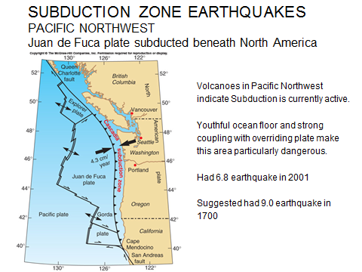

Slide 3
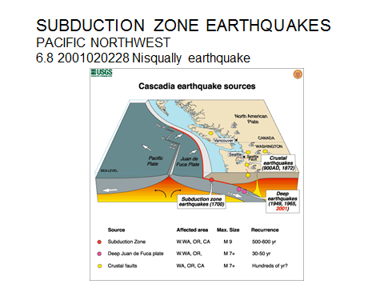

Slide 4
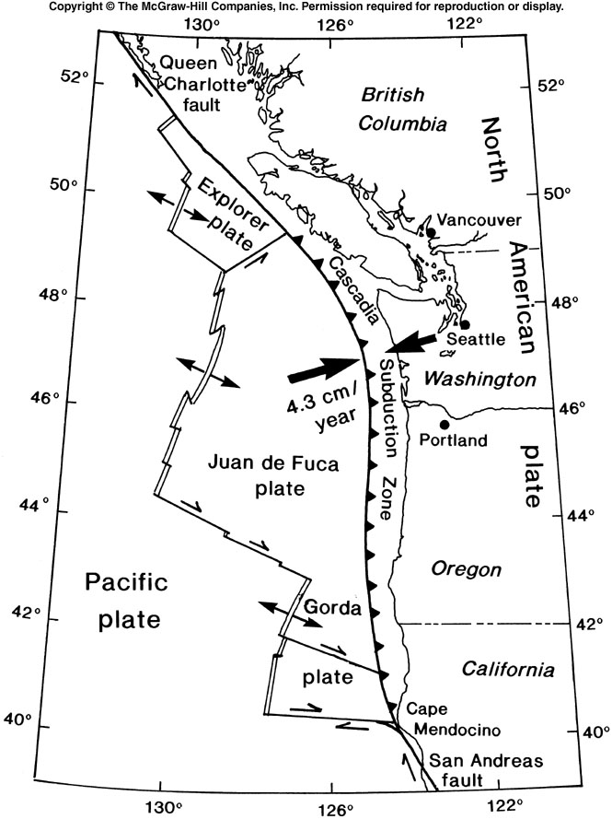
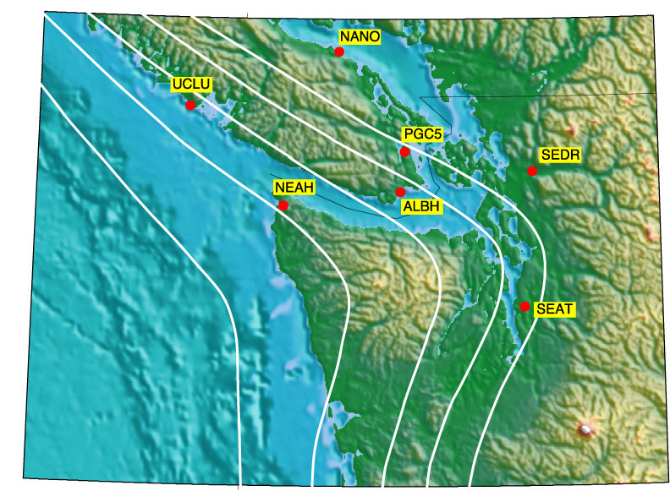
SUBDUCTION ZONE EARTHQUAKES
PACIFIC NORTHWEST
1872 M6.8, Lake Chelan
1949, M 7.1 earthquake, Puget Sound
1965, M6.5 earthquake, Puget Sound
2001 M 6.8 earthquake, Puget Sound
1700 M 9.0 earthquake, Cascadia

Slide 5
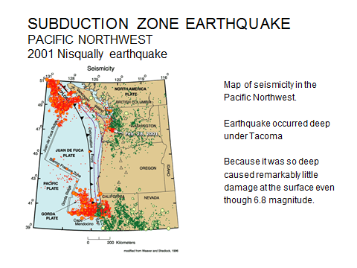

Slide 6
SUBDUCTION ZONE EARTHQUAKES
PACIFIC NORTHWEST
OFFSHORE TURBIDITE RECORD FOR PAST EARTHQUAKES
A number of events can potentially trigger turbidity currents.
Tsunamis
Storm induced waves
Slope failures
Earthquakes
The turbidite record strongly suggests that Cascadia experienced strong coast-wide shaking typical of a large subduction zone earthquake.

Slide 7
SUBDUCTION ZONE EARTHQUAKES
PACIFIC NORTHWEST
OFFSHORE TURBIDITE RECORD FOR PAST EARTHQUAKES
54 new cores in Cascadia, document the event record temporally and spatially.
Thirteen post-Mazama and 18 Holocene events are found along~ 660 km of plate margin.
The most recent event took place in 1700 AD (Satake et al., 1996; Nelson et al., 1995)
An additional 12 turbidite events have occurred during the preceeding 7200 years, yielding a mean recurrence time of ~575 years.

Slide 8
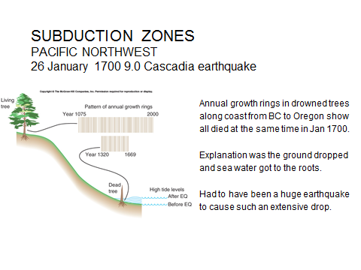
Evidence for the 1700 Event

Slide 9
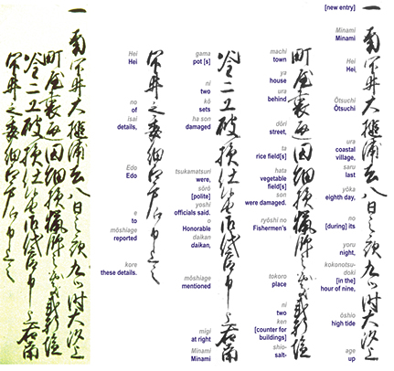
Japanese records show evidence of a tsunami January 26 1700 that was not from a local earthquake but probably from Pacific Northwest.

Slide 10
SUBDUCTION ZONE EARTHQUAKES
PACIFIC NORTHWEST
Kenji Sataki found Japanese records to tsunami occurrences along the country's eastern coastline between January 27 and 28, 1700. Careful analysis of these historic tsunami records indicated that several coastal villages were damaged.
The following is a chronicle by the head of Miho village, 145 km southwest of Tokyo. This account tells of sea water covering land as if it were high tide.
"The water also went into the pine trees of Ego. The receding water went out very fast, like a big river. It came in about seven times before 10 a.m. of that day and gradually lost its power…Because the way the tide came in was so unusual, and was in fact unheard of, I advised the villagers to escape to Miho Shrine…It is said that when an earthquake happens, something like large swells result, but there was no earthquake in either the village or nearby."

Slide 11
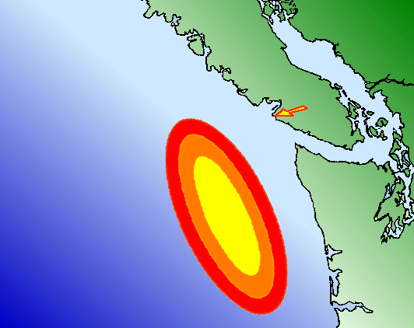
Approximate area of rupture zone
Pachena Bay

Slide 12
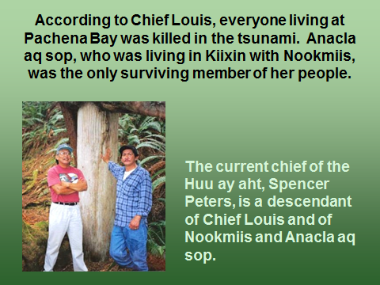

Slide 13
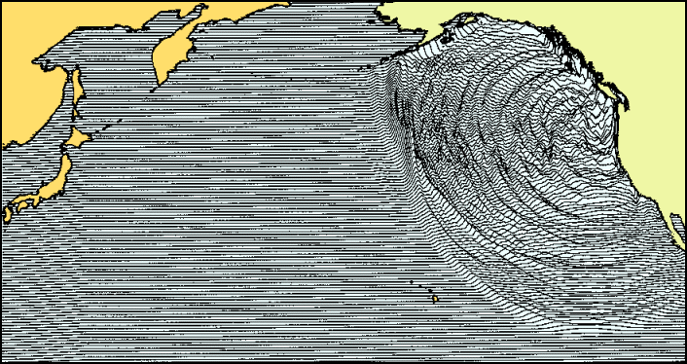
A tsunami wave hit several locations in western Japan on January 27th 1700. There is no record of a corresponding earthquake occurring near to Japan, or anywhere else around the Pacific Ocean
Based on the time for the wave to cross the ocean it is estimated that the quake struck at around 9 PM local time on January 26th, 1700.

