Slide 1
Black Sea Flood 5600 BC (What happened ?)
Originally proposed in 1997 by Ryan and Pittman at Columbia University

Slide 2
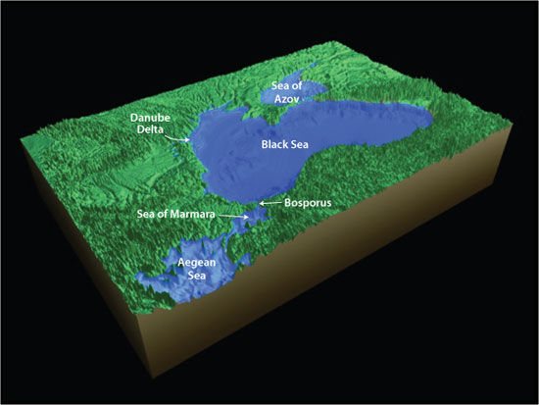
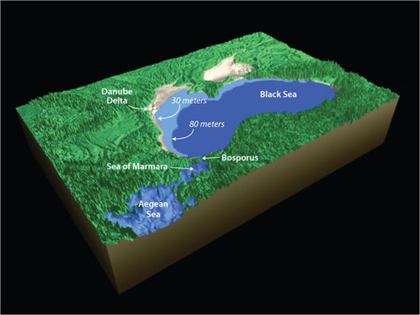
Noah’s Ark
Ryan and Pittman attempt to link this event to the story of Noah’s Flood.
The scientific debate:
Was it catastrophic?
Evidence supports mild version as well → no catastrophic breakage of the Bosporus Sill; original Black sea was 30m lower not the 80m figure of Ryan and Pittman; 9500 vs 7600 years go

Slide 3
Catastrophic Scenario

Slide 4
Black Sea today: dimensions
At present the Black Sea is 750 miles long and 380 miles wide (1210 km by 610 km), and covers an area comparable to the size of California.
The Black Sea’s deepest bed is 7238 feet, ie 2206 m, below the surface.

Slide 5
A global warming trend commences ~15000 BP
The last Ice Age (~100,000 yr in duration) began to come to an end ~15,000 BP, as the earth started to warm up.
The upper latitudes of the continents laid buried under sheets of glacial ice.
At the peak of glaciation, oceans were several hundred feet lower than today.

Slide 6
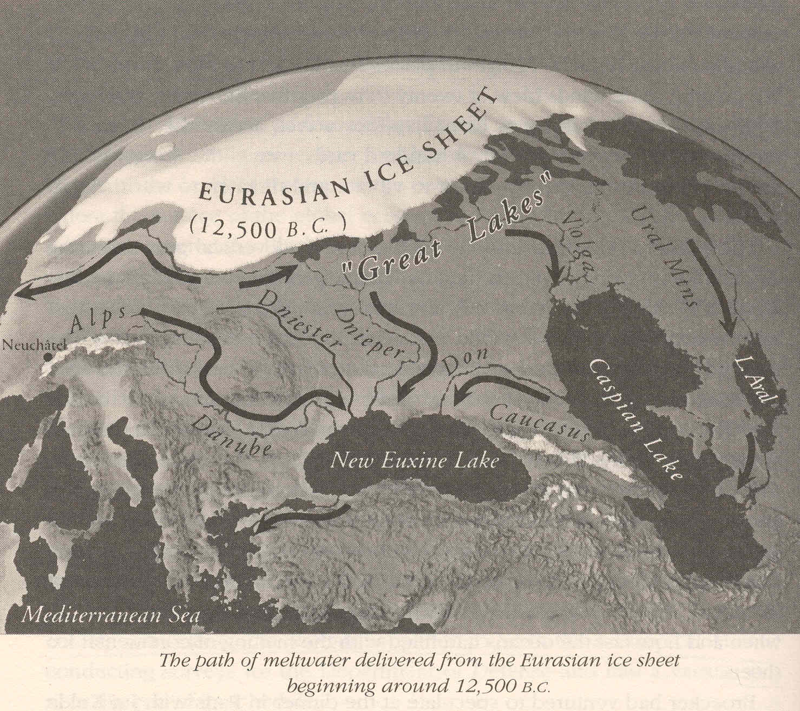
EurAsian IceCap (Ryan P.156)
Melt-waters formed large Inland Lakes similar to what happened in the Lake Missoula Case

Slide 7
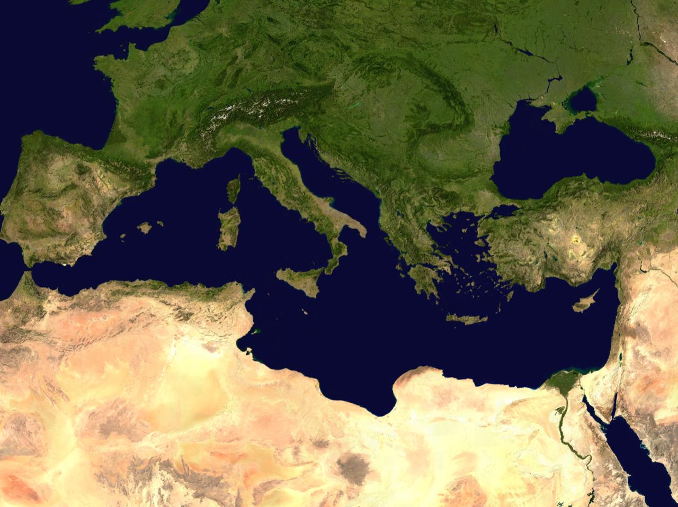
Composite Satellite Image

Slide 8
Sea Level Rise vs Time
The linear rise rate is about 2 cm per year or 2 meters per century

Slide 9
Sea Level rise over last 9000 yr

Slide 10
Black Sea isolated
Note that during (15000-7600 BP), the Mediterranean was cut off from the Black Lake, so that as the level of the Atlantic Ocean started to rise, the Mediterranean did as well, but the Black Lake did not. The water level discrepancy reached as much as 400 feet.
By using core samples taken from the floor, and computer reconstruction of the seabed, Ryan and Pitman determined that before the flood, the Black Sea was a freshwater lake. It lay several hundred feet below the Bosporous Valley.

Slide 11
Mediterranean did not connect to Black
During the period (9000-7600 BP) the water level of the Mediterranean continued to rise, but in expanding northward, it was only able to reach the edge of the Bosporous Valley, since it was ultimately held back by a natural sediment dam, there (~400 feet high and ~2 mile wide).
Hence, up to 7600 BP, the Mediterranean had no water exchange with the Black Sea (Ryan, 1998).

Slide 12
Bosporous Valley lies between the Marmara and Black seas

Slide 13
Mediterranean finally overflows
Finally, at (~7600 BP, ie 5600 BC): Excess waters in the Mediterranean pushed northward, causing the Agean and Maramara seas to rise, and the water broke through the dam at Bosporous, and finally spilled into the Black Lake, in a massive flood.
The incoming salt water, more dense than freshwater, plunged to the bottom of the lake bed, transforming it into a sea where the depths do not support life (anoxic).

Slide 14
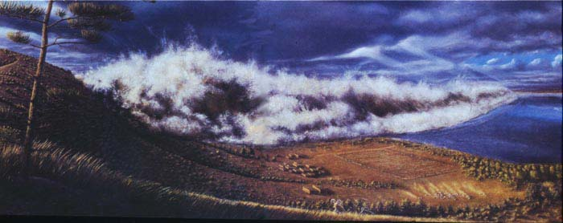
The Flood: a massive onslaught of water
Run away, Run away

Slide 15
Ryan and Pitman seek evidence
Deep gorge discovered at Bosporous
Freshwater -> saline water
Carbon 14 dating of mussel shells

Slide 16
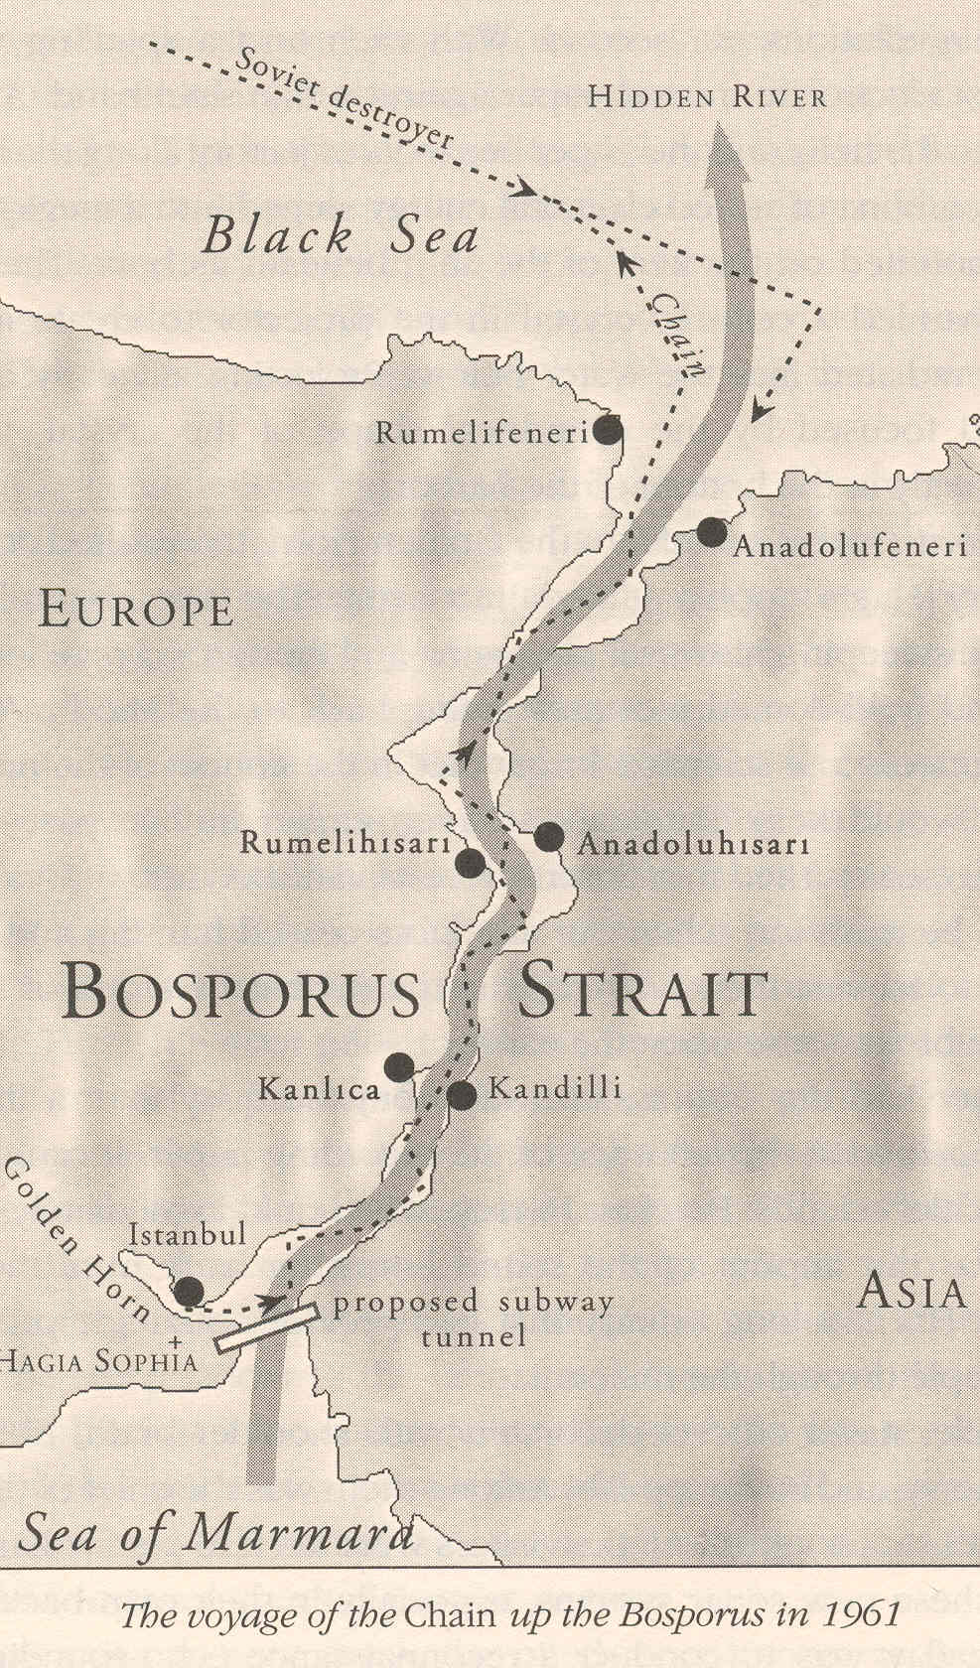
Ryan found a deep gorge in the Bosporous Strait

Slide 17
Deep gorge (~80m-100m) at Bosporous
Ryan discovered a large gorge in the Bosporous, which cut deep into the bedrock. It is interpreted as evidence of the passage of an enormous flow of water (pouring) through it.
Dr. Walter Pitman: “The depth of the hard rock below the sediment was between 80m to 100m. It indicated that this channel had to have been cut by a rush of fast-moving water”. (100 km/hr) (BBC interview)

Slide 18
Coarse sediments tilted northward, to the Black Sea
The coarse sediment at the gorge’s bottom was found arrayed in dune shapes, tilted to the north, thereby indicating flow from Agean to Black Seas.

Slide 19
Dating of Black Sea mussel shells
Carbon 14 dating of shells of freshwater mussles (found in sediment core investigation), were compared with shells of mussles and plankton that lived in saline water, in order to test the abrupt transition hypothesis. (ie Transition from freshwater to saline water composition.)

Slide 20
Ballard finds old shoreline, confirming Ryan
Marine archaeologist Robert Ballard, in a separate investigation of the Black Sea Flood, identified ancient shorelines, freshwater snail shells, drowned valleys and man made structures. Ballard’s research of the Black Sea, found a previous shoreline, ~450 feet below present water level, supporting Ryan’s contention.

Slide 21
Confirmed: Flood occurred over a short time span
Amazingly, the carbon 14 dating showed that the mussel shells from across the Black Sea transect were all pretty much the same age: about (7500-7600) yrs old.
This indicated that the flooding took place over a short time period, termed as “instantaneous” on a geological time scale.
This is strong evidence for catastrophic scenario

Slide 22
Migration
Ryan also proposed that the flood may have triggered massive migrations of people from the Black Sea region, to destinations as far away as Egypt, western Europe and central Asia.
Pitman: “We think it (the Flood event) had a great effect on human history, because it widely dispersed people who had different methods of farming and had different languages.”

Slide 23
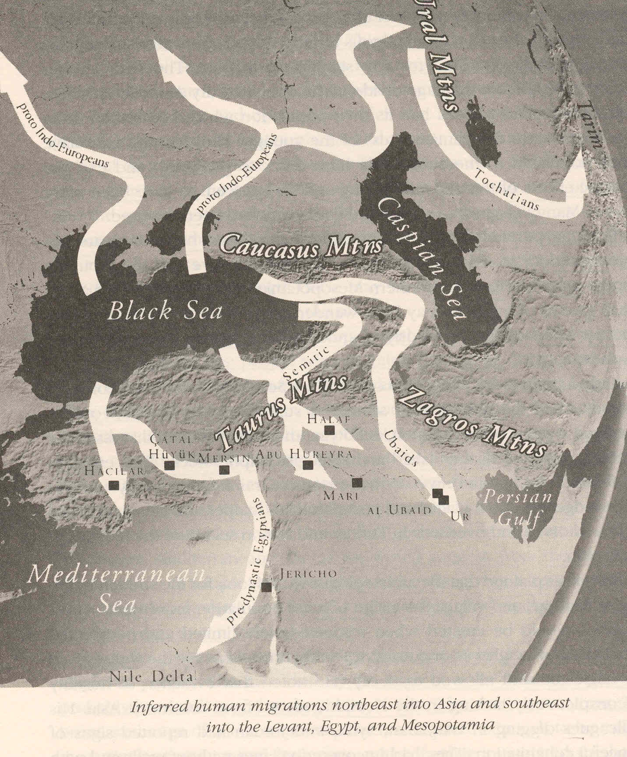

Slide 24
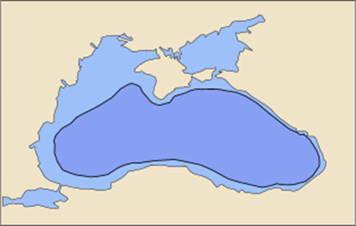
Migration spreads
The change from hunter-gatherer societies to farming communities in Europe at approximately 6th millenium BC, may have been catalyzed by this great migration to escape the Flood.
Overall, there was a ~30% expansion in the size of the Black Sea, leaving it with its modern day configuration
Seismic soundings and sediment cores reveal traces of the Black Sea’s former shoreline, showing a 500 foot rise in water level

Slide 25
Key Question
The key question to be addressed, in assessing Ryan’s claim was whether the water level of the Black Sea changed gradually or within a very short period of time (a few years).
While there is some evidence that this event was more gradual and less catastrophic, the basic Random Disaster Rapid Cultural Dispersal hypothesis is not easily refuted.

