Slide 1
The Storegga Land Slide
About 8000 years ago and the flooding of DoggerLand

Slide 2
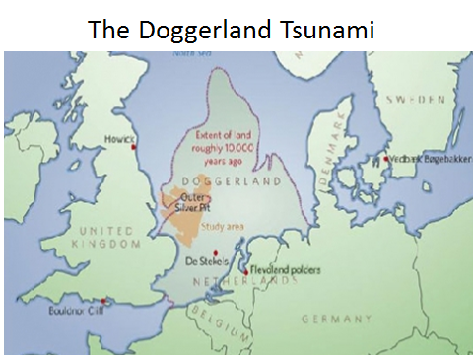
Doggerland (lowland emergence from last ice age) Connects UK to Europe

Slide 3
The Storegga Slide is a very large submarine landslide that occurred off the coast of southwestern Norway about 8200 years ago. The slide involved between 600 and 840 cubic miles of sediment and is thought to have occurred as a single event. The water disturbance produced by the slide generated a tsunami with significant run-ups on the west coast of Norway (30 to 35 feet), Scotland (12 to 18 feet), the Shetland Islands (60 to 90 feet) and the Faroe Islands (30 feet). The tsunami is believed to have had a catastrophic impact on people living along the coastlines.

Slide 4
The head of the slide is at the edge of the continental shelf about 60 miles off the coast of Norway. The slide travelled down the continental slope for a distance of at least 500 miles where the topography had a slope of just two degrees or less. The western portion of the slide encountered a ridge and that deflected part of the flow to the southwest. .

Slide 5
The slide occurred after glacial melting had deposited enormous thicknesses of sediments on the continental shelf and slope. The weight of these sediments and their geologically rapid deposition are thought to have elevated pore pressure within the sediment. The movement may have been triggered by an earthquake or failure of methane hydrate deposits at shallow depths within the sediment. Other enormous slides have occurred in this area within the past 500,000 years with an average recurrence interval of about 100,000 years.

Slide 6
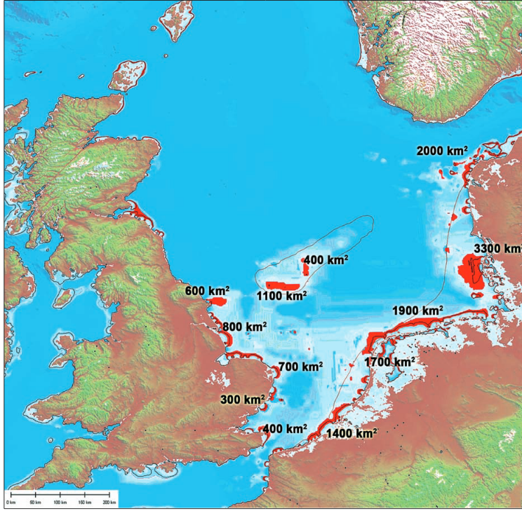
Estimated impact regions for Tsunami of height approximately 20 feet

Slide 7
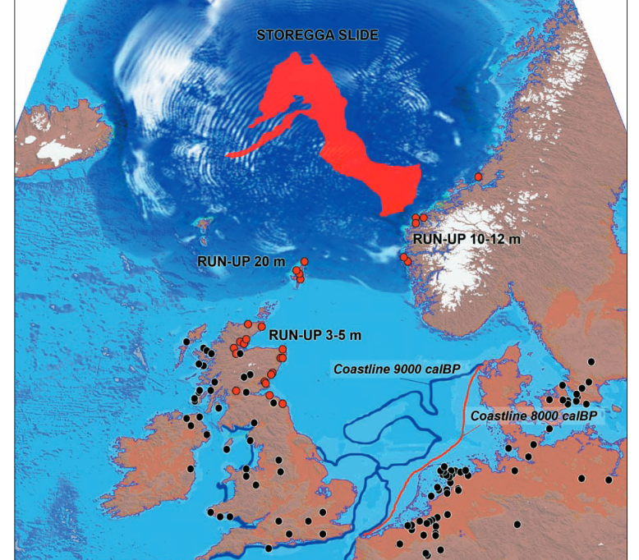
Impacts
Black dots = archaeological evidence of local inhabitation at the time of the Tsunami
Red dots are actual age data Tsunami deposits

