Slide 1
Historical Deadly Earthquakes
By Cultural Region

Slide 2
China
Sept. 27, 1290 (near Ningcheng – inner mongolia) →100,000 killed; est. mag = 6.8
January 23, 1556 (Shaanxi) → 830,000 killed; est. mag = 8.0
December 16, 1920 (Haiyuan County) → 200-240 thousand killed; mag: 7.8—8.5
May 22, 1927 (Xining) → 40,900 – 200,000; mag = 7.9
January 28, 1976 (Tangshan) → 655,000 killed; mag = 8.2 (damage and death kept secret)

Slide 3
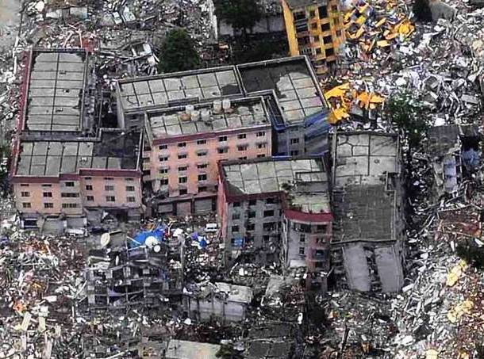
China Continued
May 8, 2008 in Sichuan
70,000 killed
15 million homeless
150 Billion dollars to repair and rebuild

Slide 4
Japan
Sept. 20, 1498 off the coast of Nankaido; 25-35000 est. death toll; mag = 8.6
Sept. 1, 1923 (Kanto) caused Great Tokyo Fire; 140,000 died from the fire; another 95,000 died from quake or tsunamis; mag = 7.9

Slide 5
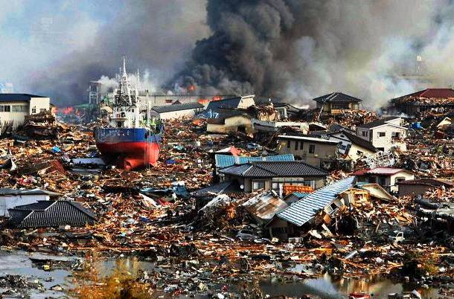
Japan Continued
March 11, 2011
6100 killed
Mag = 9.03
130,000 buildings collapsed.

Slide 6
Italy
Dec 28 1908: 100-200,000 est; mag = 7.1; 40 foot tsunami killed 70,000. 90% of the structures in Messina were destroyed
Jan 11, 1693 – Sicily 60,000; mag = 7.4
Feb/Mar 1783 – Calbria cluster quakes (4 in 7 weeks) – 75,000 est. death toll; mag range from 6 to 7.9

Slide 7
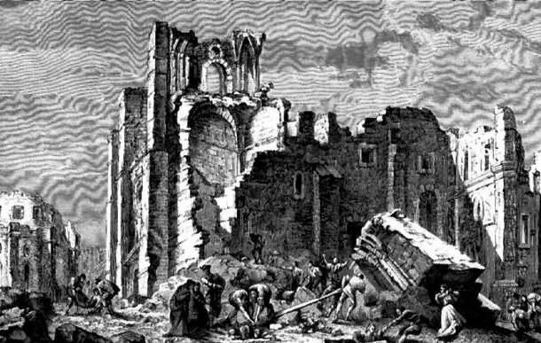
Great Lisbon Quake
Known as the ‘Great Lisbon Earthquake,’ this event occurred on November 1, 1755 in the Kingdom of Portugal. Seismologists today estimate the Lisbon earthquake in the range of 8.5 to 9.0 on the moment magnitude scale that has a deadly combination of subsequent fires and a tsunami.
It totally destroyed Lisbon and its surrounding areas with an estimated death toll of between 10,000 and 100,000 people. Because of its devastating effects over large areas, this event resulted in the scientific studies of modern seismology and earthquake engineering.

Slide 8
Middle East
Dec 22, 856 Damghan, Iran: est. 200,000; mag = 8.0; destroyed city of Bustam
Syria – Oct 11, 1138; est. death toll 230,000; est. mag = 8.5

Slide 9
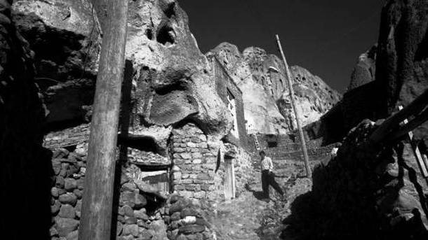
Cultural Event in Tabriz Iran
This took place near the city of Tabriz, Iran on April 26, 1721, and destroyed prominent mosques and schools resulting in death casualties of 8,000 to 250,000, though it was approximated at 80,000 only. Interpreted as an omen of misfortune or a demonstration of divine wrath, it contributed to the success of the Ottoman take-over of Tabriz in 1722 and on its economic difficulties, as well as the destruction of the city’s significant historical monuments.

Slide 10
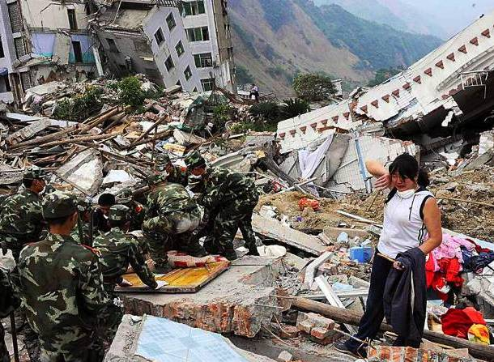
Rudbar, Iran
This disastrous event happened on June 21, 1990 and caused widespread damage within 100 kilometers of the epicenter’s radius near the city of Rashi, and about 200 kilometer northwest of Tehran. It destroyed 700 villages across the cities of Rudbar, Manjiil, and Lushan and cost $200,000,000 in damages, including 40,000 fatalities, 60,000 injured and 500,000 people homeless.

Slide 11
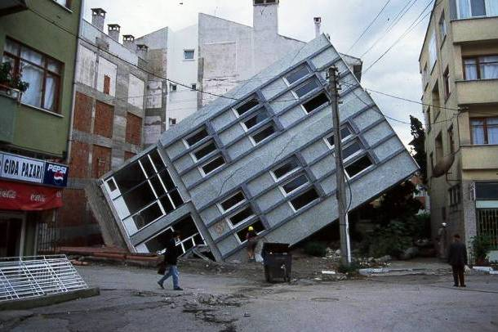
Izmit, Turkey
This was a 7.9-magnitude earthquake that struck northern Turkey on August 17, 1990, which lasted for only 3.7 seconds. The city of Izmit was very badly damaged and had a death toll of 17,127 and 43, 959 injured though other sources suggested that the actual figure for fatalities may be closer to 45,000.Another report from September 1999 showed that the earthquake had destroyed 120,000 poorly-engineered houses, heavily damaged 50,000 houses; caused 2,000 buildings to collapse while 4,000 other buildings left severely damaged, and made more than 300,000 people homeless.

Slide 12
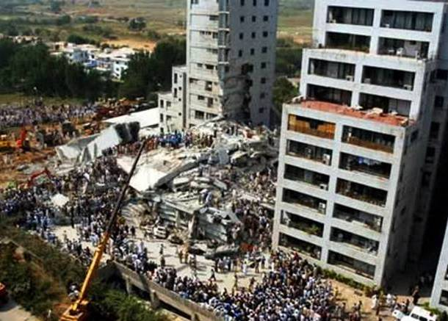
Pakistan
The October 8, 2005 Kashmir, Pakistan was visited by an earthquake with a moment magnitude of 7.6. The disaster had a death toll of 85,000 and more than 69,000 were injured. Considered to be smaller in size than the 1906 San Francisco earthquake, it affected countries in surrounding regions with 14,000 deaths in Jammu and tremors felt in Taijikistan and western China. It also cost a staggering $5.4 billion in aids from all around the world.

Slide 13
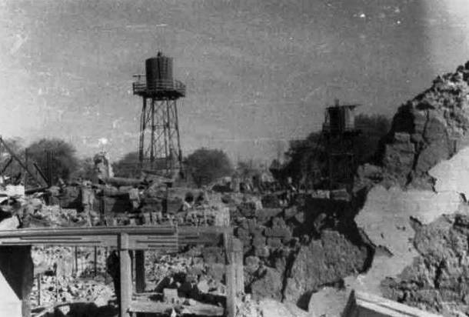
Soviet Union
This earthquake occurred on October 6, 1948 near Ashgabat, USSR with a magnitude of 7.3. Due to censorship, this was not reported in the media so there were no reports regarding its casualties or damages. Due to the secrecy, it was purported that the earthquake was the result of Soviet Union’s first atomic bomb test. Media sources also vary on the number of casualties from 10,000 to 176,000 though a correct death toll was reported in December 9, 1988 as 110,000.

Slide 14
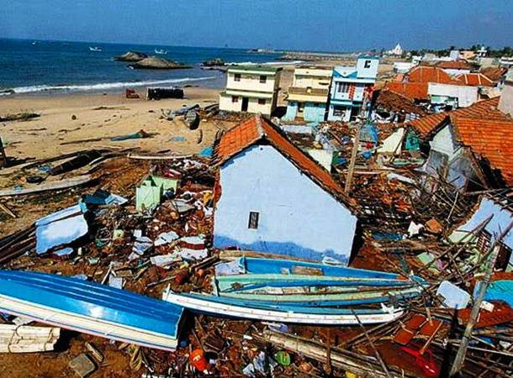
Indonesia (raised Tsunami awareness)
This earthquake hit the sea bed of the Indian Ocean on December 26, 2004 with a magnitude of 9.1 to 9.3 and caused the Boxing Day Tsunami. This was the second highest seismic activity recorded with the longest duration of tremors. The after-effects even reached Maldives and Thailand, with more than 5 tsunamis hitting the coastlines of the Indian Sea. It had a death toll of 100,100 to 225,000 with over $7 billion worth of rescue and damage costs during the first 8.3 to 10 minutes alone.

Slide 15
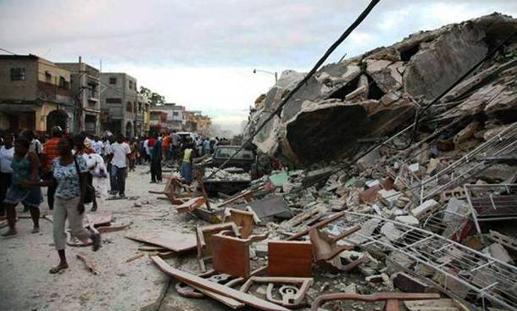
Haiti (raised building code awareness)
The Haiti earthquake was a magnitude 7.0 on the Richter scale, with an epicenter near Leogane, 25 km west of its capital, Port-au-Prince. It struck on January 12, 2010 where at least 52 aftershocks measuring 4.5 or greater could still be felt even 12 days later. The earthquake left a devastating wake of 316,000 deaths, 300,000 injured and 1,000,000 people homeless. It was estimated that 250,000 houses and 30,000 commercial buildings had collapsed or were severely destroyed.

Slide 16
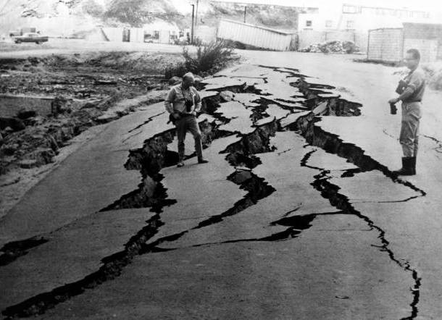
Peru
This Great Peruvian Earthquake was an undersea earthquake that affected the regions of Ancash and La Libertad. It occurred in May 31, 1970 ad was recorded as the worst catastrophic natural disaster that hit Peru, which affected over 3 million people. It has a magnitude of 7.9 to 8.0 on the Richter scale which lasted for 45 seconds. This caused the rock, ice, and snow avalanche on the northern wall of Mount Huascaran burying the towns of Yungay and Ranrahirca, which led to the death of 20,000 people in Yungay alone..
The damages incurred tallied to 74,194 deaths, 25,600 missing, 143,331 injured, and more than a million homeless. The estimated economic loss was more than half a billion USD with the entire communication system and basic facilities destroyed

Slide 17
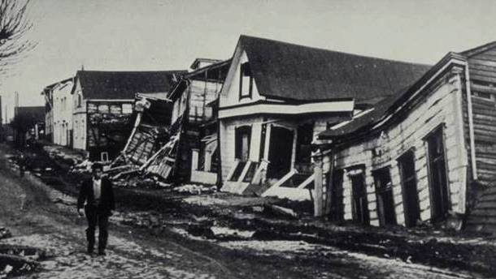
Chile (The big one)
The 1960 Valdivia earthquake was 9.5, which is equivalent to 1,000 atomic bombs going off at the same time. The earthquake was not only felt in Valdivia but also reached Hawaii, at a distance of 435 miles. While only 6,000 people died in the catastrophe, it incurred more than $1 billion worth of damages.

