Slide 1
Ice Ages and Culture Migration
Over the last 100,000 years – an extremely uncertain story

Slide 2
100,000 years ago:
The north is covered in ice (the grey regions in the maps below – the brown are is reduced sea level).
There are three species of man:
Home erectus in Africa and Eurasia
Neanderthals in West Eurasia
Homo sapiens in eastern Africa
The Southern Migration out of Africa

Slide 3
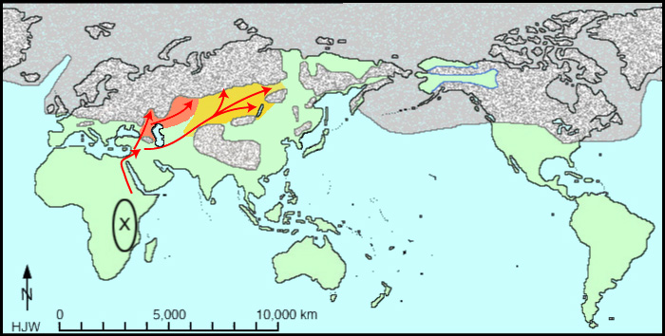
The Northern Migration
These Migrations occur over tens of thousands of years timescale.

Slide 4
The Toba (rhyolite volcano) Catastrophe
the biggest volcanic explosion of the past 28 million years takes place in Sumatra. Six years of volcanic winter follow:
Home erectus is wiped out.
Neanderthals live.
Homo sapiens are almost wiped out: no more than 10,000 (est) breeding pairs live.
Circles are know ash fall sites -Ash fall is also recorded and preserved in Greenland

Slide 5
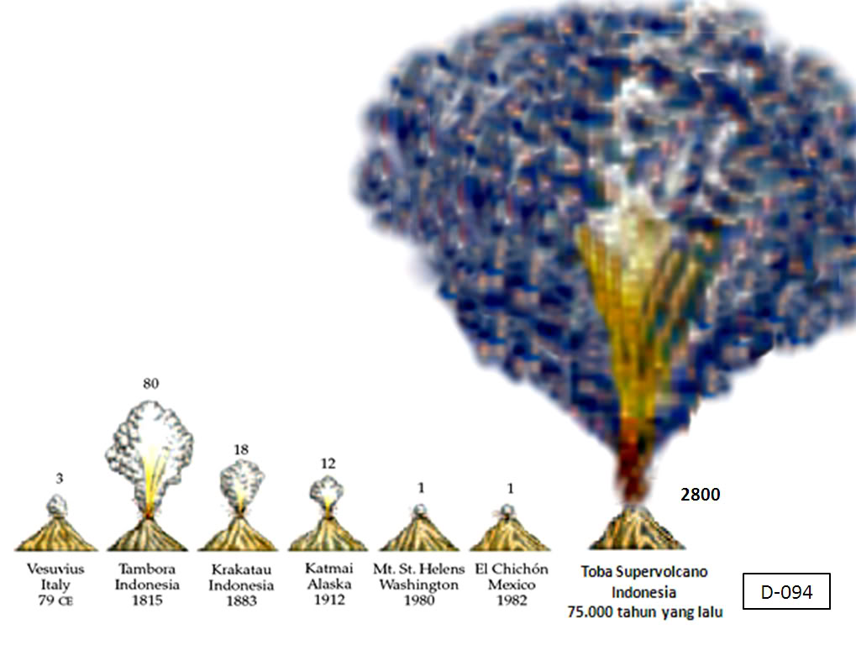
Toba – possibly serious event
The Toba super-volcano, located in Sumatra, has erupted explosively a number of times over the past 1.2 million years. By far the largest and most destructive of these occurred around 74,000 years ago, and it is this ‘Youngest Toba Tuff’ or YTT eruption. At least 2800 cubic km of volcanic material was ejected during this super-eruption, dwarfing historical eruptions such as Krakatoa and Pinatubo.
One of the most critical missing keys in understanding Toba’s impact is a lack of archaeological research looking at the actual remains left by humans who were directly affected by the YTT ash fall, particularly in India. We are not even sure if humans had reached India as part of the ‘Out of Africa’ dispersal by 74,000 years ago,

Slide 6
Second Ice Age – 20,000 years ago
Two significant routes: EurAsian Continent to Australia and Siberian Land Bridge; These new routes likely last for about 10,000 years

Slide 8
5000 Years Ago – boat migration out of Taiwan
Is this migration being triggered by the rise of Sea Level?

