Slide 1
The consumption of the Earth
How it came to be?

Slide 2
Two Views:

Slide 3
World War II production Machine
In this conventional war, simply produce more bullets than your enemy and you will eventually prevail.
US Production Statistics:
69,000 airplanes (aluminum industry) (55 planes per day)
5,000 naval battleships (4 ships per day!)
7 million aircraft bombs (5,500 per day)
31 million artillery shells (1 shell every 3 seconds)

Slide 4
Prophetic Quotes
Only if we have large demands can we expect large production. Therefore, it is important that in planning for the postwar period, we give adequate consideration to the need for ever-increasing consumption on the part of our people as one of the prime requisites for prosperity. (robert nathan, 1944, white house economist)

Slide 5
Why Marketing Works
Our enormously productive economy demands that we make consumption our way of life, that we convert the buying and use of goods into rituals , that we seek our spiritual satisfactions, our ego satisfactions, in consumption. The measure of social status , of social acceptance, of prestige , is now to be found in our consumptive patterns. The very meaning and significance of our lives is today expressed in consumptive terms (Victor Lebow 1955 - The Journal of Retailing)

Slide 6
Somebody did warn us …
The question that I will ask you to consider today is this: When the war is over, are we likely, and do we want to keep this attitude to work and the results of work? Or are we preparing and do we want to back to our old habits of thought? Because I believe that on our answer to this question the whole economic future of society will depend. Sooner or later the moment will come when we have to make a decision about this. At the moment, we are not making it - it is being made for us (by the machine). (Dorothy Sayers 1942 College Lecture)
( i.e. do we intentionally turn the war production machine off and go back to our former means of production )

Slide 7
The start of Mass Consumption
Marketing to Americans in the 1950s: Americans are Privileged
Americans are Entitled
Personal freedom from every day constraints
Slogans, slogans, slogans.
All this SHIT actually works!
https://www.youtube.com/watch?feature=player_embedded&v=m7t9YlMxWoE
https://www.youtube.com/watch?feature=player_embedded&v=gWOt25_btqg
https://www.youtube.com/watch?v=aMwbvIVh2EQ

Slide 8
The 1950s: The Decade that changed everything
The Atomic Age; Prosperity for All; Interstates; Suburbia; Television; Rock N Roll; The Age of Advertising; The Happy Homemaker; Slogans and personal freedom run amuck.
Don’t believe me, ask your grandparents …

Slide 15
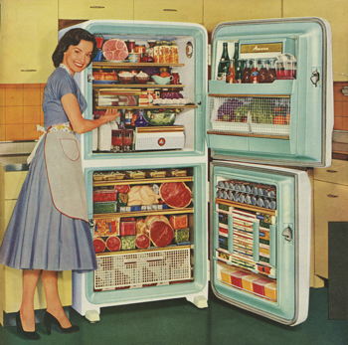
The persistent image of the Happy Homemaker

Slide 16
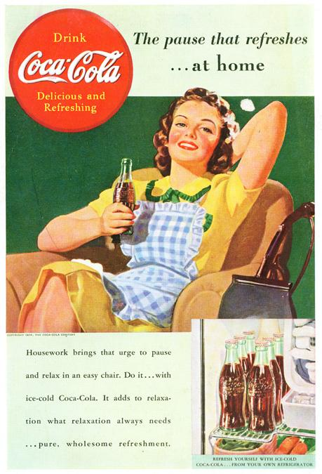

Slide 17
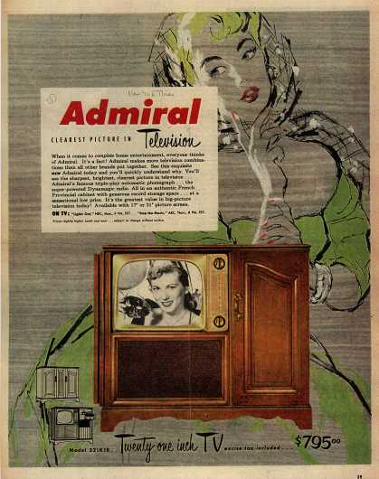

Slide 18
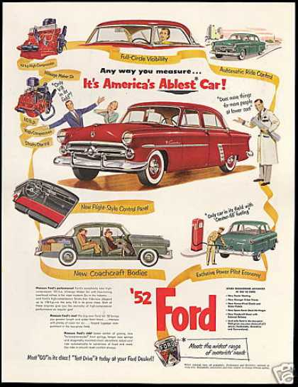

Slide 19
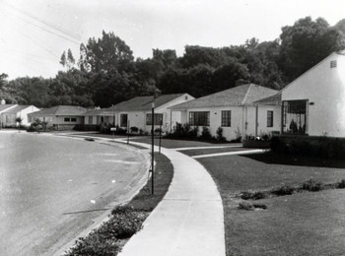
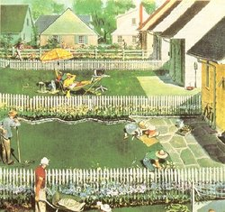
1950s conversion to Suburbia and Conformity:

Slide 20
As a result of suburbia + interstates the US built the most energy intensive transportation economy that could be built. But since the price of gas was so low, and America produced 50% of world oil during the 1950's, possible scalability problems with this approach were wholly ignored.

Slide 21
And so set the stage for every increasing production and consumption. American prosperity required dominating the world in trade and products and for a long time we did and in the short term, it certainly did pay off. Life the 1950s and 1960s was a lot better than life in the 1920's and 1930's - personal prosperity and personal productivity were very high and the free market society was borne without boundaries. But what will life be like in 2030 compared to 2010?

Slide 22
The WalMart Express: Best Proxy for Global Consumption Increases:

Slide 23
Factor of 10 Growth in just 25 years! This is the principle driver of Climate Change

Slide 24
Quick Recovery
Global Economic crises

Slide 25
All markets are involved

Slide 26
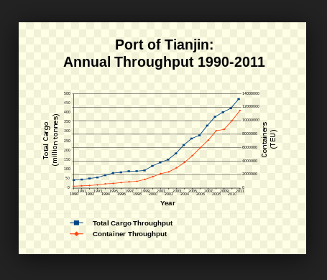
The Waveform of Doom

Slide 28
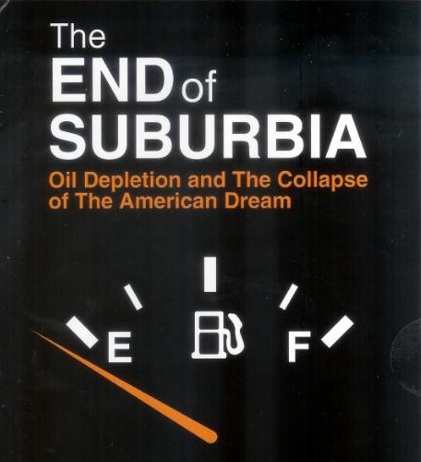
Our Legacy

Slide 29
Sustainability = Consume Less; lower the global rate. Reintroduce the Sacred.

