Slide 1
The state of the planet (the 6th exintction?)
All subsequent figures From the May 2014 living planet report

Slide 2
The Biocapacity Deficit
The difference between the biocapacity and Ecological Footprint of a region or country. A biocapacity deficit occurs when the Footprint of a population exceeds the biocapacity of the area available to that population.
The Ecological Footprint measures the amount of biologically productive land and water area required to produce the resources an individual, population or activity consumes and to absorb the waste it generates, given prevailing technology and resource management.

Slide 3
In general
Biocapacity deficit is in statistical equilibrium with ecological foot print over some spatial scale.
This all changes with the industrial revolution and the use of machines to greatly increase our ecological footprint while reducing biocapacity.

Slide 4
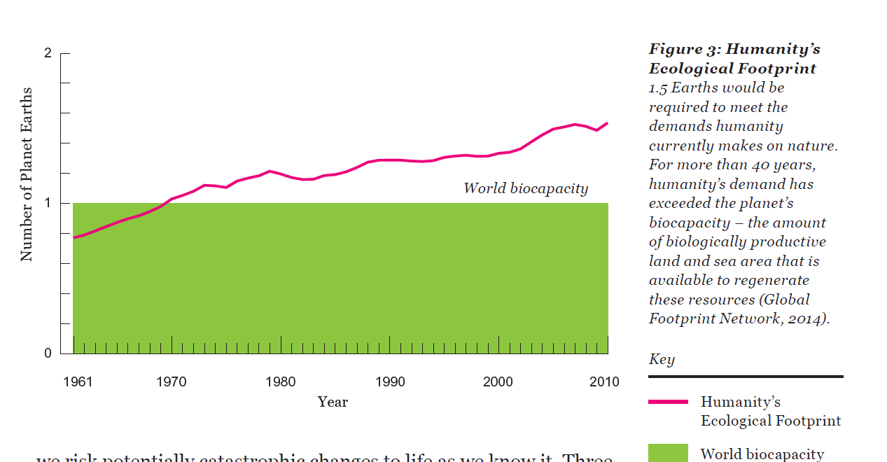

Slide 5
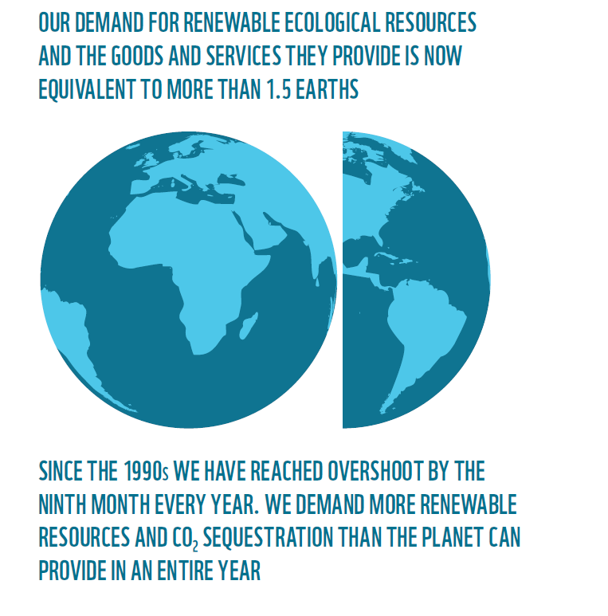

Slide 6
Loss of Biodiversity
The Operational God Waveform

Slide 7
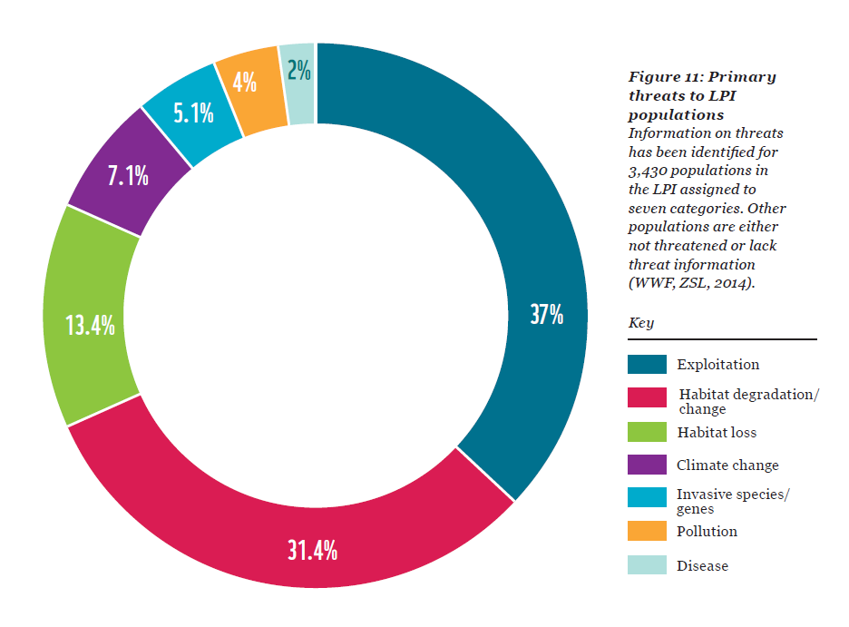
The Threat Matrix

Slide 8
Freshwater environment is impacted the most

Slide 9
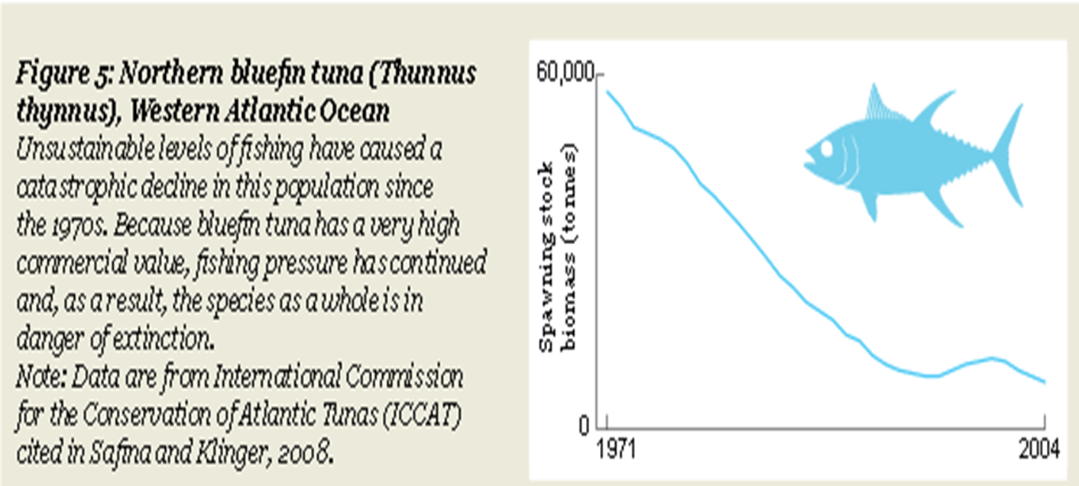
Rhino Horns – Fetish Society

Slide 10
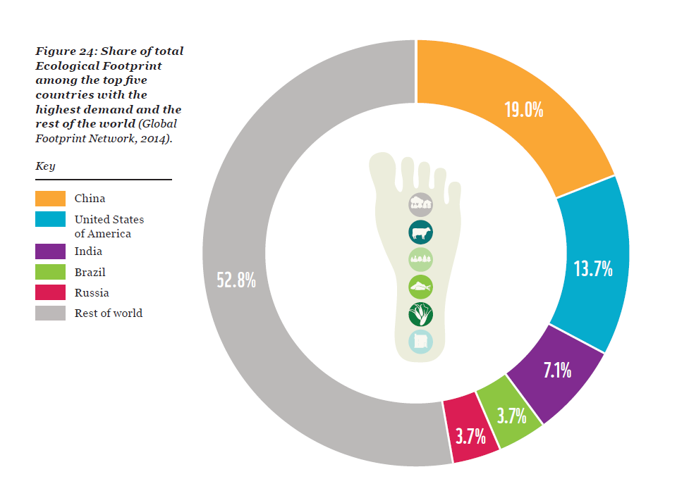
ROW MATTERS!

Slide 11
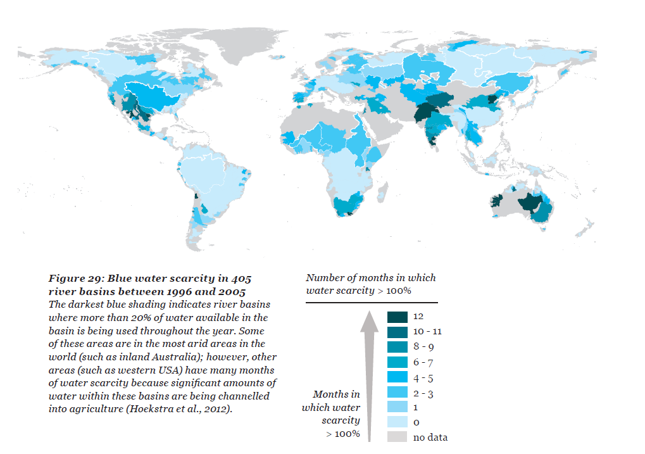
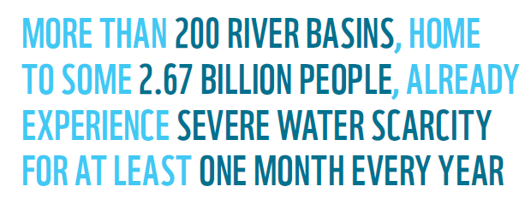

Slide 12
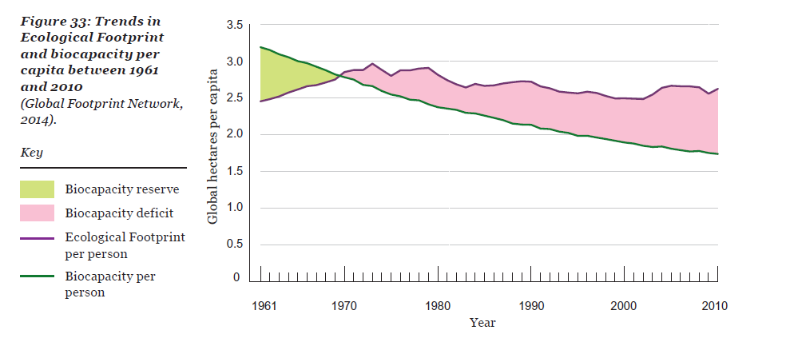
Annual decline in biocapacity per person

Slide 13
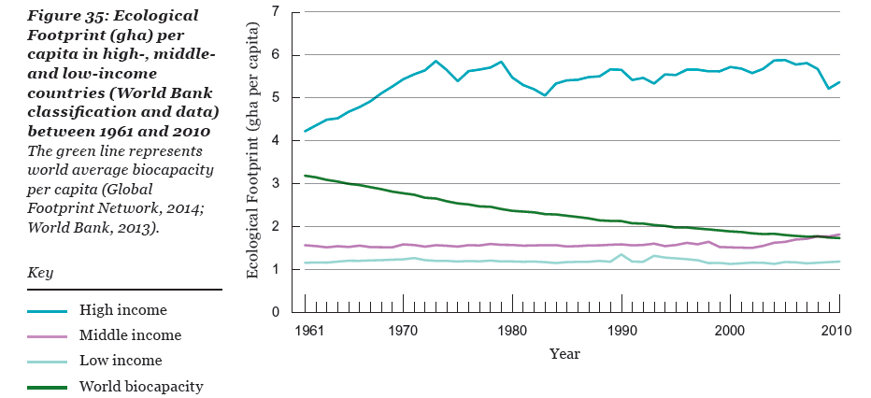

Slide 14
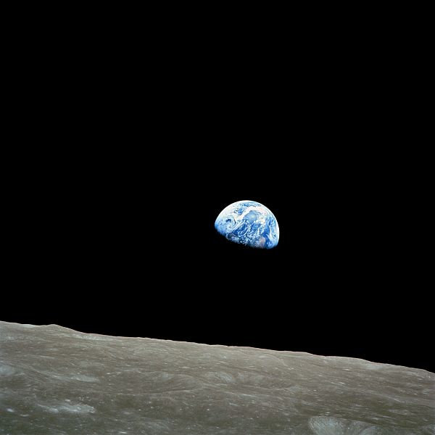

Slide 15
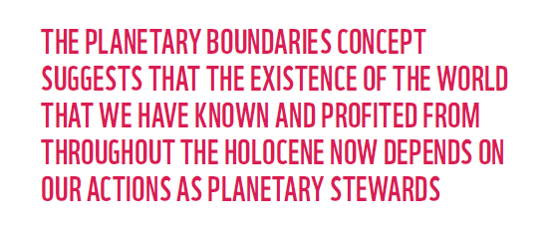
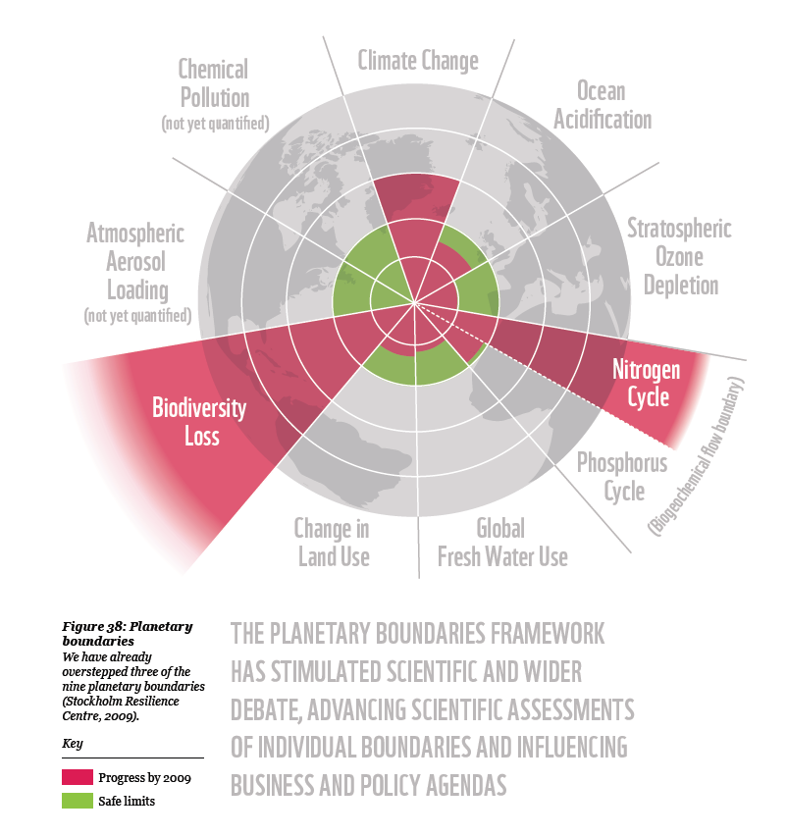
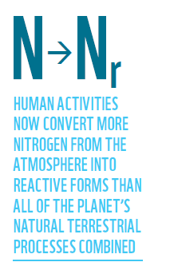
WE have been in overshoot for a while
In 2008 people used the equivalent of 1.5 planets to support their activities; in 2013 that number was 1.67
Most of this behavior is driven by increasing use of carbon resources for energy

Slide 16
The Business as Usual Future

Slide 17
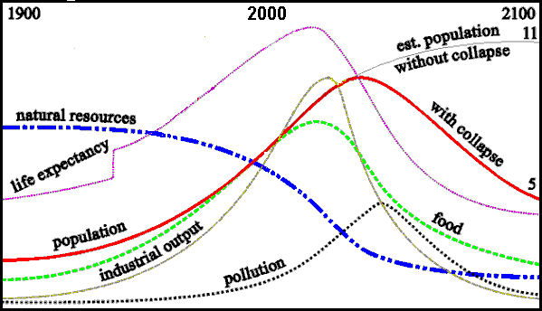
Overshooting the “Carrying Capacity” of Earth?
-1992 prediction
From Donella Meadows, Beyond the Limits
Notes:
This chart is from Donella Meadows & J Randers, Beyond the limits: confronting global collapse and envisioning a sustainable future (1992).
Take this as a hypothesis that needs to be evaluated if we’re to think intelligently about environmental ethics? Are we in an era of limits? If we do not decrease human numbers, or per-capita consumption, or both, will there be a widespread collapse of human economic and social systems, precipitating a great deal of human suffering as their numbers decline rapidly?
And where we turn shortly, how are current trends affecting non-human organisms, and what will be their fate, according to differing scenarios?

Slide 18
Current Projection

