Slide 1
Island Cultures
Always at Risk

Slide 3
Tasmania Black War (1824-1831)
It was a clash between the most culturally and technologically dissimilar humans to have ever come into contact. At stake was nothing less than control of the country, and the survival of a people.
Waves of ships containing British prisoners exterminated the entire population of Tasmanian Aboriginals through grossly inefficient combat and the introduction of diseases

Slide 4
The Andaman Island Culture
Present for about 65000 years
British colonizers in 1858 again killed or diseased most of the culture
The last documented surviving member of the culture with knowledge of its language died in 2010 http://www.survivalinternational.org/news/5509

Slide 5
Tierra Del Fuega: Yahgan & Ona
During the nineteenth century, the Yahgan and Ona peoples of Tierra del Fuego captured the attention of many Europeans. Charles Darwin, who visited the area, insisted that the inhabitants were the least civilized race on earth.
Some individuals from each of these groups were taken to Buenos Aires and to Europe where they were exhibited in cages. Others were dressed in western clothes, taught English and introduced to British royalty and high society.

Slide 6
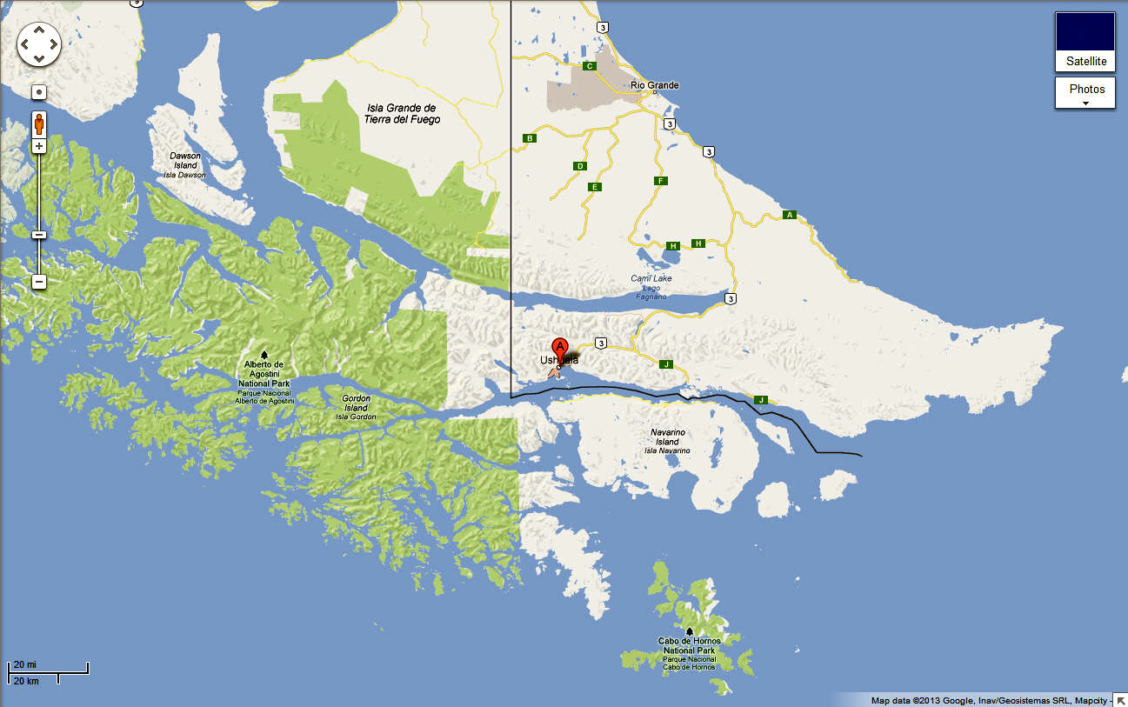

Slide 7
Bigger version of EI
Before whites began to colonize Tierra del Fuego in the nineteenth century, the indigenous population and thousands of guanaco, a small deer-like animal, roamed the 17,000 square mile island. The northern half of the island was covered with grasses, ideal for the herds of guanaco. Dense forests gave way to mountains in the southwest. On the southern coast the mountains gave way to forests and, in a narrow strip along the shore, more natural grasslands.

Slide 8
Horrible Climate!!!
The island's climate was described by an early settler as 65 unpleasant days per year along with 300 days of rain and storms.
The Yahgan lived along the south coast of Tierra del Fuego and on the smaller islands to the south and west. Because of their location directly on the ocean, they were probably the first people contacted by European sailors, sometime in the sixteenth century. From 1850 onward, contact intensified. Between 1863 and I870, one author estimated that half of the Yahgan population died from epidemic diseases introduced to them by sailors and sealers and indirectly via the Alakalouf who live to the northwest and traded with Europeans. From the 1870s on the number of deaths surpassed the number of births.

Slide 9
The Ona
The Ona lived throughout the interior of Tierra del Fuego. They were contacted later than the Yahgan because they did not have boats or spend much of their time along the coast. They depended upon the guanaco as their main source of food, but supplemented it with ground rats, birds, stranded whales, fish, mussels, berries and mushrooms. The Ona did, however, have contact with other indigenous groups in the area, so the effects of western disease were felt long before sustained contact occurred.

Slide 10
Ona Continued
As sheep ranching and barbed wire spread, however, particularly on the northern half of the island, the Ona, and the guanaco which they depended on for food, were squeezed into the forest-covered southern half of the island. By 1885 animal life on the island was scarce
By 1912, residents estimated that there were only 300 guanaco left on the island. As Ona looked for food they came into increased contact with whites. Some Ona began to raid sheep; many of them were shot, as herders increased the bounties paid to hunters for each Ona they killed.
The last full-blooded Ona died in 1973

