Slide 1
Financial Losses from Quakes
Are also quite disruptive in the modern world

Slide 2
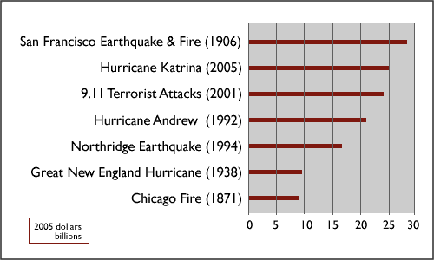
Worst Financial Losses in US

Slide 3
Costliest Earthquakes
Two forms of financial losses
  Insured Losses (so well documented)
  Uninsured Losses (mostly estimates)
  The ratio of these two numbers is a measure of earthquake preparedness. An excellent ratio would be 1-2. Poor would be anything > 4; A terrible ratio (bad preparedness) would be > 10.
  Note the cultural dependence on the following 10 worse events in terms of insured losses

Slide 4
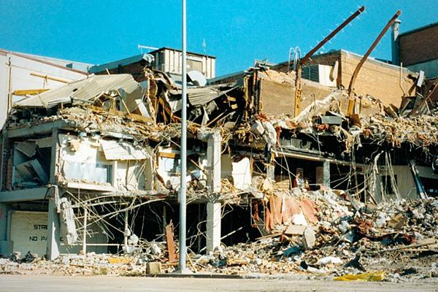
Australia (ratio = 2)
Newcastle, Australia (1989)
Insured losses: $670 million
Overall losses: $1.2 billion
Fatalities: 13
Described by the Australian Government as "one of Australia's most serious natural disasters," the Newcastle earthquake of 1989 shook the area around Sydney with 5.6 magnitude tremors that left 13 people dead and 160 injured.

Slide 5
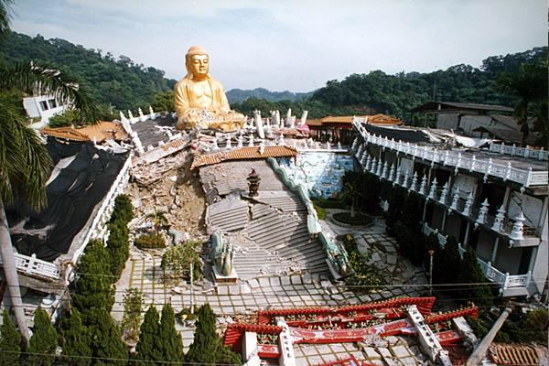
Taiwan (ratio = 20)
Nantou, Taiwan (1999)
Insured losses: $750 million
Overall losses: $14 billion
Fatalities: 2,400
In Taiwan's second-deadliest earthquake of all time, the Nantou quake in September 1999 killed approximately 2,400 people and did about $14 billion in total damage.

Slide 6
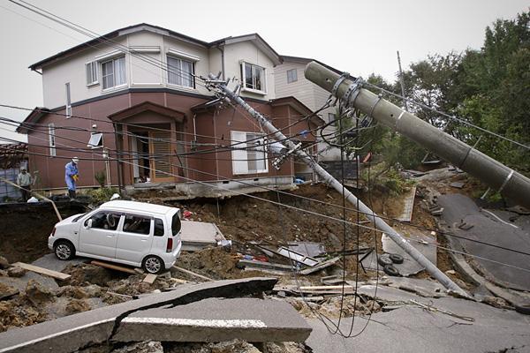
Japan (ratio = 35)
Niigata, Japan (2004)
Insured losses: $760 million
Overall losses: $28 billion
Fatalities: 33
The October 2004 earthquake near Japan's west coast was responsible for at least 33 deaths, 2,900 injuries and registered a 6.6 on the Richter scale.

Slide 7
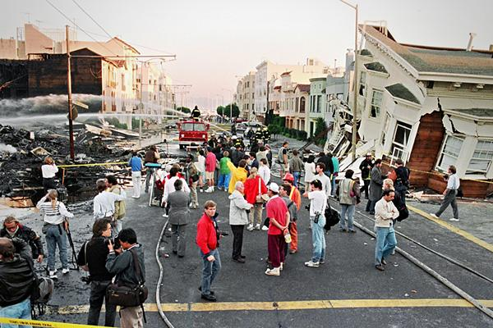
Oakland (ratio = 11)
Loma Prieta, United States (1989)
Insured losses: $960 million
Overall losses: $10 billion
Fatalities: 63
With an epicenter about 10 miles northeast of Santa Cruz, the 1989 earthquake registered with a 6.9 magnitude, affecting San Francisco and Oakland the most severely.

Slide 8
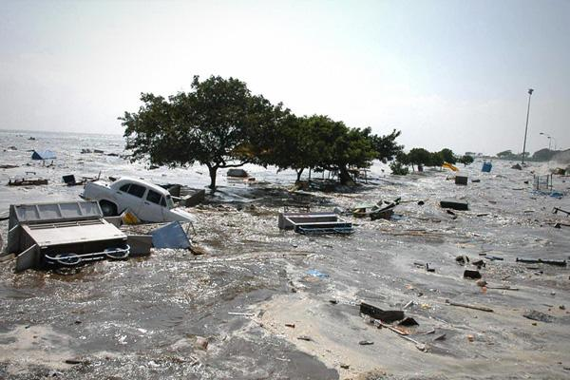
The deadliest Tsunami (ratio=10)
Indian Ocean (2004)
Insured losses: $1 billion
Overall losses: $10 billion
Fatalities: 227,898
The largest earthquake in the last 50 years was listed at a magnitude of 9.1, and killed 227,898 people from the earthquake and resulting tsunami, the deadliest tsunami in recorded history. 1.7 million people were displaced in 14 countries in Asia and East Africa with waves that reached up to 100 feet high.

Slide 9
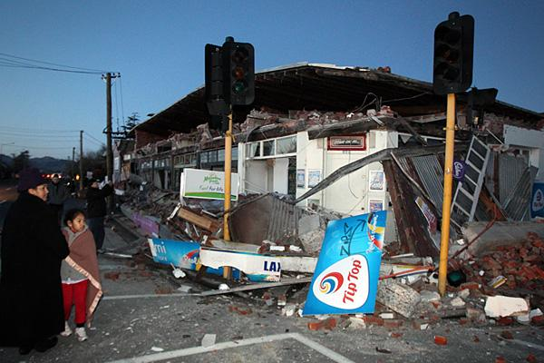
New Zealand – Zero Fatalities (ratio = 1.2)
$5 billion
Overall losses: $6.5 billion
Fatalities: 0
The 2010 earthquake occurred about 25 miles west of the country's second largest city, Christchurch , on New Zealand's South Island . But the 7.0 magnitude quake was felt as far as the North Island.

Slide 10
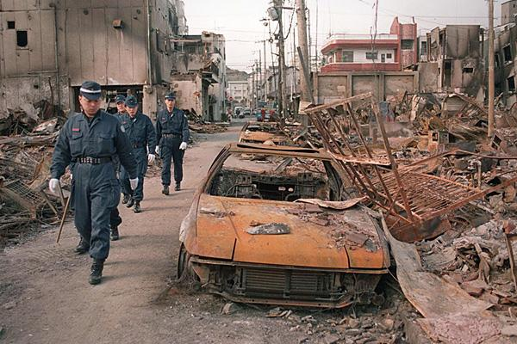
Japan – record losses (ratio = 33)
Kobe, Japan (1995)
Insured losses: $3 billion
Overall losses: $100 billion
Fatalities: 5,502
Although Japan has experienced numerous major earthquakes, none ha s been more economically destructive than 1995's 6.9 magnitude quake in Kobe. With overall economic losses totaling $100 billion

Slide 11
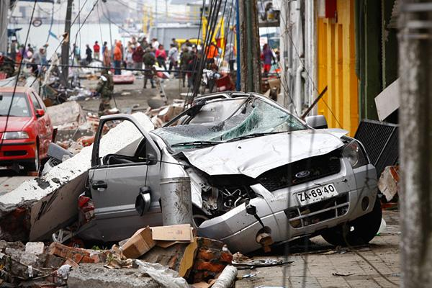
Chile (ratio = 4)
Maule, Chile (2010)
Insured losses: $8 billion
Overall losses: $30 billion
Fatalities: 521
At least 521 people were killed, 56 missing, 12,000 injured and 800,000 were displaced during the February 2010 earthquake that hit 8.8 on the Richter scale

Slide 12
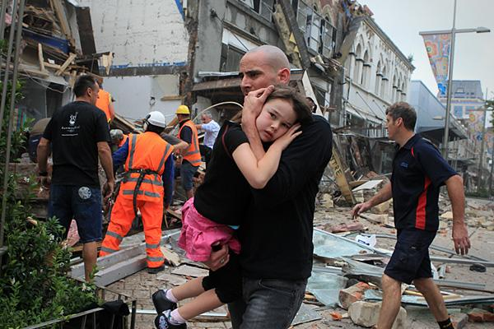
New Zealand (ratio = 2)
Christchurch, New Zealand (2011)
Insured losses: $10 billion*
Overall losses: $20 billion*
Fatalities: 166
Technically an aftershock of the 2010 Canterbury earthquake, the earthquake on February 22, 2011 was more destructive than its predecessor, in large part because it was centered only 6 miles from heavily-populated city of Christchurch.

Slide 13
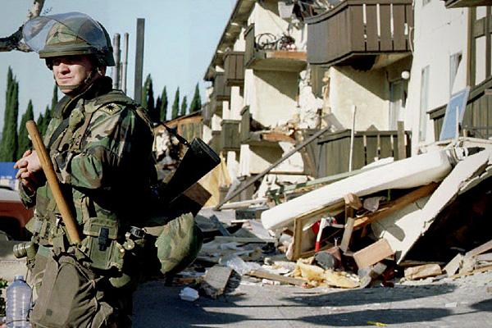
Northridge CA (ratio = 3)
Northridge, California (1994)
Insured losses: $15.3 billion
Overall losses: $44 billion
Fatalities: 60
On January 17, 1994 a 6.7 magnitude earthquake occurred in the San Fernando Valley just north of Los Angeles. Damage from the earthquake occurred up to 85 miles away, killing 60 people, injuring more than 7,000, damaging 40,000 buildings and leaving 20,000 homeless

