Slide 1
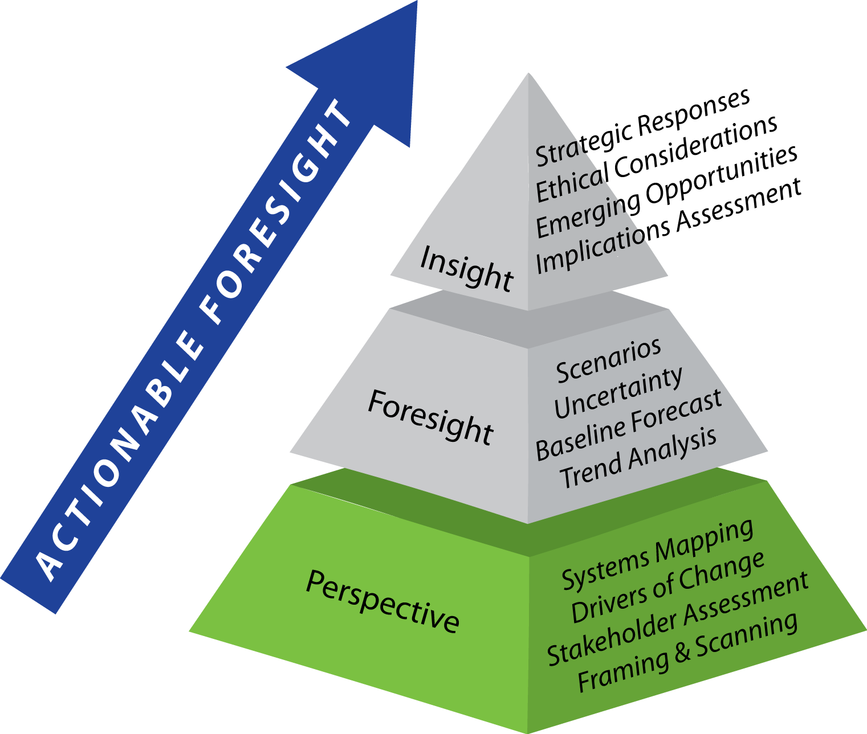
A wisdom approach to problem solving

Slide 2

Are things getting BETTER or WORSE in the world?
How Can This Question Be Answered?
Notes:
Ask the students what is needed to answer this question. Lead them to a path that is similar to the futures research path: First put the topic in context. Then define the indictors that can be used for assessment. Then gather evidence. Then synthesize the evidence into a useful assessment of the expected future.
Next, transition the discussion to the SOF approach to the foresight challenge.

Slide 3

The Millennium Project
GLOBAL FUTURES STUDIES & RESEARCH
    http://www.millennium-project.org/
Founded in 1996
Real-Time Delphi Technique-Expert Knowledge
State of the Future and SOF Index
15 Global Challenges - Updated Annually

Slide 4
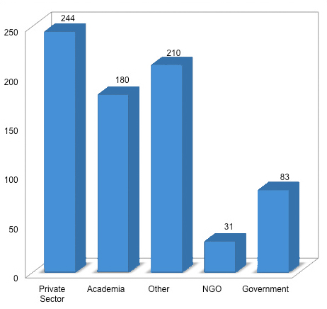
State of The Future Index (SOFI)
A composite index to measure progress
Expert polling via Real-Time Delphi process
Looks back 20 years, forward 10 years
~ 750 global experts
28 indicators
Updated annually

Slide 5
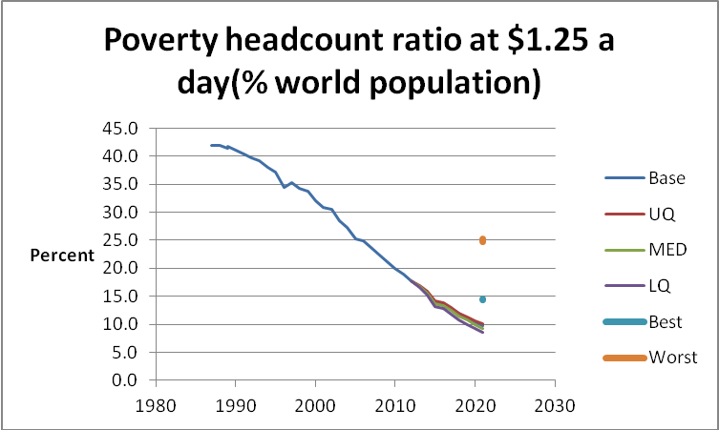
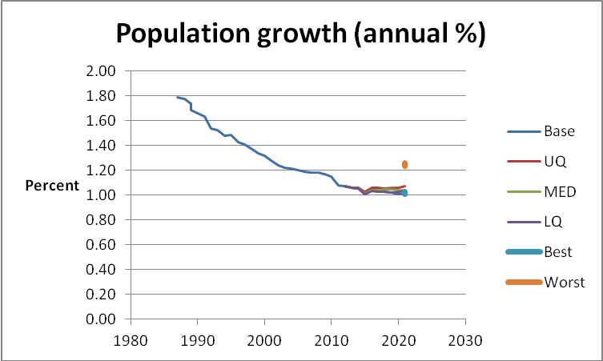
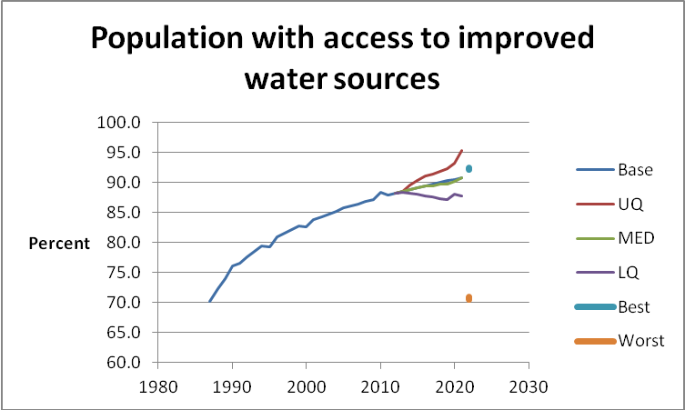
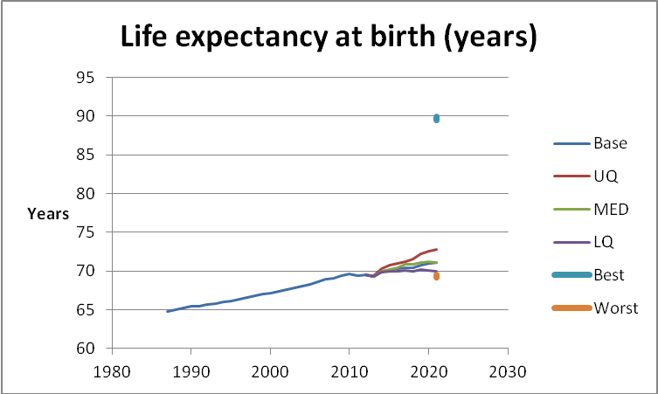
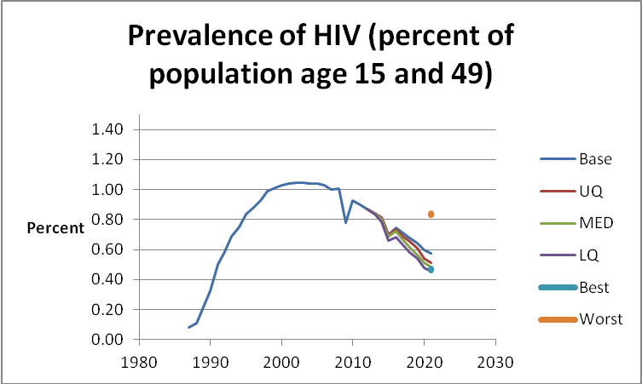
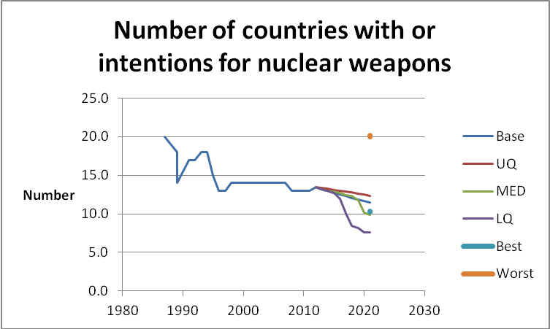
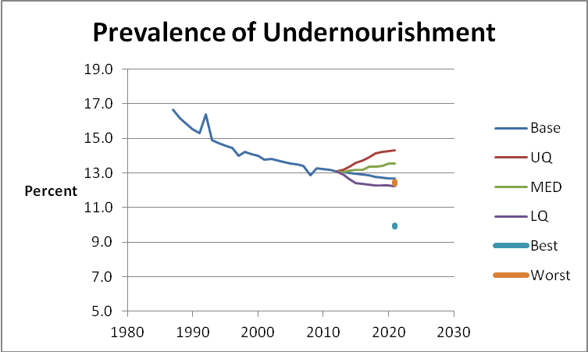
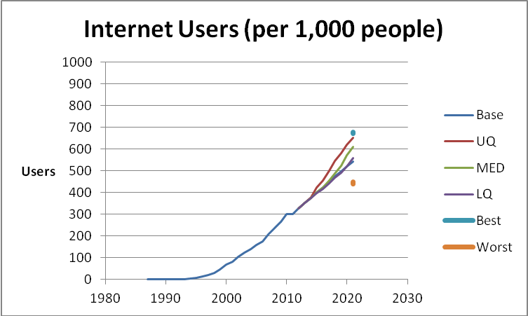
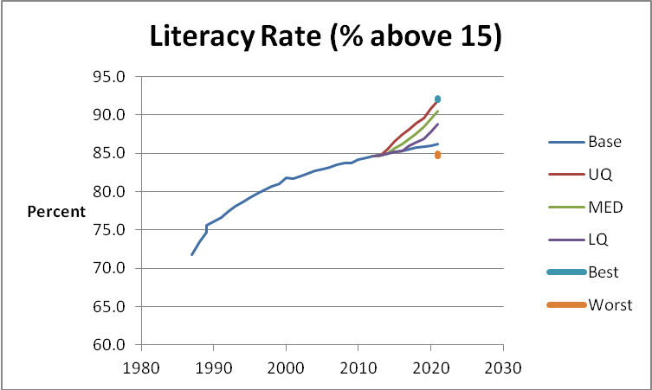
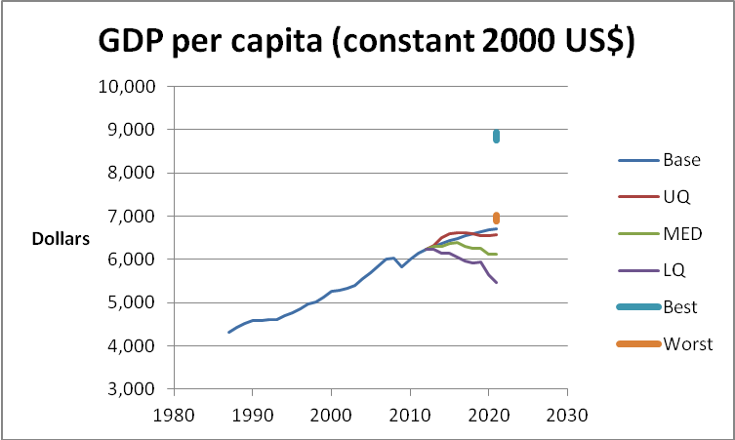
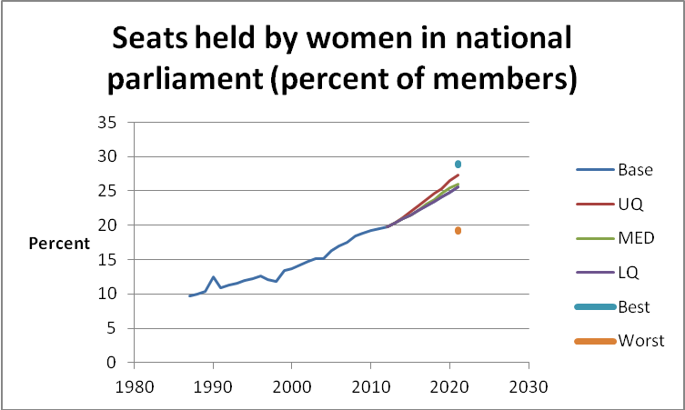
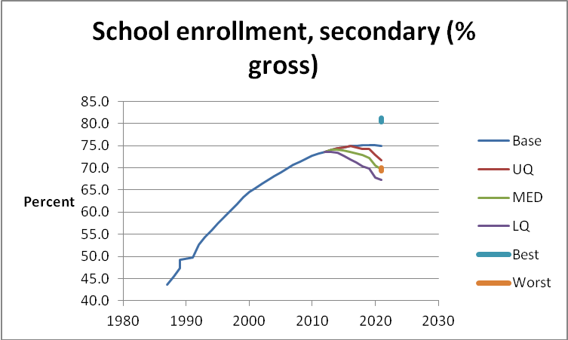
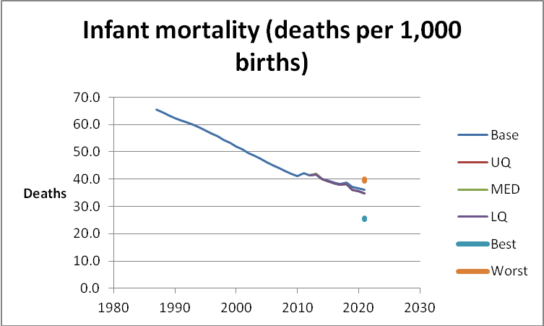
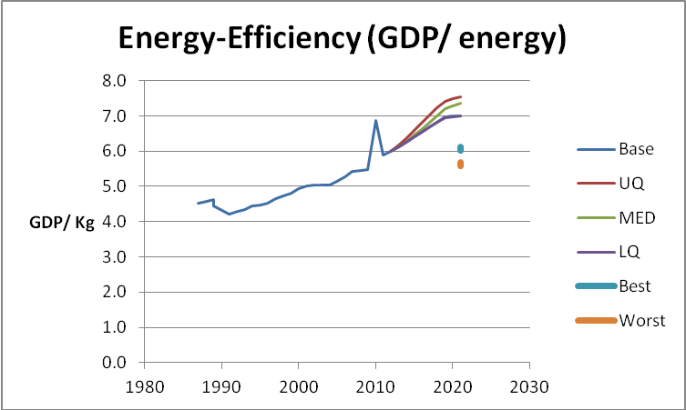
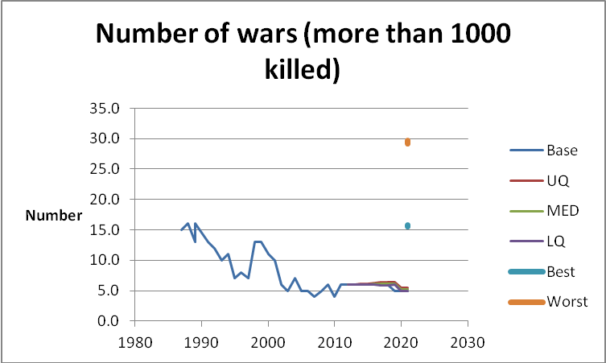
How are we doing?
Improvements:
Access to water
Internet users
Literacy rate
GDP/capita
Life expectancy at birth
Women in parliaments
School enrollment, secondary
Energy efficiency
Poverty $1.25 a day
Population growth
Infant mortality
Undernourishment prevalence
Wars
Nuclear proliferation
HIV prevalence
Source: 2012 State of the Future

Slide 6
How are we doing?
Where we are winning
© 2013 University of Notre Dame. All rights reserved.
Source: 2012 State of the Future
Notes:
Work through the various indicators and discuss the trajectory of the baseline (which is extrapolated from past data, using statistical methods) and how it coincides with or differs from the perspectives of the experts. Ask the students to explain, for example, why the expectation for literacy rate is so much more optimistic that the statistical baseline projection. The optimism is being driven by the expansion of access to technology. Do the same assessment for other indicators as well.

Slide 7
How are we doing?
Where we are winning
Source: 2012 State of the Future
© 2013 University of Notre Dame. All rights reserved.
Notes:
Work through the various indicators and discuss the trajectory of the baseline (which is extrapolated from past data, using statistical methods) and how it coincides with or differs from the perspectives of the experts. Ask the students to explain, for example, why the expectation for literacy rate is so much more optimistic that the statistical baseline projection. The optimism is being driven by the expansion of access to technology. Do the same assessment for other indicators as well.

Slide 8
How are we doing?
Where we are winning
Source: 2012 State of the Future
© 2013 University of Notre Dame. All rights reserved.
Notes:
Work through the various indicators and discuss the trajectory of the baseline (which is extrapolated from past data, using statistical methods) and how it coincides with or differs from the perspectives of the experts. Ask the students to explain, for example, why the expectation for literacy rate is so much more optimistic that the statistical baseline projection. The optimism is being driven by the expansion of access to technology. Do the same assessment for other indicators as well.

Slide 9
How are we doing?
Where we are winning
© 2013 University of Notre Dame. All rights reserved.
Source: 2012 State of the Future
Notes:
Work through the various indicators and discuss the trajectory of the baseline (which is extrapolated from past data, using statistical methods) and how it coincides with or differs from the perspectives of the experts. Ask the students to explain, for example, why the expectation for literacy rate is so much more optimistic that the statistical baseline projection. The optimism is being driven by the expansion of access to technology. Do the same assessment for other indicators as well.

Slide 10
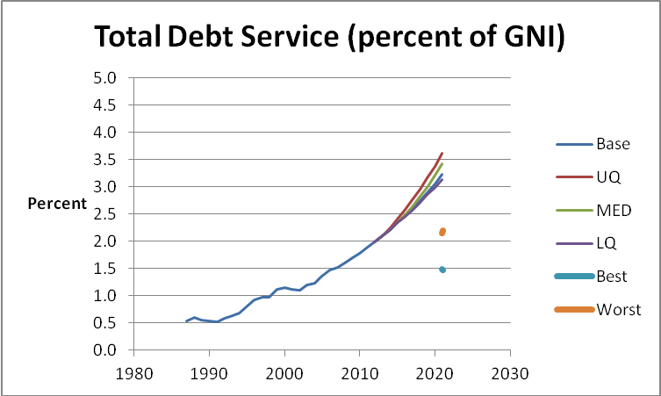
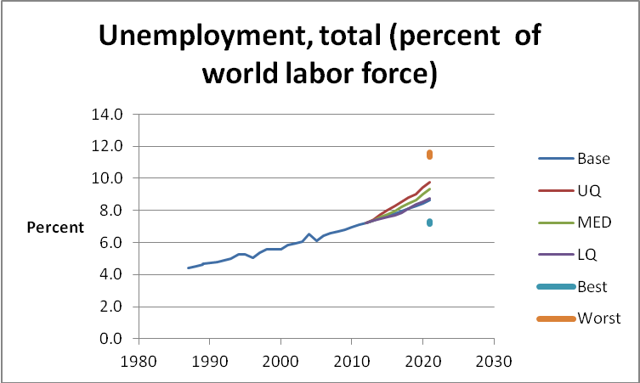
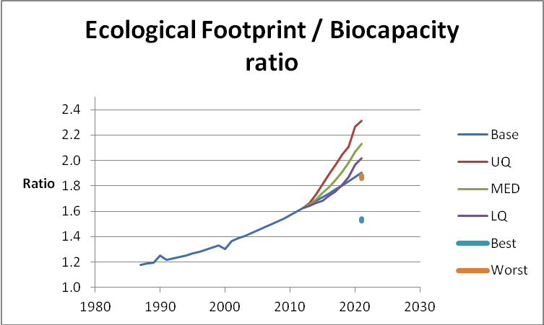
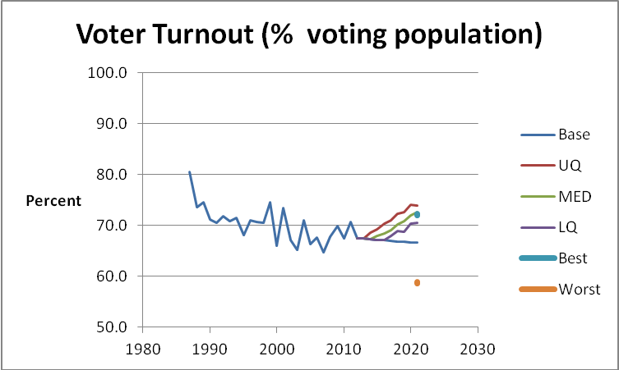
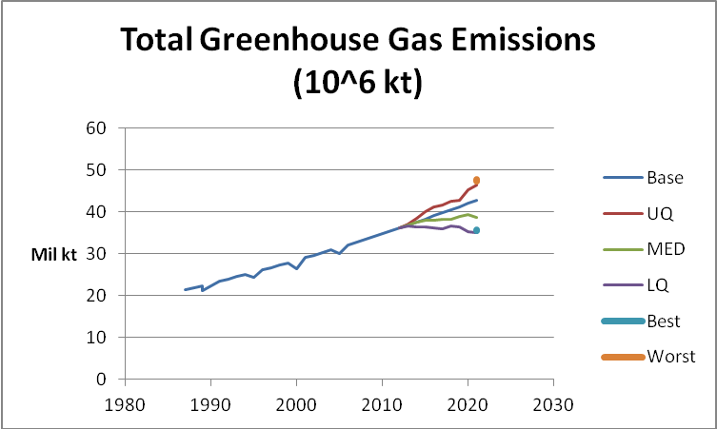
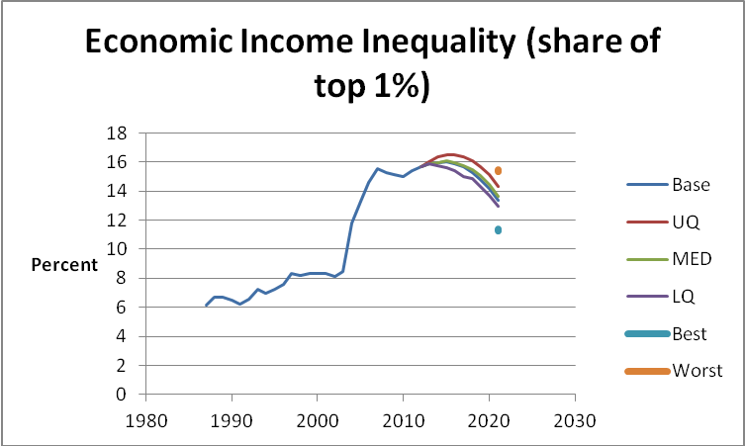
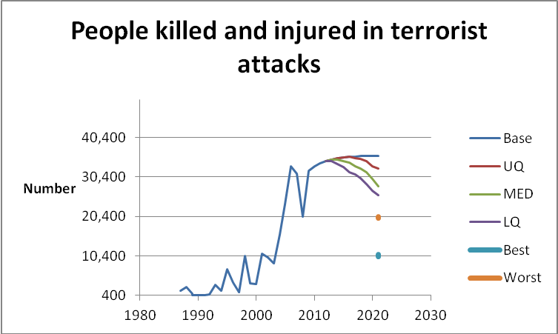
How are we doing?
Poor Trajectory
Total debt
Unemployment
Income inequality
Ecological footprint / biocapacity ratio
GHG emissions
Terrorist attacks victims/1000
Voter turnout
Source: 2012 State of the Future

Slide 11
How are we doing?
Where we are losing
© 2013 University of Notre Dame. All rights reserved.
Source: 2012 State of the Future
Notes:
Continue the discussion similar to that of Where we are Winning.

Slide 12
How are we doing?
Where we are losing
© 2013 University of Notre Dame. All rights reserved.
Source: 2012 State of the Future
Notes:
Continue the discussion similar to that of Where we are Winning.

Slide 13
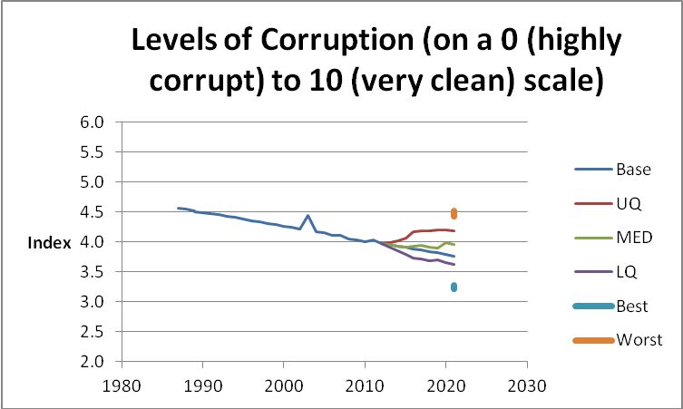
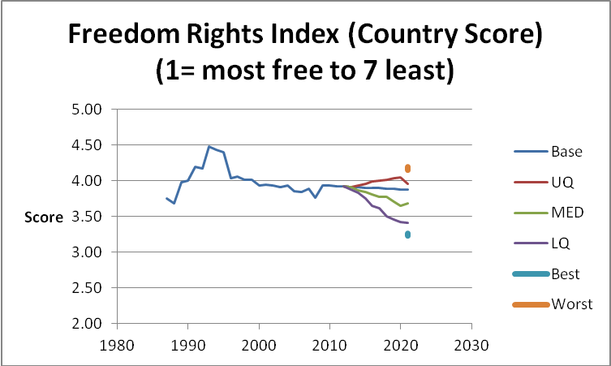
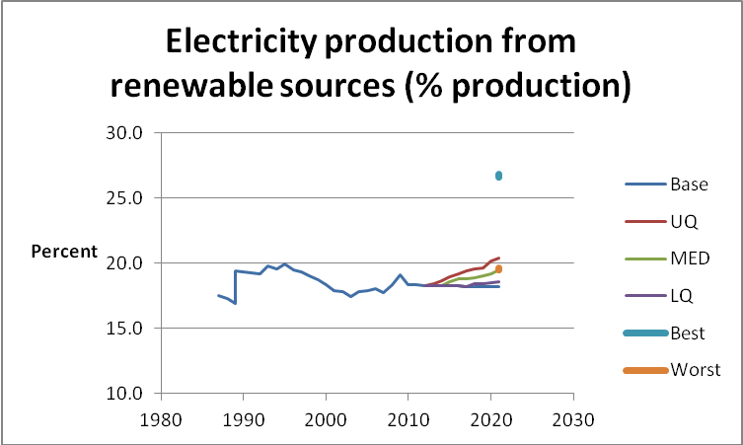
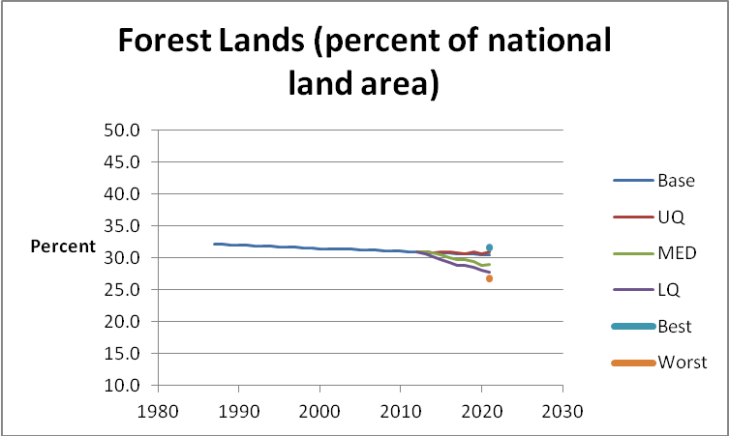
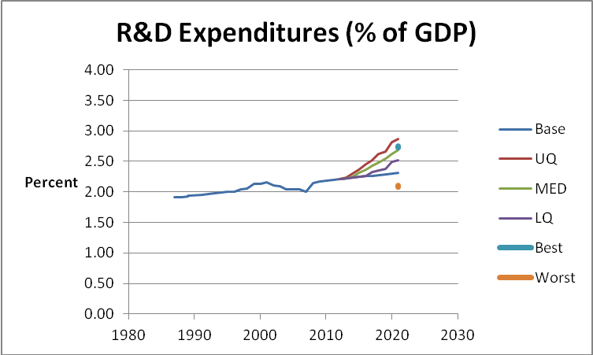
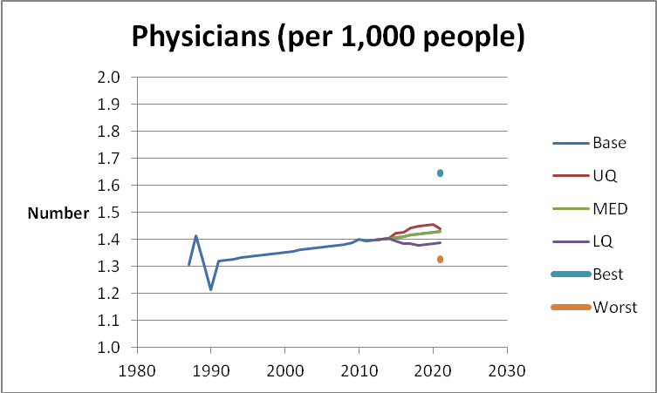
How are we doing?
Apparently Flat Trajectories
Corruption
Freedom rights
Electricity from renewables
Forest lands
R&D expenditures
Physicians
Source: 2012 State of the Future
Notes:
Some trajectories do not give a clear indication of whether we are winning or losing. None the less the data is a useful reference point about future change.

Slide 14
How are we doing?
Where there is uncertainty
Source: 2012 State of the Future
© 2013 University of Notre Dame. All rights reserved.

Slide 15
How are we doing?
Where there is uncertainty
Source: 2012 State of the Future
© 2013 University of Notre Dame. All rights reserved.

Slide 16
How are we doing?
Where we are winning
Access to water
Internet users
Literacy rate
GDP/capita
Life expectancy at birth
Women in parliaments
School enrollment, secondary
Energy efficiency
Poverty $1.25 a day
Population growth
Infant mortality
Undernourishment prevalence
Wars
Nuclear proliferation
HIV prevalence
Where we are losing
Total debt
Unemployment
Income inequality
Ecological footprint / biocapacity ratio
GHG emissions
Terrorist attacks victims/1000
Voter turnout
Where there is uncertainty
Corruption
Freedom rights
Electricity from renewables
Forest lands
R&D expenditures
Physicians
Source: 2012 State of the Future

Slide 17
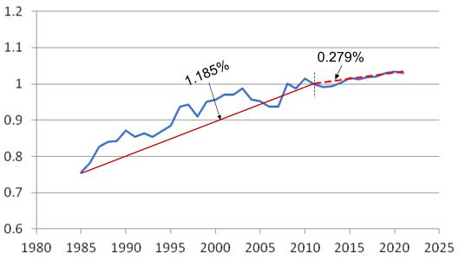
State of the Future Index (SOFI)
2012 State of the Future Index
2012 = 1.0
© 2013 University of Notre Dame. All rights reserved.
Notes:
Show this slide as an example of the outcome from the SOFI. It is a composite index that combines the projections of 28 indicators to project the overall future.
The indexed is normalized to 1.0 for the current year.
Emphasize that, although this index is very complex and take a lot of time and money to create each year, it is very similar in concept to how we want the teams to project change with their projects – to identify the indicators for the main drivers of change, to gather past data, assess the patterns of trends and create statistic projections of future change. Then combine these baseline projections into a projection for the main question and explore how disruptions to the trends might alter the projections.

Slide 18
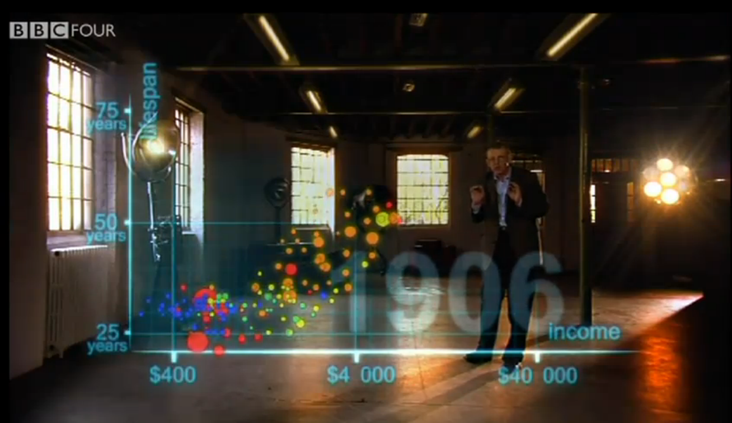
http://www.youtube.com/watch?v=jbkSRLYSojo

Slide 19
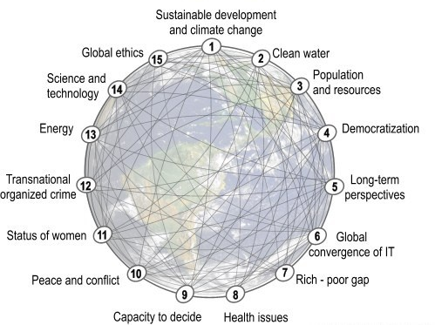
15 Global Challenges
http://www.millennium-project.org/millennium/challenges.html
Notes:
These are the 15 Global Challenges as identified by the experts working with the Millennium Project team. Students will have read through one page summaries of each. I did not go into them each in depth, but rather suggested that these challenges can serve as a great framing lens for business leaders. Where there is a challenge, there is a need for a solution. And often the company that can develop the solution can open new markets.

Slide 20
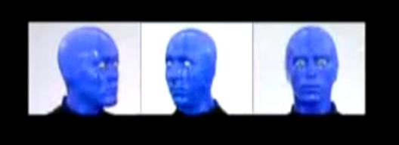
Blue Man Group

Slide 21
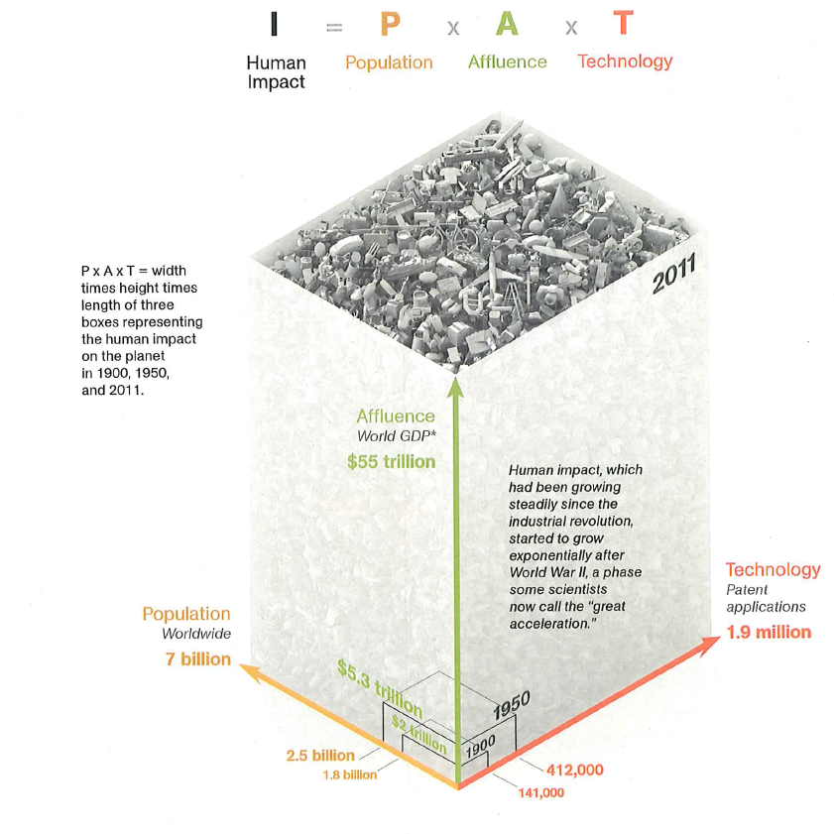

I =$p^{n}{∗a}^{m}∗t^{x}$
Source:
National Geographic, March 2011
Notes:
Use this slide as a set up for the next slide – which asks whether it may be possible for innovation and human ingenuity to move technology from the numerator of this question (where increases result in additional impact) to the denominator (where increased use of technology can lessen impact)
Show the comparison of how impact has dramatically grown since the year 1900.

Slide 22
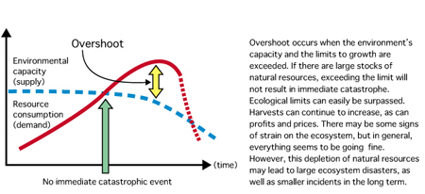
Overshoot
This behaves like Natural Hazard Random Input
Source: Wackernagel & Rees 1996

Slide 23

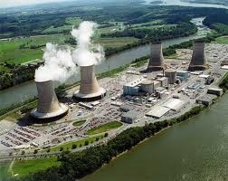
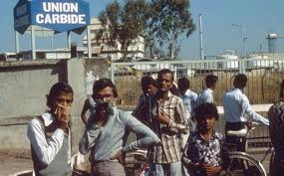
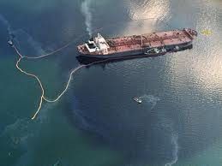





Sustainability - A Tale of 3 Eras
The Awakening
Reluctant Compliance
1970
1980
1990
2000
Sustainable Value
But so far the scale is minimal

Slide 24
Triple Bottom Line Sustainability
Integrated Sustainability
Socio-Environmental
Social
Performance
Environmental
Performance
Sustainability Sweet Spots
For Business
Economic
Performance
Eco-Efficiency
Socio- Economic
Source: World Resources Institute 1998

