Slide 1
Risk Assessment For Volcanoes

Slide 2
300,000 fatalities from 1600 to 2000

Slide 3
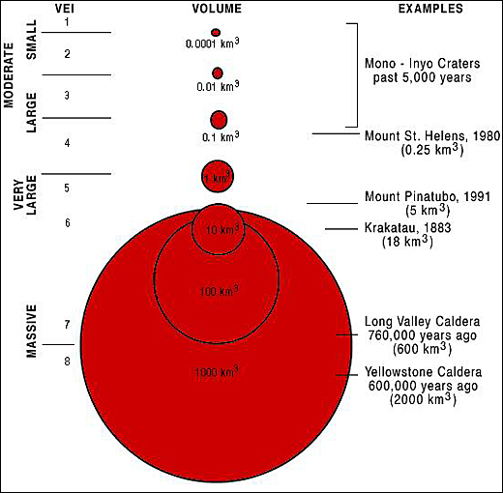
Viscosity Issue – relates to explosiveness

Slide 4
The VEI

Slide 5
Make a Map First of Hazard relative to terrain and population distribution

Slide 6
Make Probability Plot vs where population IS

Slide 7
Turn the graph into a table

Slide 8
Now make Scenarios – this should be an element of hour presentations

Slide 9
Visualization Helps

Slide 11
Build Matrix Table

Slide 12
Will this get worse or not?

Slide 13
Uh, Uh, Yes ….

Slide 14
Local Ash Fallout

Slide 15
Not Dangerous; Contained within structure of volcano

Slide 16
Eruption-Landslide Danger

Slide 17
Construct Event Tree

