Slide 1
The Colorado River Water Allotment
A Case Study of a Policy that resulted in various substantial negative impacts.

Slide 2
In General for policy
Formulate the question or problem your trying to address at the procedural level with a new policy
Discover data that can be used to help determine the policy
Critical evaluate the knowns and the unknows and try to avoid policy that may exacerbate the unknowns
Determine metrics for how to evaluate your policy decision to determine if a) its been reasonably successful, b) further data on impacts of the policy call for its revision or c) shitcan the original policy.

Slide 3
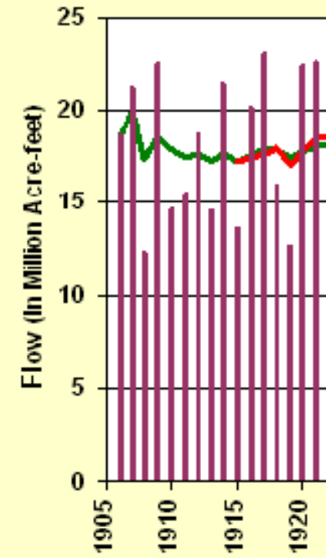
For the Colorado River System
The problem is how to best divide up the river resources among seven (growing) states and Mexico, so various agricultural economies can thrive.
What is known in 1922, the time of the Water Rights study (also known as the Colorado Compact) (rather little):
16 yrs of data
AVG: 15 million
SD: ~3 million
7 years 20+
2 years 12-
The system is highly volatile

Slide 4
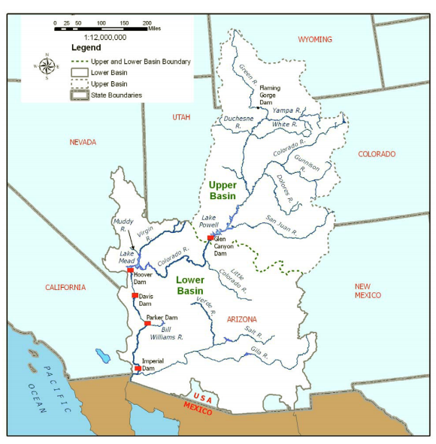
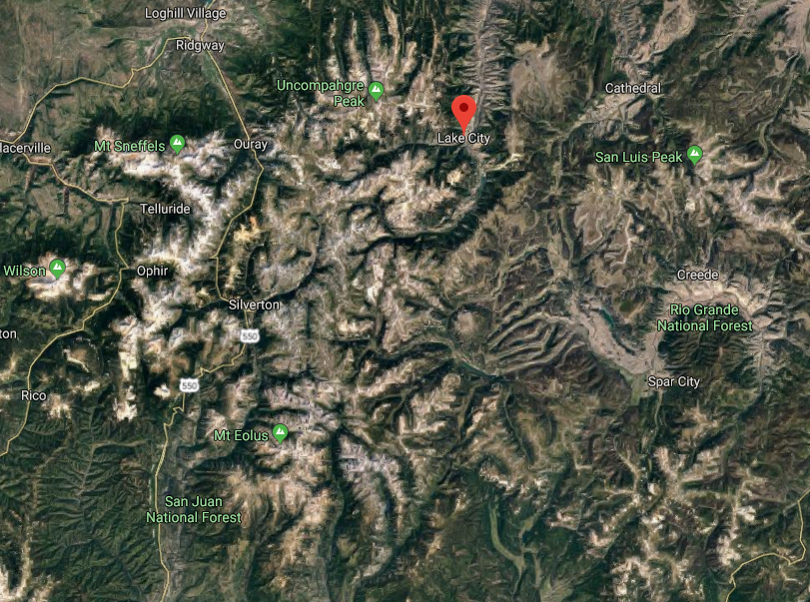
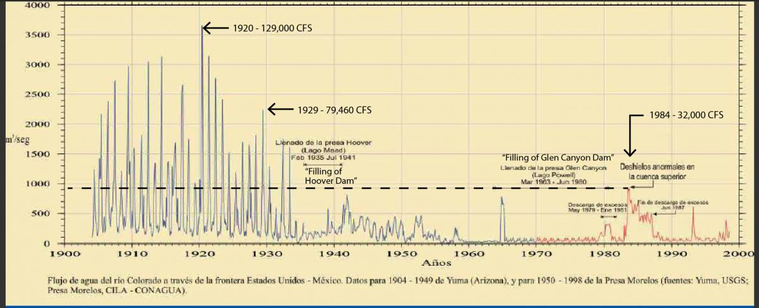
The Colorado River System:
By Geography Arizona dominates
By Population California dominates
This will create tension
Upper Basin not as prone to drought as the Lower Basin
Snowfall in the San Juan Mountains of Colorado as highly variable but is the main contributor of Lower Basin replenishment via the San Juan River

Slide 5
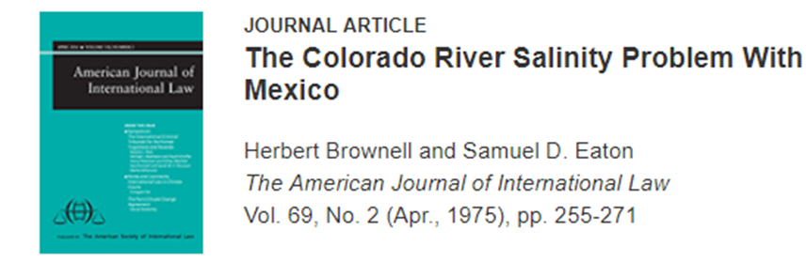
From the data
There is considerably interannual variably by at least 33%
Therefore you desire a policy that allows agricultural operation to still thrive amidst this variability
The most conservative threshold would be 12 Million annual allocation (units are acre-feet – 1 acre horizontal 1 foot deep; 1AF ~1250 cubic meters)
An allocation of 20 Million, as annual policy, would clearly be unwise, especially for states in the lower basin. Yet, this was done initially (revised later when more data and real life experience kicked in)

Slide 6
What is unknown? – why scientists Matter
Differential population growth within the states
Overall population growth and increased usage in the six states plus Mexico
Not enough data to define true variability and drought cycle
Behavior of the Colorado River when it gets dammed
Role that climate change might play
That Hoover Dam makes Las Vegas Possible
That Glen Canyon Dam makes Phoenix Possible
Environmental Impacts on the Delta (in Mexico) of reduced flow
Possible effects of increased salinity

Slide 7
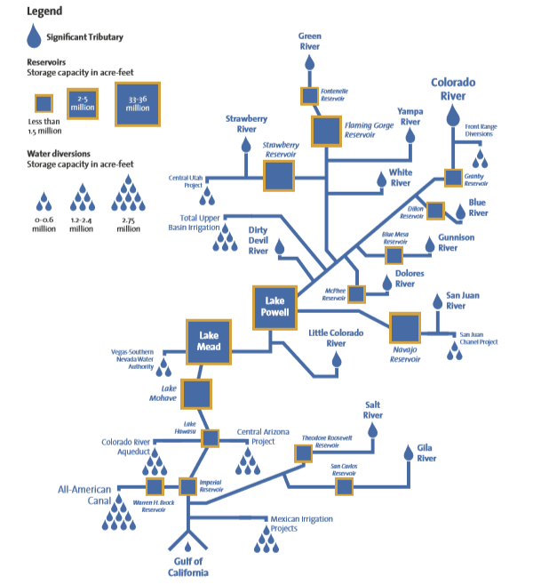
To best regulate, one needs to build reservoirs (behind dams) to store water
What Happens when you have a reservoir in this geology?
  Seeps into porous sandstone
  Prone to evaporation
  Evaporation cause the salinity of the water to increase.
None of this was apparently thought about

Slide 8
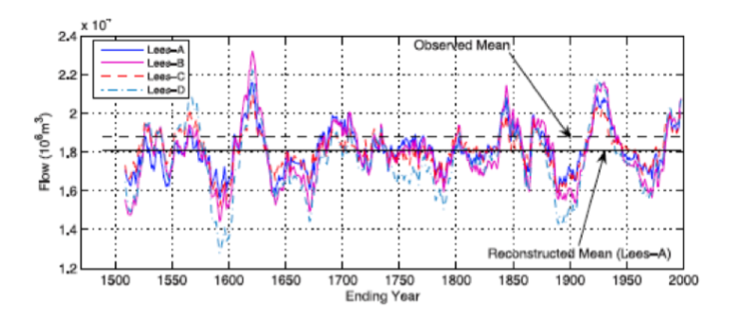
Better Data: Note the Period centered on 1925

Slide 9
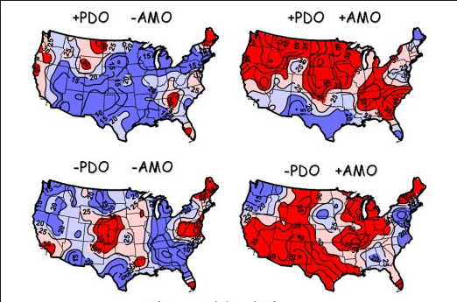
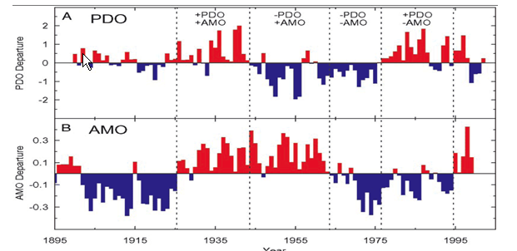
Multi Decadel Oscillations not known at this time:

Slide 10
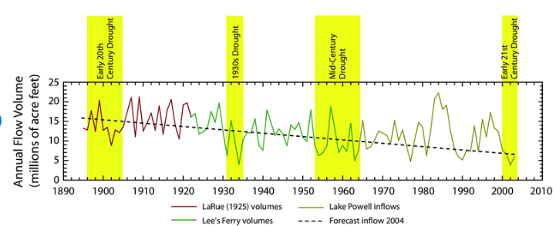
Problems
Allocations were made on very incomplete data for a system whose annual volume is highly variable
Explosion of population unforeseen
Effects of damming the CR in that particular geology were not considered at all
And now we know that climate change is also an issue; flow volume down by ~2

Slide 11
Off to a Bad Start
In 1902 the US Bureau of Reclamation was establish
By then the settlement of the American West was well underway
Reclamation means: Engineering Dryness out of the West
1922 agreement (more on this later)
Revised in 1944 due to pressure from Mexico
  Assumes flow of 15 million
  7.5 million equally assigned to Upper and Lower Basin
  Upper Basin has to deliver to Lower Basin 75 million over a ten year period
  1.5 Million needs to go from Lower Basin to Mexico
If the 10 year amount is not meant, which basin is responsible?

Slide 13
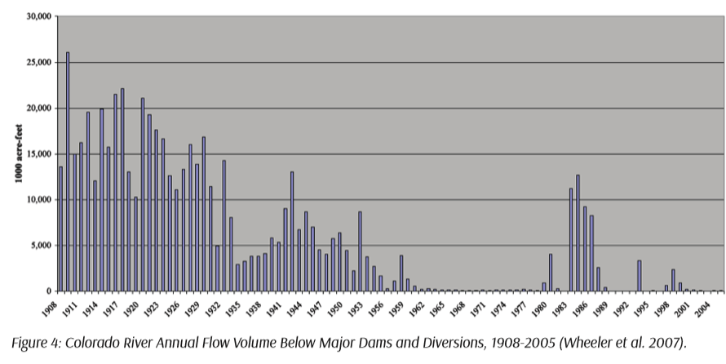
What Mexico Gets after the US Damming Projects are Done (the 2014 Pulse Flow)

Slide 14
Time Line of Allocations
1922 Compact (Engineered by Herbert Hoover, Secretary of Commerce)
  UB where most of the water originates
  LB where most of the water is used
  UB concerned that construction of Hoover Dam will threaten their future allocations
  Hoover splits to equal basin allocation at 7.5 maf (annually)
Boulder Canyon act of 1928
  Authorized Hoover Dam Construction
  Allocated AZ (2.8 maf); California (4.4 Maf); Nevada (0.3 Maf)

Slide 15
Scaling:
 |  | 1925 Population | 2010 Population
Arizona | 37% | 27% | 14%
California | 59% | 67% | 80%
Nevada | 4% | 6% | 6%
There was a long standing tension and several court cases about the use of the Colorado River between Arizona and California as California continually sought more water to use for its ever expanding agricultural industry
Note Combined population of Arizona and California now 7 times higher

Slide 16
More Timeline
1931: The California Seven Agreement sets up various irrigation districts for annual allotment
1944: Mexican Water Treaty of 1.5 maf
1948: UB river compact (combined population is 3.5 times higher)
 |  | 1948 Population | 2010 Population
Colorado | 52% | 41% | 48%
New Mexico | 11% | 20% | 20%
Utah | 23% | 21% | 27%
Wyoming | 14% | 18% | 5%

Slide 17

More timeline
Colorado River Storage Project of 1956: Build dams for river regulation and power
Arizona vs California Supreme Court Decision of 1964: CA argued that AZ gets more water from Tributaries to CR and that flow should be considered as part of their allocation … they lost
1973-74: Mexico sues the US because of increased salination and crop damage. US is order to build the Yuma (AZ) delating plant to improve CR river quality (but by then the flow is so low, it was laughable).

