Slide 1
Discovery of Building Materials
Early Uses of Concrete

Slide 2
Circa 5000 BC

Slide 3
A naturally occurring material –what is it?

Slide 4
Pozzolans: The Chemical Key to Cement
Volcanic Ash mixed with a little water could be observed to contain binding clumps of material you could pick up with your hand

Slide 5
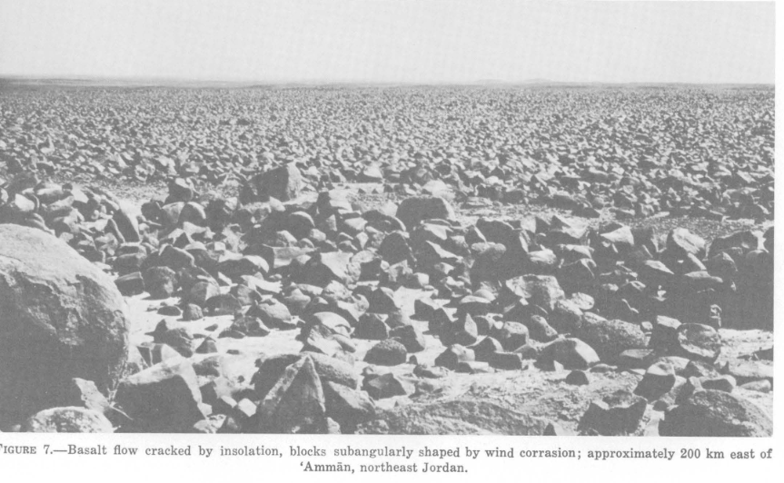
Brief History
6500 BC tribes in Southern Syria and Northern Jordan mixed volcanic debris with water to beginning building small structures
Much fine silica sand here as well
5600 BC had concrete floors

Slide 6
Jordan, Nabataea traders (Bedouins)
Thousands of years later they discovered the advantages of hydraulic lime -- that is, cement that hardens underwater
By 700 BC building kilns to supply mortar for the construction of rubble-wall houses, concrete floors, and underground waterproof cisterns. The cisterns were kept secret and were one of the reasons the Nabataea were able to thrive in the desert. (this tribe prefers functionality over monuments)

Slide 7
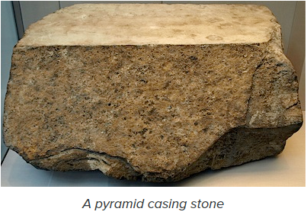
Egypt
Around 3000 BC they mixed mud with straw, let it dry out and you have a brick (kind of) – this is more like adobe (American SW) than concrete.
Mixing stuff with water makes some kind of mortar which can be experimented with over time; eventually learn how to paste quarried limestone rocks together

Slide 8
China
Also around 3000 BC were experimenting with mortar and various forms of cement (again, mixing water with sand, volcanic ash, and similar naturally occurring things – mostly in Northern China.
Anything which works as mortar, works: Spectrometer testing has confirmed that a key ingredient in the mortar used in the Great Wall was glutenous, sticky rice.

Slide 9
The Romans form the Cement Industry
By 600 BC, the Greeks had discovered a natural pozzolan material that developed hydraulic properties when mixed with lime
By 200 BC, the Romans were building very successfully using concrete; not pouring into wooden forms but by stacking stones of different sizes and hand-filling the spaces between the stones with mortar
they made cement from a naturally reactive volcanic sand
the mortars commonly used were a simple limestone cement that hardened slowly from reacting with airborne carbon dioxide. These mortars are not chemically bound material and therefore are weaker.

Slide 10
Does this work?
Built by Rome's Emperor Hadrian and completed in 125 AD, the Pantheon has the largest un-reinforced concrete dome ever built. The Pantheon has exterior foundation walls that are 26 feet wide and 15 feet deep and made of pozzolana cement (lime, reactive volcanic sand and water) tamped down over a layer of dense stone aggregate. That the dome still exists is something of a fluke. Settling and movement over almost 2,000 years, along with occasional earthquakes, have created cracks that would normally have weakened the structure enough that, by now, it should have fallen. The exterior walls that support the dome contain seven evenly spaced niches with chambers between them that extend to the outside. These niches and chambers, originally designed only to minimize the weight of the structure, are thinner than the main portions of the walls and act as control joints that control crack locations. Stresses caused by movement are relieved by cracking in the niches and chambers

Slide 11
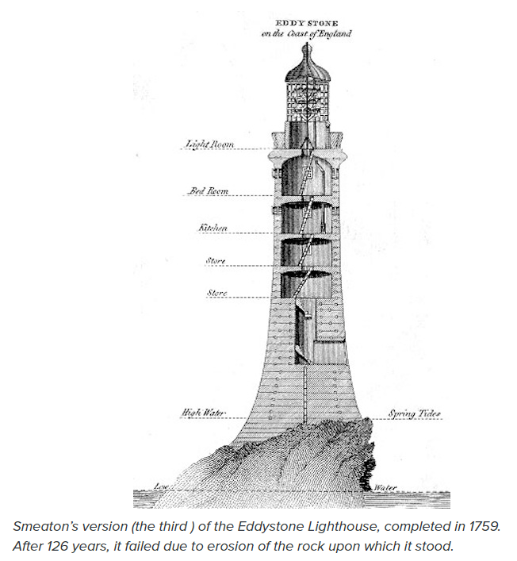
Delay in further progress:
After the fall of the Roman Empire in 476 AD, the techniques for making pozzolan cement were lost until the discovery in 1414 of manuscripts describing those techniques rekindled interest in building with concrete.
1793 John Smeaton discovered using limestone containing clay that was fired and turning that into power to make stronger material:

