Slide 1
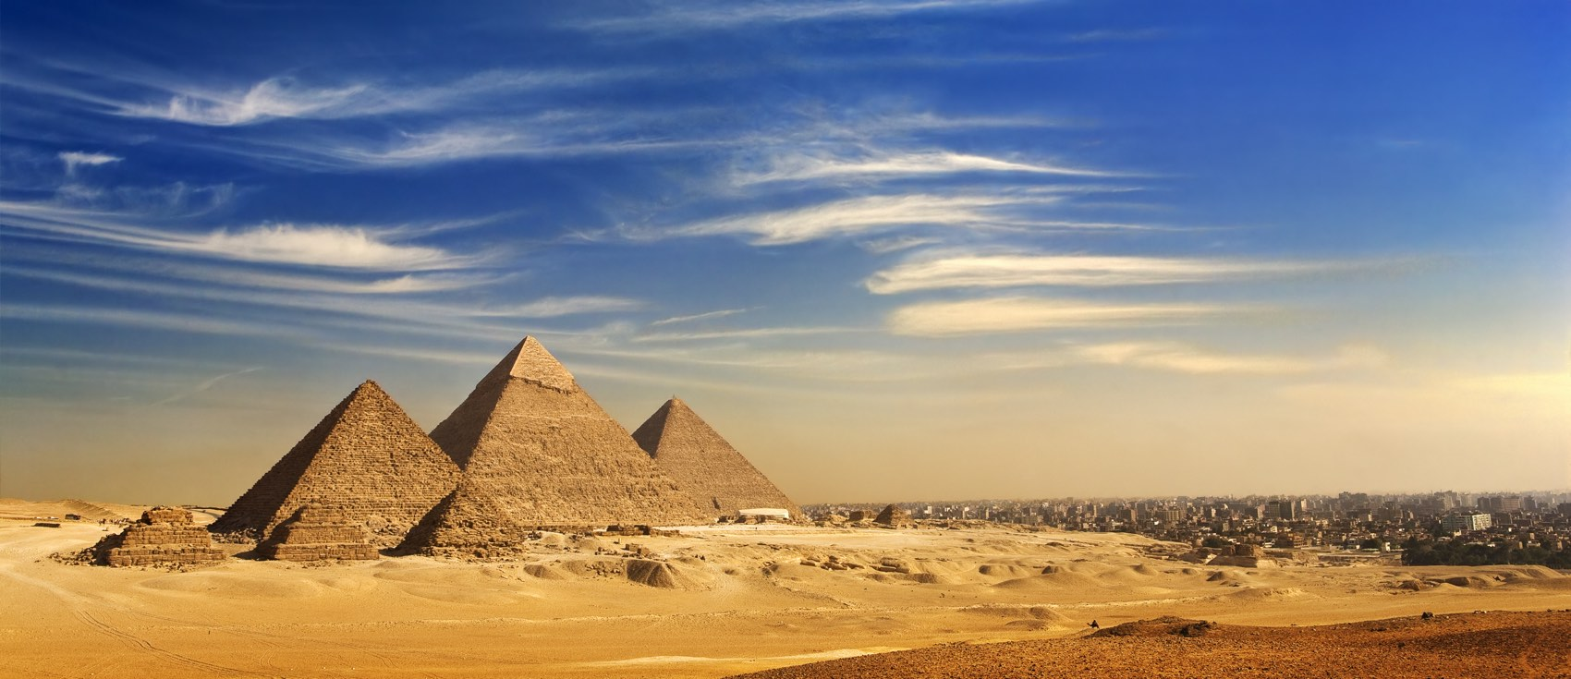
Some Logistics of Building the Great Pyramids
Really, it just takes time and lots and lots of workers

Slide 2
Largest Pyramids (built during the pyramid fad)
Giza 455 feet tall 2550 BC
Khafre just a bit smaller 2520 BC
Menkaure 215 feet tall 2490
Herodotus wrote (450 BC) that each pyramid took about 20 years to build using continuous labor involving possibly a labor force of 100,000 per pyramid. Later estimates and research suggest 10,000.
At this time the population of the world is about 25 million; hence 10,000 workers per project today would scale to 3 Million workers!
Its unclear how many of these workers were slaves compare to paid laborers but the data indicant slaves were a minority

Slide 3
Pyramid Building
First started around 5000 BC building crude rectangular structures until about 2630 BC when a rectangular structure was carved into a six step pyramid (not a continuous rectangle)
Hence, there were 1000’s of years practice in how to build this kind of structure
They were able to align the structures very close to pure North likely using the North Star and ropes to layout the configuration
The logistics of 10,000 workers – 4000 lbs of meet from cattle, sheep and goats are required. This was an incentive – better meals if you worked on the pyramid supply line

Slide 4
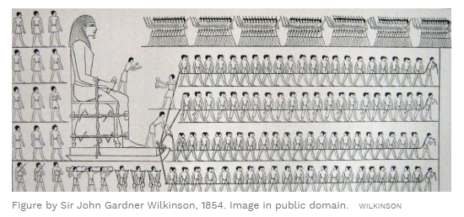
Moving the Rocks
Located in various quarries along the Nile River a “few km” from the building sites
Its possible the size of the Pyramid is Quarry Limited:
Sled clearly used to move the rock but a sled made of wood being
Pulled on Sand most of the way has a lot of friction! Need to
Reduce the friction.

Slide 5
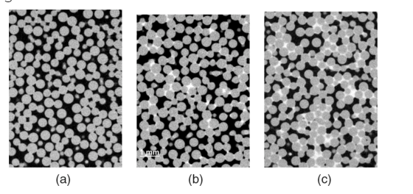
Much of the Quarry stone could be transported a long the Nile River
To minimize the sled dragging distance

Slide 6
The Use of water mixed in the Sand can reduce the coefficient of friction by a factor of 2, therefore requiring only ½ the labor

Slide 7
Another Labor Saving Device
They cheated – only put the finished precisely cut stones on the outside and left the crappy stones on the inside where no one could see them.
https://www.youtube.com/watch?v=7mjgyciRxMs

Slide 8
The Ultimate Supply Chain
There are about 2.4 million individual stones that make up the Giza pyramid
This means that about 3200 stones per day must be delivered to the site.
Each sled is reported to hold two tons of stones or about 10-20 individual stones.
This implies about 200-300 sleds per day had to be managed and so there must have been a gigantic sled highway in the desert – this is real commitment!

