Slide 1
Earthquake Hazards in Greece
And elsewhere in the Mediterranean Region

Slide 2
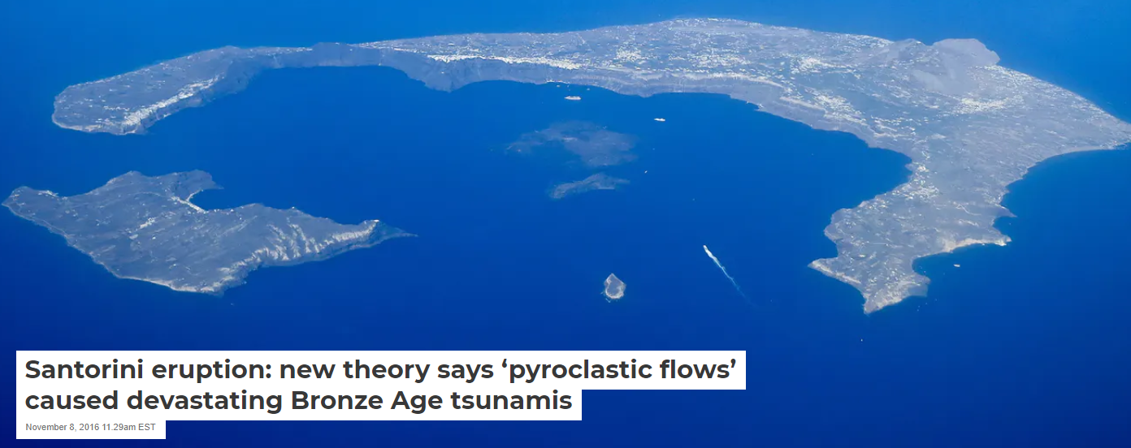
Greece
Is a very active seismic zone; less so with volcanoes although there was the ~1650 BC eruption of Santorini and the collapse ( but not extinction) of the Minoan culture

Slide 6
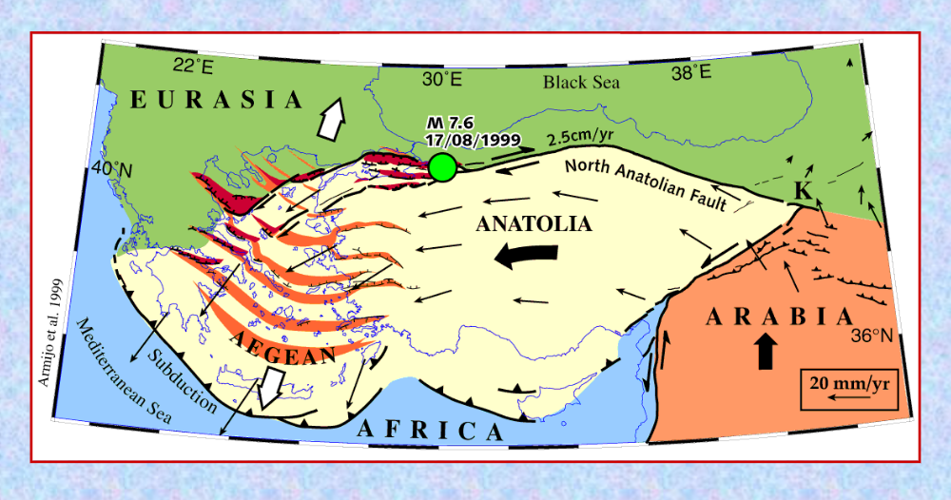
Significant small scale plate movement in this overall region

