Slide 1
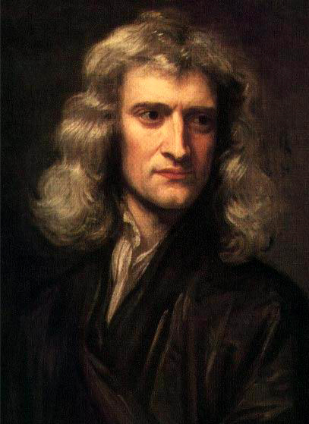
SIR ISAAC NEWTON
1643-1727
BORN THREE MONTHS AFTER HIS FATHER DIED IN A SMALL ENGLISH TOWN THE YEAR GALILEO DIED
HIS MOTHER REMARRIED BUT HE WAS RAISED BY HIS MATERNAL GRANDMOTHER
HIS MOTHER WANTED TO MAKE A FARMER OUT OF HIM WHEN HIS STEPFATHER DIED BUT HENRY STOKES, MASTER AT THE KING’S SCHOOL GRANTHAM, PERSUADED HER TO SEND HIM BACK TO SCHOOL.

Slide 2
ISAAC NEWTON
AT AGE 18 HE ENTERED TRINITY COLLEGE, CAMBRIDGE AS A SIZAR.
A SIZAR WAS KIND OF A “WORK-STUDY” ASSISTANTSHIP FOR TALENTED STUDENTS FROM POOR FAMILIES. THEY PAID NO TUITION BUT HAD TO PERFORM MENIAL, SOMETIMES DEMEANING TASKS AND WERE CONSIDERED SUBORDINATE TO TUITION PAYING STUDENTS.
WHILE ARISTOTILEAN PHILOSOPY WAS EMPHASIZED THERE HE PREFERRED TO STUDY DESCARTE.
HE ALSO IMMERSED HIMSELF IN THE STUDY OF COPERNICUS, GALILEO AND KEPLER

Slide 3
ISAAC NEWTON
HE GRADUATED AT AGE 22 AND, BEFORE HE COULD EMBARK ON HIS GRADUATE STUDIES THE GREAT PLAGUE (THE BUBONIC PLAGUE) HIT IN 1665. IT KILLED OVER 100,000 PEOPLE, OVER 20% OF LONDON’S POPULATION.
HE SPENT THE NEXT TWO YEARS AT HOME WHERE HE DEVELOPED HIS BASIC THEORIES ON CALCULUS, OPTICS, HIS LAWS OF PHYSICS AND HIS LAW OF UNIVERSAL GRAVITATION.
HE DEVELOPED CALCULUS (FLUXIONS AND INVERSE FLUXIONS) TO SOLVE ONE OF THE PROBLEMS HE FACED IN DEVELOPING HIS LAW OF UNIVERSAL GRAVITATION.
HE CALLED THIS PERIOD, "the prime of my age for invention"
DURING THAT TIME HE WROTE A LARGE PART OF WHAT BECAME Philosophiae Naturalis Principia Mathematica OR WHAT WE NOW SIMPLY CALL “THE PRINCIPIA”
HOWEVER IT WASN’T PUBLISHED UNTIL TWENTY YEARS LATER IN 1687 AT THE INSISTANCE AND GENEROUS SUPPORT OF EDMOND HALLEY.
ALSO, BY THE MID-60’S HE HAD ALSO INDEPENDENTLY DERIVED THE EXPRESSION: F=mv²/r FOR THE CENTRIPITAL FORCE THAT HUYGENS HAD DERIVED independently

Slide 4
ISAAC NEWTON
ONE PROBLEM HE HAD TO OVERCOME: HE COULDN’T SEE HOW THE GRAVITATIONAL FORCE WOULD NOT BE SHIELDED BY INTERVENING MATTER.
WHEN HE DID REALIZE THAT THE INTERVENING MATTER DID NOT SHIELD THE GRAVITATIONAL FORCE HE STATED “THE ATTRACTION LAW MUST BE IMPOSED BY GOD”.
ANOTHER PROBLEM: HOW DO YOU CALCULATE THE GRAVITATIONAL FORCE BETWEEN THE MILLIONS AND MILLIONS OF MASSES THAT MAKE UP THE MOON AND THE EARTH?
FOR THIS HE INVENTED CALCULUS AND PROVED THAT, IF THE MASSES WERE UNIFORM AND SPHERICAL THAT ONE COULD ASSUME THAT ALL OF THEIR MASS WAS AT THEIR CENTERS AND TREAT THEM AS POINTS.

Slide 5
ISAAC NEWTON
HALLEY HAD DISCUSSED THE DYNAMICS OF PLANETARY ORBITS WITH HOOKE.
HALLEY WAS FLABBERGASTED WHEN HE ASKED NEWTON ABOUT THE SHAPE OF A PLANET’S ORBIT AND NEWTON REPLIED IMMEDIATELY THAT IT WAS AN ELLIPSE.
This was used to successfully predict the return of Halley’s comet (1682) in 75 years

Slide 6
THE SUCCESSES OF NEWTON’S LAWS
THE MOON’S ORBIT WAS CORRECTLY DESCRIBED
THE TIDES WERE EXPLAINED
THE EARTH’S BULGE WAS CORRECTLY PREDICTED – oblate spheroid
PRECESSION OF THE EQUINOXES (CAUSED BY THE MOON’S ATTRACTION ON THE EARTH’S EQUATORIAL BULGE)

Slide 7
THE IMPACT OF THE PRINCIPIA
IT WAS MATHEMATICALLY VERY CHALLENGING, PERHAPS IN SOME RESPECT, DUE TO NEWTON’S DISLIKE FOR HOOKE WITH WHOM HE WAS FEUDING SO HE WROTE IT AT SUCH A HIGH LEVEL THAT HOOKE COULD NOT UNDERSTAND IT.
IN FACT, THE LEVEL OF THE MATHEMATICS IN IT WERE SO CHALLENGING THAT FEW COULD UNDERSTAND IT, SO IT FAILED TO GAIN MUCH TRACTION.
ALEXANDER POPE WROTE: “NATURE AND NATURE’S LAWS LAY HID IN NIGHT. GOD SAID, ‘LET NEWTON BE’, AND ALL WAS LIGHT”.
MICHAEL HART, AN OXFORD FELLOW IN POLITICS, RANKS NEWTON 2ND ONLY TO MOHAMMED AS THE MOST INFLUENTIAL PERSON IN HISTORY.

Slide 8
MORE ACCOLADES
French mathematician Joseph-Louis Lagrange often said that Newton was the greatest genius who ever lived, and once added that Newton was also "the most fortunate, for we cannot find more than once a system of the world to establish.”
NEWTON, IN A LETTER TO HOOKE SAID, “If I have seen further it is by standing on the shoulders of Giants”.
SOME SAY THIS WAS A STAB AT HOOKE WHO WAS RATHER STOOPED, OTHERS SAY IT WAS AN HONEST SENTIMENT.

Slide 9
NEWTON’S OTHER CONTRIBUTIONS
DEVELOPED THE NEWTONIAN TELESCOPE
WROTE A LARGE VOLUME ON OPTICS – STATED THAT WHITE LIGHT WAS SIMPLY A MIX OF ALL COLORS
DESCRIBED THE PHENOMENON KNOWN AS CHROMATIC ABERRATION
POSITED (INCORRECTLY) THE EXISTENCE OF A SUPERLUMINIFEROUS EITHER

Slide 10
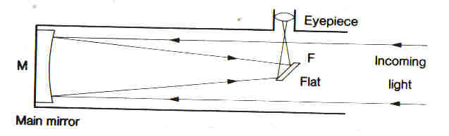
NEWTONIAN TELESCOPE

Slide 11
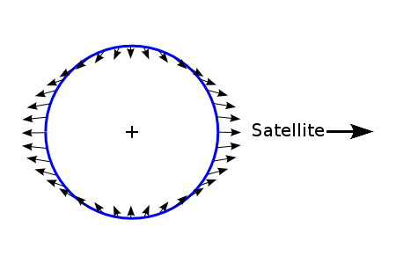
TIDES
THE TIDE FORCE IS A DIFFERENTIAL FORCE
F_{T} = const/r³
THEREFORE: THE MOON RAISES GREATER TIDES ON THE EARTH THAN THE SUN DOES BY ALMOST A FACTOR OF 2.
THERE ARE 2 HIGH TIDES AND 2 LOW TIDES PER DAY.

Slide 12
TIDES
THE FRICTION CAUSED BY THE TIDAL MOTION SLOWS THE EARTH’S ROTATIONAL RATE DOWN BY ABOUT 1.5 MSEC/CENTURY
CONSERVATION OF ANGULAR MOMENTUM CAUSES A SHIFT IN ANGULAR MOMENTUM TO THE MOON
THE MOON IS MOVING AWAY FROM THE EARTH AND THE LENGTH OF THE MONTH IS INCREASING
IN THE FAR FUTURE THE EARTH’S ROTATION WILL SLOW TO 47 DAYS, THE MONTH WILL LAST 47 DAYS AND THE EARTH AND MOON WILL KEEP THE SAME FACE TOWARD EACH OTHER

