Slide 1
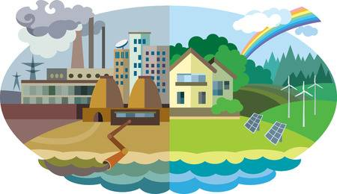
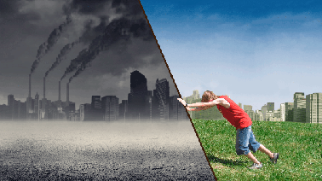
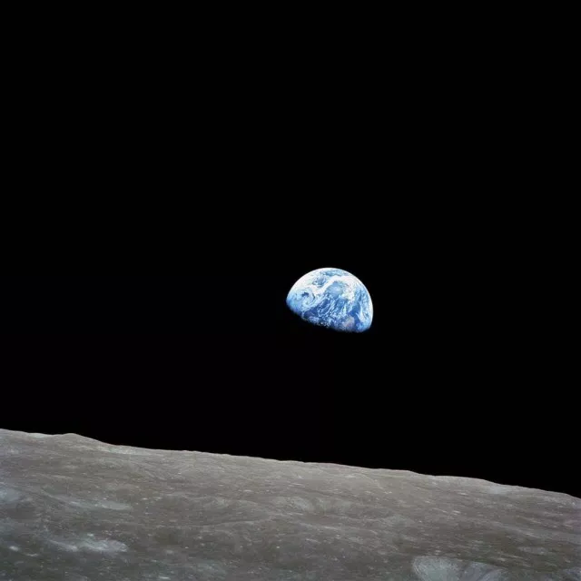
Environmental Studies 202
50 years Ago
How to look at environmental problems from the data lens?**
**Note – we don’t ever do this and this is the principle reason that environmental problems continue to grow

Slide 2
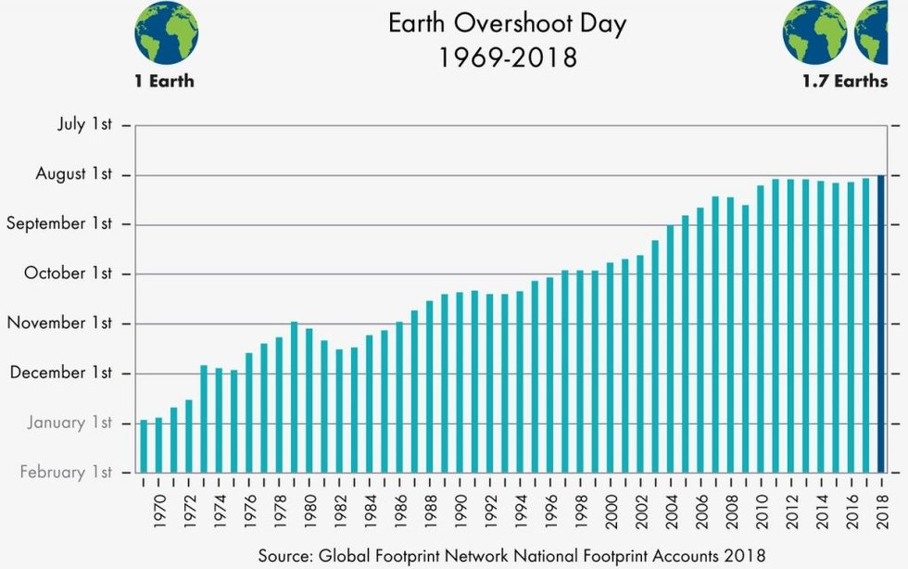
We are currently living in the most unsustainable time in history
Global Consumption means:
Each year more goods are consumed and distributed than in the previous year
Each year sees more CO₂ emission
Each year sees more plastic dumped into the ocean
From 1850- 2003 there were about 500 million consumers that used up about ½ of the Earth
From 2003-2018 there were have been 2 billion consumers added that have just about consumed the other 1/3

Slide 3
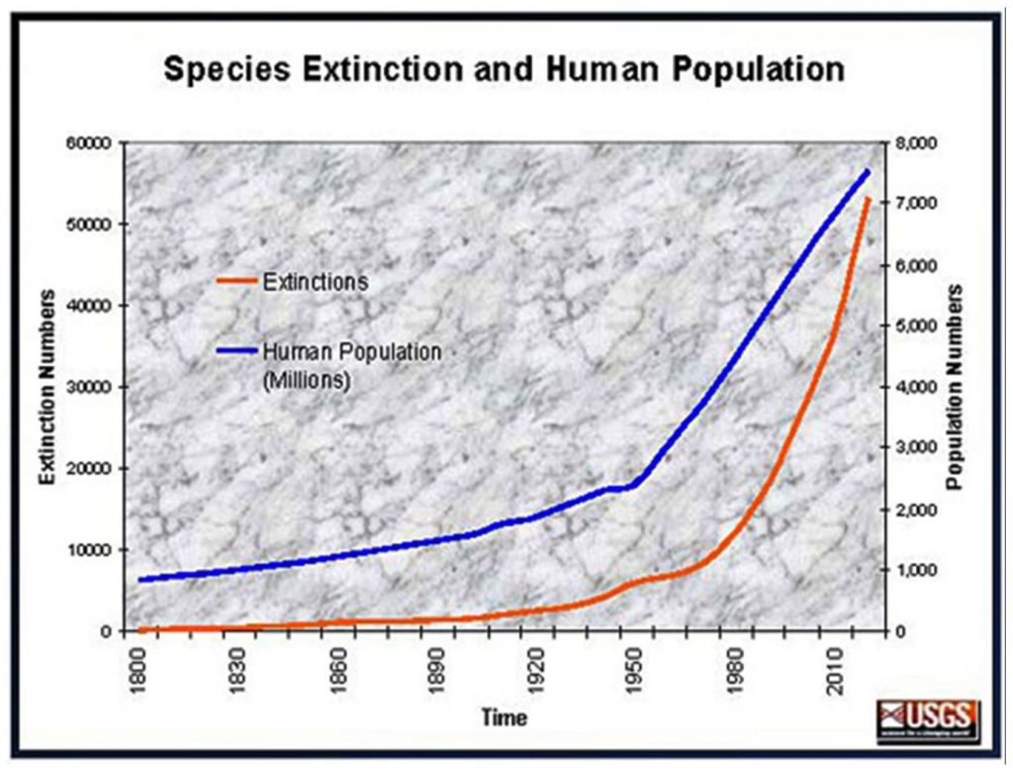
The Earth is a System – Humans are part of it and can change that system now.

Slide 4
Nature is a machine
Humans are not part of Nature
The machine exists to support Humans
This is the belief of the “advanced world” entering the Industrial Revolution – the unintended consequences were not considered

