Slide 1
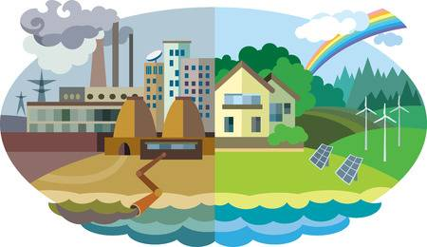
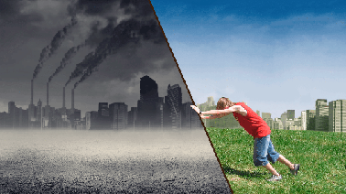
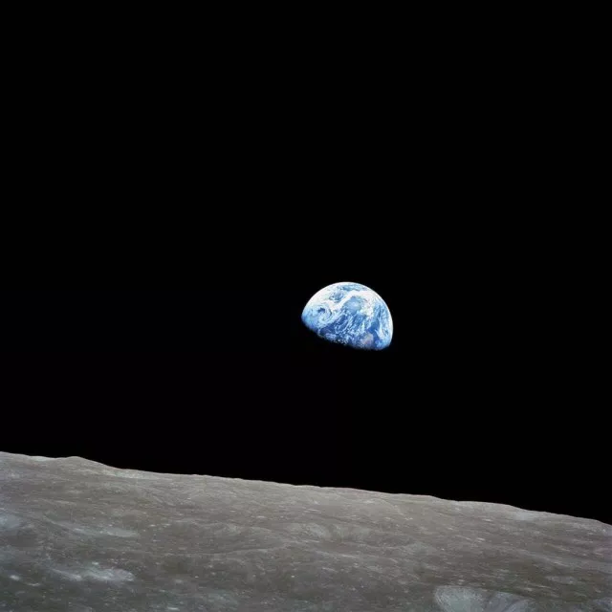
Environmental Studies 202
50 years Ago
How to look at environmental problems from the data lens?**
**Note – we don’t ever do this and this is the principle reason that environmental problems continue to grow

Slide 2
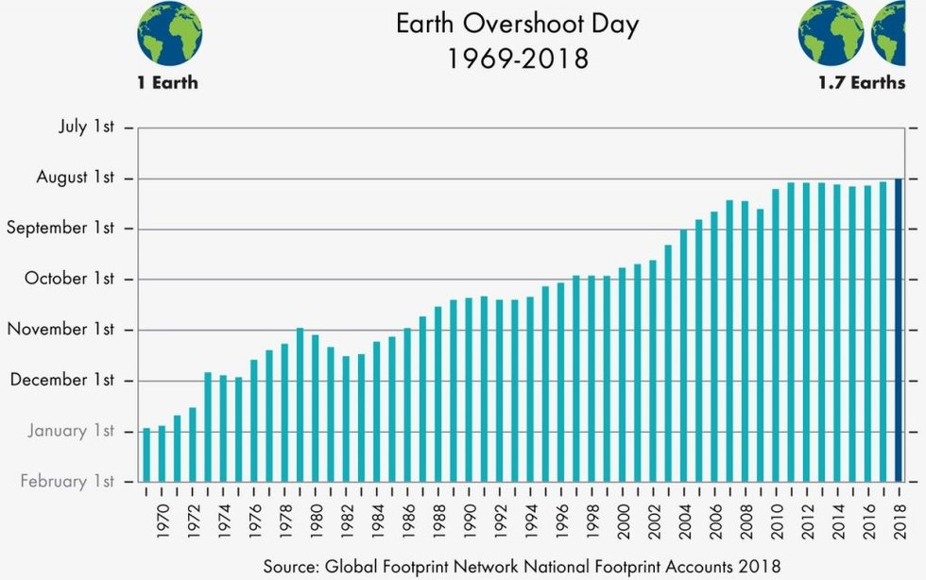
We are currently living in the most unsustainable time in history
Global Consumption means:
Each year more goods are consumed and distributed than in the previous year
Each year sees more CO₂ emission
Each year sees more plastic dumped into the ocean
From 1850- 2003 there were about 500 million consumers that used up about ½ of the Earth
From 2003-2018 there were have been 2 billion consumers added that have just about consumed the other 1/3

Slide 3
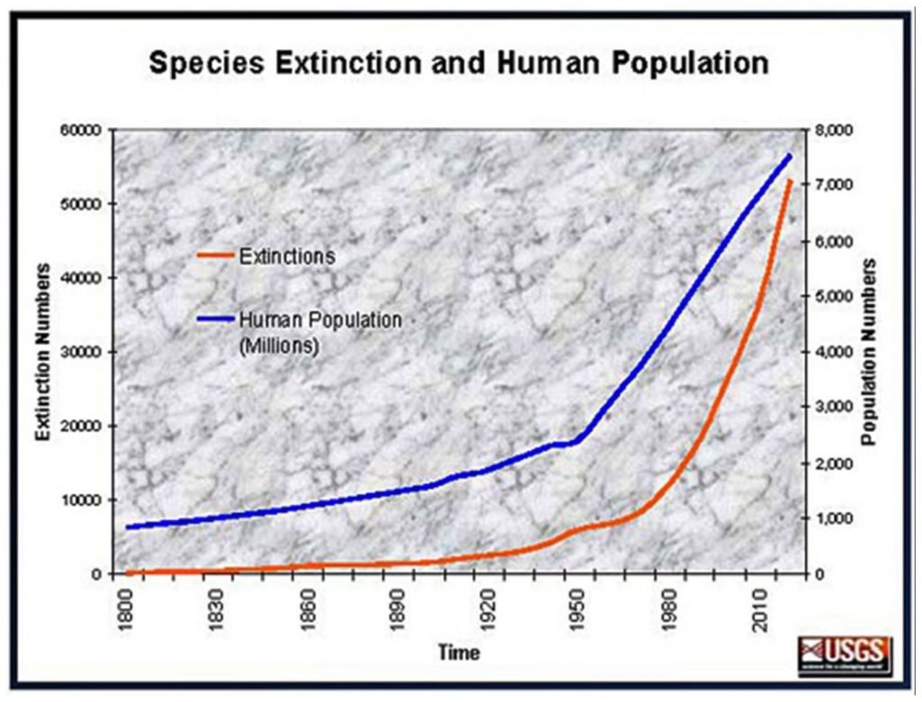
The Earth is a System – Humans are part of it and can change that system now.

Slide 4
Nature is a machine
Humans are not part of Nature
The machine exists to support Humans
This is the belief of the “advanced world” entering the Industrial Revolution – the unintended consequences were not considered

Slide 5
Furthermore, Earth is the system that we live in. That system can be measured quantitatively. However, at many levels these days we think numbers and data are irrelevant and constitute fake news. If your scared of data, then you can not do anything sensible about environmental management, because all management plans would be based on Disney's First Law
In this course we will touch upon many topics but will remain grounded in the physical reality that the root of all environment problems lies in global consumption which has now disrupted most of the equilibrium pathways in the Earth system.

