Slide 1
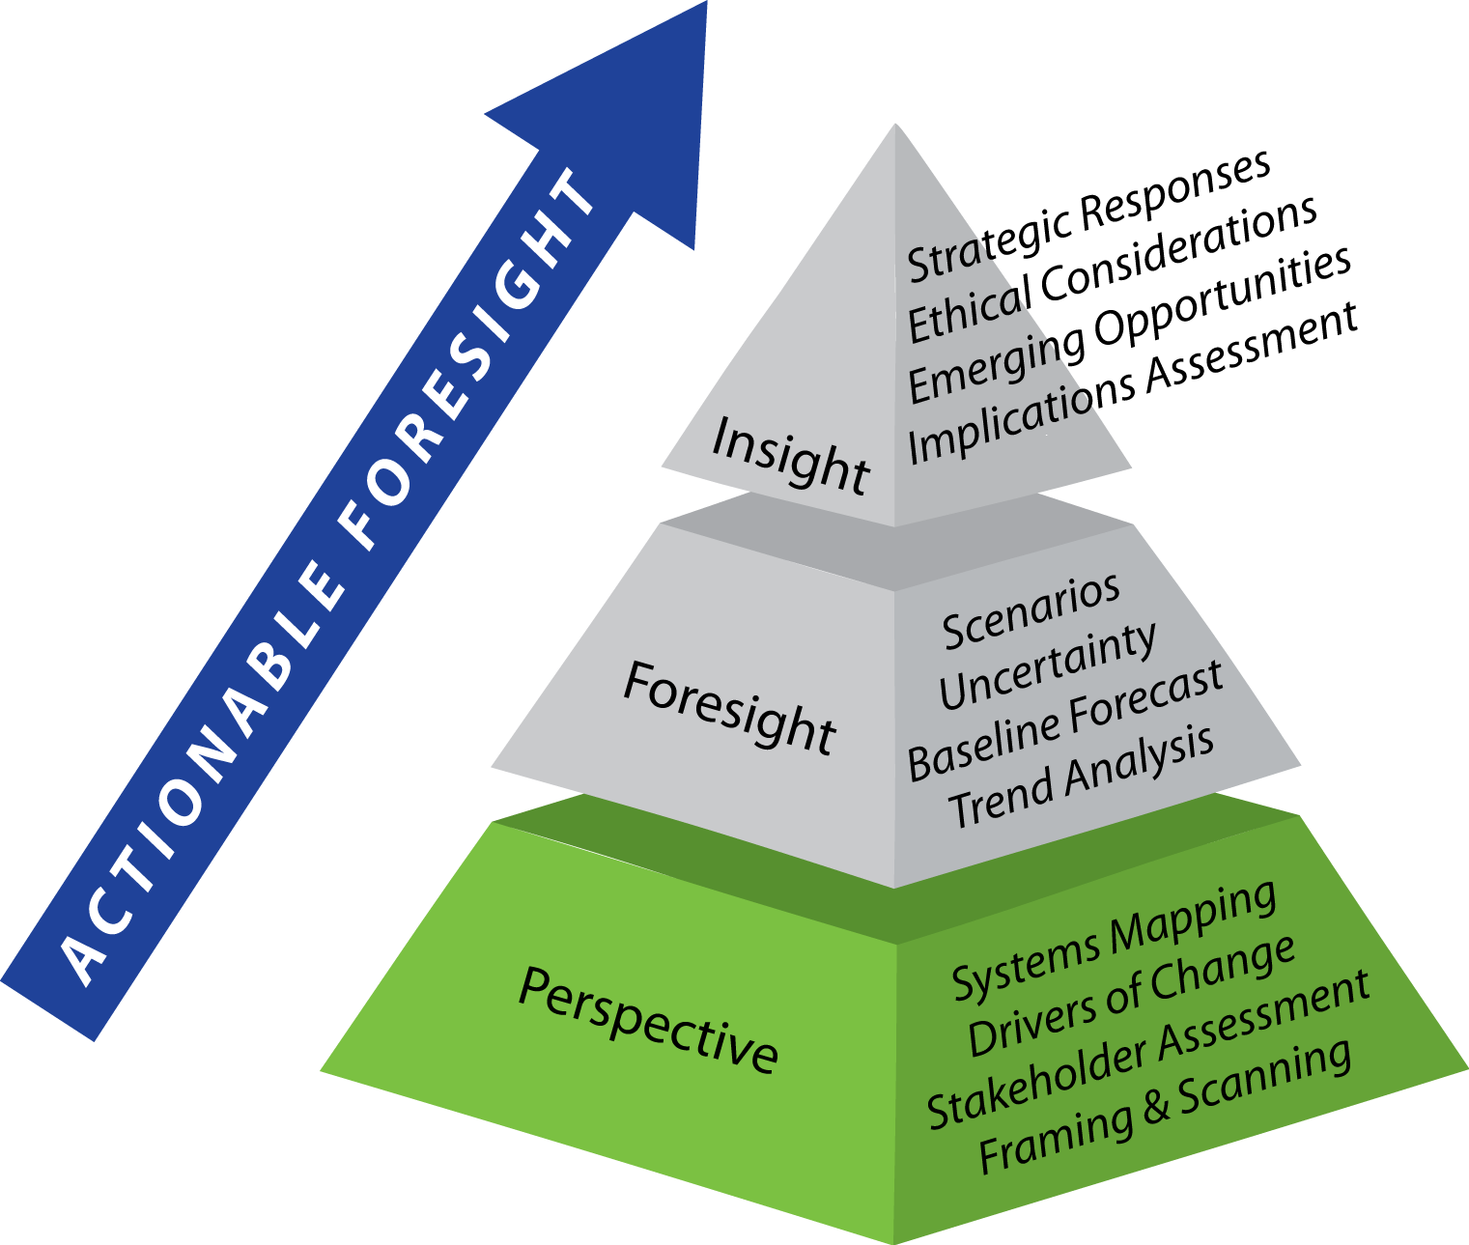
A wisdom approach to problem solving – are we capable?

Slide 2

Are things getting BETTER or WORSE in the world?
How Can This Question Be Answered?
Notes:
Ask the students what is needed to answer this question. Lead them to a path that is similar to the futures research path: First put the topic in context. Then define the indictors that can be used for assessment. Then gather evidence. Then synthesize the evidence into a useful assessment of the expected future.
Next, transition the discussion to the SOF approach to the foresight challenge.

Slide 3

The Millennium Project
GLOBAL FUTURES STUDIES & RESEARCH
    http://www.millennium-project.org/
Founded in 1996
Real-Time Delphi Technique-Expert Knowledge
State of the Future and SOF Index
15 Global Challenges - Updated Annually but there has been little change since 2000

Slide 4
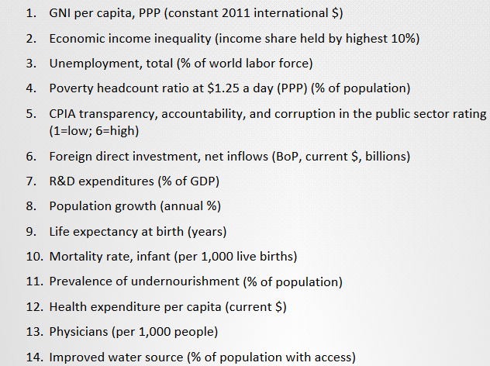
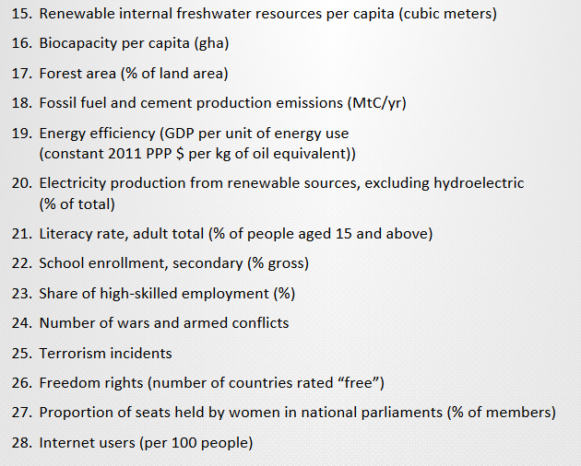
State of The Future Index (SOFI) from these indicators

Slide 5
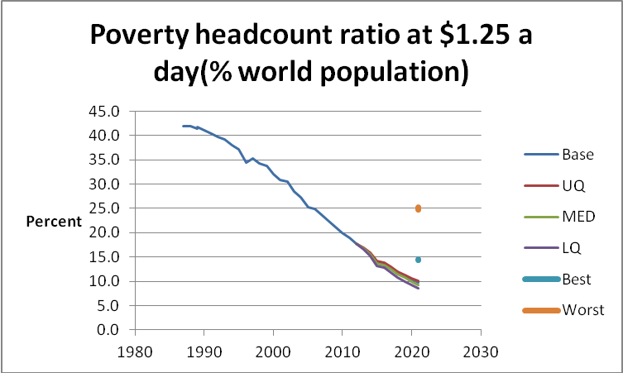
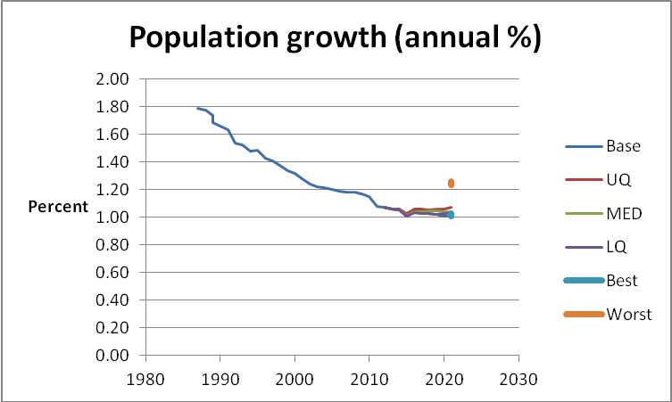
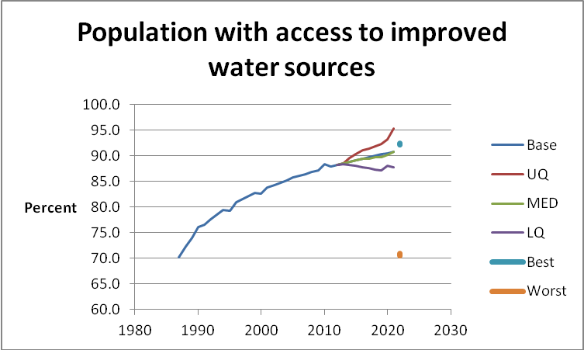
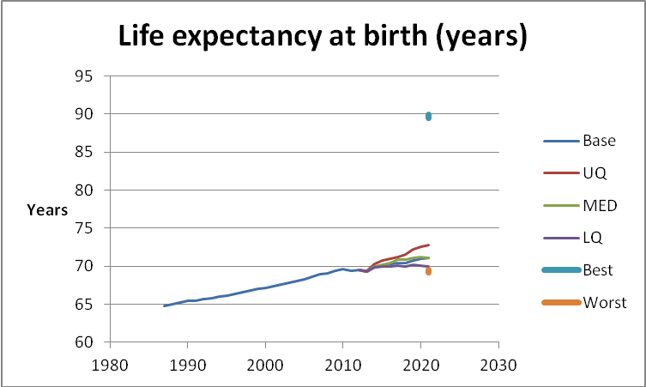
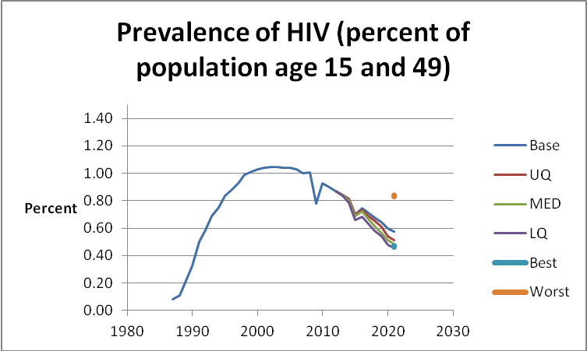
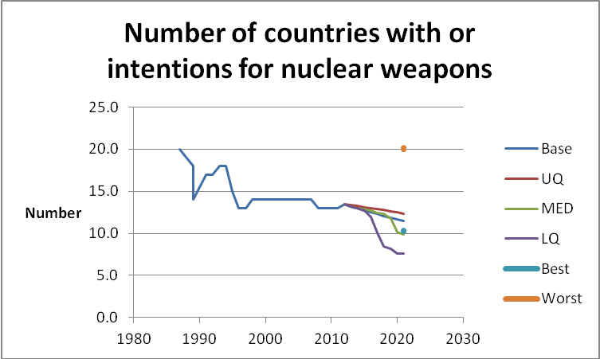
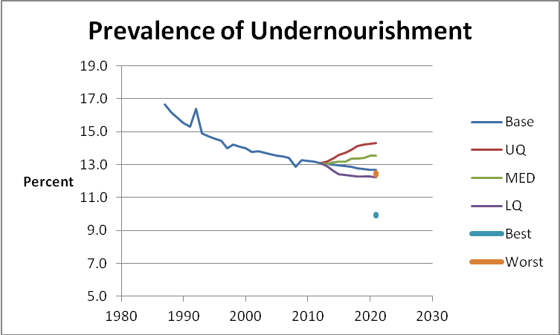
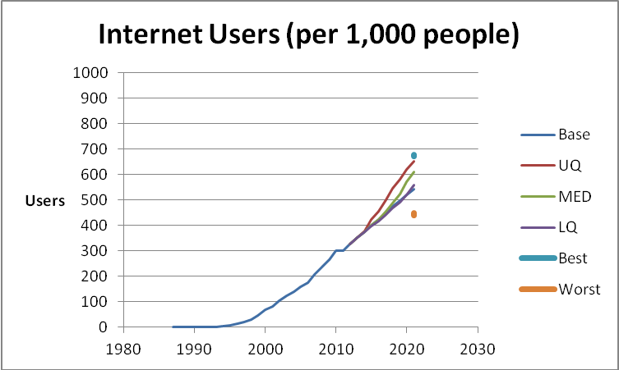
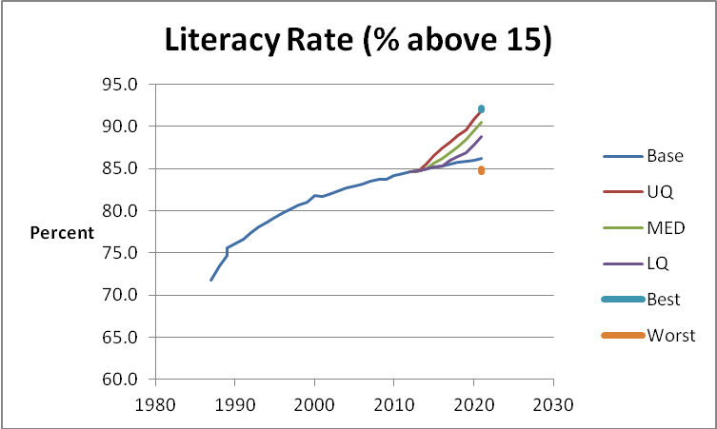
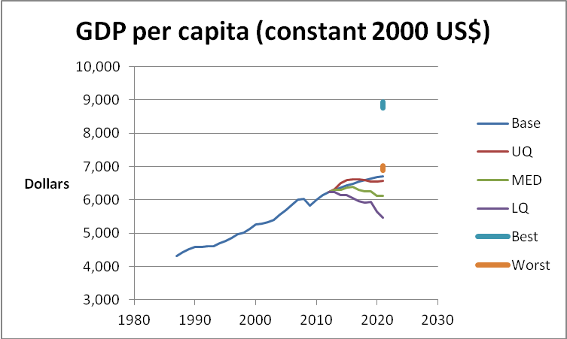
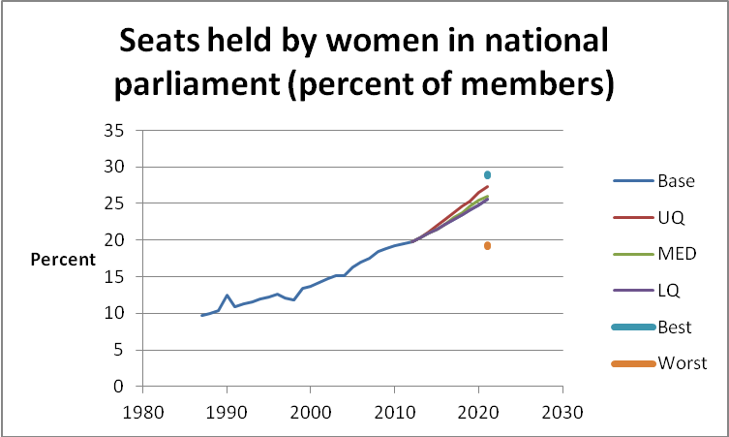
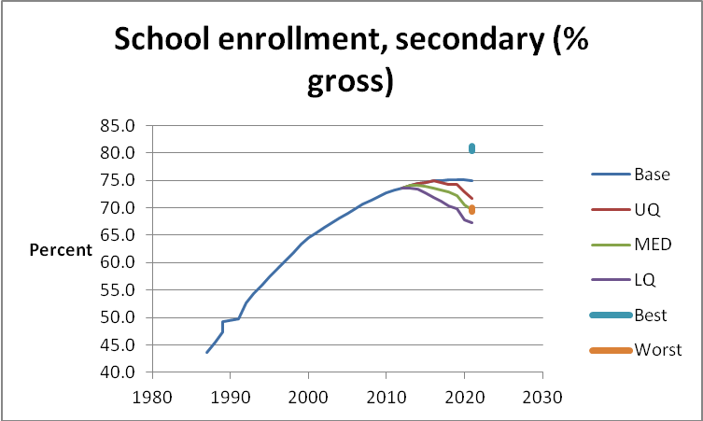
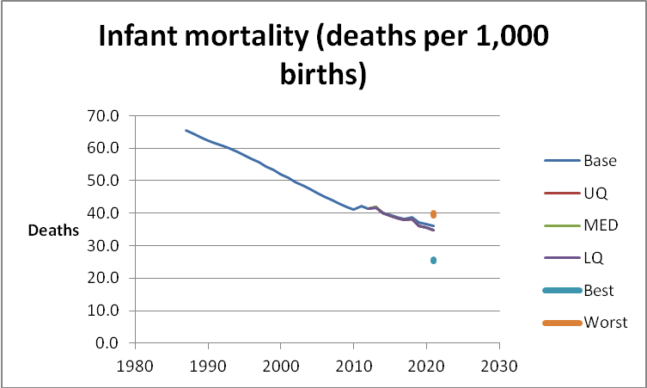
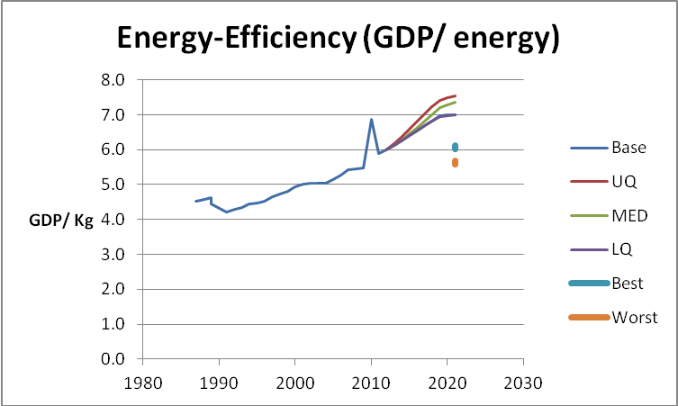
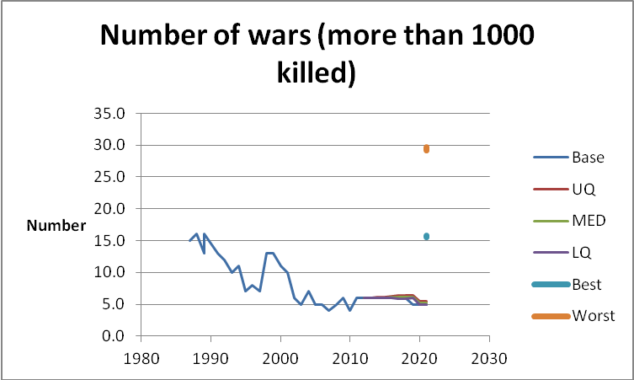
How are we doing?
Improvements:
Access to water
Internet users
Literacy rate
GDP/capita
Life expectancy at birth
Women in parliaments
School enrollment, secondary
Energy efficiency
Poverty $1.25 a day
Population growth
Infant mortality
Undernourishment prevalence
Wars
Nuclear proliferation
HIV prevalence
Source: 2012 State of the Future

Slide 6
How are we doing?
Where we are winning
© 2013 University of Notre Dame. All rights reserved.
Source: 2012 State of the Future
Notes:
Work through the various indicators and discuss the trajectory of the baseline (which is extrapolated from past data, using statistical methods) and how it coincides with or differs from the perspectives of the experts. Ask the students to explain, for example, why the expectation for literacy rate is so much more optimistic that the statistical baseline projection. The optimism is being driven by the expansion of access to technology. Do the same assessment for other indicators as well.

Slide 7
How are we doing?
Where we are winning
Source: 2012 State of the Future
© 2013 University of Notre Dame. All rights reserved.
Notes:
Work through the various indicators and discuss the trajectory of the baseline (which is extrapolated from past data, using statistical methods) and how it coincides with or differs from the perspectives of the experts. Ask the students to explain, for example, why the expectation for literacy rate is so much more optimistic that the statistical baseline projection. The optimism is being driven by the expansion of access to technology. Do the same assessment for other indicators as well.

Slide 8
How are we doing?
Where we are winning
Source: 2012 State of the Future
© 2013 University of Notre Dame. All rights reserved.
Notes:
Work through the various indicators and discuss the trajectory of the baseline (which is extrapolated from past data, using statistical methods) and how it coincides with or differs from the perspectives of the experts. Ask the students to explain, for example, why the expectation for literacy rate is so much more optimistic that the statistical baseline projection. The optimism is being driven by the expansion of access to technology. Do the same assessment for other indicators as well.

Slide 9
How are we doing?
Where we are winning
© 2013 University of Notre Dame. All rights reserved.
Source: 2012 State of the Future
Notes:
Work through the various indicators and discuss the trajectory of the baseline (which is extrapolated from past data, using statistical methods) and how it coincides with or differs from the perspectives of the experts. Ask the students to explain, for example, why the expectation for literacy rate is so much more optimistic that the statistical baseline projection. The optimism is being driven by the expansion of access to technology. Do the same assessment for other indicators as well.

Slide 10
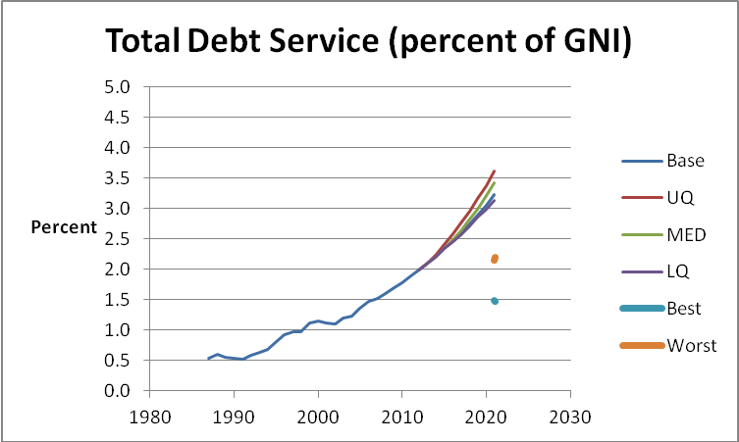
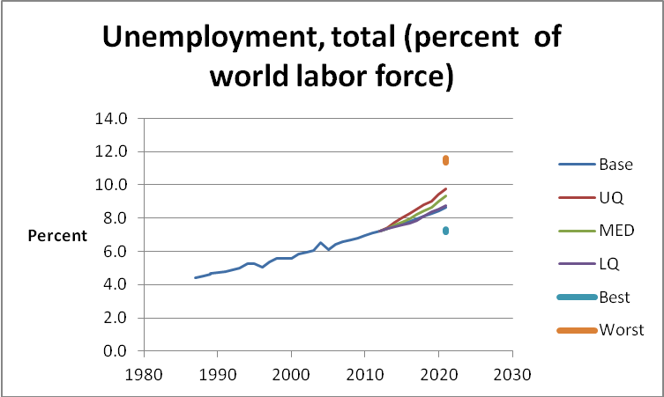
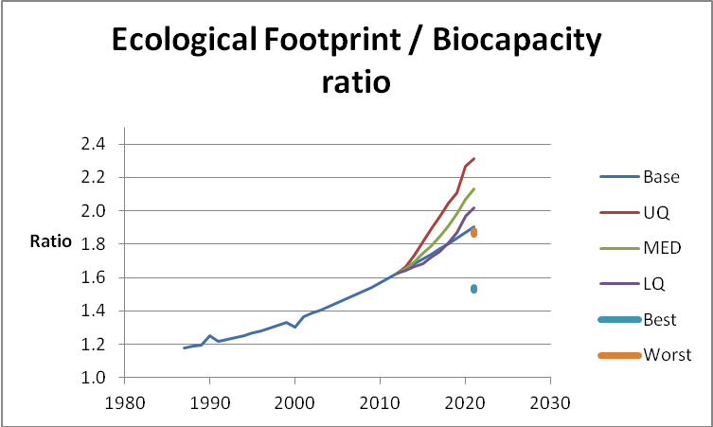
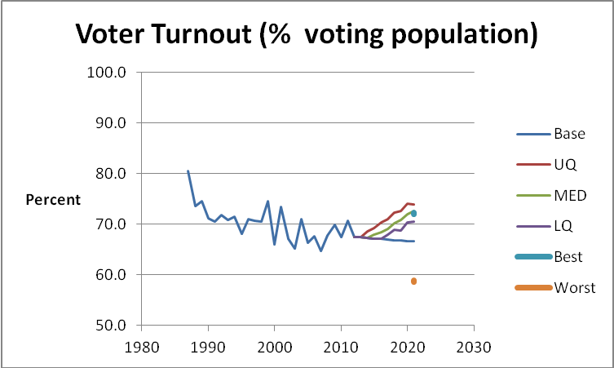
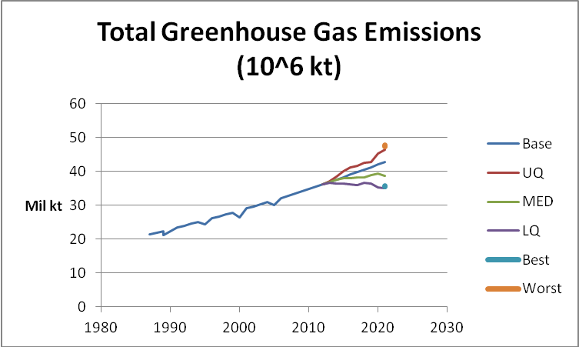
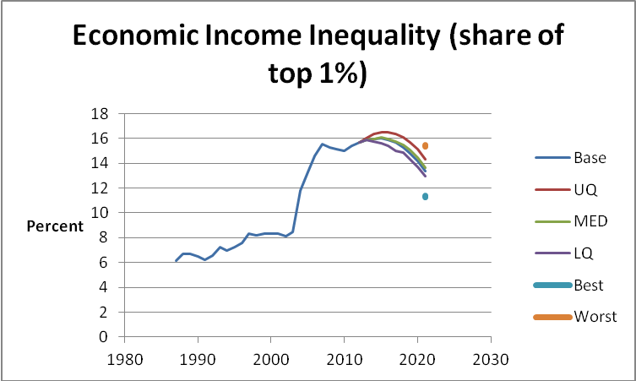
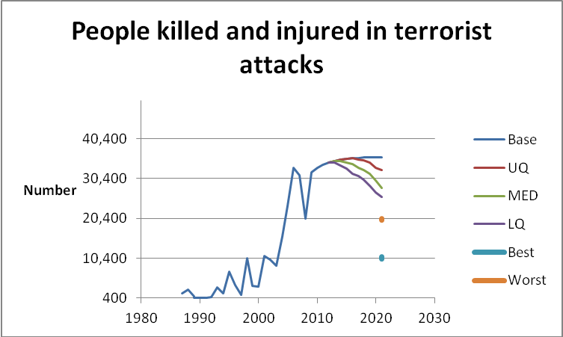
How are we doing?
Poor Trajectory
Total debt
Unemployment
Income inequality
Ecological footprint / biocapacity ratio
GHG emissions
Terrorist attacks victims/1000
Voter turnout
Source: 2012 State of the Future

Slide 11
How are we doing?
Where we are losing
© 2013 University of Notre Dame. All rights reserved.
Source: 2012 State of the Future
Notes:
Continue the discussion similar to that of Where we are Winning.

Slide 12
How are we doing?
Where we are losing
© 2013 University of Notre Dame. All rights reserved.
Source: 2012 State of the Future
Notes:
Continue the discussion similar to that of Where we are Winning.

Slide 13
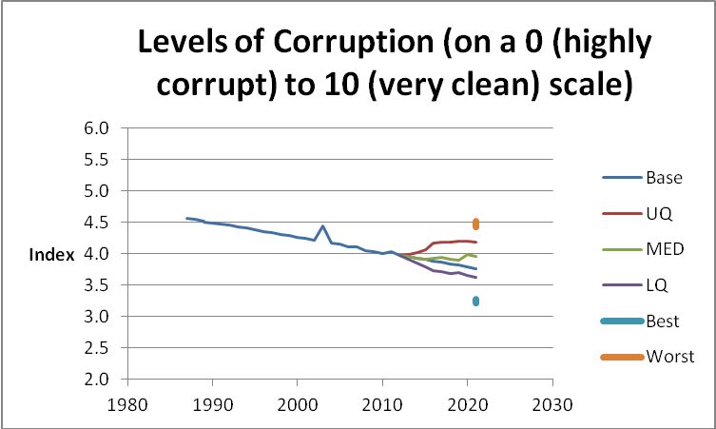
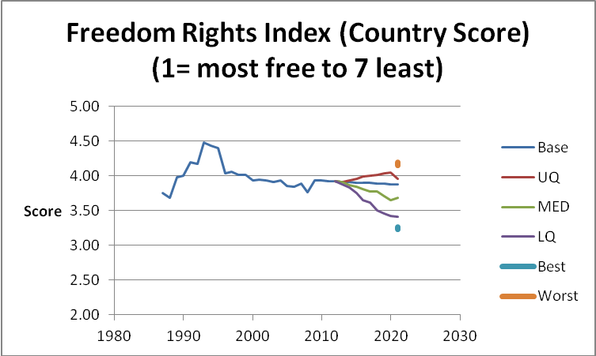
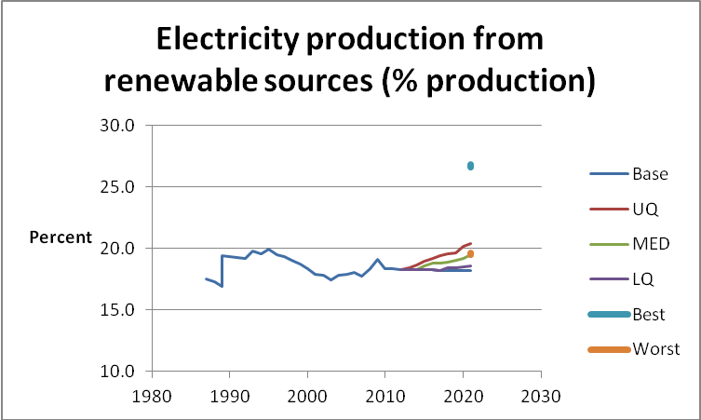
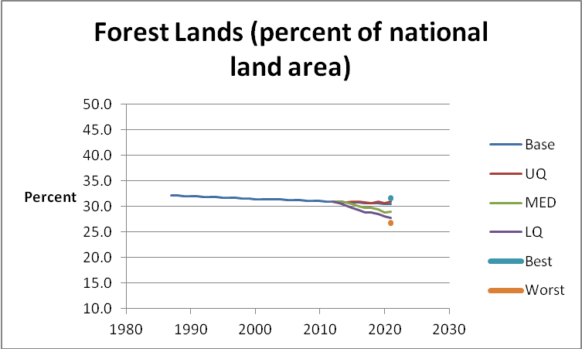
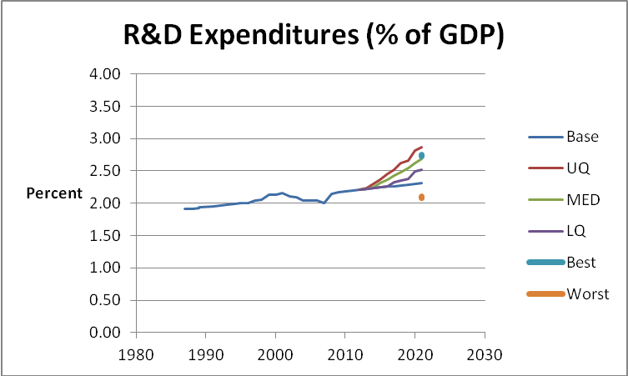
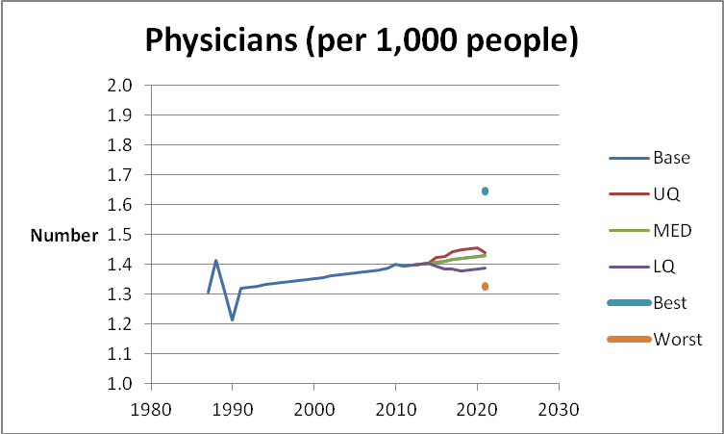
How are we doing?
Apparently Flat Trajectories
Corruption
Freedom rights
Electricity from renewables
Forest lands
R&D expenditures
Physicians
Source: 2012 State of the Future
Notes:
Some trajectories do not give a clear indication of whether we are winning or losing. None the less the data is a useful reference point about future change.

Slide 14
How are we doing?
Source: 2012 State of the Future
© 2013 University of Notre Dame. All rights reserved.

Slide 15
How are we doing?
Source: 2012 State of the Future
© 2013 University of Notre Dame. All rights reserved.

Slide 16
How are we doing?
winning
Access to water (tho this is degrading now)
Internet users
Literacy rate
GDP/capita
Life expectancy at birth
Women in parliaments
School enrollment, secondary
Energy efficiency
Poverty $1.25 a day
Population growth
Infant mortality
Undernourishment prevalence
Wars
Nuclear proliferation
HIV prevalence
Losing:
Total debt
Unemployment
Income inequality
Ecological footprint / biocapacity ratio
GHG emissions
Terrorist attacks victims/1000
Voter turnout
Unclear:
Corruption
Freedom rights
Electricity from renewables
Forest lands
R&D expenditures
Physicians
Source: 2012 State of the Future

Slide 17
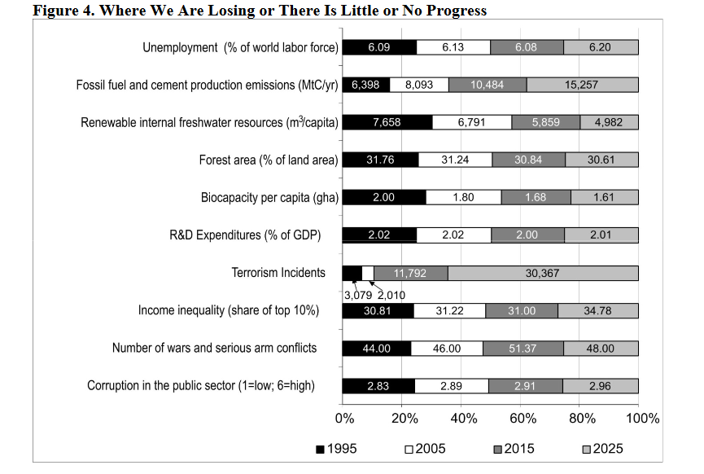
Update from 2015 Report

Slide 18
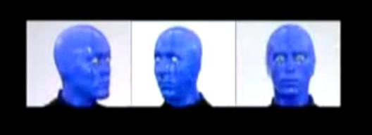
Blue Man Group

Slide 19
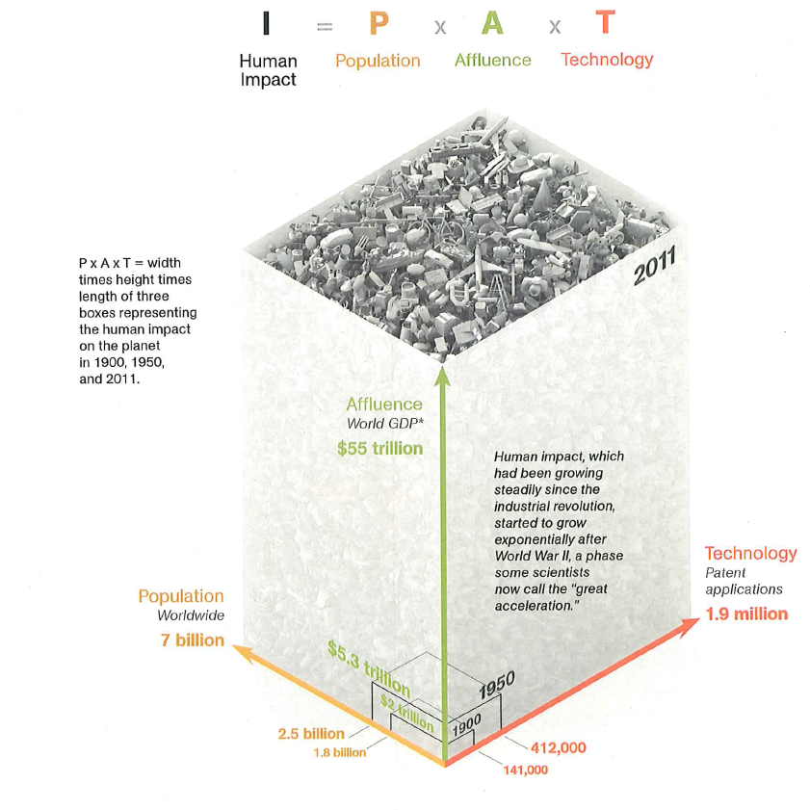

I =$p^{n}{∗a}^{m}∗t^{x}$
Source:
National Geographic, March 2011
Notes:
Use this slide as a set up for the next slide – which asks whether it may be possible for innovation and human ingenuity to move technology from the numerator of this question (where increases result in additional impact) to the denominator (where increased use of technology can lessen impact)
Show the comparison of how impact has dramatically grown since the year 1900.

Slide 20
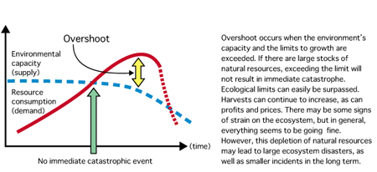
Overshoot
This behaves like Natural Hazard Random Input
Source: Wackernagel & Rees 1996

Slide 21

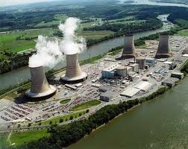
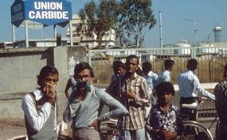
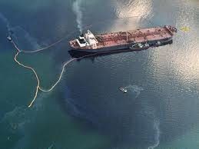





Sustainability - A Tale of 3 Eras
The Awakening
Reluctant Compliance
1970
1980
1990
2000
Sustainable Value
But so far the scale is minimal

Slide 22
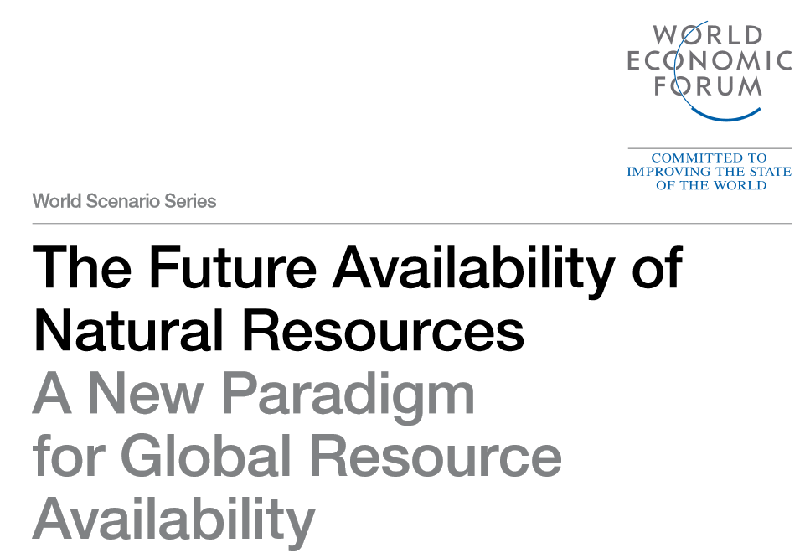

Slide 23
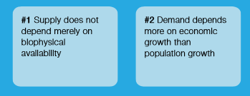
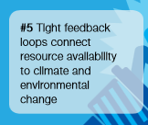
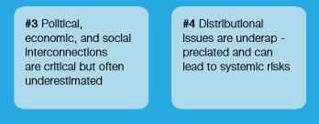
New Insights

Slide 24
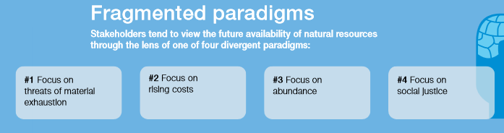
What has Priority?

Slide 25
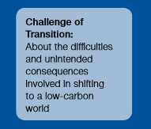
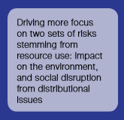
Two main challenges

Slide 26
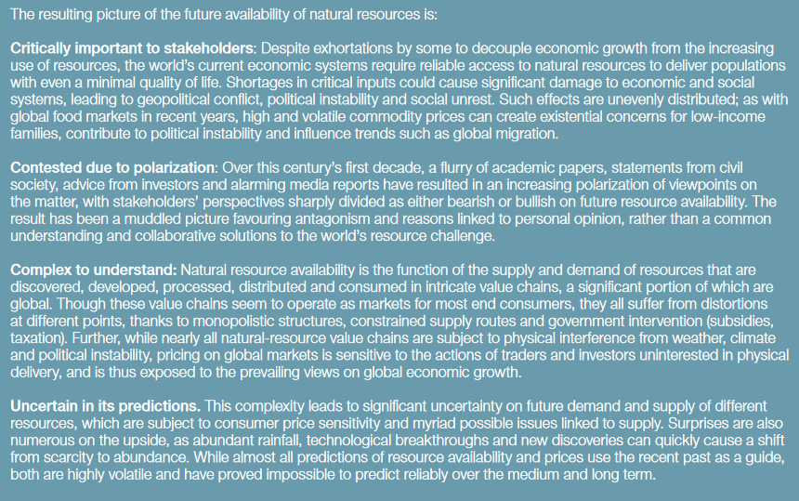

Slide 27
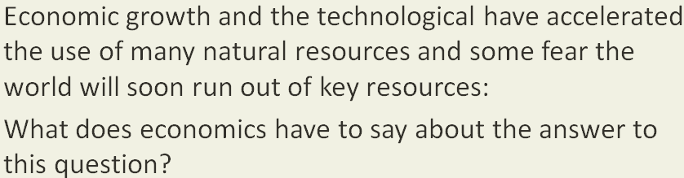
We are now approaching earth limited Scales
So looking to the past is NOT and using a traditional view is not helpful:

Slide 28
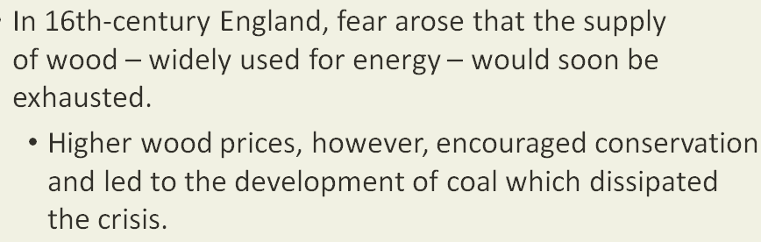
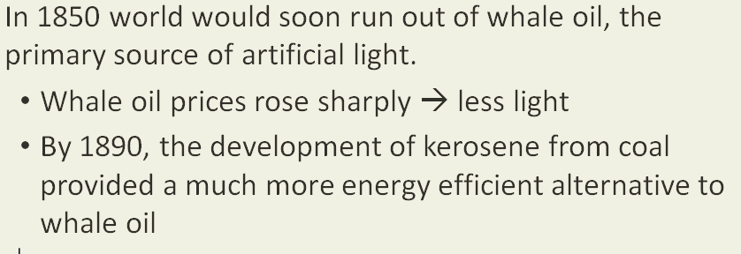
Economic Corrections History

Slide 29
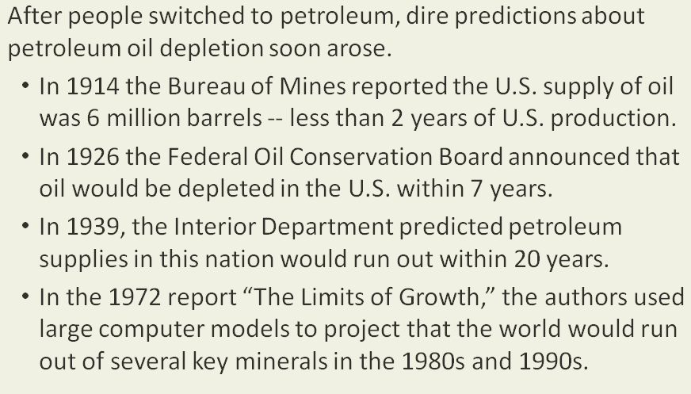
The sky is falling problem

Slide 30

Why have forecasts been wrong?

Slide 31


But can we also rely on this?
Okay, is everything really a market commodity? Like, water, electricity?
How do markets work when there is actually physical resource scarcity on a planet wide basis;

Slide 32

Fine, but substitutes have to EXIST at scale!!!
We are rapidly losing surplus!
What really drives prosperity?

Slide 33

The Real Threat Matrix

Slide 34


Buffers protect us, but as said before, we are running out of this protection!

Slide 35


Slide 36

THIS IS GLOBAL
INEQUITY

Slide 37
The Future is obviously Uncertain
But your generation has to have a different value system and different practices form the past in order to produce a more holistic view of the world that allows for reduced consumption and better partnership with nature
But those are just words – real action is required!

