Slide 1
The Eugene Firestrom
Scenario

Slide 2
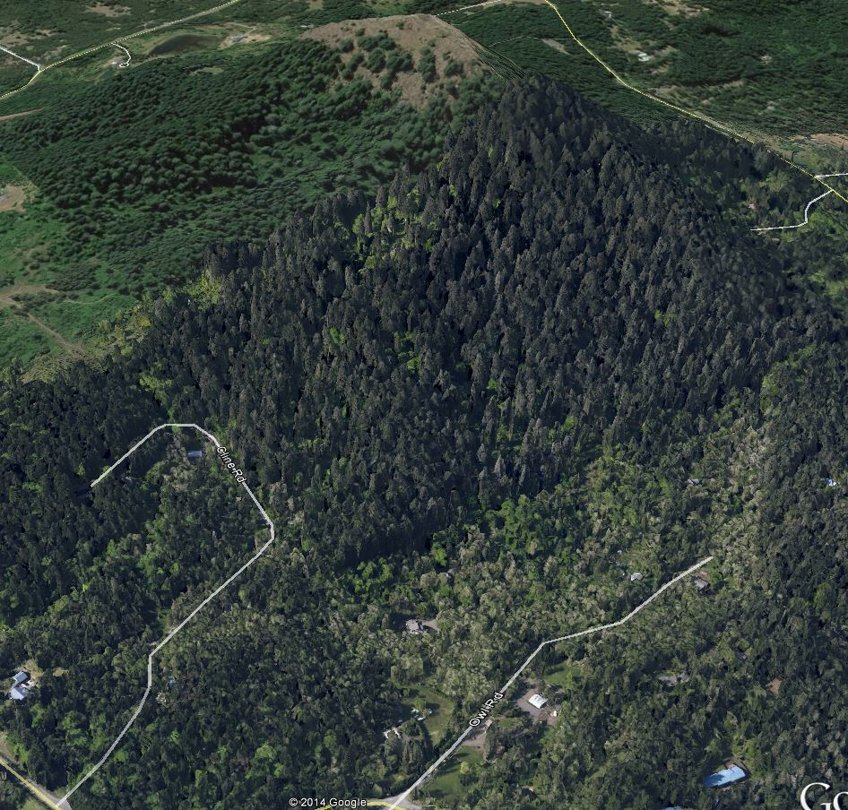
SW Wind on Spencer Butte

Slide 3
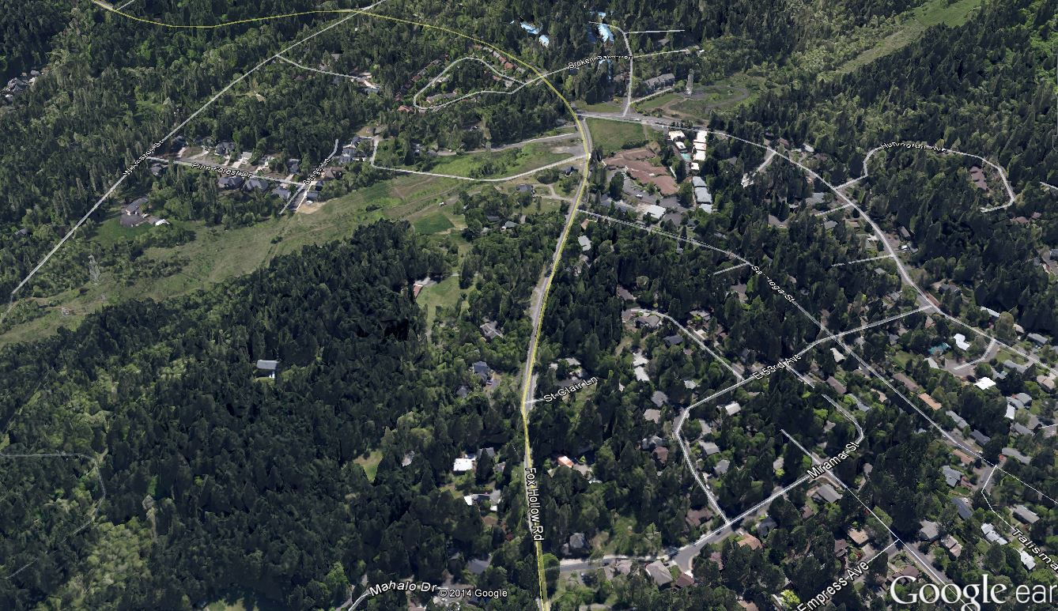
Power line Corridor not sufficient fire break; Fire Travels down Fox Hollow

Slide 4
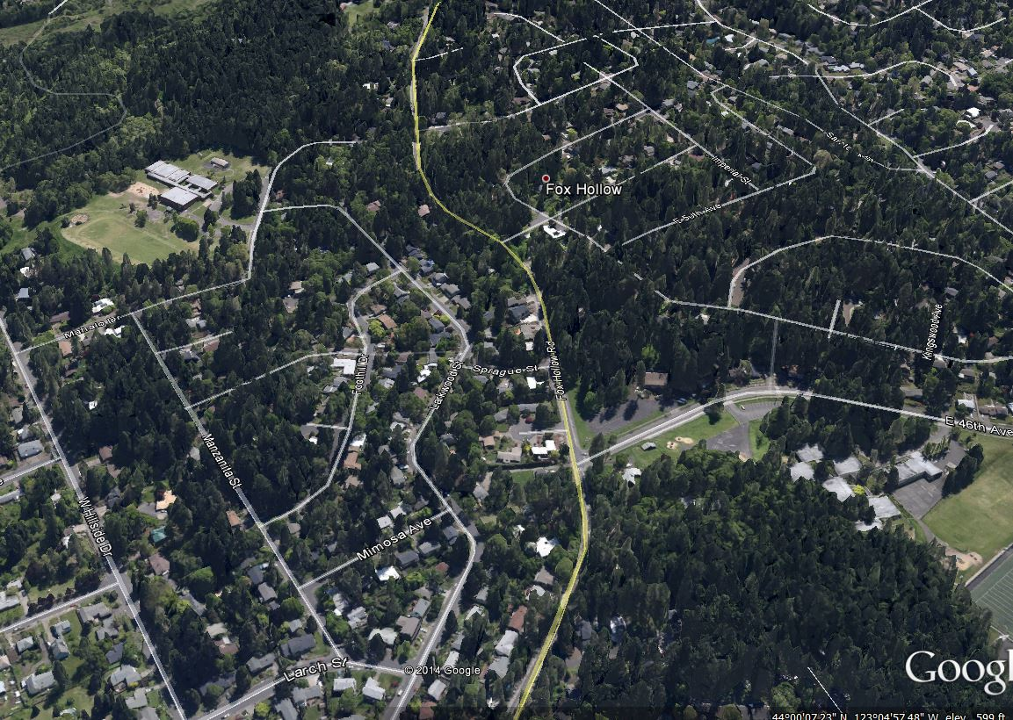
Notice all the Fuel

Slide 5
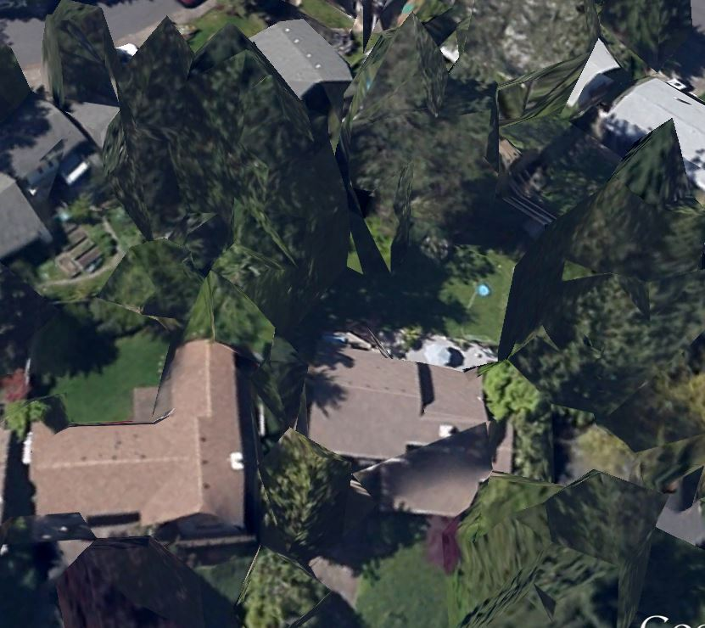
My House –note the luxurious pool

Slide 6
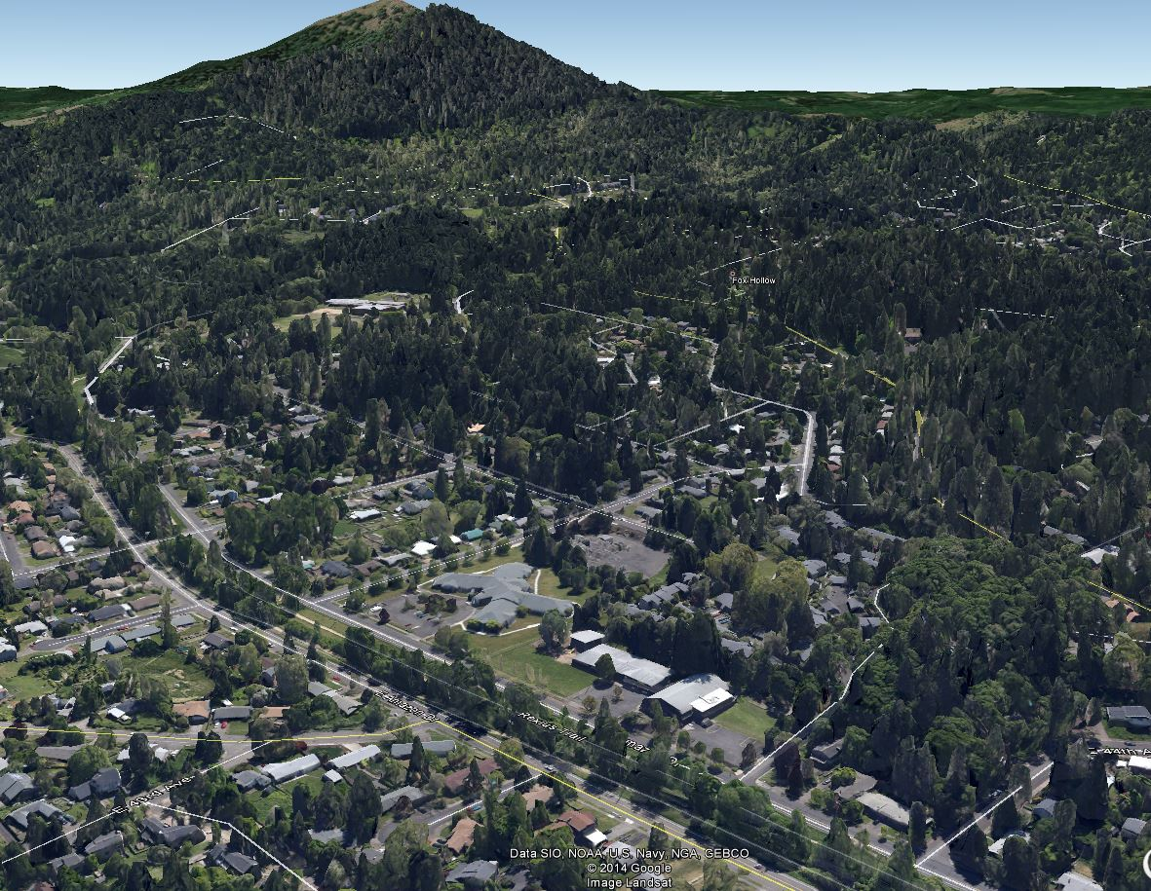
Major Burn Zone

Slide 7
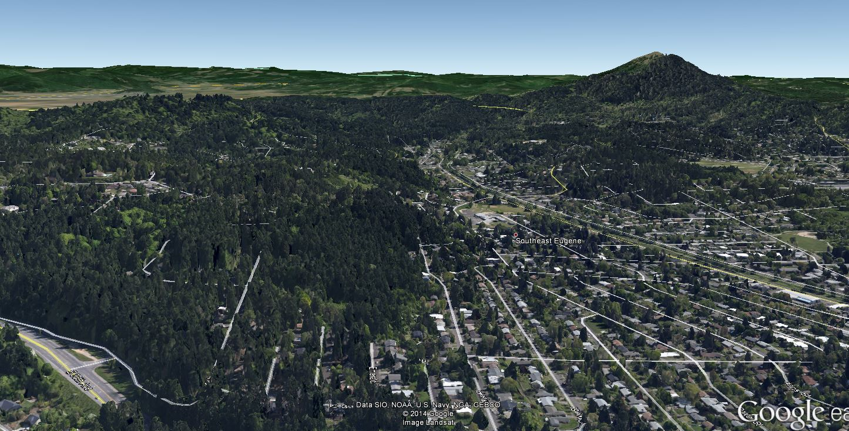
Would Fire make it to the other ridge?
???

Slide 8
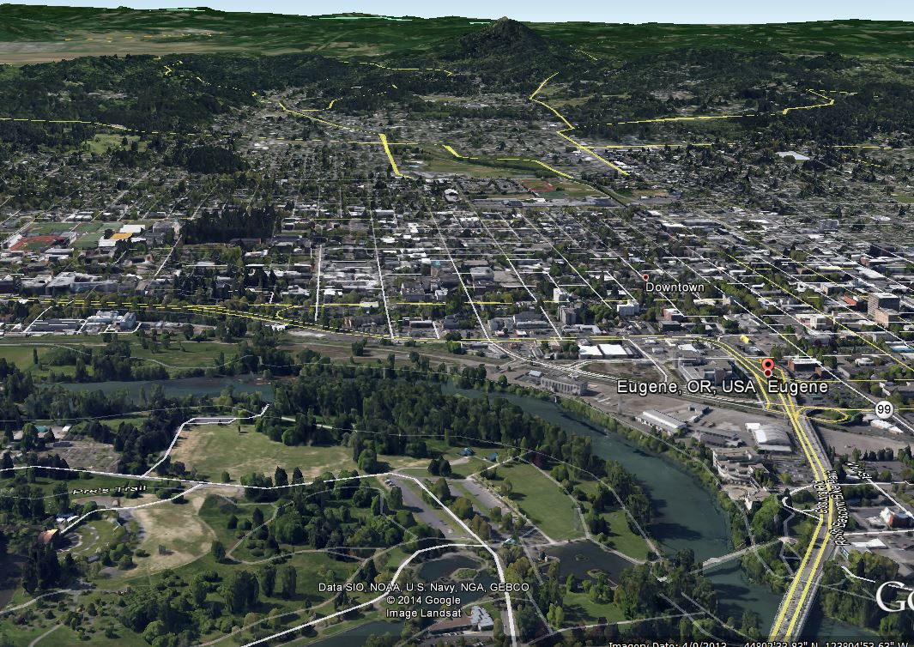
Likely Fire Break

