Slide 1
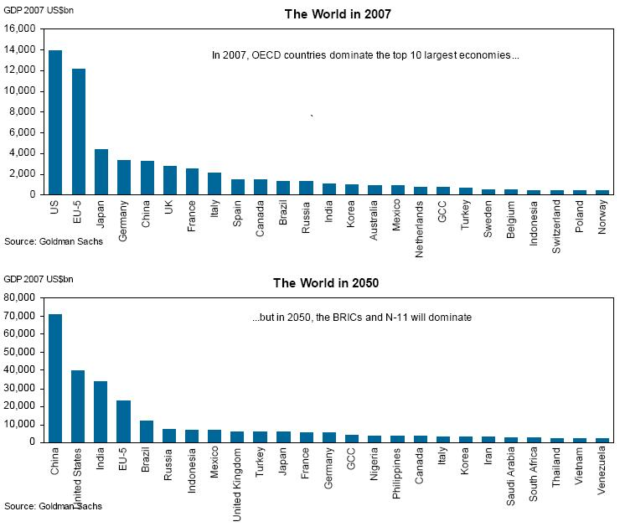
A Cultural Shift in world economic power
US = 5* (China+India)
Post WW II
Japan + Germany = 0.5*US
New Players = Indonesia, Mexico, Turkey
(China + India) = 3* US
Japan + Germany = 0.2*US

Slide 2
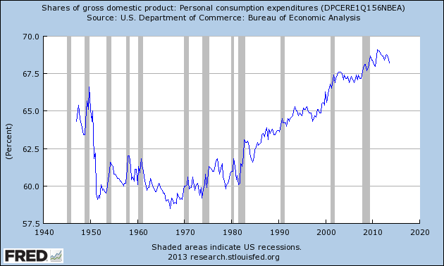
The Consumptive Mandate Waveform: if you got more, consume even more: Maintain BAU
Greed
sustainability

Slide 3
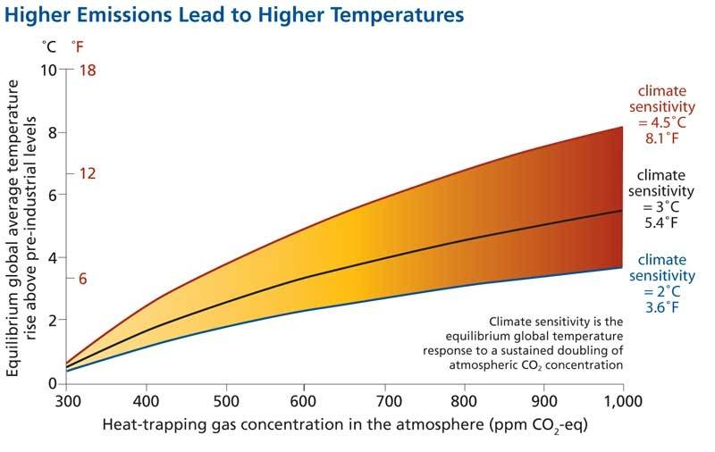
Accelerated Climate Change
This is driven entirely by consumption
CONSUMPTION →

Slide 4
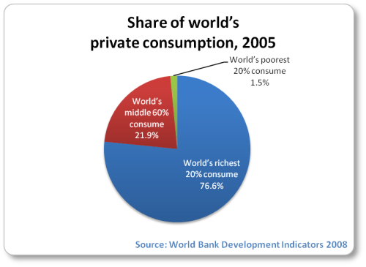
Correct this →
Our view of the world as a resource to use up must change!
Profit vs Equity: Surplus → Growth or Equity? Growth or Prosperity?
This is your generations challenge:

Slide 5
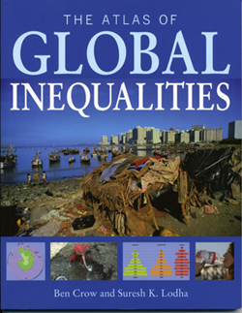
What Inequity Looks Like

Slide 6
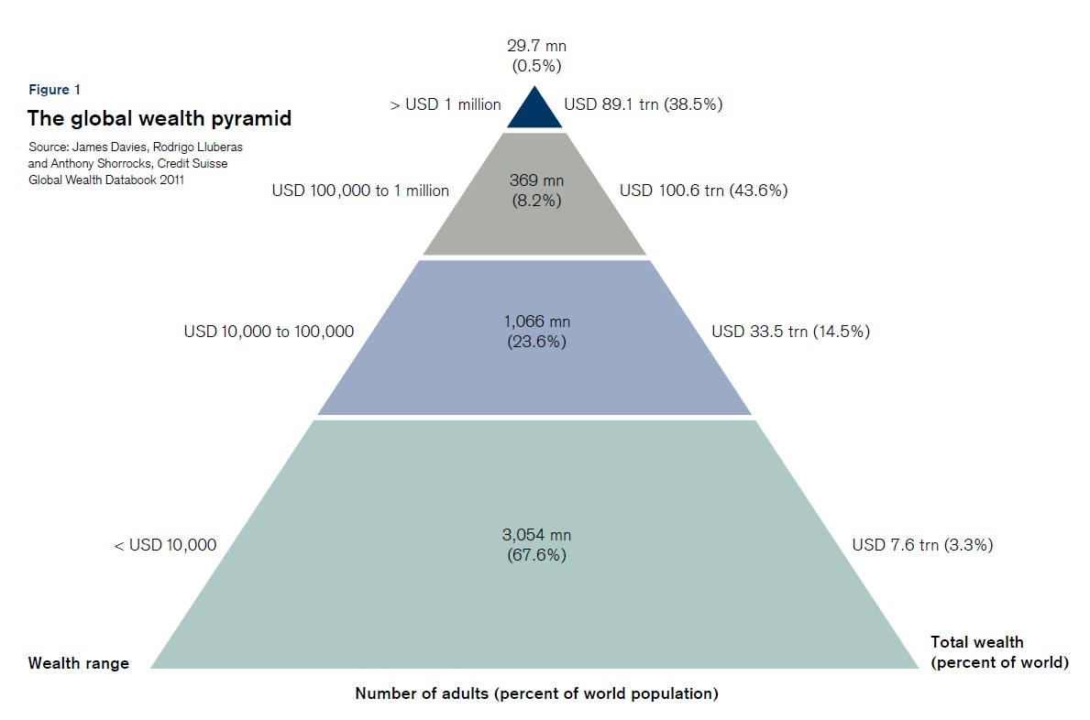
What Inequity Looks Like

Slide 7
Summary
Once again, the issue is not that inequity exists but rather that the amplitude of the inequity is enormous (and getting larger)
However, bubble collapse now gives us a second chance to behave differently → which do we value more – personal wealth or global equity?

