Slide 1
Regional Climate Impacts
Highlights (lowlights?) for the US

Slide 2
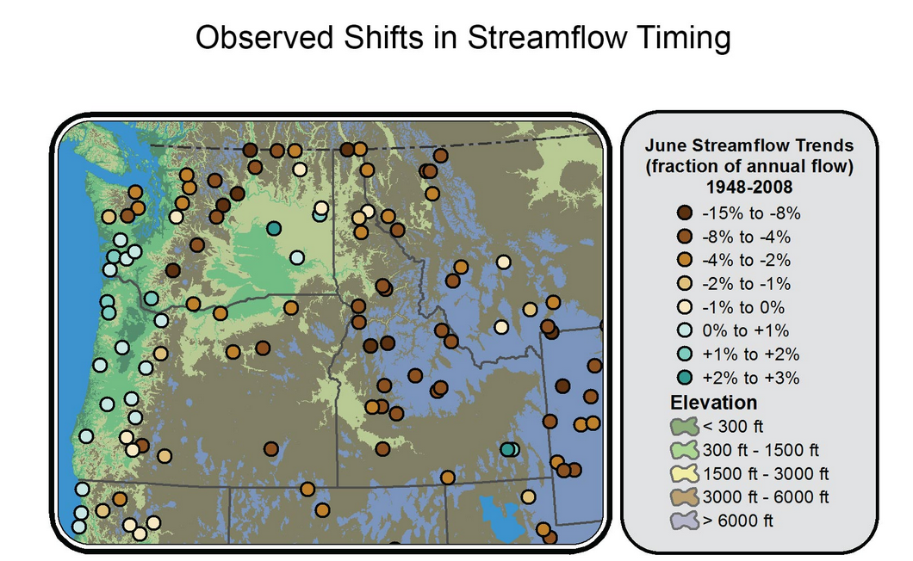

Slide 3
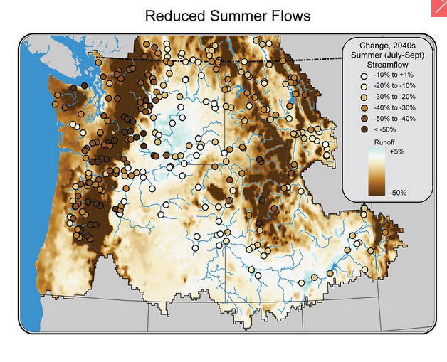

Slide 4
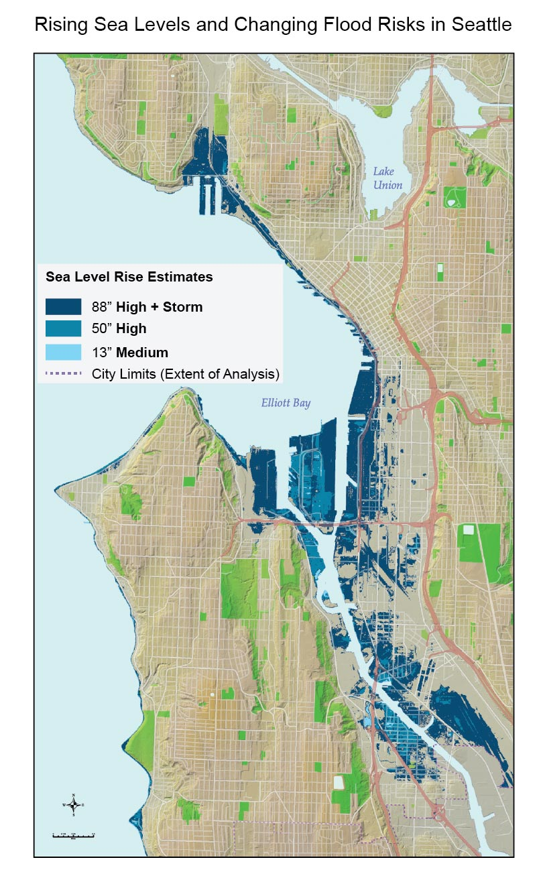
Areas of Seattle projected by Seattle Public Utilities to be below sea level during high tide (Mean Higher High Water) and therefore at risk of flooding or inundation are shaded in blue under three levels of sea level rise,⁵⁶ assuming no adaptation. (High [50 inches] and medium [13 inches] levels are within the range projected for the Northwest by 2100; the highest level [88 inches] includes the compounding effect of storm surge, derived from the highest observed historical tide in Seattle⁵⁷). Unconnected inland areas shown to be below sea level may not be inundated, but could experience problems due to areas of standing water caused by a rise in the water table and drainage pipes backed up with seawater. (Figure source: Seattle Public Utilities⁵⁸).

Slide 5
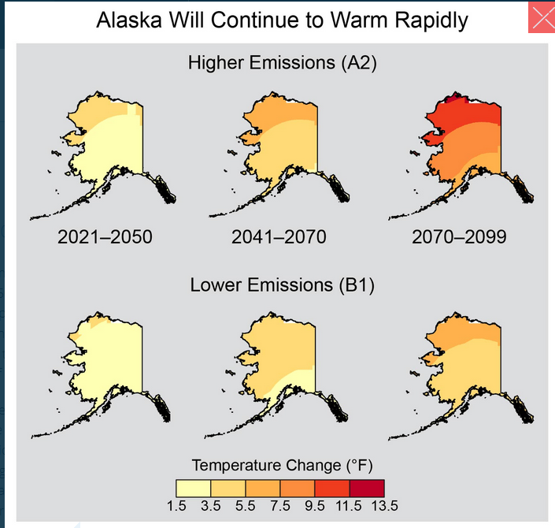

Slide 6
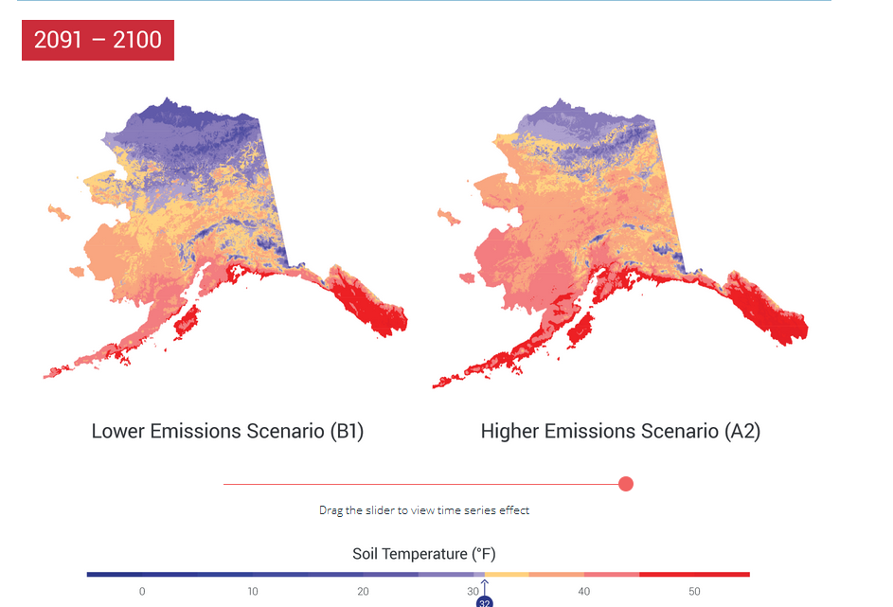
Large, catastrophic, methane release

Slide 7
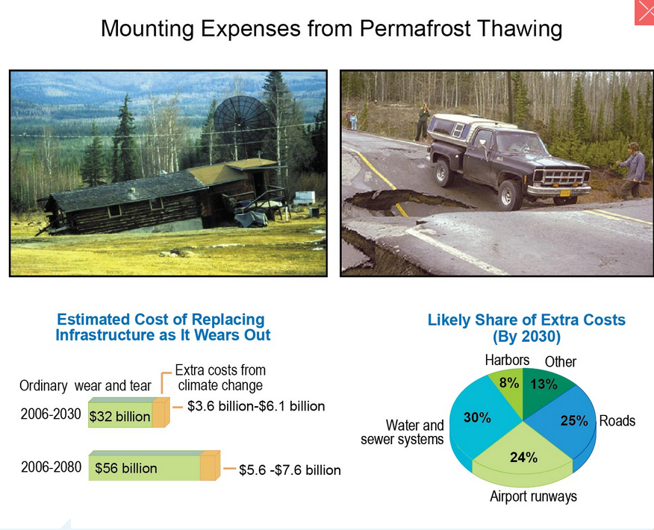
Much foundational support vanishes

Slide 8
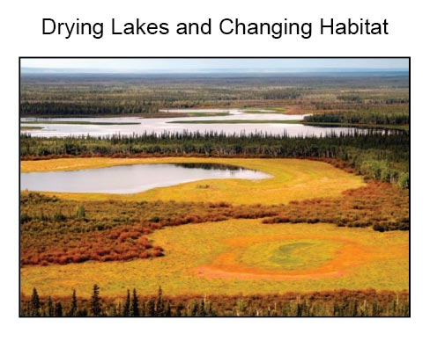
Wholesale Ecosystem Change
Progressive drying of lakes in northern forest wetlands in the Yukon Flats National Wildlife Refuge, Alaska. Foreground orange area was once a lake. Mid-ground lake once extended to the shrubs.

Slide 9
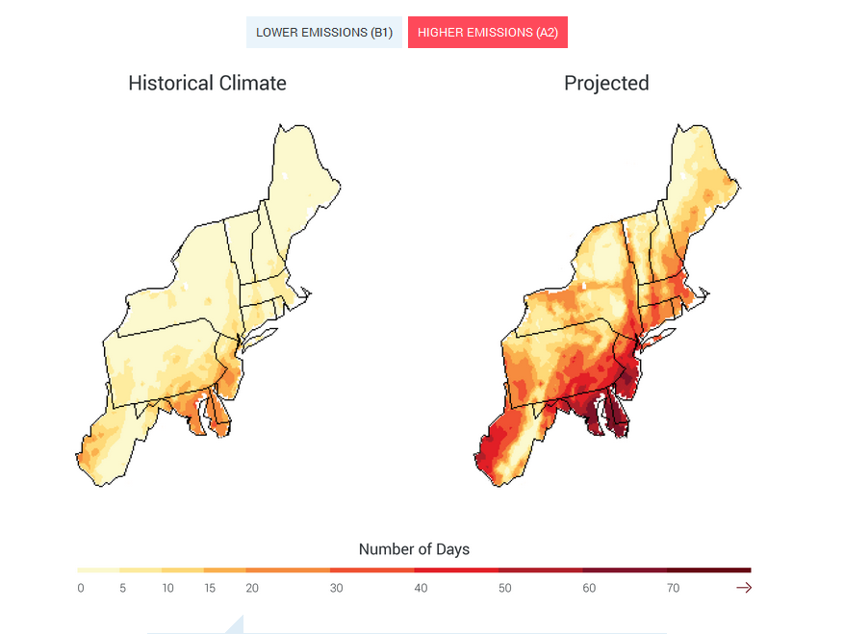
Death by Heat Wave

Slide 10
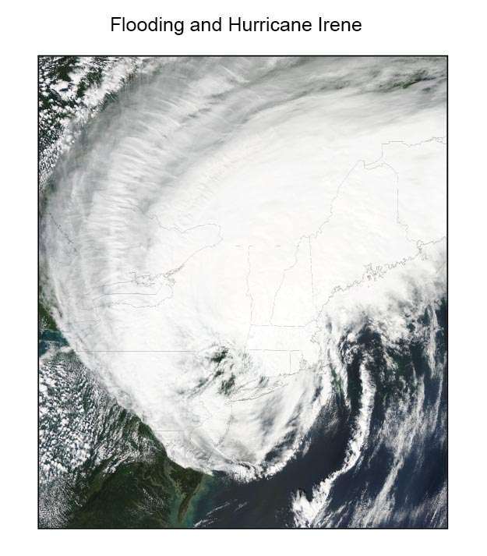
Hurricane Irene over the Northeast on August 28, 2011. The storm, which brought catastrophic flooding rains to parts of the Northeast, took 41 lives in the United States, and the economic cost was estimated at $16 billion

Slide 11
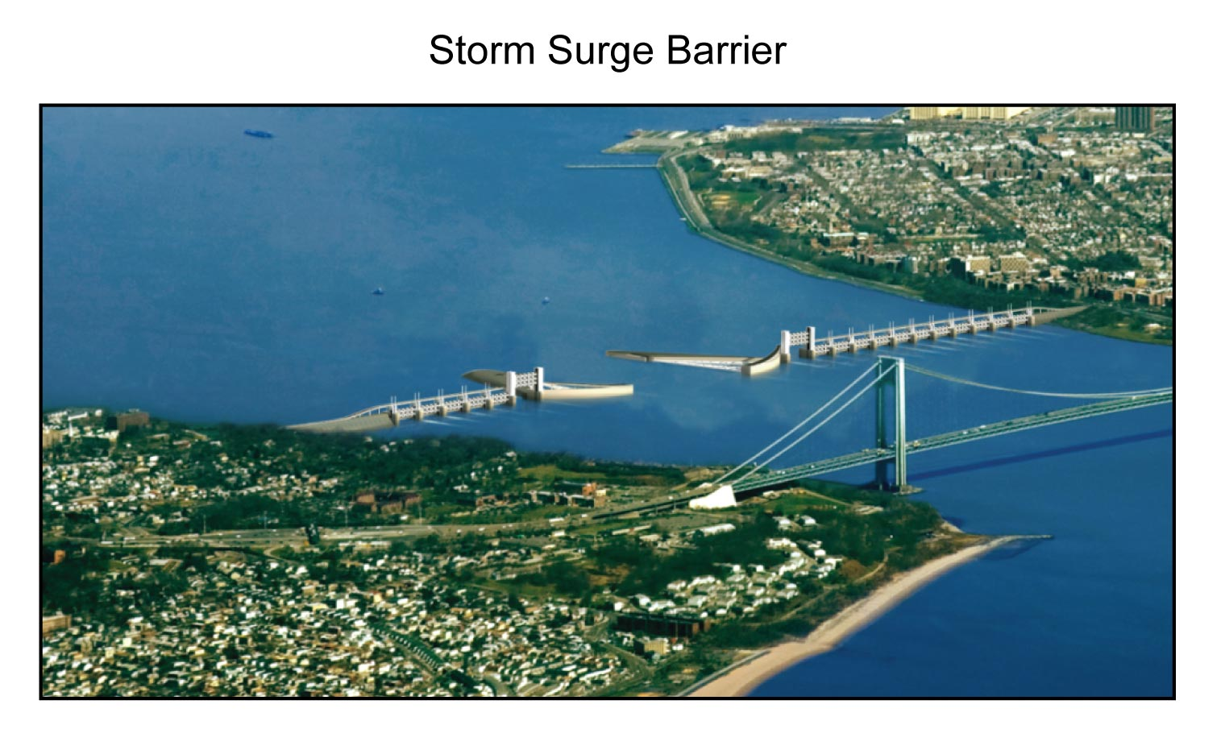
Hypothetical Mitigation

Slide 12
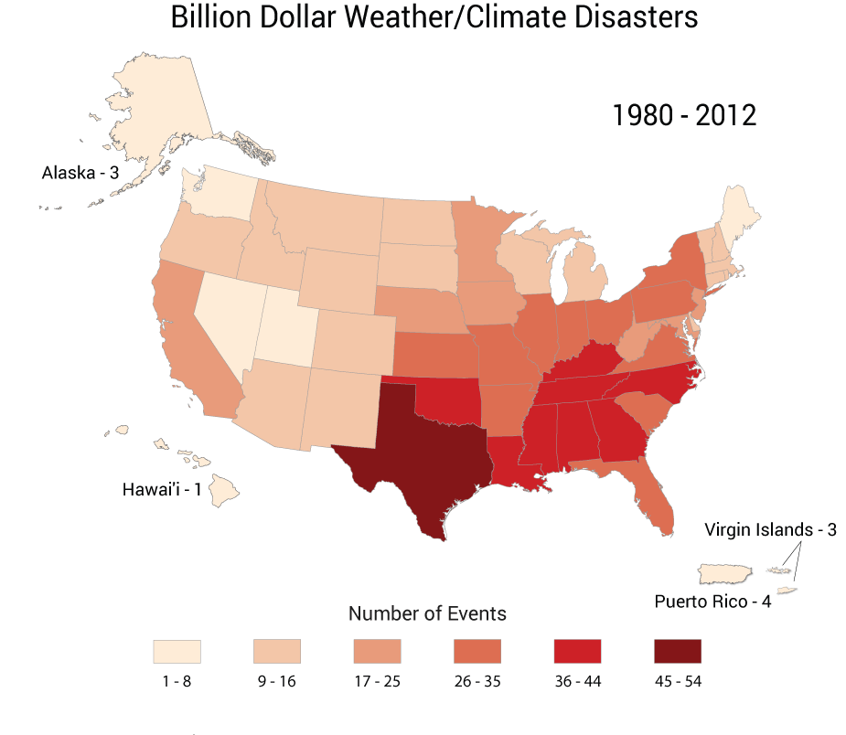
Climate
Change
Refugees
The Disaster Oval

Slide 13
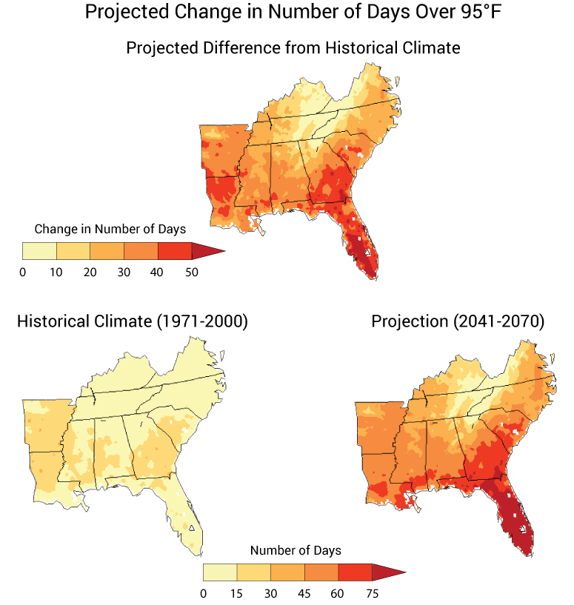
More Death by Heat Wave

Slide 14
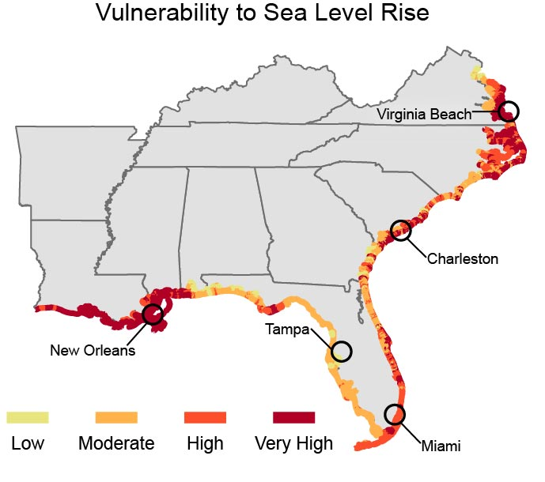

Slide 15
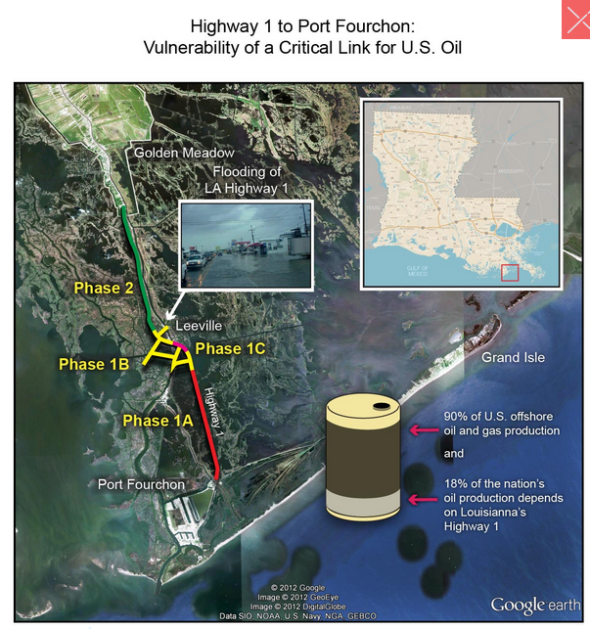
Significant Economic Disruption

Slide 16
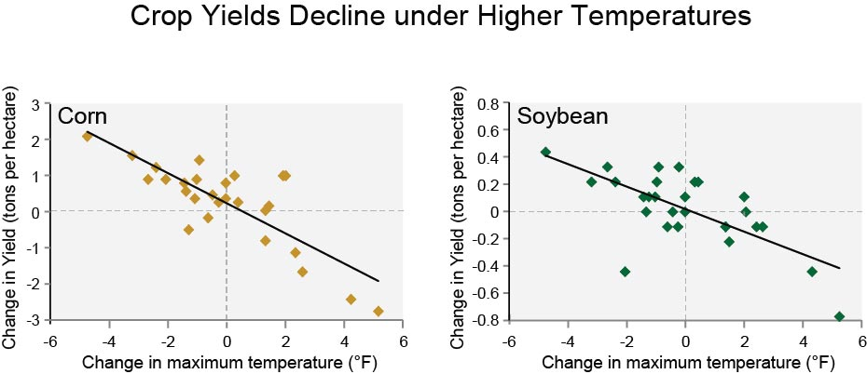
More Disruption

Slide 17
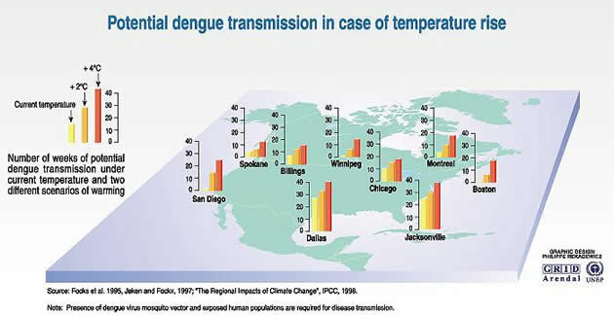
Public Health Impact!!

Slide 18
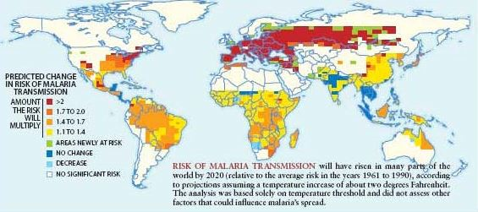
The World becomes more Tropical

