Slide 1
Homework 3 Responses
Stare at the black cross
This was meant to give you practice with data management/mining given a non ideally formatted input data structure and to prove that counting is hard

Slide 2
Hurricane Frequency

Slide 3
Double counting – counting is hard

Slide 4
Counting time steps, not unique IDs!

Slide 6
Less meaningful – scientific insight important – hurricane years are generally correlated and not independent

Slide 7
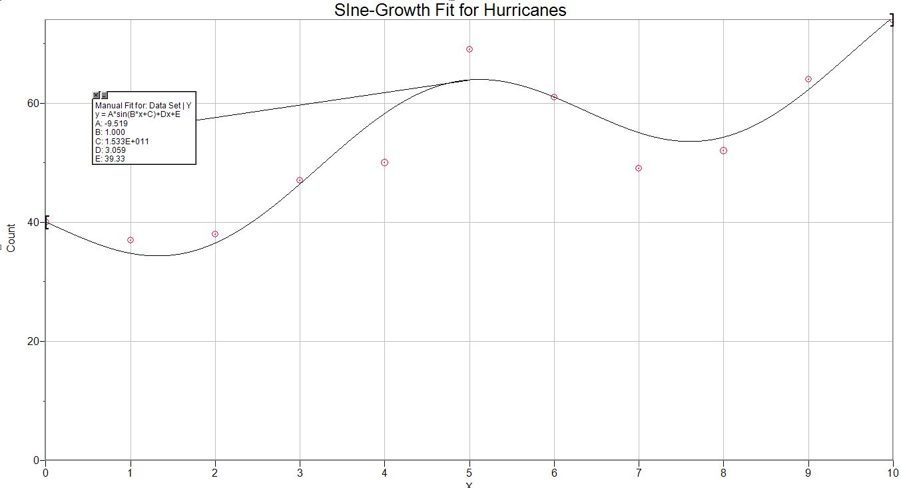
Future Hurricanes

Slide 8
Minimum pressures – over resolution – histograms should be smooth

Slide 9
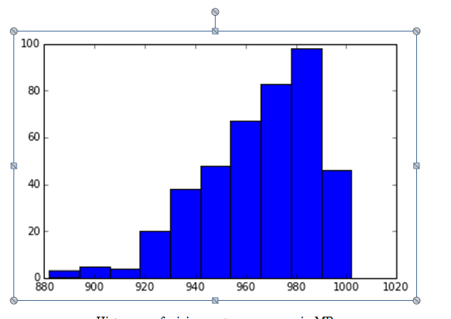
Maybe oversmoothed?

Slide 10
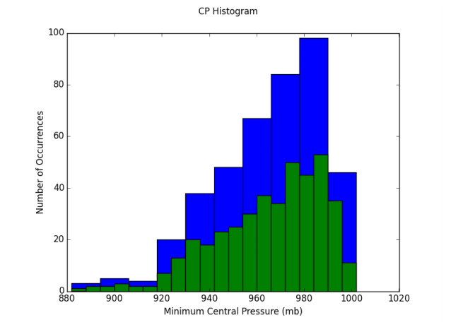
Nice
Why is an average and standard deviation for this distribution not meaningful?
How would you define a strong vs weak hurricane from this distribution?

Slide 11
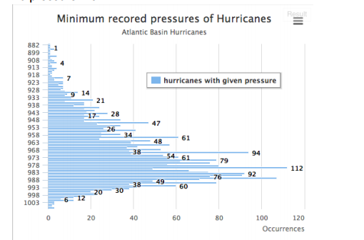
An Alternative View

Slide 12
Spin Up times
Let's define a standard of 1000 MB and a "hurricane threat" level of 970 mb. Calculate the "spin up time" (the time it takes to go from 1000 MB to 970 MB) for each storm
These directions usually were not followed – what is this asking you to do with the data?
The spinup time for a hurricane is defined to be the amount of time that it takes a hurricane’s central pressure to drop from 1000 mb to 970 mb. I noticed that there were very few hurricanes that ever had a central pressure as high as 1000 mb so I wrote some code to count the number of hurricanes that did have a central pressure at or above 1000 millibar and only found 16

Slide 13
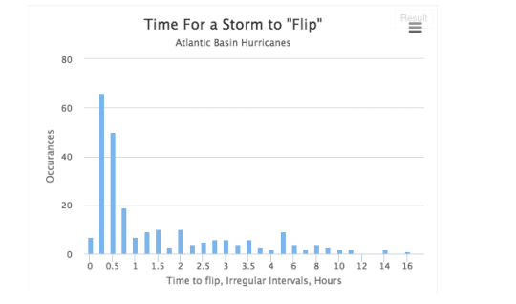
Part of this Class it have you practice with project Time Management.
What is a time step?
SIX HOURS

Slide 14
What does this suggest?

Slide 15
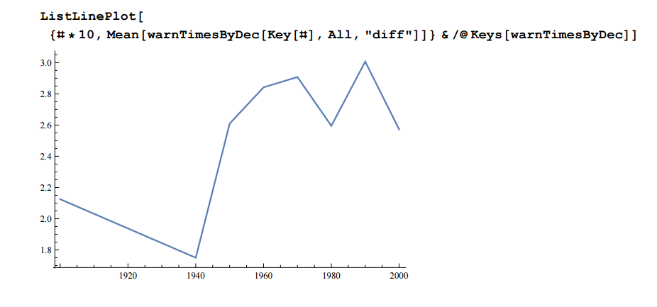
Per Decade

Slide 16
Cat 3+

Slide 18
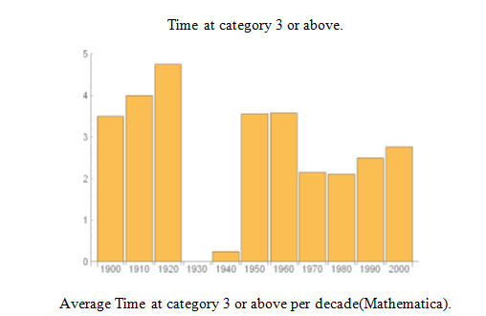

Slide 19
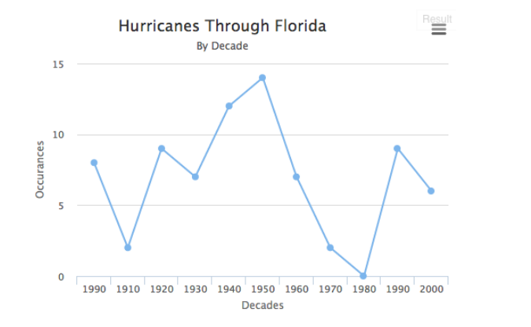
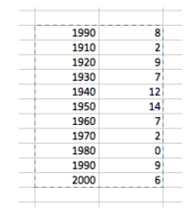
Florida

Slide 21
What does this tell you?

Slide 24
Many Counting Problems

Slide 25
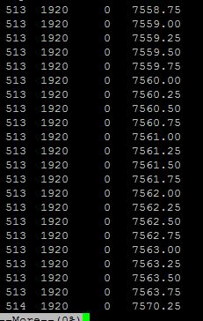
Code to Produce a new data file
I could have filtered on “0” pressure but that would have reduced the actual number of Hurricanes carried forward

Slide 26
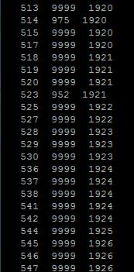
Next Pass produces initial “counting” file

Slide 27
Science
An example of science that is enabled by doing list management operations on data bases
Current project, track analysis of Atlantic Basic Hurricanes – all previous analysis is only for LANDFALL events.

Slide 29
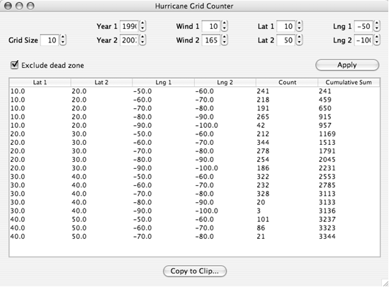

Slide 30
Frequency:
What detection efficiency improvement happened in 1950 relative to 1940?

Slide 31
Lots of Information!

Slide 32
Pressure analysis for strong storms < 965 mb; 2005 is dramatic!

Slide 33
New Important Result: Dynamics are changing; evolution is faster; KS TEST and CFDs!!

