Slide 1
Image Processing is replacing Original Pixels by new Pixels using a Transform
Origin
x
a
b
c
r
s
t
d
e
f
*
u
v
w
g
h
i
x
y
z
Original Image Pixels
Filter
Simple 3*3 Neighbourhood
e
3*3 Filter
e_{processed} = v*e + r*a + s*b + t*c + u*d + w*f + x*g + y*h + z*i
y
Image f (x, y)
The above is repeated for every pixel in the original image to generate the smoothed image

Slide 2
Smoothing Spatial Filters
One of the simplest spatial filtering operations we can perform is a smoothing operation
Simply average all of the pixels in a neighbourhood around a central value
Especially useful in removing noise from images
Also useful for highlighting gross detail
¹/₉ | ¹/₉ | ¹/₉
¹/₉ | ¹/₉ | ¹/₉
¹/₉ | ¹/₉ | ¹/₉
Simple averaging filter

Slide 3
Weighted Smoothing Filters
More effective smoothing filters can be generated by allowing different pixels in the neighbourhood different weights in the averaging function
Pixels closer to the central pixel are more important
Often referred to as a weighted averaging
¹/₁₆ | ²/₁₆ | ¹/₁₆
²/₁₆ | ⁴/₁₆ | ²/₁₆
¹/₁₆ | ²/₁₆ | ¹/₁₆
Weighted averaging filter

Slide 4
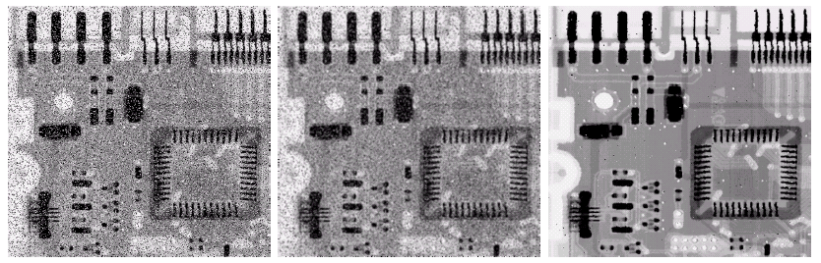
Averaging Filter Vs. Median Filter Example
Original Image With Noise
Image After Averaging Filter
Image After Median Filter
Filtering is often used to remove noise from images
Sometimes a median filter works better than an averaging filter
Images taken from Gonzalez & Woods, Digital Image Processing (2002)

Slide 5
First and Second Derivative are transformations
The 2nd derivative is more useful for image enhancement than the 1st derivative
Stronger response to fine detail
Simpler implementation

Slide 6
The Laplacian in 2D
The Laplacian is defined as follows:
where the partial 1st order derivative in the x direction is defined as follows:
and in the y direction as follows:

Slide 7
The Laplacian (cont…)
So, the Laplacian can be given as follows:
We can easily build a filter based on this
0
1
0
1
-4
1
0
1
0

Slide 8
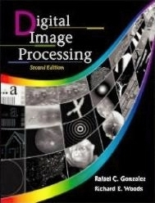
The Laplacian (cont…)
Applying the Laplacian to an image we get a new image that highlights edges and other discontinuities
Original Image
Laplacian Filtered Image
Laplacian Filtered Image Scaled for Display
Images taken from Gonzalez & Woods, Digital Image Processing (2002)

Slide 9
But That Is Not Very Enhanced!
The result of a Laplacian filtering is not an enhanced image
We have to do more work in order to get our final image
Subtract the Laplacian result from the original image to generate our final sharpened enhanced image
Laplacian Filtered Image Scaled for Display
Images taken from Gonzalez & Woods, Digital Image Processing (2002)

Slide 10
Laplacian Image Enhancement
-
=
Original Image
Laplacian Filtered Image
Sharpened Image
In the final sharpened image edges and fine detail are much more obvious
Images taken from Gonzalez & Woods, Digital Image Processing (2002)

