Slide 1
Clustering and randomness

Slide 2
Is this random?

Slide 4
Which side is randomly generated?
People Perceive Patterns easily in randomly generated data

Slide 5
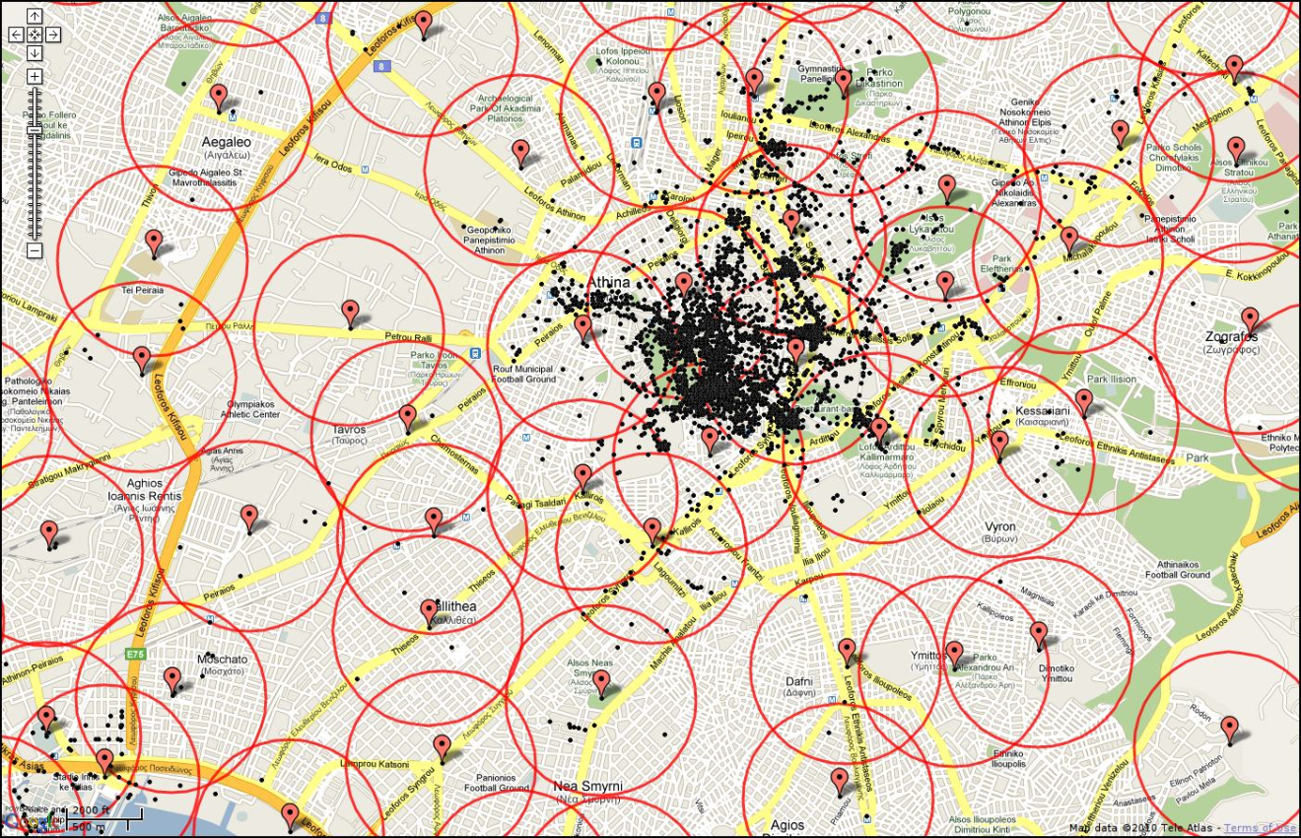
Clustering
Event density that occurs on different spatial scales.
Is there a characteristic scale?

Slide 7
K-Means clustering (data mining)
Code Example
Game of Life Example

Slide 8
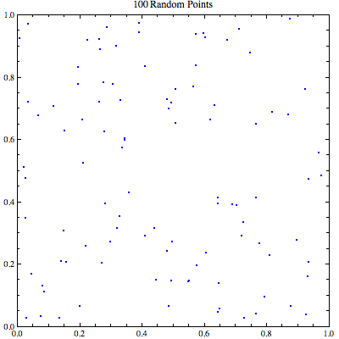

Slide 9
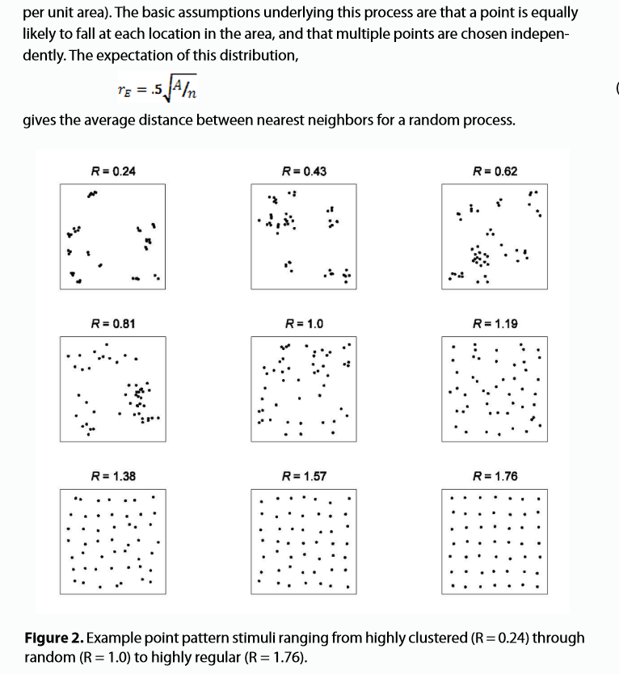

Slide 10
Sub-clustering – sub structure – expectation shapes …

Slide 11
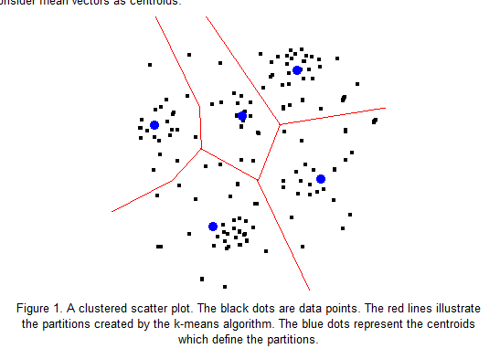
Centroid Approach

Slide 12
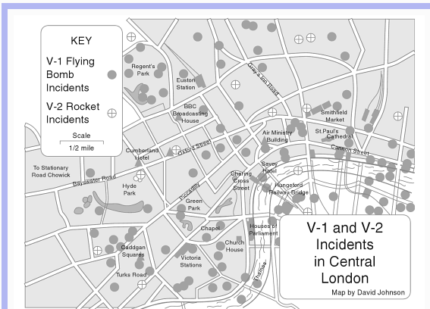
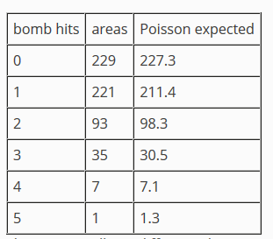
Bombs Per Grid

Slide 13
http://www.seas.upenn.edu/~ese502/NOTEBOOK/Part_I/3_Testing_Spatial_Randomness.pdf
http://www.colorado.edu/geography/class_homepages/geog_4023_s11/Lecture12_PointPat1.pdf
http://web.stanford.edu/class/cs345a/slides/12-clustering.pdf

