Slide 1
Data and Data Science
Some Final Thoughts

Slide 2
Scientific Programming
Basically always follows the same structure:
Formatted reading in of the data and convert to arrays (data initially is probably in an array)
Data sorting and possible reformat/transform
Looping through the data
Conditional If statements everywhere
Mathematical operations on pieces of the data – often calls to library subroutines
Output for analysis

Slide 4
Things you should now recognize after experiencing this “class”
Preparing raw data for analysis is a lot more time consuming than you think
Preparation is best done via formatted read and formatted write operations. Prepare subsets of data to operate on.
Always try to array the data
Attempt to write your own mathematical operation filters and not use “libraries”
Always keep track of local minimization when fitting data;

Slide 5
More things
Plot the data early and often – get a feeling for the noise.
Use powerful command line procedures for certain data sorts or global edits.
Build command line pipeline that produces a graphical output whenever your re-run code on data
Search for existing tools to adapt – especially for visualization needs
Practice, practice, practice; mistakes, mistakes, mistakes is the best way to learn.

Slide 6
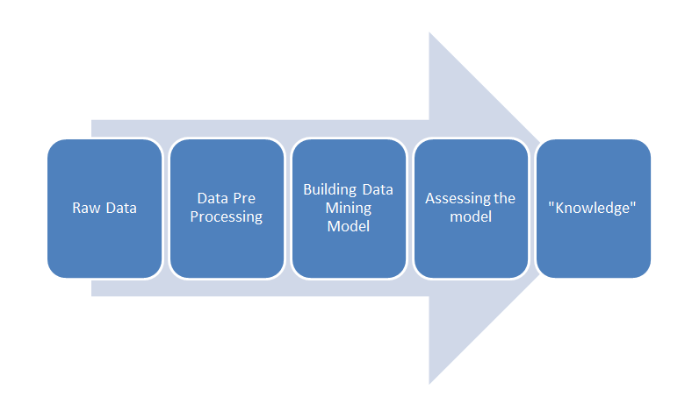
Data Mining
The third exercise in the last homework assignment is effectively a data mining exercise.
Find Global Max
Temp. Gradient

Slide 7
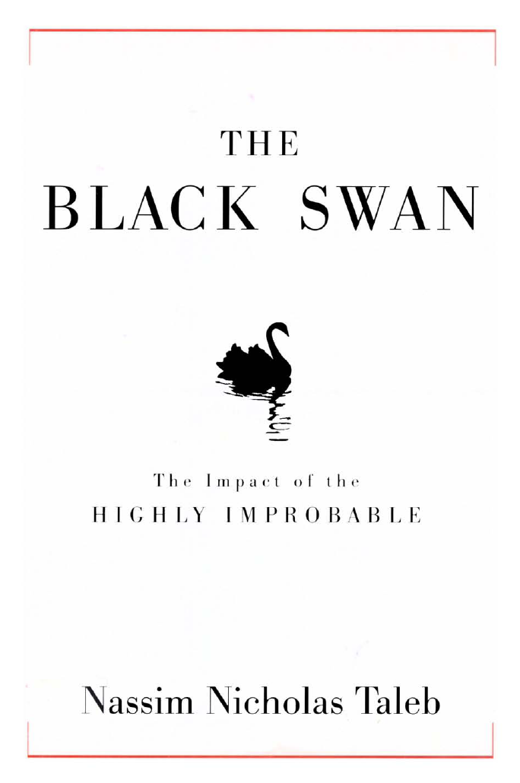
Books To Read

Slide 8
So you wanna be a data scientist?

Slide 9
Skills Needed (adapted from Burtch Works Executive Recruiting)
Python Easily Trumps R

Slide 10
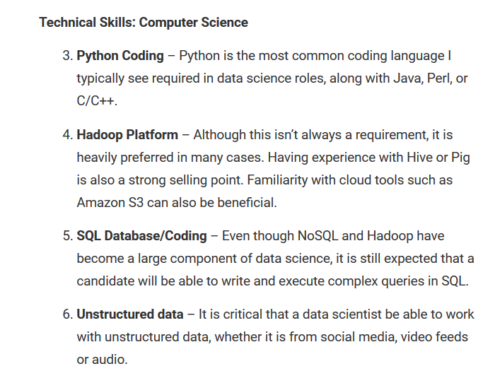

Slide 11
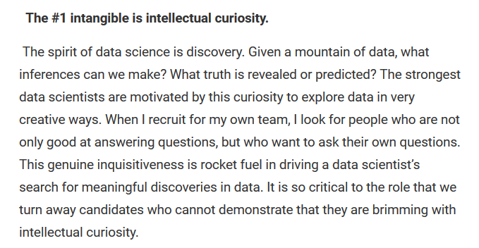

Slide 13
How to practice:

Slide 14
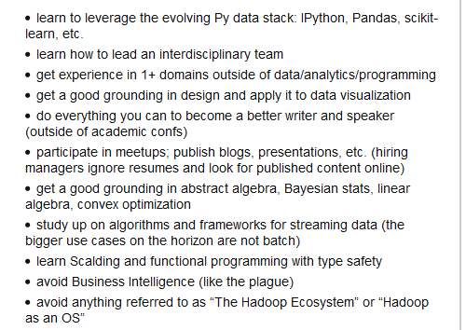
Advice from Paco Nathan (google him)
Scalding: https://github.com/twitter/scalding/wiki/Getting-Started

Slide 15
Summary
We didn’t hold your hand and teach you specific code for a reason → that won’t help you – you can either be pissed off at that or realize that to make progress you have to go forth and practice.
Your career as a data scientist is much more probable than that as a physicist → either your believe that or you don’t

