Slide 1
Data Science/Data Scientist
What are the components?

Slide 2
A scientifically trained person who explores all the dimensions of the data in an open ended way far better than a computer scientists elegant algorithmic approach; better at writing data exploration and representation code than any discipline based scientist.

Slide 6
Some Data Science Principles
Data is dirty, deal with it
Data wrangling/management > 70% of time on project.
Employ curiosity, empiricism, skepticism.
A tool exists → find it and customize it
Build your engine and use HPC to run lots of combinations fast. Don’t worry about being “clever” up front. Make mistakes fast.

Slide 8
Things you know
Questions to ask questions your not asking
Things you don’t know
Data Intelligence
Data Discovery

Slide 10
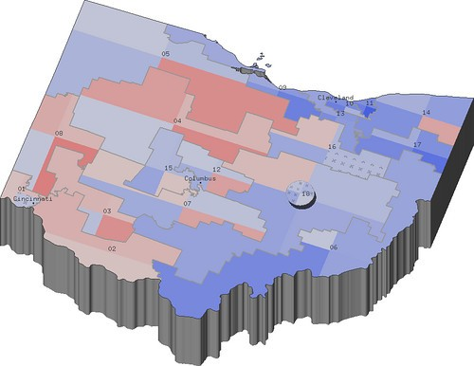
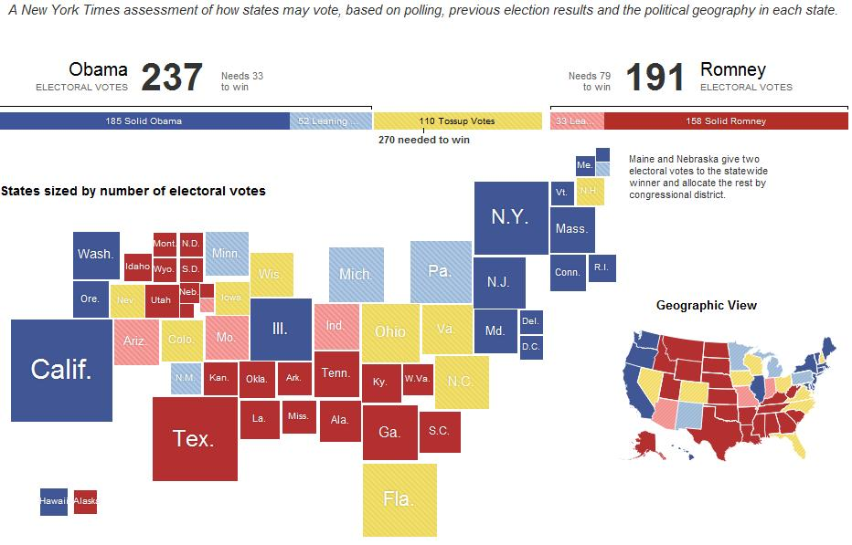
Jeff Hammerbacher’s Model
1. Identify problem
2. Instrument data sources
3. Collect data
4. Prepare data (integrate, transform, clean, ﬁlter, aggregate)
5. Build model
6. Evaluate model
7. Communicate results

Slide 11
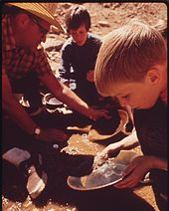
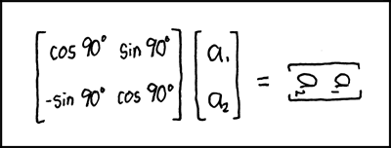
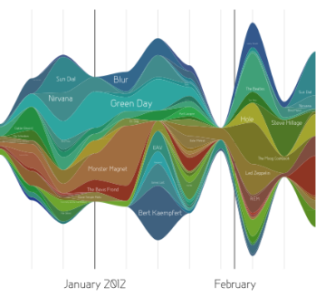
Data Scientist’s Practice
Clean,
prep
Hypothesize Model
Large Scale Exploitation
Digging Around in Data
Evaluate Interpret

Slide 12
What’s Hard about Data Science
Overcoming assumptions
Making ad-hoc explanations of data patterns
Overgeneralizing
Communication
Not checking enough (validate models, data pipeline integrity, etc.)
Using statistical tests correctly
Prototype to Production transition
Data complexity and pipeline step processing – when is human vetting needed?
Notes:
Quote from paper “I’d rather the data go away than be wrong and not know”
Assumptions not communicated: transformations not documented.

Slide 13
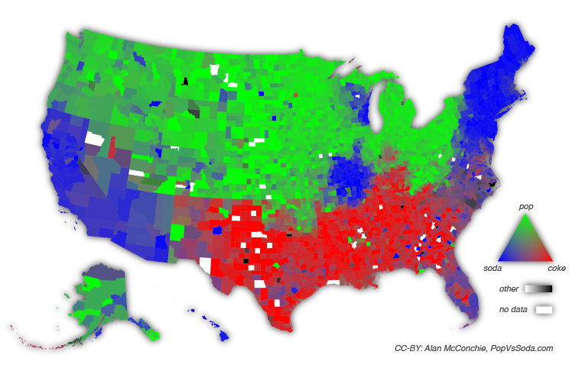
Visually Represent Data in Novel ways

Slide 14
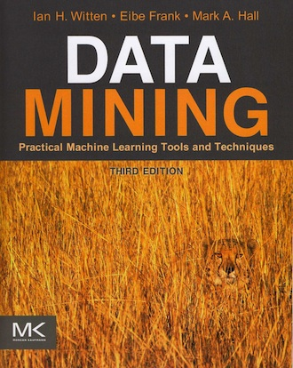
It can be easy to fool yourself!
Human beings are really good at pattern detection...
Perhaps a bit too good!
http://en.wikipedia.org/wiki/Cydonia_(region_of_Mars)

Slide 15
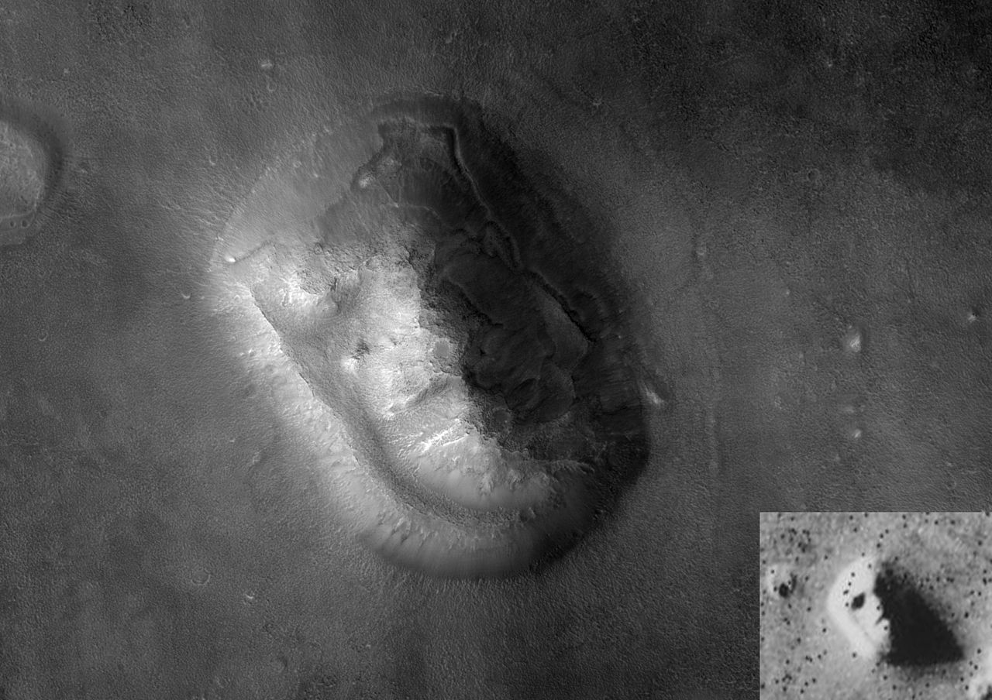
It can be easy to fool yourself!
http://en.wikipedia.org/wiki/Cydonia_(region_of_Mars)

Slide 16
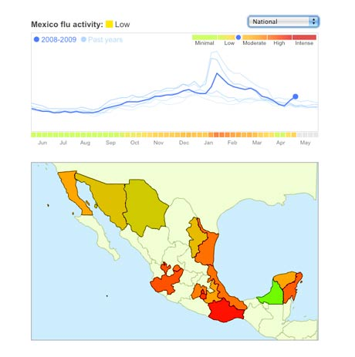
Data Science: Why all the Excitement?
e.g.,
Google Flu Trends:
Detecting outbreaks
two weeks ahead
of CDC data
New models are estimating which cities are most at risk for spread of the Ebola virus.

Slide 17
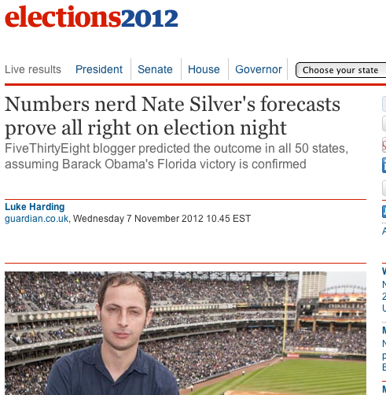
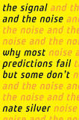
Why the all the Excitement?

Slide 18
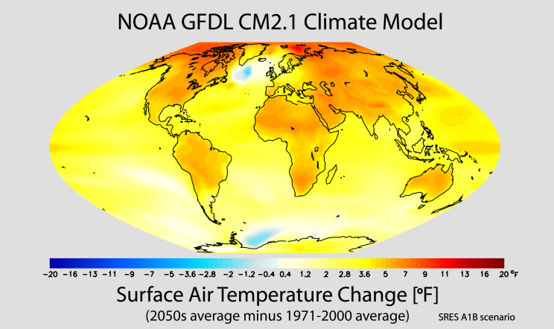
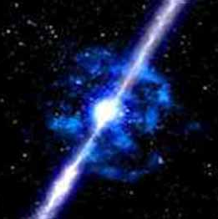
Contrasts
Image
General purpose classifier
Supernova
Not
Nugent group / C3 LBL
Scientific Modeling
Physics-based models
Problem-Structured
Mostly deterministic, precise
Run on Supercomputer or High-end Computing Cluster
Data-Driven Approach
General inference engine replaces model
Structure not related to problem
Statistical models handle true randomness, and unmodeled complexity.
Run on cheaper computer Clusters (EC2)
Notes:
ACID = Atomicity, Consistency, Isolation and Durability
CAP = Consistency, Availability, Partition Tolerance

Slide 19
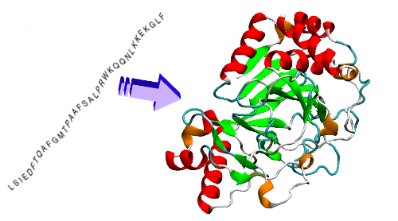
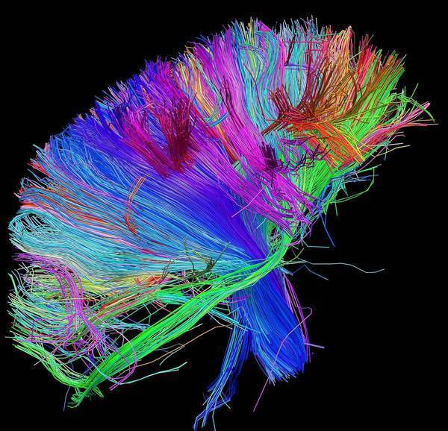
Computational Science
Brain Mapping: Allen Institute, White House, Berkeley
CASP: A Worldwide, Biannual Protein Folding Contest
Techniques (Massive ML)
Principal Component Analysis
Independent Component Analysis
Sparse Coding
Spatial (Image) Filtering
Quark
Rich, Complex Energy Models
Faithful, Physical Simulation
Raptor-X
Data-intensive, general ML models
Feature-based inference
Conditional Neural Fields
Notes:
CASP - Critical Assessment of protein Structure Prediction

