Slide 1
The El Nino Time Series
A classically difficult problem because of nested features and different time scales

Slide 2
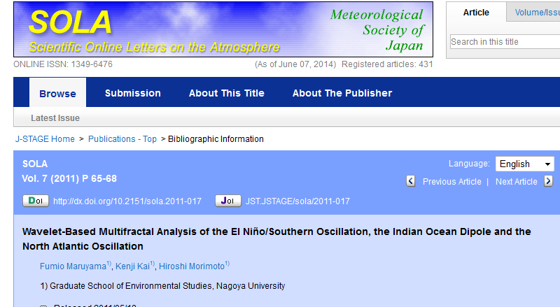
Some Brave Attempts

Slide 3
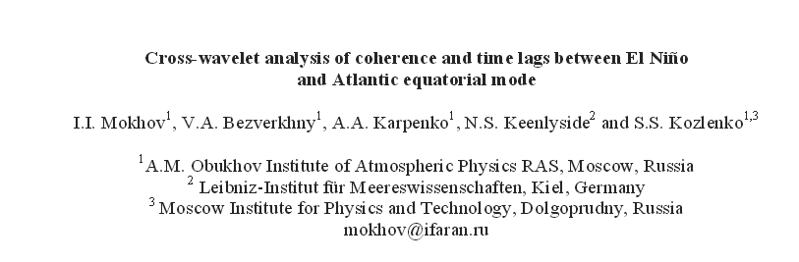
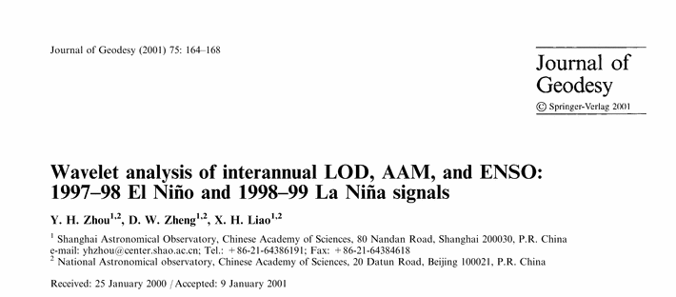

Slide 4
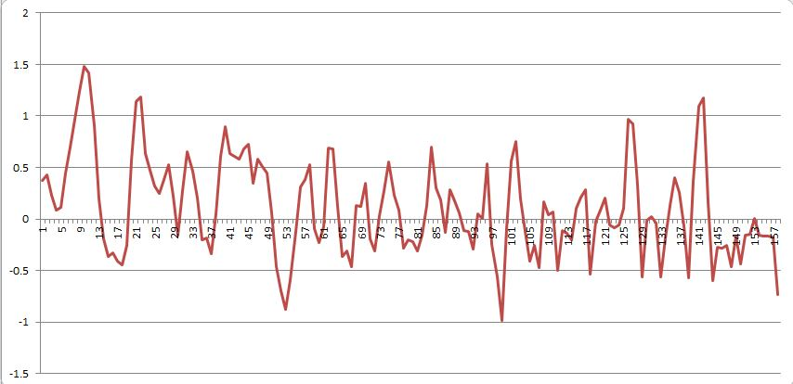
Why the problem is difficult:
Let’s look at the data – what can we notice? (there are 3 main “features/problems”)

Slide 5
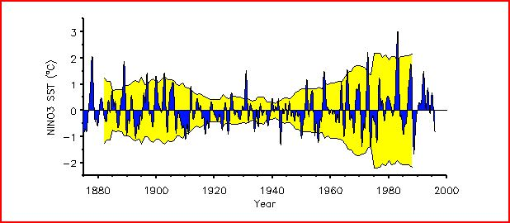
Variance analysis (15 years)

Slide 6
Raw + 10 year window

Slide 7
Raw + 15 year variance window

Slide 8
Variance = 15; Smooth = 3
problem

Slide 9
Smooth = 5; Variance = 15

Slide 10
Local Minimums abound
Because of these nested features, no convergence will occur when trying to fit the time series to “harmonics” – no matter how many iterations you run. Multiple solutions are all equally good/poor fits to the sequence.
In the real world, this is why there is little predicative power for El Nino/La Nina.

Slide 11
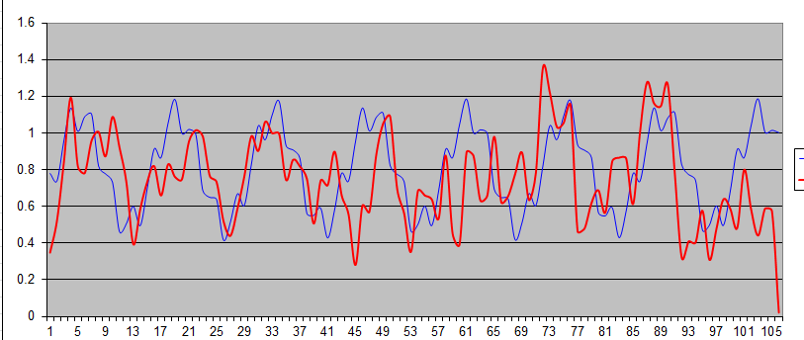
My best attempt
Where is fit maximally bad?
Ignore the first 50 years; note zp shift for χ²
P1 = 14 yrs; p2 = 3 yrs; phase shift= 3 yrs.
Amplitude ratio = 5

Slide 12
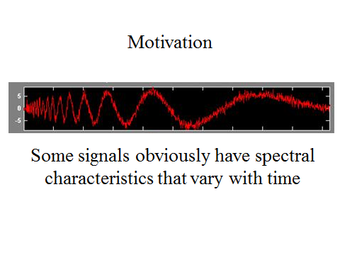
Wavelet Analysis

Slide 13
Criticism of Fourier Spectrum
It’s giving you the spectrum of the
‘whole time-series’
Which is OK if the time-series is stationary
But what if its not?
We need a technique that can “march along” a timeseries and that is capable of:
Analyzing spectral content in different places
Detecting sharp changes in spectral character

Slide 14

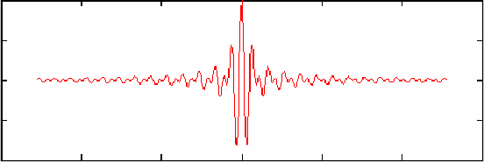
Fourier Analysis is based on an indefinitely long cosine wave of a specific frequency
time, t
Wavelet Analysis is based on an short duration wavelet of a specific center frequency
time, t

Slide 15
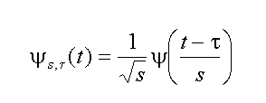
Wavelet
A mother wavelet is the basic shape function that can be stretched in various ways
normalization
shift in time
change in scale:
big s means long wavelength
wavelet with
scale, s and time, τ
Mother wavelet

Slide 16
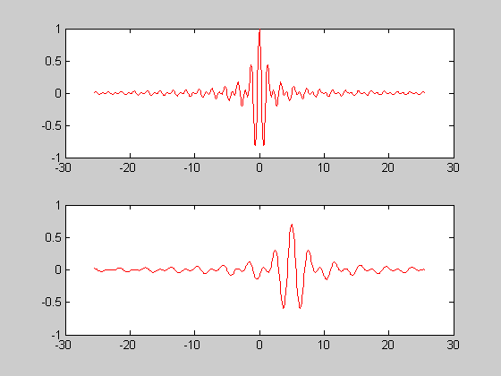
Shannon Wavelet
Ψ(t) = 2 sinc(2t) – sinc(t)
mother wavelet
τ=5, s=2
Stretched wave form
time

Slide 17
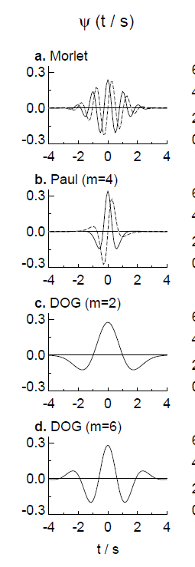
The wavelet transform can be used to analyze time series that contain non-stationary power at many different frequencies (Daubechies 1990).

Slide 18
In essence, the coefficients at a fixed scale, s, can be thought of as a filtering operation (high pass, low pass, etc) γ(s,τ) = ∫ f(t) Ψ[(t-τ)/s] dt = f(τ) * Ψ(-τ/s) where the filter Ψ(-τ/s) has a band-limited spectrum, so the filtering operation is like applying a bandpass filter to various parts of the time series.
This works best when the appropriate mother wavelet is used

Slide 19
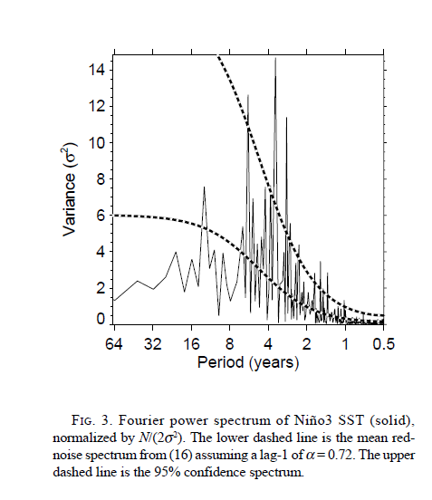

Slide 20
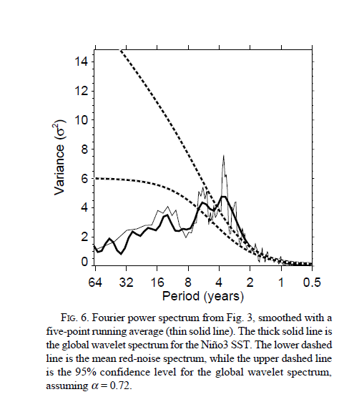
Y-axis is measure of total power at some frequency (time scale)
Fundamental period is 3-7 years; no better discrimination is possible

Slide 21
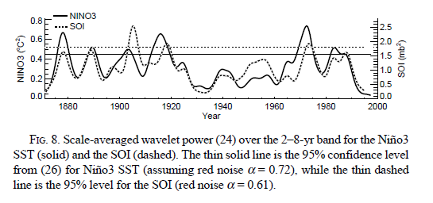
Best transform representation
The obvious period of suppression is strange and recent post 2000 data is consistent with the planet entering a new 40 year period of suppression.

Slide 22
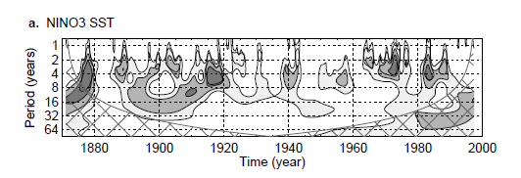
“4 Year” period is dominant but not continuous
Emergence of long period behavior?

