Slide 1
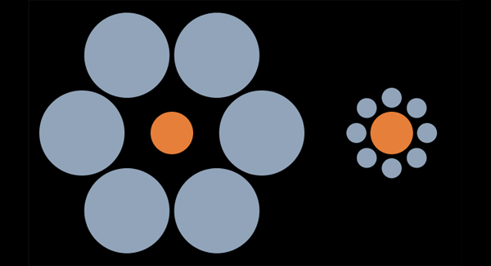
Homework 1
Generally done well – but remember all is an illusion

Slide 2
Convert x,y,z to 2D array of intensity values
There are many ways to do this but all are operationally the same that involve two loops (for loop, do loop, etc)
Always do code tests on small pieces of the data. (like turn the first 100 lines into 10x10 array)

Slide 3
C++

Slide 4
Fortran Loops (similar in Python)

Slide 5
Reshape function in Python

Slide 6
Array of Values
Best way to actually report 100x100 = 1000 values is via EXCEL

Slide 7
Byte Array to Image
Why?

Slide 8
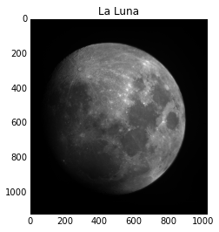
Need to get X and Y correct

Slide 9
Paving the Moon

Slide 10
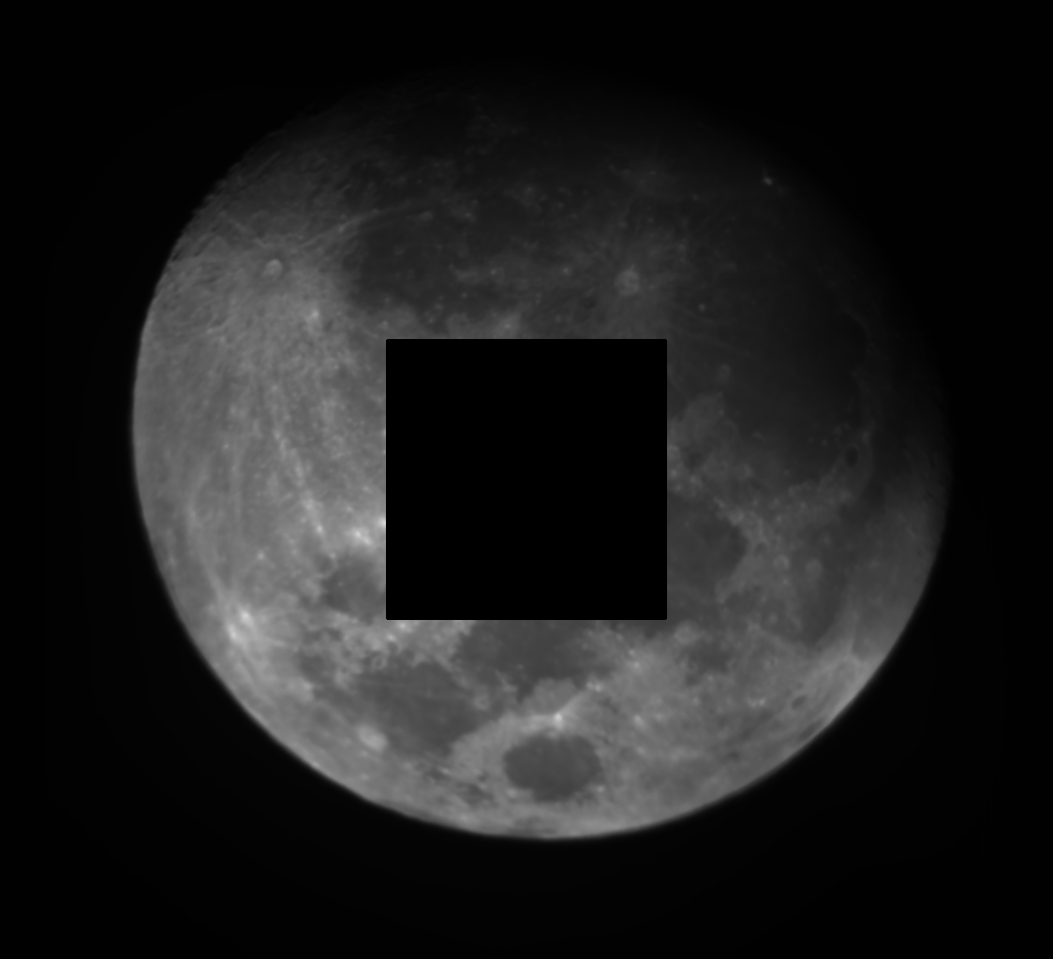

Slide 11
Cheating ☺

Slide 12
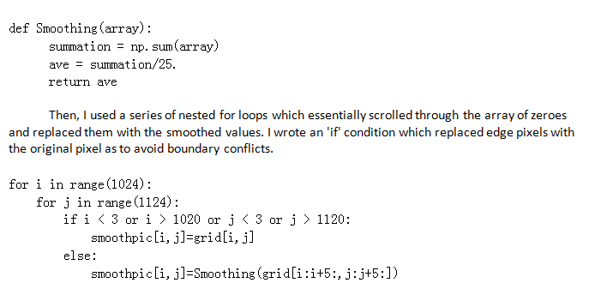
Smoothing Filters

Slide 13
Fortran

Slide 14
Done in C

Slide 15
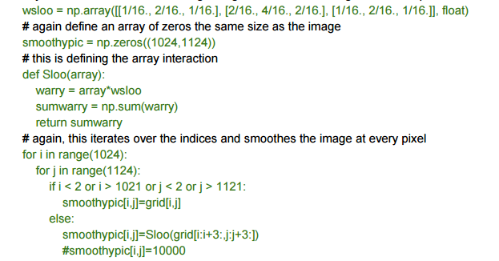
3x3 weighted

Slide 16
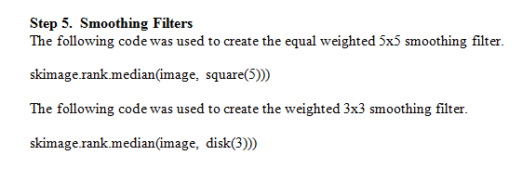

Slide 17
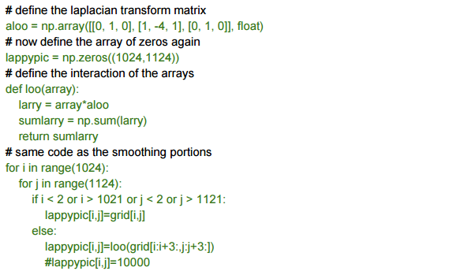
La Place

Slide 18
Assorted Nonsense

