Slide 1
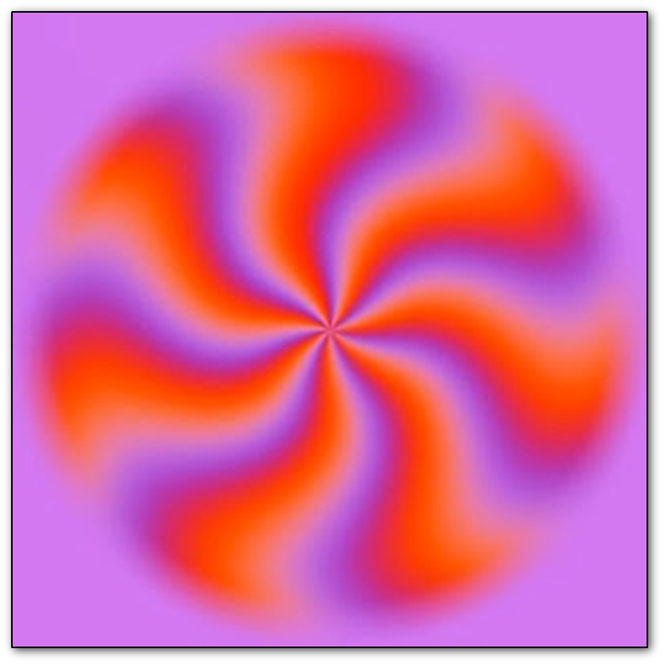
HW 2 Discussion
Remember, everything is still an illusion

Slide 2
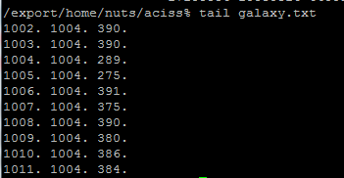
Stars.txt and Galaxy.txt
First thing to do is to understand the structure of the two files. THEY ARE NOT THE SAME
Stars.txt is the same as moon.txt
Galaxy.txt is in a slightly different 2D format:

Slide 3
Read Original.txt file in python

Slide 4
Find the Stars
This is about finding local maxima in a 2D array
http://stackoverflow.com/questions/3684484/peak-detec tion-in-a-2d-array
http://stackoverflow.com/questions/16842823/peak-detection-in-a-noisy-2d-array
http://www.mathworks.com/matlabcentral/fileexchange/37388-fast-2d-peak-finder
http://scikit-image.org/docs/dev/api/skimage.feature.html
http://www.filipekberg.se/2014/02/10/understanding-peak-finding/

Slide 5
What does the data actually look like in the Array?
USE MEDIAN FILTERING TO FIND THE LOCAL PEAKS BECAUSE ITS VALUE IS MUCH HIGHER THAN MEDIAN – OR USE RANKS. THE POINT IS THAT MAXIMUM IN THIS DATA ARE DEFINED BY A SINGLE PIXEL VALUE AND NOT A REGION (UNLESS THE STARS ARE SATURATED ON THE DETECTOR IN WHICH CASE THEY ARE JUNK DATA

Slide 6
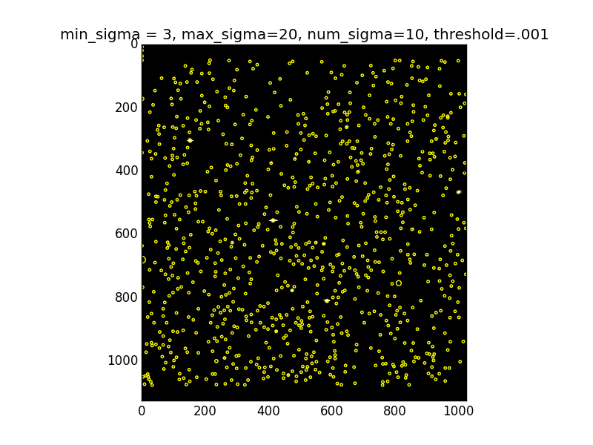
You have to think a bit about the data as well
Its easy to find too many “stars” in this data file:

Slide 8
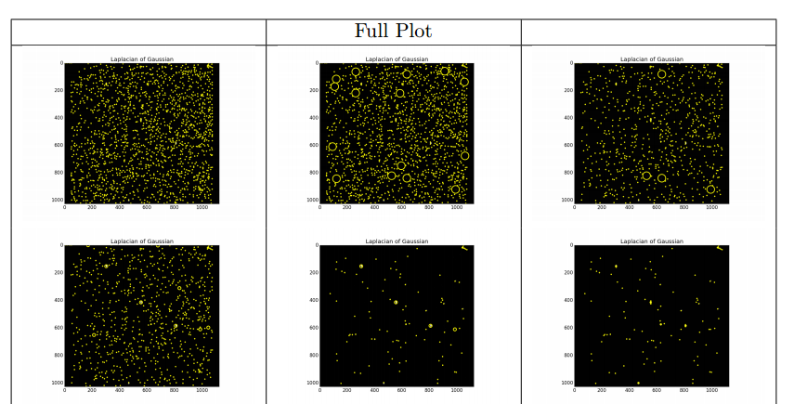
Real Stars + Defects – need physically sensible threshold - experiment

Slide 9
Contrast Adjusting – not all those faint things might be stars ….

Slide 10
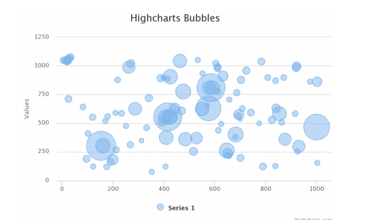
Bubble Chart – what “problem” does this indicate?

Slide 11
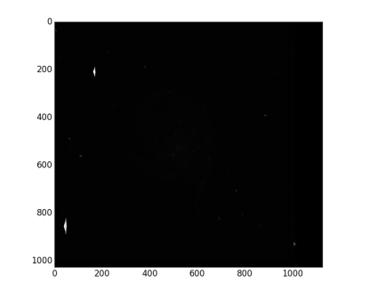
What the galaxy should look like in sensible lookup table

Slide 13
Luminosity Profile

Slide 14
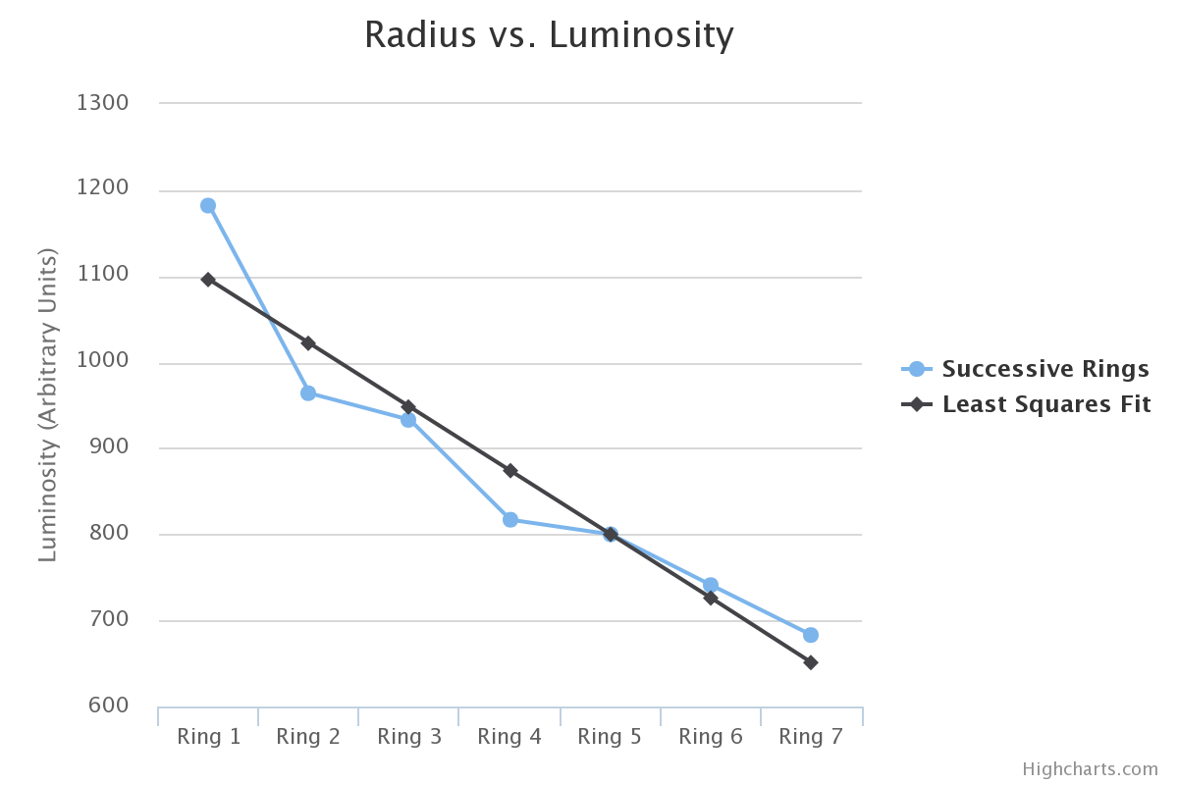
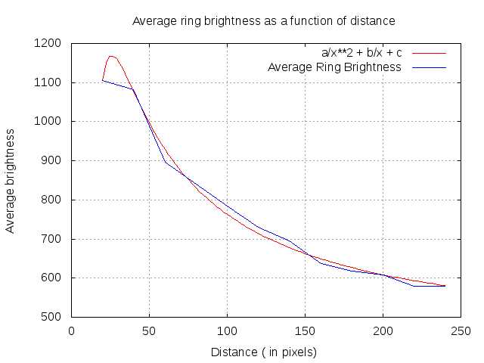
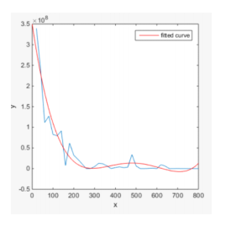
Calibration errors?

Slide 15
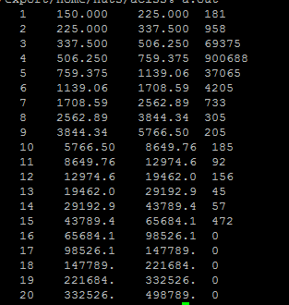
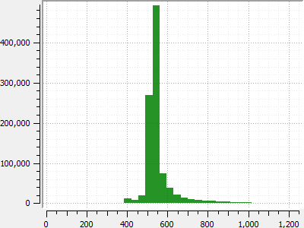
Histogram – Just Work with Raw Data – 105 million Pixels
What does this distribution tell you about your gray scale dynamic range?

Slide 16
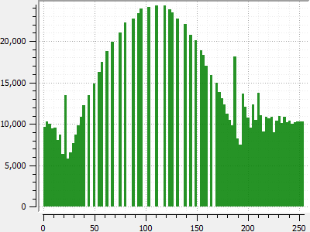
Histogram Equalization Stretch (how many pixels go into what bit ranges)

Slide 17
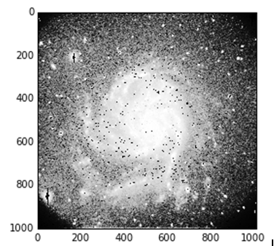

Slide 18
Make the Galaxy Disappear

Slide 20
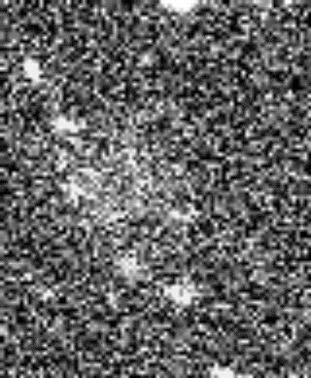
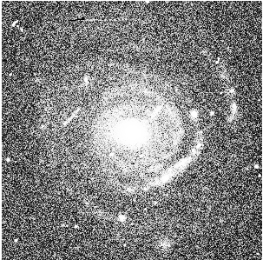
Low Surface Brightness Galaxies
Galaxies are extended objects imaged against the noise of the night sky

