Slide 1
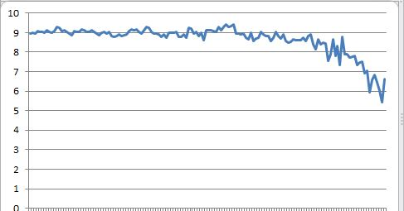
Raw data scaled to ymin=0 – Arctic Sea Ice Extent changes over the last 150 years

Slide 2
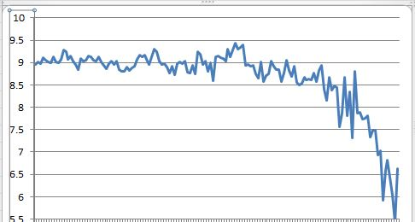
Fool the Public Scale as the public assumes bottom = 0

Slide 3
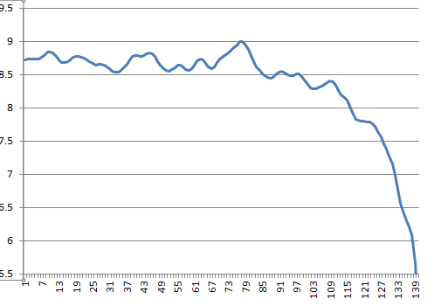
Gaussian Kernel Smoothing produces best wave form (with possible features in it)

Slide 4
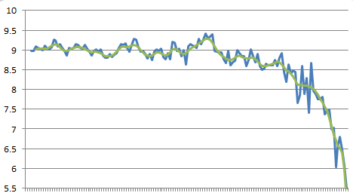
Exponential (Blue) (recent year weighted; k =.9) vs Gaussian Kernel(Green)

Slide 5
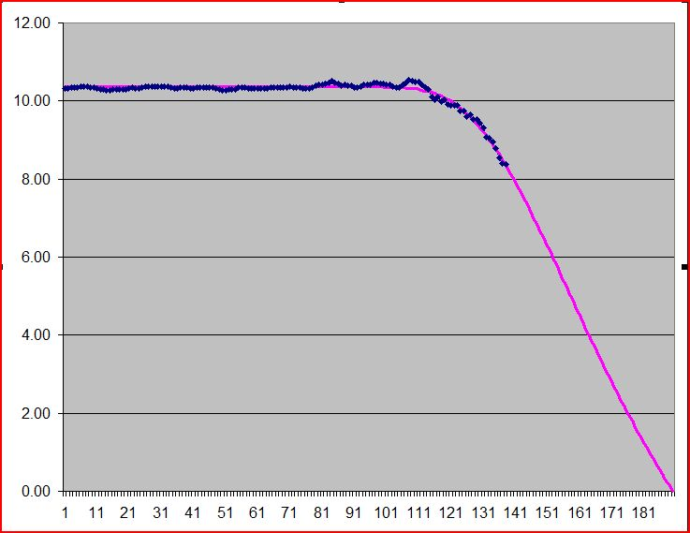

Seek “exponential cutoff” model
$$y=a−be^{{(−cx}^{d})}$$
A = 10.35
B = 17.46
C = 2.2E10
D =-4.69

Slide 6
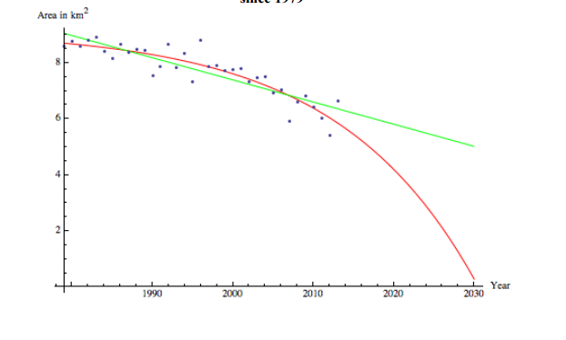
Science/Policy Issue; 2095 vs 2030

