Slide 1
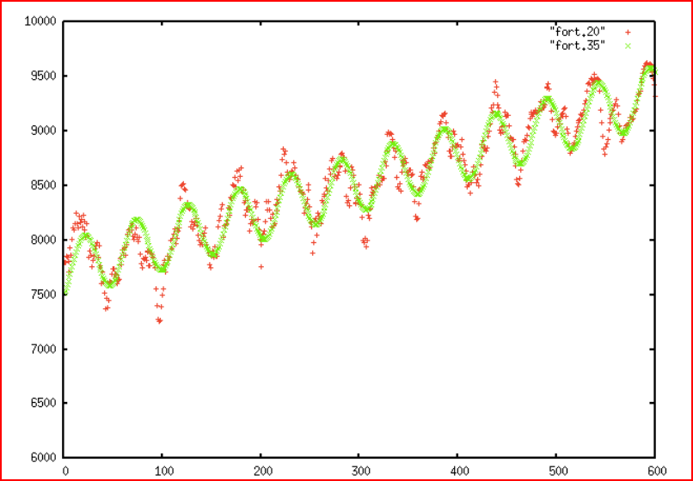
Chi^2 min solution involving 7 parameters
Specify reasonable min + max for the parameters and randomly adjust them to compare solutions
Maximum
Likelihood
Slope=par1 ; Amplitude= par2
Period=par3 ; Phi=par4
Phi1= -par5 ; Xstep = par6
Zero Point = par7

Slide 2
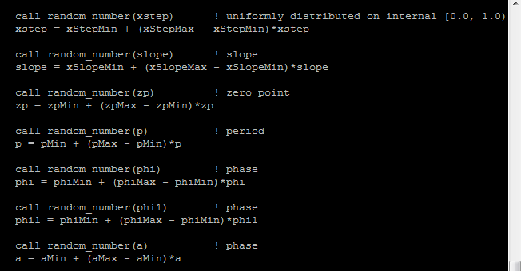
Vary all 7 params randomly at once over many iterations

