Slide 1
Bruno: (1548-1600)
In his cosmology, Bruno followed Lucretius and Copernicus, but he developed the implications of the Copernican system much further than Copernicus himself had done (indeed, Copernicus really didn't do much at all!).
More than the other Italian philosophers who were his contemporaries, Bruno deserves to be called a forerunner, if not a founder, of modern science and philosophy.

Slide 2
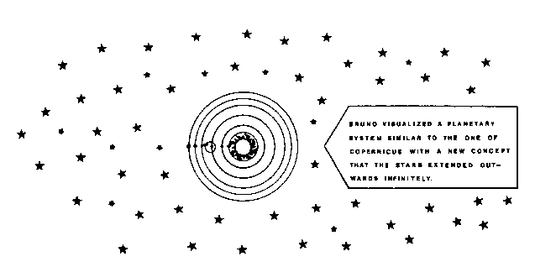

Slide 3
"This entire globe, this star, not being subject to death, and dissolution and annihilation being impossible anywhere in Nature, from time to time renews itself by changing and altering all its parts. There is no absolute up or down, as Aristotle taught; no absolute position in space; but the position of a body is relative to that of other bodies. Everywhere there is incessant relative change in position throughout the universe, and the observer is always at the center of things.
BRUNO WRITES
As to us on Earth, the Earth seems to be the center of the Universe, so to inhabitants of the Moon, the Moon will appear as such ... Each world has its center, each its up and down; these differences are to be assigned relatively . . .

Slide 4
Bruno followed Nicholas of Cusa in developing the concept of the "acentric" Universe (there is no center). He also asserted that if homogeneity and isotropy are properties of such a universe, then it is most logical that life would exist elsewhere as well as on Earth. This was added to his problems with the Catholic church at the time that on February 16, 1600 he was burned at the stake for heresy.
Although his life stands as a testimony to the drive for knowledge and truth his death also stands as testimony to cultures that are imprisoned by fear of the unknown.
In 1992, after 12 years of deliberations, the Roman Catholic Church grudgingly admitted that Galileo Galilei had been right in supporting the theories of Copernicus. The Holy Inquisition had forced an aged Galileo to recant his ideas under threat of torture in 1633. But no such admission has been made in the case of Bruno. (His writings are still on the Vatican's list of forbidden texts.)

