Slide 1
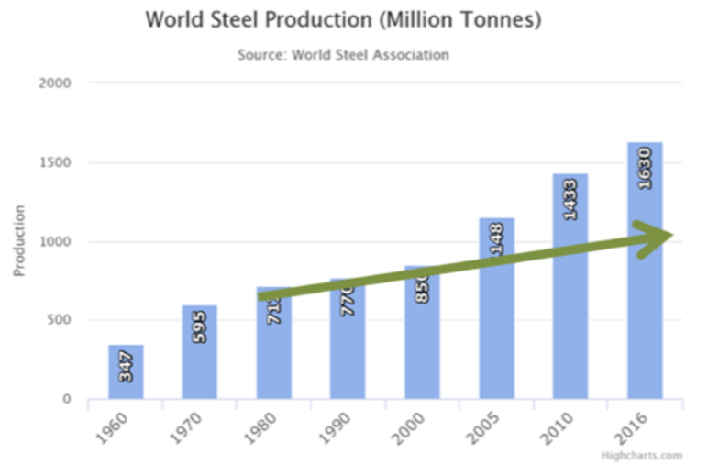
Non-linear Growth of everything defines the Industrial Revolution
For this example:
over a span of 56 years steel production has increased by a factor of 4.7
over this same time population growth has increased by a factor of 2.45
2.45^{N} = 4.7; N ~ 1.75
The meaning of N is that if the population doubles, the associated steel output does not also double but increases by 2 ^{1.75} = 3.6 times more steel. This mathematical reality of resource use is continually disregarded.

Slide 2
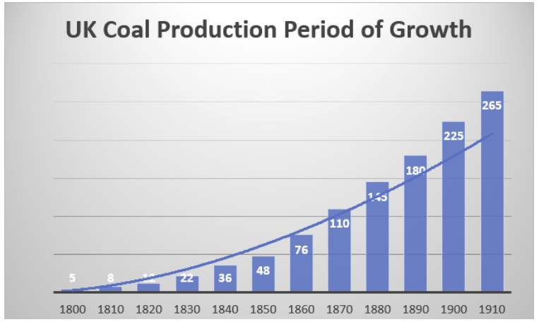
This behavior first seen for Coal use in the UK
How? Hire more miners; build more mines; scale the infrastructure to support global demand

Slide 3
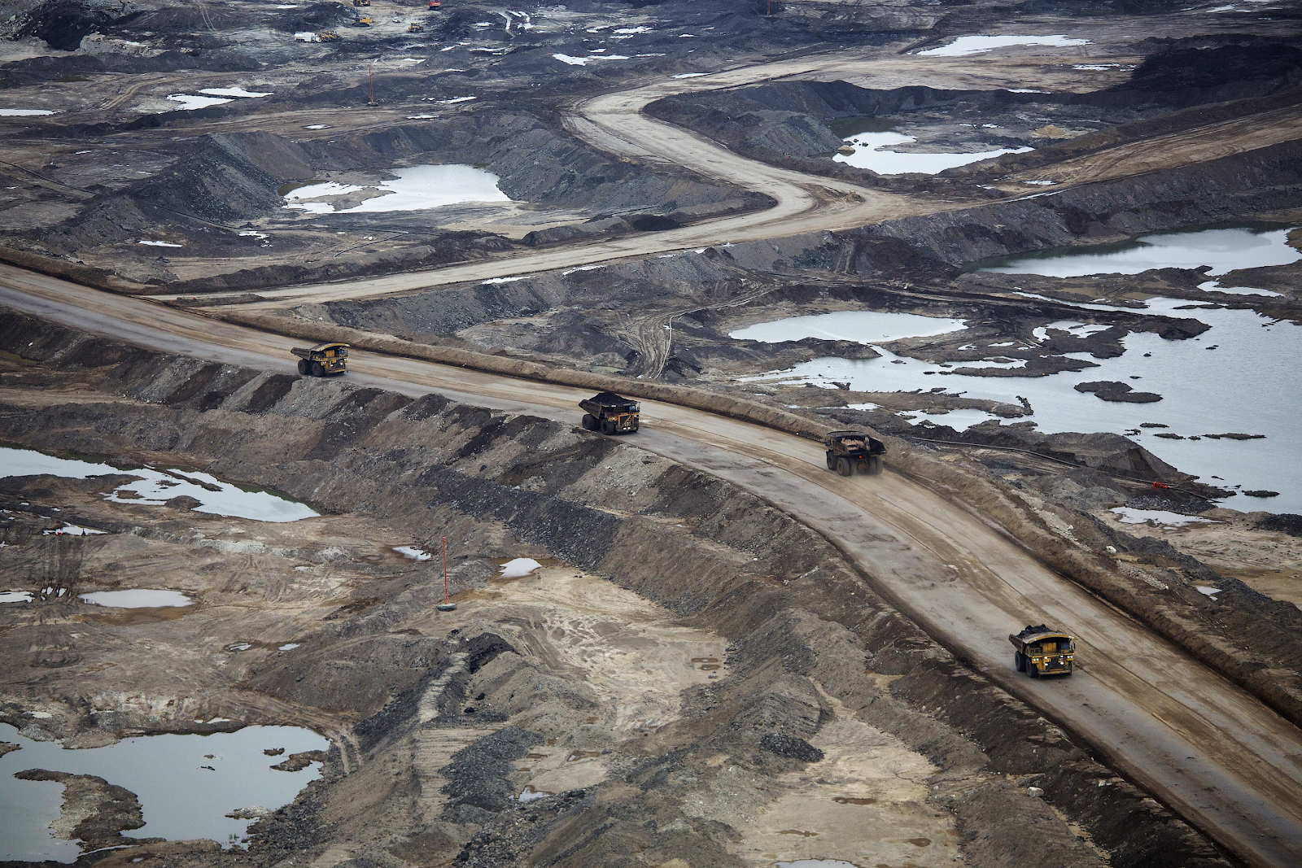
Scaled Infrastructure

Slide 4
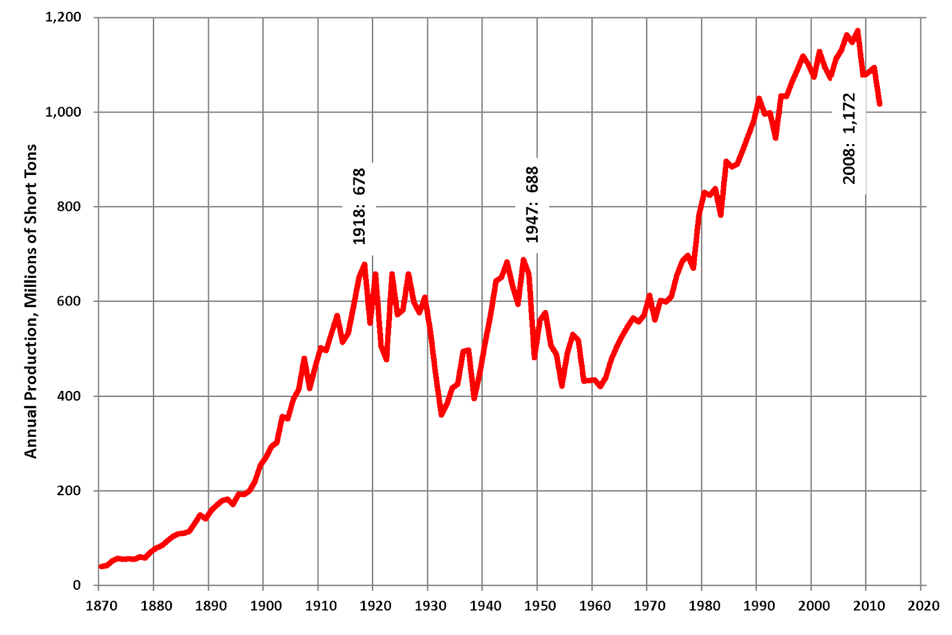
US Coal Consumption
Factor of 10 growth from 1870-1920

Slide 5
Technology Efficiency Increases Consumption

