Slide 1
Evolution of Cosmologies
From Mythic to Mathematical

Slide 2
Natural Cycles begat Explanations
Over time, people notice patterns and cycles in the sky.
The cycles of sunrise and sunset,
lunar phases,
seasonal motions of the stars,
These cycles were likely known by everyone (in contrast to today!)
Different cultures had different explanations for these observed motions. With a growing awareness of self and a need to feel connected to the cosmos, individual cultures began to project their personality onto the celestial canopy. Certain patterns of stars took on special importance as they were endowed with human or animal characteristics.

Slide 3
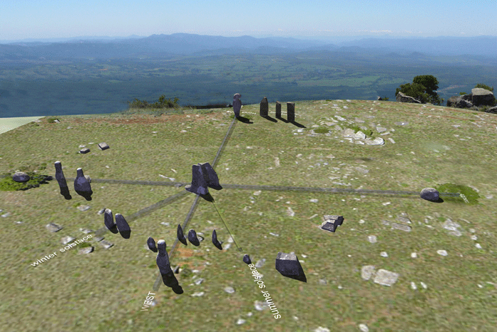
Natural Cycles and Seasonal Weather
Over time, a statistical association between weather and the positions of stars became apparent.
This leads to building very large scale calendars (Pyramids, Stonehenge, etc) as a means of known when seasonal change is coming (flooding, time to plant crops, etc)

Slide 4
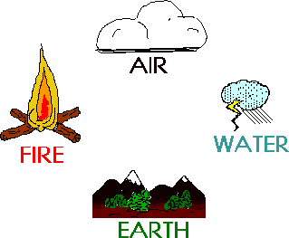
Fundamental Forces
Starting around 600 BC the Greeks developed this sense:
All the world can be understood as an interaction between 4 primal elements: Air, Earth Fire and Water.

Slide 5
Air, Earth, Fire and Water
Table of Elements → ordering the Cosmos and removing the Chaos
However, given their hierarchical nature, various Greek philosophers attempted to make one of these elements more fundamental than the others.
Thales → water
for there must be some natural substance, either one or more than one, from which the other things come-into-being, while it is preserved -- Thales
Anaximenes → Air (stars are fires in the sky → fire now subservient to Air)

Slide 6
More World Views
Anaximander thought of the primal elements as opposites in conflict (e.g. Fire vs Water, Air vs Earth)
Anaximenes had a different conception: the primal elements are not opposed, but different stages of a continuum.
Air is most important because other elements “condense out of it”.
Air is the nearest to an immaterial thing; for since we are generated in the flow of air, it is necessary that it should be infinite and abundant, because it is never exhausted.

Slide 7
Alternate Viewpoint
Democritus (500 BC) → The Universe consists of atoms and the Void; all else is opinion and illusion
The Atomists argue that visible change in the Universe is a consequence of RANDOM rearrangement of atoms interacting in an infinite void.
This provides and answer to Parmenides who claims it impossible for “something to come from nothing”
In the atomist view, new stuff randomly comes into “being” in the Kosmos all of the time, but all of this stuff is impermanent as is everything that is observed currently.

Slide 8
Alternate Viewpoint
This alternate viewpoint was not culturally acceptable to the strong Greek desire for logic and order and hence the idea was essentially dismissed (but still recorded)
The atomist view point also requires there to be a void – which according to Aristotle and followers, is a logical impossibility
In the atomist view The Universe runs by itself → there is no order → no need for physical laws → just like Max Planck says 2500 years later

Slide 9
Thales
Scientific thought was the discovery of nature
natural phenomena we see around us are explicable in terms of matter interacting by natural laws, and are not the results of arbitrary acts by gods.
Thales’ theory of earthquakes → the (presumed flat) earth is actually floating on a vast ocean, and disturbances in that ocean occasionally cause the earth to shake or even crack, just as they would a large boat.

Slide 10
Water is the Primary Principle

Slide 11
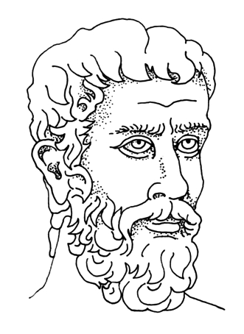
Parmenides of Elea (c. 490 B.C.)
Only two states: Being (Eon) and Non-being
Both states are permanent
Change is an illusion – this is the essence of a long debate on whether or not change exists
The senses can’t be trusted; truth comes through reason alone – many decipher his hard to read prose as saying this in his “The Way of Turth” poem

Slide 12
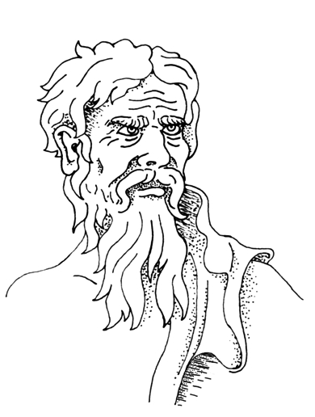
Heraclitus (c. 500 B.C.)
Change is the only permanent thing, given structure by logos (logic)
“You can’t step in the same river twice”
Senses can be trusted if interpreted correctly
World made from fire (symbol of change)

Slide 13
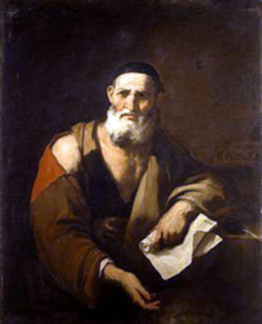
Leucippus of Abdera (c. 425 B.C.)
Materials can be divided until a primal, uncuttable particle is reached: “ATOMOS”
Atoms move through a void space (not according to Aristotle later in about 100 years)
Motion caused by a primeval vortex (like the Prime Mover)

Slide 14
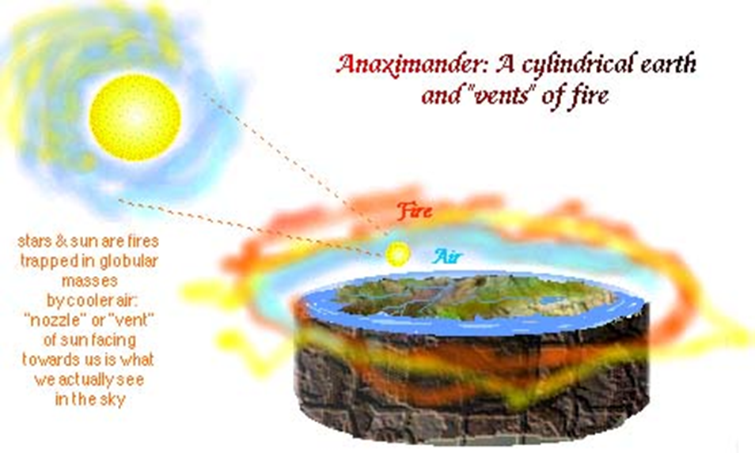
Order, order, order,
Above all, Air Earth Fire and Water are arranged in some order to create the World. Many different philosophies change component order, but order is always preserved

