Slide 1
Is light a particle or a Wave?
Should be a simple question – its not

Slide 2
Maxwell
In 1865 Maxwell published that light is an electromagnetic wave that travels at finite speed.
A changing electric field produces a changing magnetic field producing a changing electric field allow wave propagation in a vacuum
Light, therefore at this time appears be a wave

Slide 3
Light and Energy
But is the energy contained in a light wave distributed like a wave?
Hertz 1886 in trying to transmit a spark (impulse of electricity) from a transmitter (A) to a receiver (B) discovers
“I occasionally enclosed the spark B in a dark case so as to more easily make the observations; and in so doing I observed that the maximum spark-length became decidedly smaller in the case than it was before. On removing in succession the various parts of the case, it was seen that the only portion of it which exercised this prejudicial effect was that which screened the spark B from the spark A. The partition on that side exhibited this effect, not only when it was in the immediate neighbourhood of the spark B, but also when it was interposed at greater distances from B between A and B. A phenomenon so remarkable called for closer investigation." ”

Slide 4
Hertz 1887
Found that the small receiver spark was more vigorous if it was exposed to ultraviolet light from the transmitter spark.
He doesn’t know why but somehow the wavelength of light matters in this “reaction”.
He concludes: I confine myself at present to communicating the results obtained, without attempting any theory respecting the manner in which the observed phenomena are brought about."

Slide 5
Hallwachs 1888
In a recent publication Hertz has described investigations on the dependence of the maximum length of an induction spark on the radiation received by it from another induction spark. He proved that the phenomenon observed is an action of the ultraviolet light. No further light on the nature of the phenomenon could be obtained, because of the complicated conditions of the research in which it appeared. I have endeavored to obtain related phenomena which would occur under simpler conditions, in order to make the explanation of the phenomena easier. Success was obtained by investigating the action of the electric light on electrically charged bodies.“
Once again, this experiment shows that the wavelength of incoming light somehow influences the way that electrically charged bodies behave.
BUT WHY?

Slide 6
Light, Electron and Metals
Thomson 1899 Found that UV light can cause electrons to be “emitted” from some metallic surfaces
Lenard 1902 – used new technology – a Carbon arc light with variable intensity of a factor of 1000
His experiment was to measure the energy (velocity) of the emitted electrons

Slide 7
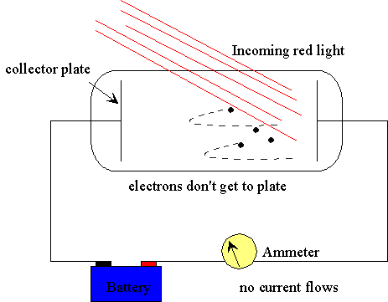
But even with the blue light the number and maximum energy of emitted electrons depends on the kind of metal being tested.

Slide 8
Not a wave, then particle
A photon with energy hf strikes a metal surface and ejects it from the metal – this means the electron is no longer bound to the metal and is free to travel through the material as a current

Slide 9
E = mc²
Yeah So What?

Slide 10
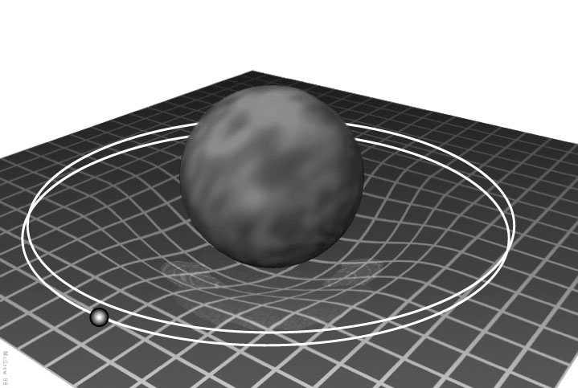
This is an Original Idea
Requires the speed of light to be finite
Light has an energy related mass and is effected by gravity
Mass can be converted to Energy → now we know how stars shine
Gravity = curvature of space-time; Mercury orbits in curved space due to proximity to the Sun

Slide 11
This Idea Seems Ludicrous
In a letter to a friend, Einstein writes:
" ...The relativity principle in connection with the Maxwell equations demands that the mass is a direct measure for the energy contained in bodies; light transfers mass... This thought is amusing and infectious, but I cannot possibly know whether the good Lord does not laugh at it and has led me up the garden path."

